Slide 1
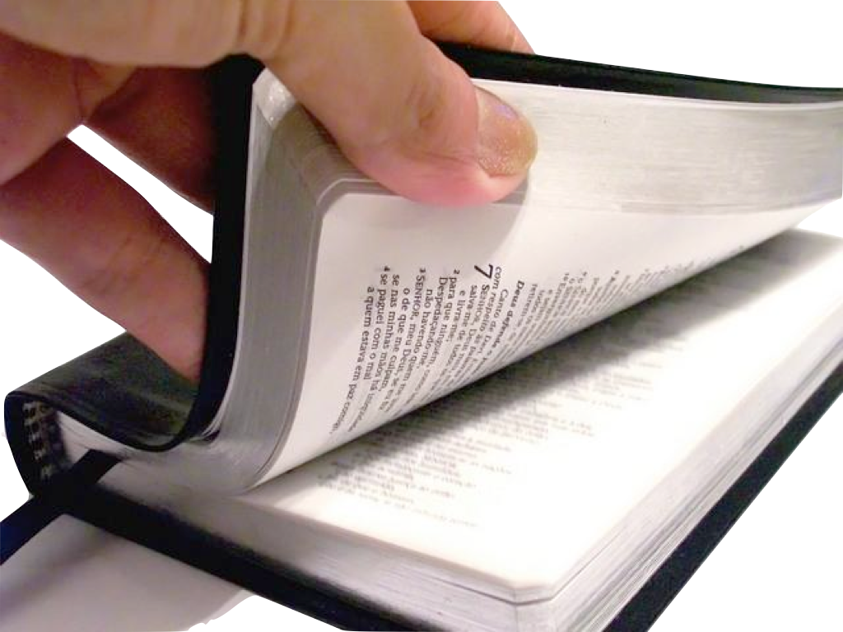
Life Instruction Manual
Read Carefully
Contains Necessary Operating Instructions and Warnings From
The Manufacturer

Slide 2
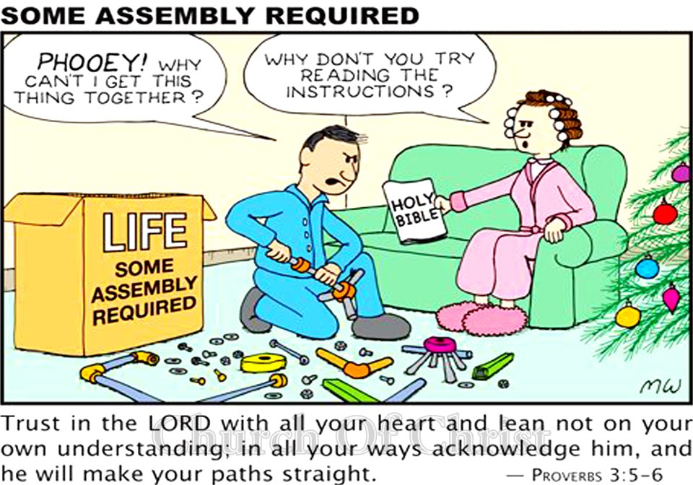


Slide 3
Life Instruction Manual
Jeremiah 10:23
“O LORD, I know the way of man is not in himself; It is not in man who walks to direct his own steps.”

Slide 4
Life Instruction Manual
Proverbs 14:12
“There is a way that seems right to a man, But its end is the way of death.”

Slide 5
Life Instruction Manual
Judges 21:25
“In those days there was no king in Israel; everyone did what was right in
his own eyes.”

Slide 6


Life Instruction Manual
Not Merely An Owners Manual
  Psalm 100:3; Romans 14:7-9; 1 Corinthians 6:19;2 Corinthians 5:15
Not Just a List of Do’s and Don’ts
  Commands/ Examples/ Principles/ Context

Slide 7



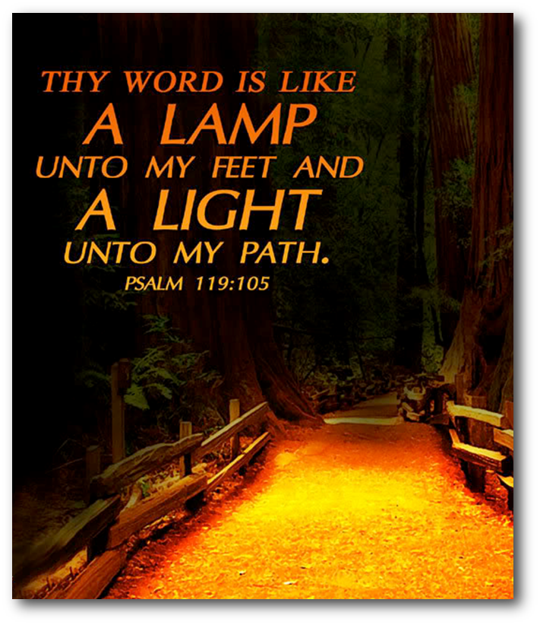
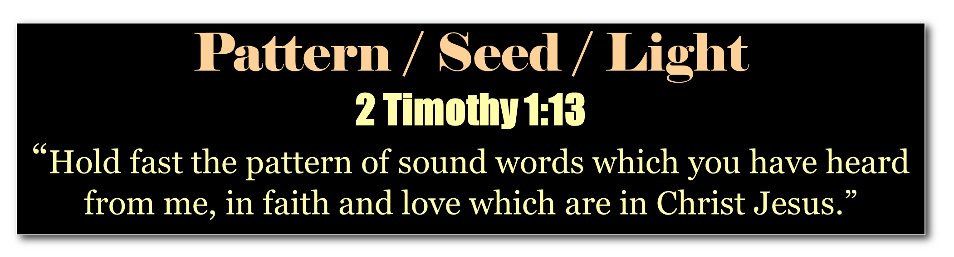

Slide 8
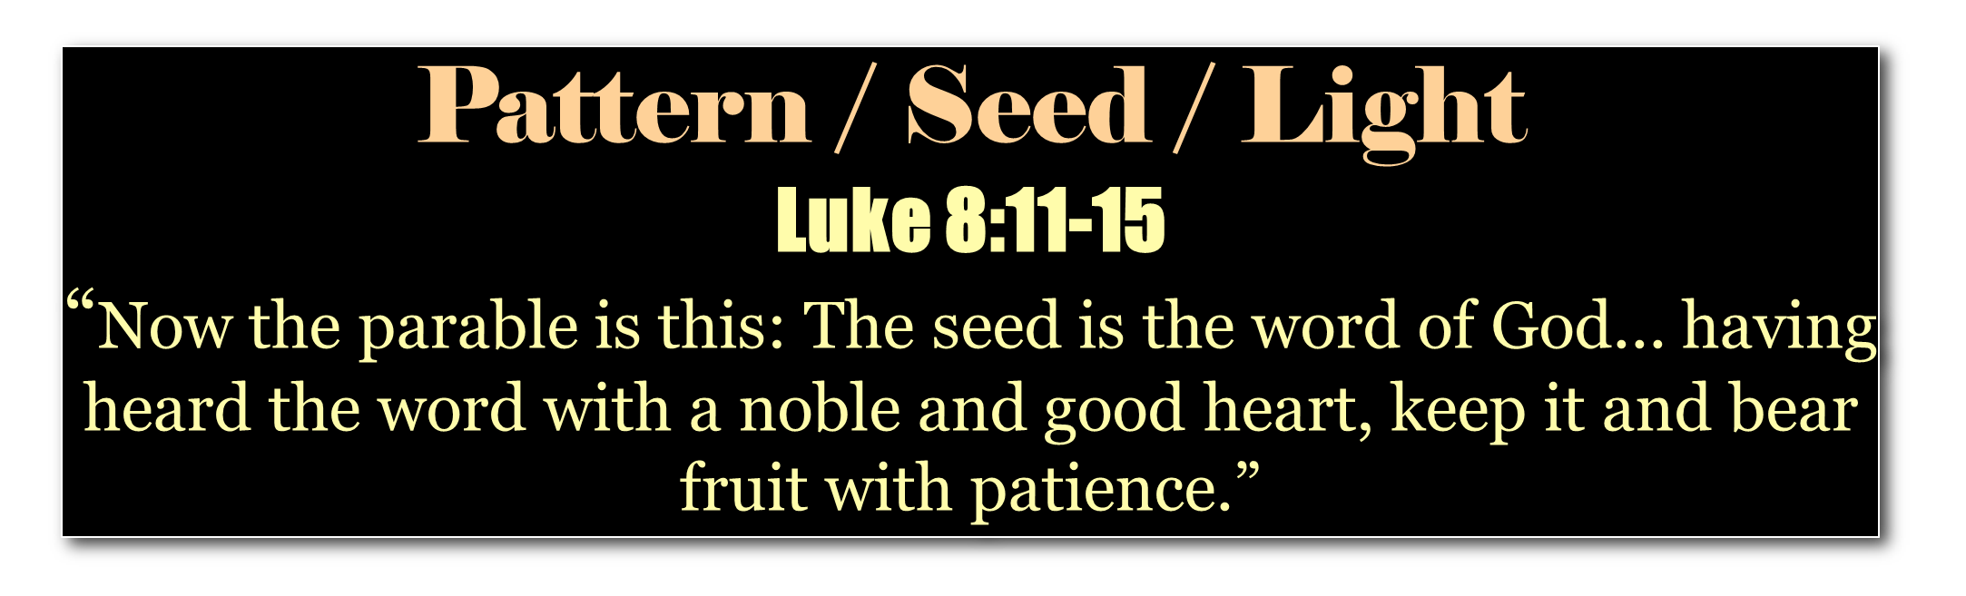

Slide 9


Slide 10

Life Instruction Manual
“The law of the LORD is perfect, converting the soul; The testimony of the LORD is sure, making wise the simple; The statutes of the LORD are right, rejoicing the heart; The commandment of the LORD is pure, enlightening the eyes.”
Psalm 19: 7,8

Slide 11
Life Instruction Manual
“The fear of the LORD is clean, enduring forever; The judgments of the LORD are true and righteous altogether.
More to be desired are they than gold, Yea, than much fine gold; Sweeter also than honey and the honeycomb.”
Psalm 19: 9,10

Slide 12
Life Instruction Manual
“Moreover by them Your servant is warned, And in keeping them there is great reward.”
Psalm 19: 11

Slide 13
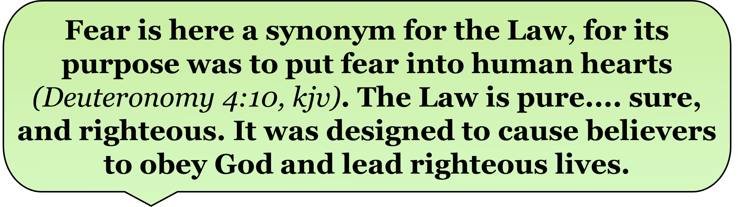

Slide 14
Life Instruction Manual
“You have commanded us To keep Your precepts diligently. Oh, that my ways were directed To keep Your statutes! Then I would not be ashamed, When I look into all Your commandments. I will praise You with uprightness of heart, When I learn Your righteous judgments.”
Psalm 119: 4-7

Slide 15
Life Instruction Manual
“I will keep Your statutes; Oh, do not forsake me utterly! How can a young man cleanse his way? By taking heed according to Your word. With my whole heart I have sought You; Oh, let me not wander from Your commandments! Your word I have hidden in my heart, That I might not sin against You!”
Psalm 119: 8-11

Slide 16
Life Instruction Manual
“Oh, how I love Your law! It is my meditation all the day. You, through Your commandments, make me wiser than my enemies; For they are ever with me. I have more understanding than all my teachers, For Your testimonies are my meditation. I understand more than the ancients, Because I keep Your precepts.”
Psalm 119: 97-100

Slide 17
Life Instruction Manual
“I have restrained my feet from every evil way, That I may keep Your word. I have not departed from Your judgments, For You Yourself have taught me.
How sweet are Your words to my taste, Sweeter than honey to my mouth!”
Psalm 119: 101-103

Slide 18
Life Instruction Manual
“Through Your precepts I get understanding; Therefore I hate every false way. Your word is a lamp to my feet And a light to my path.”
Psalm 119: 104,105

Slide 19


“Grace and peace be multiplied to you in the knowledge of God and of Jesus our Lord, as His divine power has given to us all things that pertain to life and godliness, through the knowledge of Him who called us by glory and virtue.”
2 Peter 1:2,3

Slide 20
“By which have been given to us exceedingly great and precious promises, that through these you may be partakers of the divine nature, having escaped the corruption that is in the world through lust.”
2 Peter 1:4

Slide 21
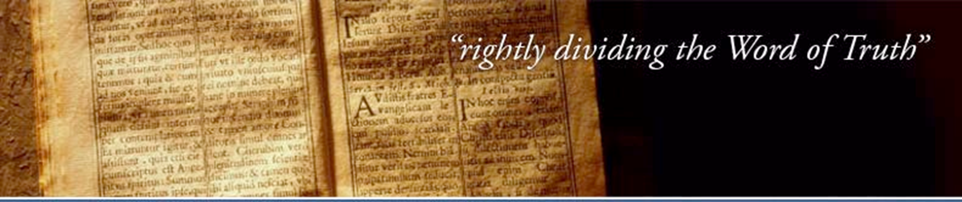
“Be diligent to present yourself approved to God, a worker who does not need to be ashamed, rightly dividing the word of truth.”
2 Timothy 2:15

Slide 22
“But shun profane and idle babblings, for they will increase to more ungodliness. And their message will spread like cancer. Hymenaeus and Philetus are of this sort.”
2 Timothy 2:16,17

Slide 23
“Who have strayed concerning the truth, saying that the resurrection is already past; and they overthrow the faith of some.”
2 Timothy 2:18

Slide 24
“But you must continue in the things which you have learned and been assured of, knowing from whom you have learned them, and that from childhood you have known the Holy Scriptures, which are able to make you wise for salvation through faith which is in Christ Jesus.”
2 Timothy 3:14,15

Slide 25
“All Scripture is given by inspiration of God, and is profitable for doctrine, for reproof, for correction, for instruction in righteousness,
that the man of God may be complete, thoroughly equipped for every good work.”
2 Timothy 3:16,17

Slide 26
Life Instruction Manual
The Challenge of Understanding and
Applying The Word of God
Rightly Dividing the Word of Truth
God Has Dealt With Men Differently In Different Dispensations Due To Man’s Particular Needs
and His Design

Slide 27
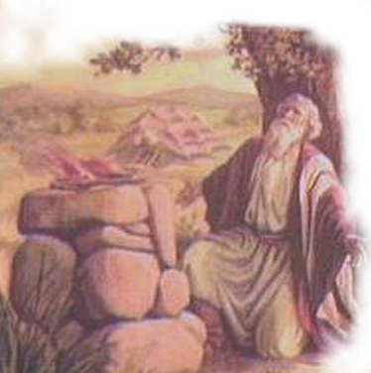
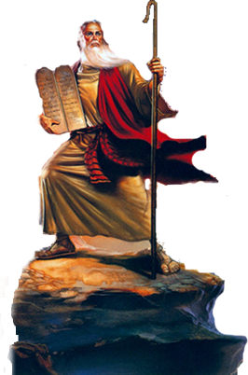
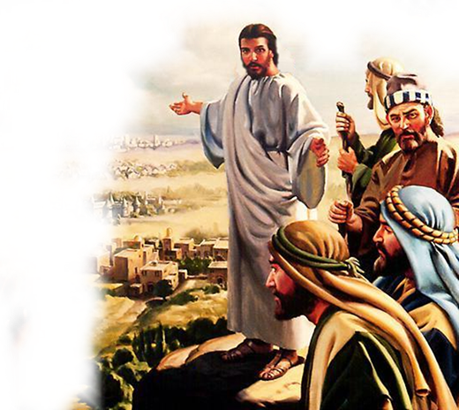
Life Instruction Manual
Specific Requirements Have Changed
Patriarchal
Mosaic
Christian
Romans 5:14
John 1:17
Hebrews 1:2
4000
3000
2000
1000
0000
500
1000
1500

Slide 28



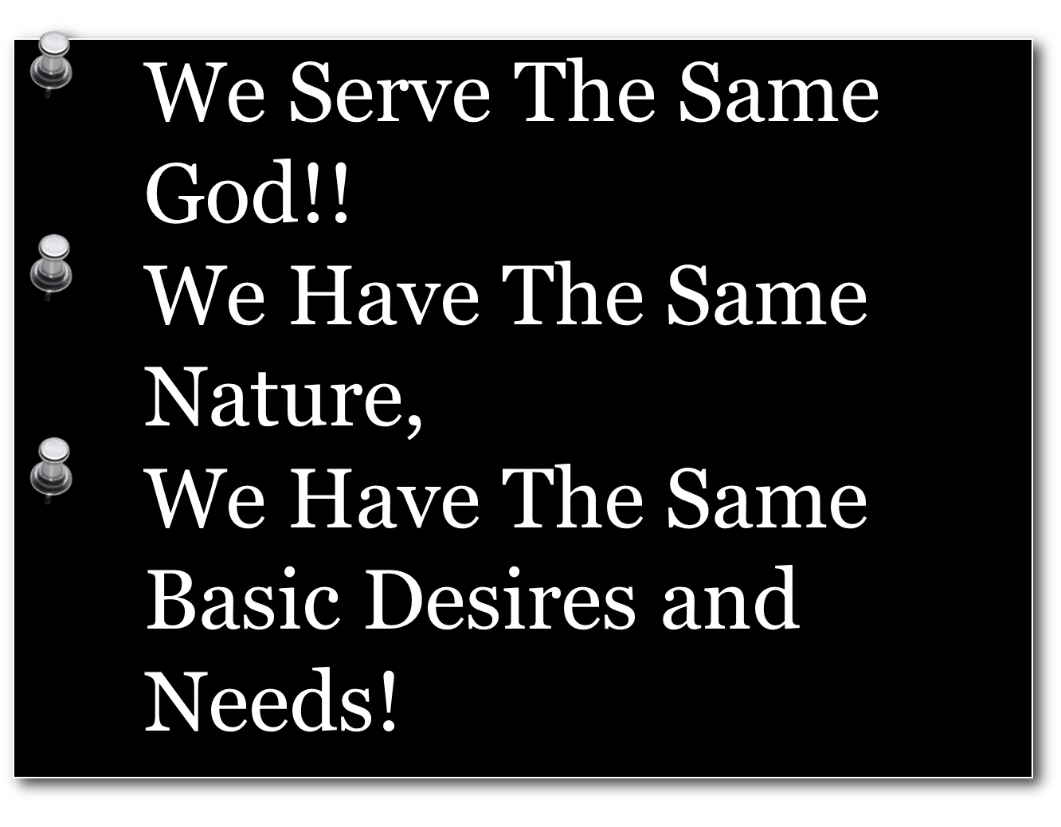
But Certain Are The Same

Slide 29


Life Instruction Manual
Specific Requirements Have Changed
But Certain Principles Are The Same
Salvation
By Grace Through Faith
Worship
In Spirit and Truth
Service
Humility and Sincerity
Relations
Righteousness and Love
God Speaks
Man Believes
Man Obeys
God Saves

Slide 30
Life Instruction Manual
The Unbelieving and Disobedient
Will Be Condemned
God Speaks
Man Disbelieves
Man Disobeys
God Condemns
The Principle Is the Same
The Specific Requirements Have Changed
Adam and Eve – Genesis 3:14-24
The antediluvian world – Genesis 6:5-7; 7:23; 1 Peter 3:19,20
Sodom and Gomorrah – Genesis 19:12,13, 24,25
Israel – Deuteronomy 30:17,18; Joshua 23:16
Us – Hebrews 9:27; 2 Corinthians 5:10
Notes:
The Principle of Judgment The Same In Every Age…
Adam and Eve Gen. 3:14-24
Antediluvian world – Gen 6:5-7; 7:23; 1 Pet.3:19,20
Sodom and Gomorrah—Gen.19:12,13, 24, 25
Israel – Deut.30:17,18; Josh.23:16; 2 Kings 17:25; Matt.23:24
Us – Heb.9:27; 2 Cor.5:10; 2 Pet.3:10-14; 2 Thess.1:7-9

Slide 31
Life Instruction Manual
The Bible Contains All the Information
We Need…
“All Scripture is given by inspiration of God, and is profitable for doctrine, for reproof, for correction, for instruction in righteousness, that the man of God may be complete, thoroughly equipped for every good work.”
To discern between right & wrong, good & bad, truth & error - Hebrews 5:12-14
To overcome Satan - Psalm 119:11, Ephesians 6:10-18; 2 Corinthians 2:11
To strengthen & comfort us in times of trouble, sorrow & hardships - Psalm 119:50; 1 Thessalonians 4:18
2 Timothy 3:16,17

Slide 32
Life Instruction Manual
The Bible Contains All the Information
We Need…
“All Scripture is given by inspiration of God, and is profitable for doctrine, for reproof, for correction, for instruction in righteousness, that the man of God may be complete, thoroughly equipped for every good work.”
To Be Right With God
To worship God acceptably
To serve God in righteousness
2 Timothy 3:16,17

Slide 33
Life Instruction Manual
The Bible Contains All the Information
We Need…
“All Scripture is given by inspiration of God, and is profitable for doctrine, for reproof, for correction, for instruction in righteousness, that the man of God may be complete, thoroughly equipped for every good work.”
To govern our relationships
To live godly in this life
To be saved eternally
2 Timothy 3:16,17

Slide 34


Slide 35
Life Instruction Manual
“Blessed is the man Who walks not in the counsel of the ungodly, Nor stands in the path of sinners, Nor sits in the seat of the scornful;
But his delight is in the law of the LORD, And in His law he meditates day and night.”
Psalm 1: 1,2

Slide 36
Life Instruction Manual
“He shall be like a tree Planted by the rivers of water, That brings forth its fruit in its season, Whose leaf also shall not wither; And whatever he does shall prosper.
The ungodly are not so, But are like the chaff which the wind drives away.”
Psalm 1: 3,4

Slide 37
Life Instruction Manual
“Therefore the ungodly shall not stand in the judgment, Nor sinners in the congregation of the righteous. For the LORD knows the way of the righteous, But the way of the ungodly shall perish.”
Psalm 1: 5,6

