Slide 2
The Obedience of the Rechabites
Jeremiah 35

Slide 3
The Kenites (Rechabites)
The Kenites (Rechabites)
A nomadic people that lived during the time of ancient Israel.
They dwelt in tents and lived among the people of Israel from the time of the Exodus to the conquest. (Judges 1:16)
They were on friendly terms with Israel during the time of Deborah, Saul, and David. (1 Samuel 15:6)
Kenites mentioned in the bible include:
  Jethro, father in law of Moses (Judges 1:16)
  Heber, husband of Jael (Judges 4:17)
  Rechab, ancestor of the Rechabites
  Jehonadab (or Jonadab), son of Rechab
    Spiritual “father” of the Rechabites
    Alive during the reign of King Jehu (~842 B.C.)
    Events of Jer. 35 occur during Jehoiakim (~570 B.C.)
    ~270 years have passed since Jonadab

Slide 4
The Test
Jeremiah 35:1-5
The Lord talks to Jeremiah and gives him a task.
Jeremiah is to gather the Rechabites to the House of the Lord.
Once there, he is to offer them wine to drink.
Jeremiah obeys, bringing “the whole house of the Rechabites” into the House of the Lord for this test.
Jeremiah sets pitchers of wine with cups before the Rechabites and offers it to them to drink.
This is intended to be a public ceremony.

Slide 5
The Reaction
Jeremiah 35:6-11
The Rechabites answer that they will drink no wine, per the commandments of their ancestors.
They cite Jonadab, son of Rechab (their patriarch), as the source of this command not to partake of the wine.
They go on to specify other commands given from Jonadab that they have followed, including building no homes, growing no crops, and dwelling in tents.
They claim they have obeyed those commands, as evident by their response to this test.

Slide 6
The Comparison
Jeremiah 35:12-16
The Rechabites had listened to the commandments of their leader, Judah had not listened to the commandments of their Leader.
The commandments of Jonadab have been delivered once and kept for centuries. The commandments of the Lord had not been kept, though He reminded them time and time again.
The word of Jonadab, a man, had been obeyed. The word of the Almighty God had not.

Slide 7
Judah’s Punishment
Jeremiah 35:17
“Therefore”
  Because of Judah’s disobedience to something the Lord has just proven can be done…
The Lord will bring disaster on Judah and its inhabitants.
This disaster has been pronounced against Judah for a long time coming, it will now come to fruition due to their disobedience.

Slide 8
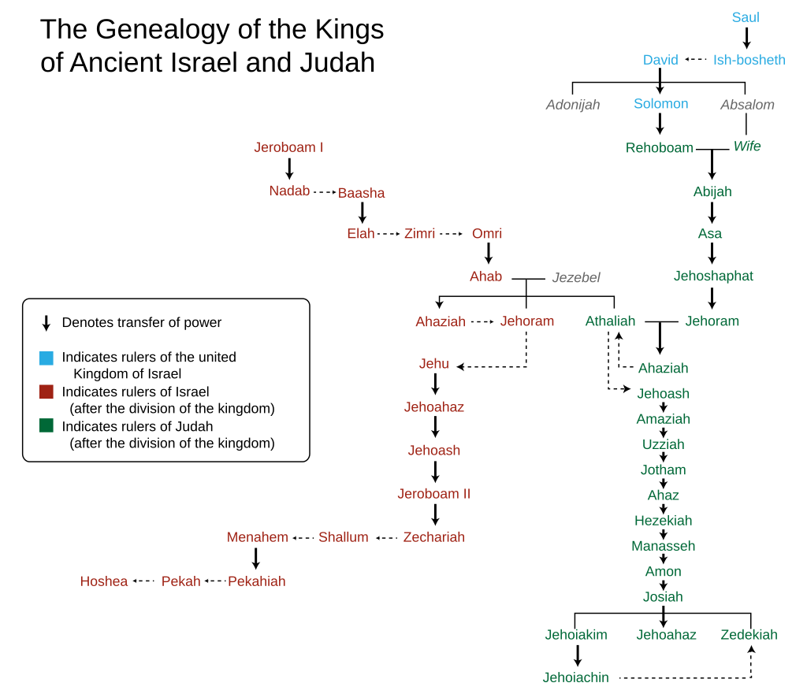
The Law
of the Lord
Rechabites
Rechab
Jonadab
The law of Jonadab
~270 years
Isaiah prophesies Judah’s demise
The Test
Jeremiah 35

Slide 9
The Rechabites Blessing
Jeremiah 35:18-19
“But to the house of the Rechabites…”
  Because of their obedience that was just shown in this test, they will be blessed.
Not just any obedience. God points out the totality of their obedience
  “You have obeyed [Jonadab]…”
  “Kept all his precepts”
  “Obeyed all his commands”
The Rechabites “shall never lack a man to stand before me.”

Slide 10
Our Lesson
God is a jealous God
  Exodus 20:4-5; 34:12-14; Psalm 135:4
God does not ask for the impossible
  1 John 5:3; 1 Corinthians 10:13;
  Matthew 19:24-26; 1 John 5:5; Romans 3:23-26
God is patient
  Jeremiah 35:14-15; 2:2-3; 2 Peter 3:9
God will punish disobedience
  2 Peter 3:7; 2 Corinthians 5:10

