Slide 2
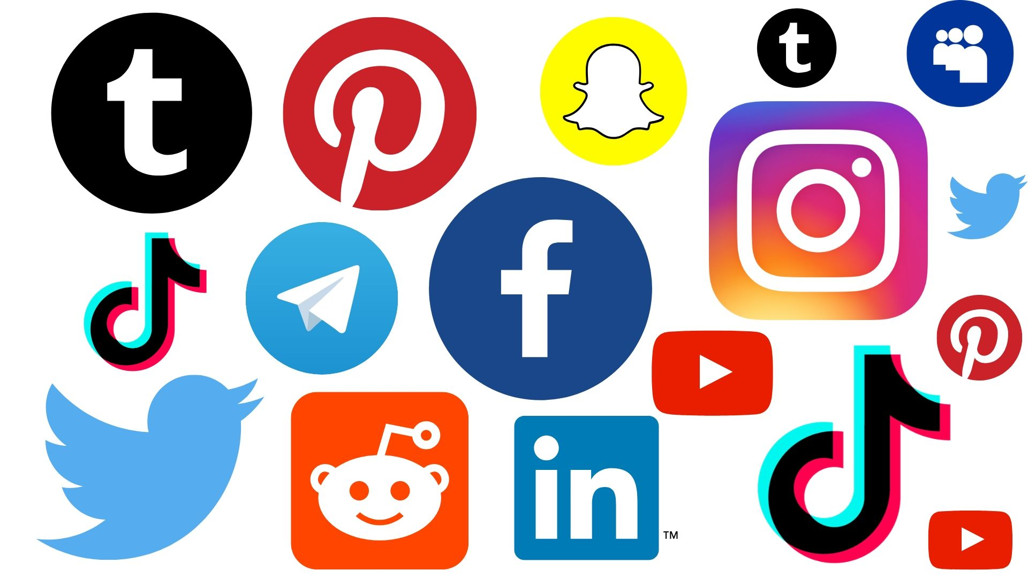
The Christian and
Social Media

Slide 3
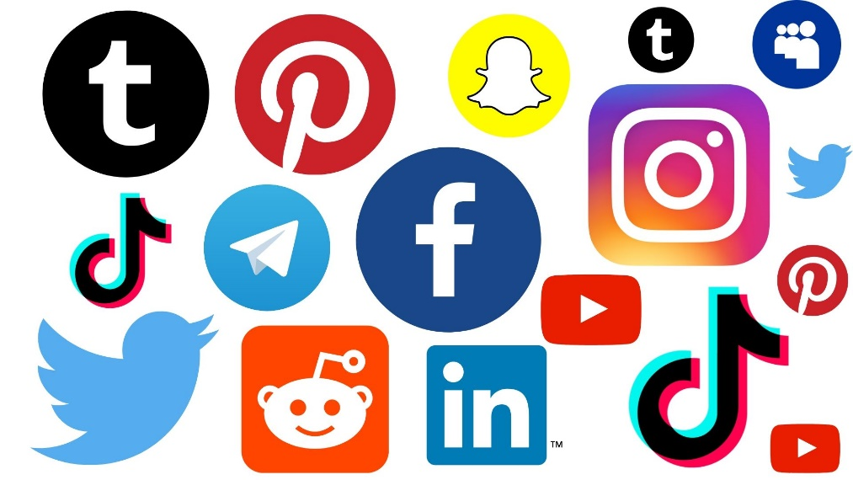
Social Media Platforms
Facebook – over 2.7 billion monthly active users
Instagram – over 1.2 billion mau’s
TikTok – over 700 million mau’s
Twitter, Youtube
Snapchat, Twitch
Pinterest, Zoom
WeChat, MeWe

Slide 4

Evils of Social Media
Can be addictive.
Become detached from personal interaction.
Creates a forum for people to be mean to others who have different views and opinions.
Cyberbullying.
Promote sin, falsehoods,
and religious error.

Slide 5

Benefits of Social Media
Instant communication.
Connection to family and friends.
Renew old friendships.
Find groups that cater to my
interests.
Promote business.
Spread the gospel.

Slide 6
1. Love is long-suffering, patient

Slide 7

1. Love is long-suffering, patient
So then, my beloved brethren, let every man be swift to hear, slow to speak, slow to wrath;
for the wrath of man does not produce the righteousness of God.
James 1:19-20

Slide 8
1. Love is long-suffering, patient
The heart of the righteous studies how to answer, but the mouth of the wicked pours forth evil.
Proverbs 15:28

Slide 9
1. Love is long-suffering, patient
He who answers a matter before he hears it, it is folly and shame to him.
The first one to plead his cause seems right, until his neighbor comes and examines him.
Proverbs 18:13, 17

Slide 10

2. Love is kind
Literally means to show oneself to be “useful.”
A willingness to meet the needs of others.

Slide 11

3. Love does not envy
Social media can give us plenty of reason to be envious and jealous.
Instead, Christians must always be
willing to “rejoice with those who rejoice” (Rom. 12:15).

Slide 12

4. Love does not brag, not arrogant
Social media is the perfect platform for the self-promoter.
“Let another man praise you, and not your own mouth; a stranger,
and not your own lips”
(Prov. 27:2).

Slide 13
5. Love does not behave rudely
Greek term literally means “to act against the scheme.”
Christians are NOT to be promoting or showcasing deviant behavior.
“Let no corrupt word proceed out of your mouth, but what is good for necessary edification, that it may impart grace to the hearers” (Eph. 4:29).

Slide 14

6. Love does not seek its own, love is not provoked
If you are easily offended, social medial probably isn’t for you.

Slide 15

7. Love does not keep account of wrongs
“You are the salt of the earth; but if the salt loses its flavor, how shall it be seasoned? It is then good for nothing but to be thrown out and trampled
underfoot by men.”
(Matt. 5:13).

Slide 16

8. Love does not rejoice in iniquity but rejoices in the truth
“Who, knowing the righteous judgment of God, that those who practice such things are deserving of death, not only do the same but also approve of those who practice them” (Rom. 1:32).

Slide 17
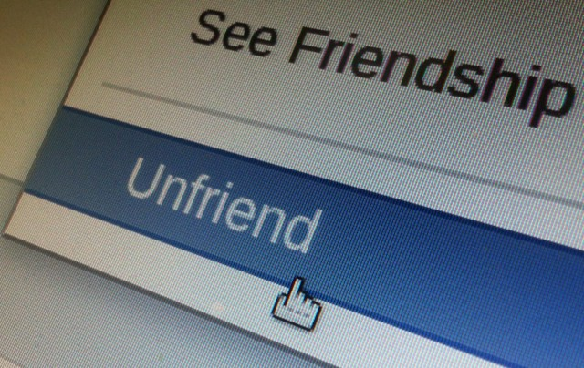
9. Love bears, believes, hopes, and endures all things
Some people need to be snoozed, hidden, blocked, or unfriended.
But, Christians never give up on their brethren.

Slide 18

“For God will bring every work into judgment, including every secret thing, whether good or evil.
Ecclesiastes 12:14

