Slide 2
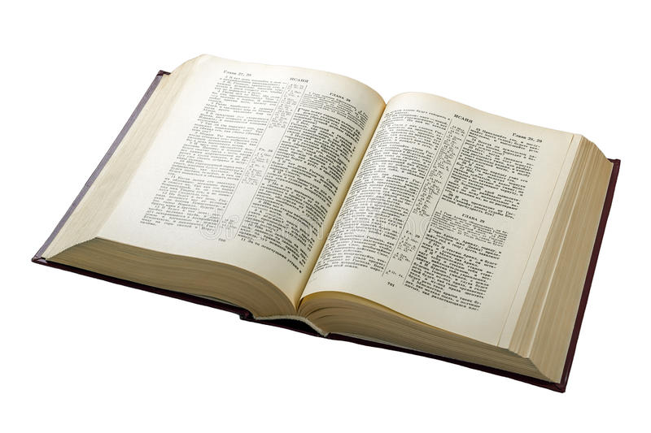
Our Attitude Towards Obedience

Slide 3
Our Attitude Towards Obedience
1. It is Our Duty
  Luke 17:10
  Romans 9:20-21
  Ecclesiastes 12:13

Slide 4
Our Attitude Towards Obedience
2. It is Better Than Sacrifice
  1 Samuel 15:22-23
  Isaiah 1:11-20
  Jeremiah 7:22-23

Slide 5
Our Attitude Towards Obedience
3. It is for Our Own Good
  Deuteronomy 6:24
  Proverbs 4:1-9

Slide 6
Our Attitude Towards Obedience
4. It Displays Our Love for Christ
  John 14:15, 21-24
  1 John 5:3

Slide 7
Our Attitude Towards Obedience
5. It Brings Us Joy
  Matthew 11:28-30
  Luke 11:27-28
  Psalm 119:33-35

Slide 8
Our Attitude Towards Obedience
6. It Leads to Our Salvation
  Luke 10:25-28
  Matthew 7:21
  Revelation 22:14

Slide 9
Has Our Attitude Towards Obedience Matured?
6. It Leads to My Salvation
5. It Brings Me Joy
4. It Displays My Love for Christ
3. It is for My Own Good
2. It is Better Than Sacrifice
1. It is My Duty

