Slide 2

SIN
MISSING THE MARK

Slide 3
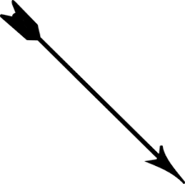
Falling Short
Matt 23:23
Luke 6:46
Matt 25:31-46
Acts 26:28

Slide 4

Going Beyond
1 Cor 10:13
1 Cor 4:6
John 16:13; Jas 1:25
2 Peter 1:3
2 Tim 3:16
Matt 7:22 - 23

Slide 5

Going Right or Left
Deut. 17:18-20
Deut. 28:14-16
2 Pet 3:16

Slide 6
Wresting
1 Peter 3:21 The like figure whereunto even baptism doth also now save us (not the putting away of the filth of the flesh, but the answer of a good conscience toward God,) by the resurrection of Jesus Christ: KJV
Eph 4:28 Let him that stole steal- (;)- no more: but rather let him labour, working with his hands the thing which is good, that he may have to give to him that needeth. KJV

Slide 7

Breaking God’s Commandments
Isa 5:20
Rom 3:20
John 5:22
Heb 1:1-2
John 12:48

Slide 8
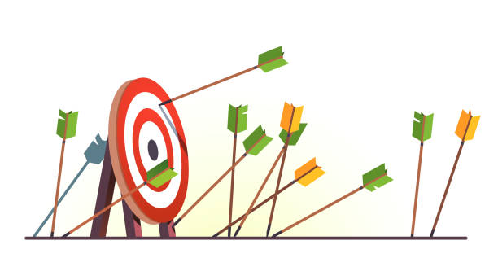
We Will not Share in the Prize If:
Fall short
Go beyond
Turn right
Turn Left
Break Commandments

