Slide 2

MICAH
“Who is a God like unto Thee?”

Slide 3

“Who is a God like unto thee?”
Micah 7:18-20

Slide 4
1. God is Willing to Forgive
Sin is offensive to God’s authority and holiness - 1 John 3:4
Sin is “exceedingly sinful” - Rom. 7:13
Sin is deserving of God’s wrath - Rom. 1:18
In spite of this, God has an incredible capacity to forgive - Ps. 103:9-14; Is. 1:18

Slide 5
2. God’s Willingness to Forgive is Based on His Character

Slide 6
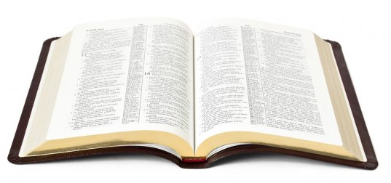
2. God’s Willingness to Forgive is Based on His Character
“…He does not retain His anger forever, because He delights in mercy.
He will again have compassion on us, and will subdue our iniquities…”
Micah 7:18b-19a

Slide 7
2. God’s Willingness to Forgive is Based on His Character
“For You, Lord, are good, and ready to forgive, and abundant in mercy to all those who call upon You.
But You, O Lord, are a God full of compassion, and gracious, longsuffering and abundant in mercy and truth.”
Psalm 86:5, 15

Slide 8
3. God’s Forgiveness is Complete and Consistent
“You will cast all our sins
into the depths of the sea.”
Micah 7:19b

Slide 9
“You will cast all our sins
into the depths of the sea.”
Micah 7:19b
“As far as the east is from the west, so far has He removed our transgressions from us.”
Psalm 103:12
“The iniquity of Israel shall be sought, but there shall be none; and the sins of Judah, but they shall not be found; for I will pardon those whom I preserve.”
Jeremiah 50:20
“For You have cast all my sins behind Your back.”
Isaiah 38:17

Slide 10
“You will cast all our sins
into the depths of the sea.”
Micah 7:19b
“As far as the east is from the west, so far has He removed our transgressions from us.”
Psalm 103:12
“For I will be merciful to their unrighteousness, and their sins and their lawless deeds I will remember no more.”
Hebrews 8:12
“The iniquity of Israel shall be sought, but there shall be none; and the sins of Judah, but they shall not be found; for I will pardon those whom I preserve.”
Jeremiah 50:20
“For You have cast all my sins behind Your back.”
Isaiah 38:17

Slide 11
3. God’s Forgiveness is Complete and Consistent
“You will give truth to Jacob and mercy to Abraham, which You have sworn to our fathers from days of old.”
Micah 7:20

Slide 12
3. God’s Forgiveness is Complete and Consistent
God’s forgiveness is always conditional!
We must repent - Is. 55:7; Ezek. 18:30-32
We must confess our sins and seek God’s forgiveness - 1 John 1:9

Slide 13
“Who is a God like unto thee?”
Micah 7:18-20

