Slide 2
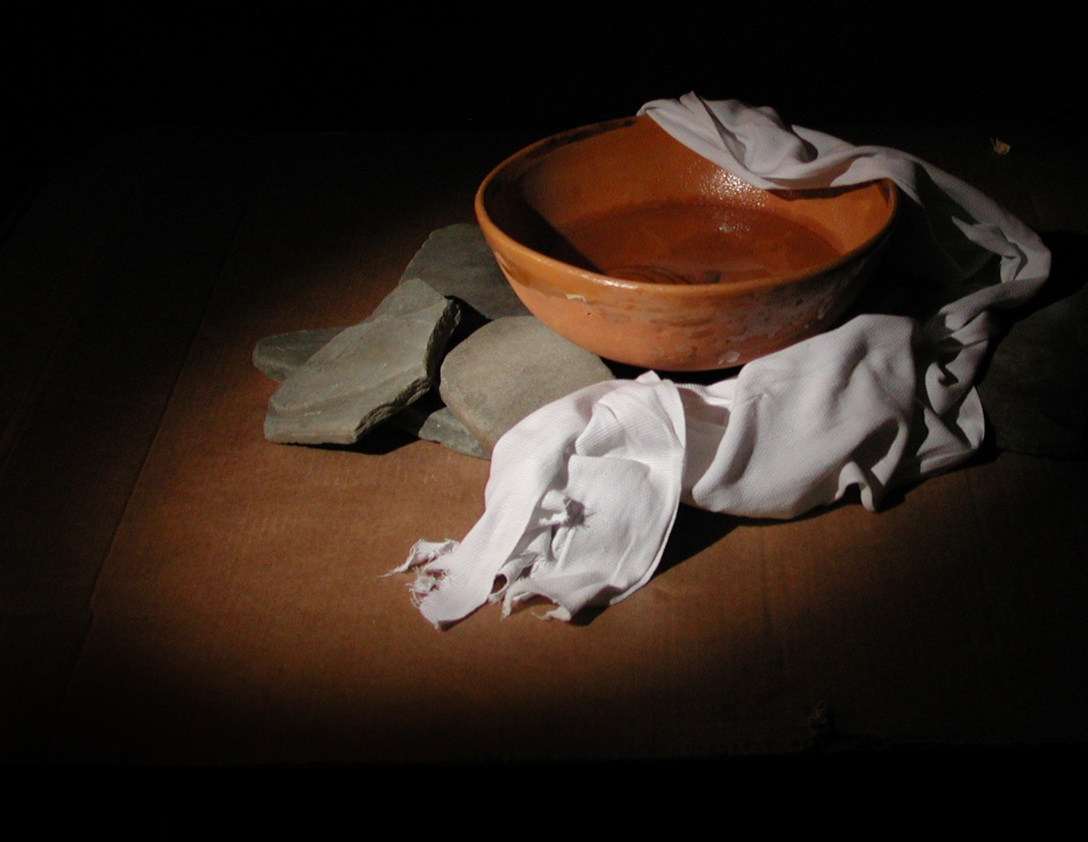
Greatness in the Kingdom
Matthew 20:20-28

Slide 3
1. Attitude
Our attitude is important - Matt. 12:35
We must serve others out of love -
Matt. 22:36-39

Slide 4
2. Awareness
Our unique talents - Rom. 12:6-8
Our task - Titus 3:8
The needs of others - Phil. 2:3-4

Slide 5
3. Action
Meet physical needs - Matt. 25:35-36
Meet emotional needs - Rom. 12:15
Meet spiritual needs -
  Babes need to be established - 1 Pet. 2:2
  Struggling need to be exhorted - Heb. 3:12-13
  Overwhelmed need to be restored - Gal. 6:1
  Unruly need to be warned - 1 Thess. 5:4
  Unfaithful need to be rescued - James 5:19-20

Slide 6
4. Availability
Luke 10:30-37
Our time
Personal involvement
Sacrifice

Slide 7
Learning How to Be a Servant
Attitude
Awareness
Action
Availability

