Slide 2

JONAH
Impossible Things

Slide 3
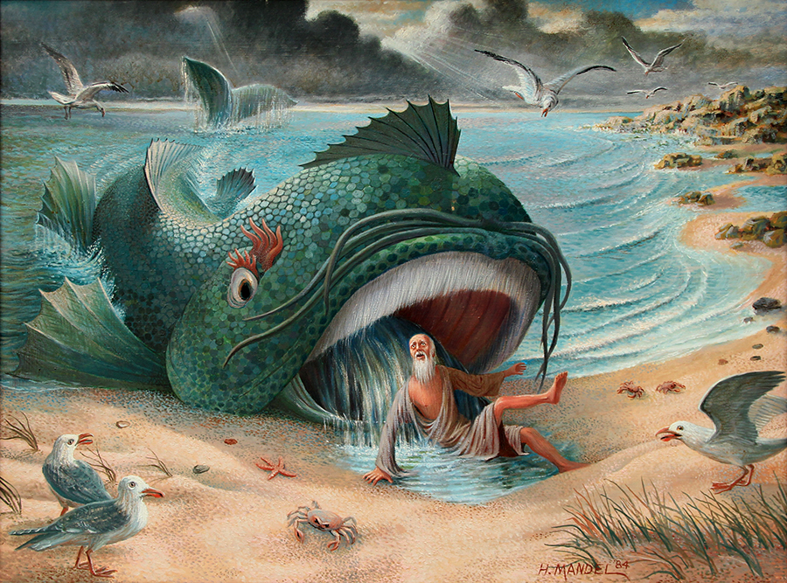

Slide 4
“So he said to them, ‘I am a Hebrew; and I fear the Lord, the God of heaven, who made the sea and the dry land.’”
Jonah 1:9

Slide 5
“So he said to them, ‘I am a Hebrew; and I fear the Lord, the God of heaven, who made the sea and the dry land.’”
Jonah 1:9
“By the word of the Lord the heavens were made, and all the host of them by the breath of His mouth.”
Psalm 33:6

Slide 6
“Is anything too hard for the Lord? At the appointed time I will return to you, according to the time of life, and Sarah shall have a son.”
Genesis 18:14

Slide 7
“Is anything too hard for the Lord? At the appointed time I will return to you, according to the time of life, and Sarah shall have a son.”
Genesis 18:14
“Ah, Lord God! Behold, You have made the heavens and the earth by Your great power and outstretched arm. There is nothing too hard for You.”
Jeremiah 32:17

Slide 8
“Jesus answered and said to them, ‘You are mistaken, not knowing the Scriptures nor the power of God.’”
Matthew 22:29

Slide 9
It is Impossible to…
1. Run Away from God

Slide 10
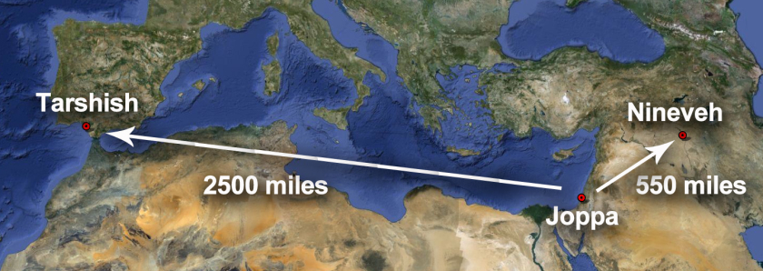
It is Impossible to…
1. Run Away from God
“But Jonah arose to flee to Tarshish from the presence of the Lord. He went down to Joppa, and found a ship going to Tarshish; so he paid the fare, and went down into it, to go with them to Tarshish from the presence of the Lord” (Jonah 1:3).

Slide 11
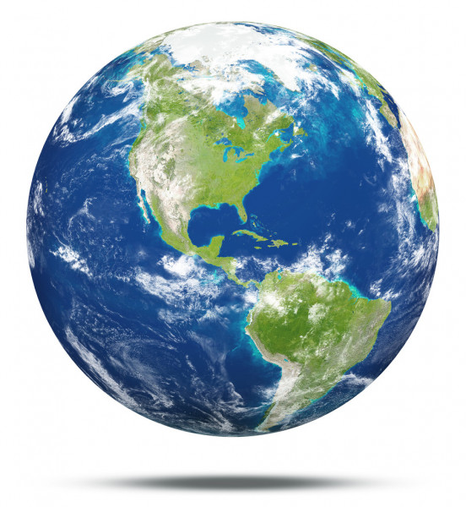
It is Impossible to…
1. Run Away from God
There is no place we can go to escape the presence of the Lord.
Psalm 139:7-12

Slide 12
It is Impossible to…
2. Change God’s Commands

Slide 13
It is Impossible to…
2. Change God’s Commands
“So he prayed to the Lord, and said, ‘Ah, Lord, was not this what I said when I was still in my country? Therefore I fled previously to Tarshish; for I know that You are a gracious and merciful God, slow to anger and abundant in lovingkindness, One who relents from doing harm.’”
Jonah 4:2

Slide 14
It is Impossible to…
2. Change God’s Commands
Now the word of the Lord came to Jonah the son of Amittai, saying,
“Arise, go to Nineveh, that great city, and cry out against it; for their wickedness has come up before Me.”
Jonah 1:1-2

Slide 15
It is Impossible to…
2. Change God’s Commands
Now the word of the Lord came to Jonah the son of Amittai, saying,
“Arise, go to Nineveh, that great city, and cry out against it; for their wickedness has come up before Me.”
Jonah 1:1-2
Now the word of the Lord came to Jonah the second time, saying,
“Arise, go to Nineveh, that great city, and preach to it the message that I tell you.”
Jonah 3:1-2

Slide 16
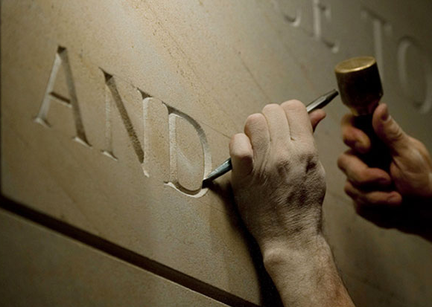
It is Impossible to…
2. Change God’s Commands
“Forever, O Lord, Your word is settled in heaven.”
Psalm 119:89

Slide 17
It is Impossible to…
3. Escape Wrath Without Repentance
Nineveh was being punished for their great wickedness (1:2).
They repented (3:10; Matt. 12:41), and God turned back His wrath.

Slide 18
It is Impossible to…
3. Escape Wrath Without Repentance
“For the wrath of God is revealed from heaven against all ungodliness and unrighteousness of men, who suppress the truth in unrighteousness.”
Romans 1:18
“Because of these things the wrath of God is coming upon the sons of disobedience.”
Colossians 3:6

Slide 19
It is Impossible to…
3. Escape Wrath Without Repentance
“Truly, these times of ignorance God overlooked, but now commands all men everywhere to repent,
because He has appointed a day on which He will judge the world in righteousness by the Man whom He has ordained. He has given assurance of this to all by raising Him from the dead.”
Acts 17:30-31

Slide 20
It is Impossible to…
4. Recruit God to Our Way of Thinking

Slide 21
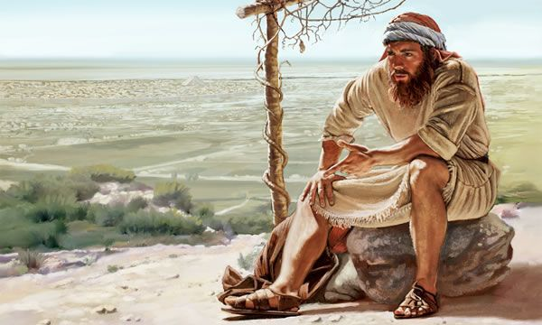
It is Impossible to…
4. Recruit God to Our Way of Thinking
“So Jonah went out of the city and sat on the east side of the city. There he made himself a shelter and sat under it in the shade, till he might see what would become of the city.”
Jonah 4:5

Slide 22
It is Impossible to…
4. Recruit God to Our Way of Thinking
“Then the Lord said, ‘You had compassion on the plant for which you did not work and which you did not cause to grow, which came up overnight and perished overnight.
Should I not have compassion on Nineveh, the great city in which there are more than 120,000 persons who do not know the difference between their right and left hand, as well as many animals?’”
Jonah 4:10-11, NASU
“So Jonah went out of the city and sat on the east side of the city. There he made himself a shelter and sat under it in the shade, till he might see what would become of the city.”
Jonah 4:5

Slide 23
Impossible Things
We Can’t Run Away from God.
We Can’t Change God’s Commands.
We Can’t Escape God’s Wrath Without Repentance.
We Can’t Recruit God to Our Way of Thinking.

