Slide 2

OBADIAH
The Sins of Edom

Slide 3
The Message of Obadiah
Concerns the sins committed against Jerusalem by the nation of Edom.
The animosity between these nations can be traced back to a sibling rivalry that began in the womb of Rebekah (Gen. 25:21-26).

Slide 4
1. The Sin of Pride
Obadiah 2-9
The pride of their heart had blinded them.
A number of things caused Edom to be lifted up in their own eyes and gave them a false sense of confidence.

Slide 5
1. The Sin of Pride
Confidence in their Physical Location (vs. 3-4)

Slide 6
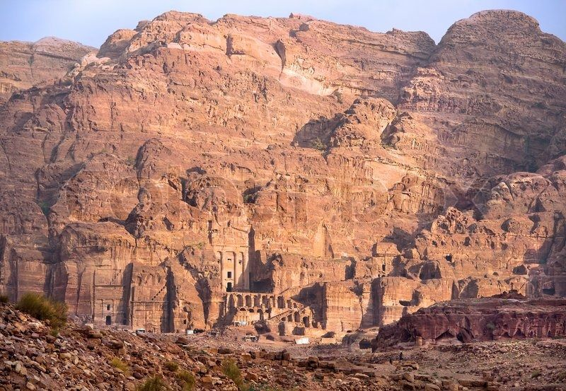
1. The Sin of Pride
Confidence in their Physical Location (vs. 3-4)

Slide 7
1. The Sin of Pride
Confidence in their Physical Location (vs. 3-4)
Confidence in their Allies (v. 7)

Slide 8
1. The Sin of Pride
Confidence in their Physical Location (vs. 3-4)
Confidence in their Allies (v. 7)
Confidence in their Wisdom (v. 8)

Slide 9
1. The Sin of Pride
Confidence in their Physical Location (vs. 3-4)
Confidence in their Allies (v. 7)
Confidence in their Wisdom (v. 8)
Confidence in their Strength (v. 9)

Slide 10
2. Violence Against Their Brother
“For violence against your brother Jacob, shame shall cover you, and you shall be cut off forever.”
Obadiah 10

Slide 11
2. Violence Against Their Brother
They stood on the other side (v. 11)

Slide 12
2. Violence Against Their Brother
They stood on the other side (v. 11)
They delighted in the misfortune of others (v. 12)

Slide 13
2. Violence Against Their Brother
They stood on the other side (v. 11)
They delighted in the misfortune of others (v. 12)
17 Do not rejoice when your enemy falls, and do not let your heart be glad when he stumbles;
18 Lest the Lord see it, and it displease Him, and He turn away His wrath from him.
Prov. 24:17-18

Slide 14
2. Violence Against Their Brother
They stood on the other side (v. 11)
They delighted in the misfortune of others (v. 12)
“Remember, O Lord, against the sons of Edom the day of Jerusalem, who said, ‘Raze it, raze it, to its very foundation!’”
Psalm 137:7

Slide 15
2. Violence Against Their Brother
They stood on the other side (v. 11)
They delighted in the misfortune of others (v. 12)
“He who mocks the poor reproaches his Maker; he who is glad at calamity will not go unpunished.”
Prov. 17:5

Slide 16
2. Violence Against Their Brother
They stood on the other side (v. 11)
They delighted in the misfortune of others (v. 12)
They took advantage of Jerusalem’s misfortune (vs. 13-14)

Slide 17
Edom Will Reap What They Have Sown
15 For the day of the Lord upon all the nations is near; as you have done, it shall be done to you; your reprisal shall return upon your own head.
16 For as you drank on My holy mountain, so shall all the nations drink continually; yes, they shall drink, and swallow, and they shall be as though they had never been.
Obadiah 15-16

Slide 18
Edom Will Reap What They Have Sown
15 For the day of the Lord upon all the nations is near; as you have done, it shall be done to you; your reprisal shall return upon your own head.
16 For as you drank on My holy mountain, so shall all the nations drink continually; yes, they shall drink, and swallow, and they shall be as though they had never been.
Obadiah 15-16
We will reap what we have sown!
“Do not be deceived, God is not mocked; for whatever a man sows, that he will also reap.”
Galatians 6:7

