Slide 1
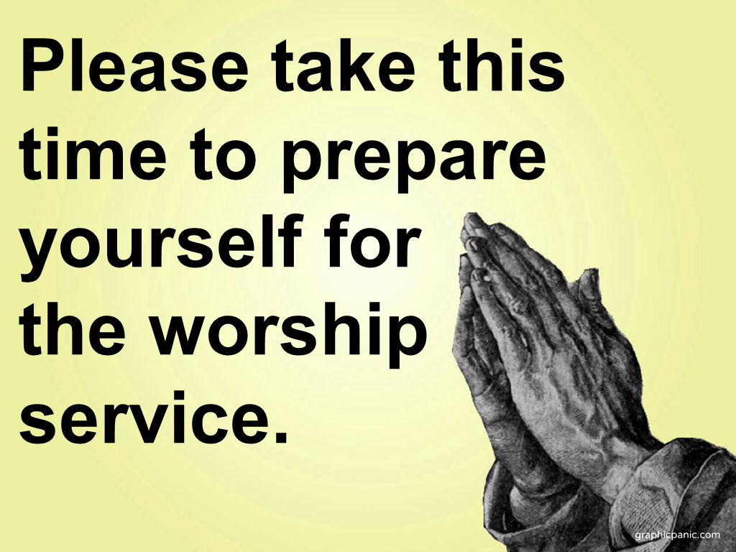

Slide 2
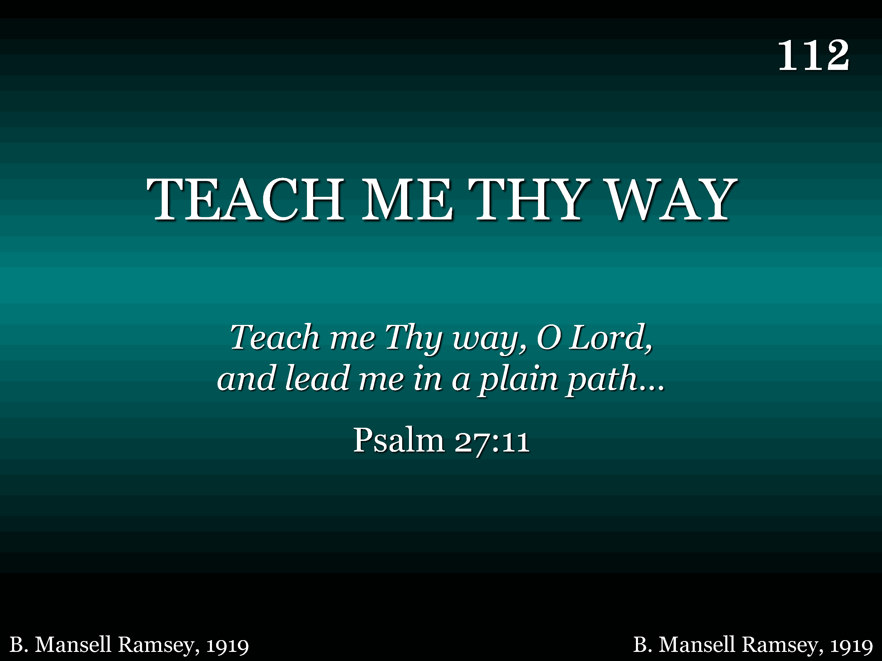
112 - Teach Me Thy Way - Title

Slide 3
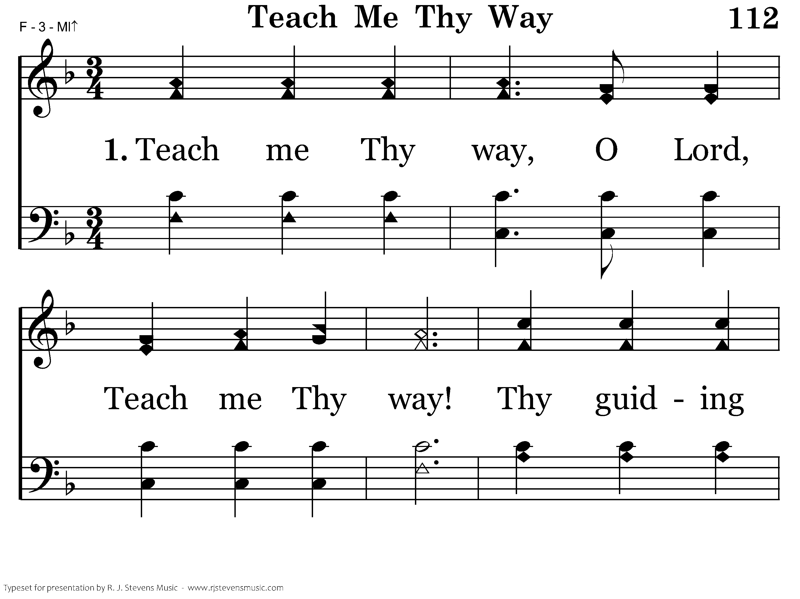
112 - Teach Me Thy Way - 1.1

Slide 4
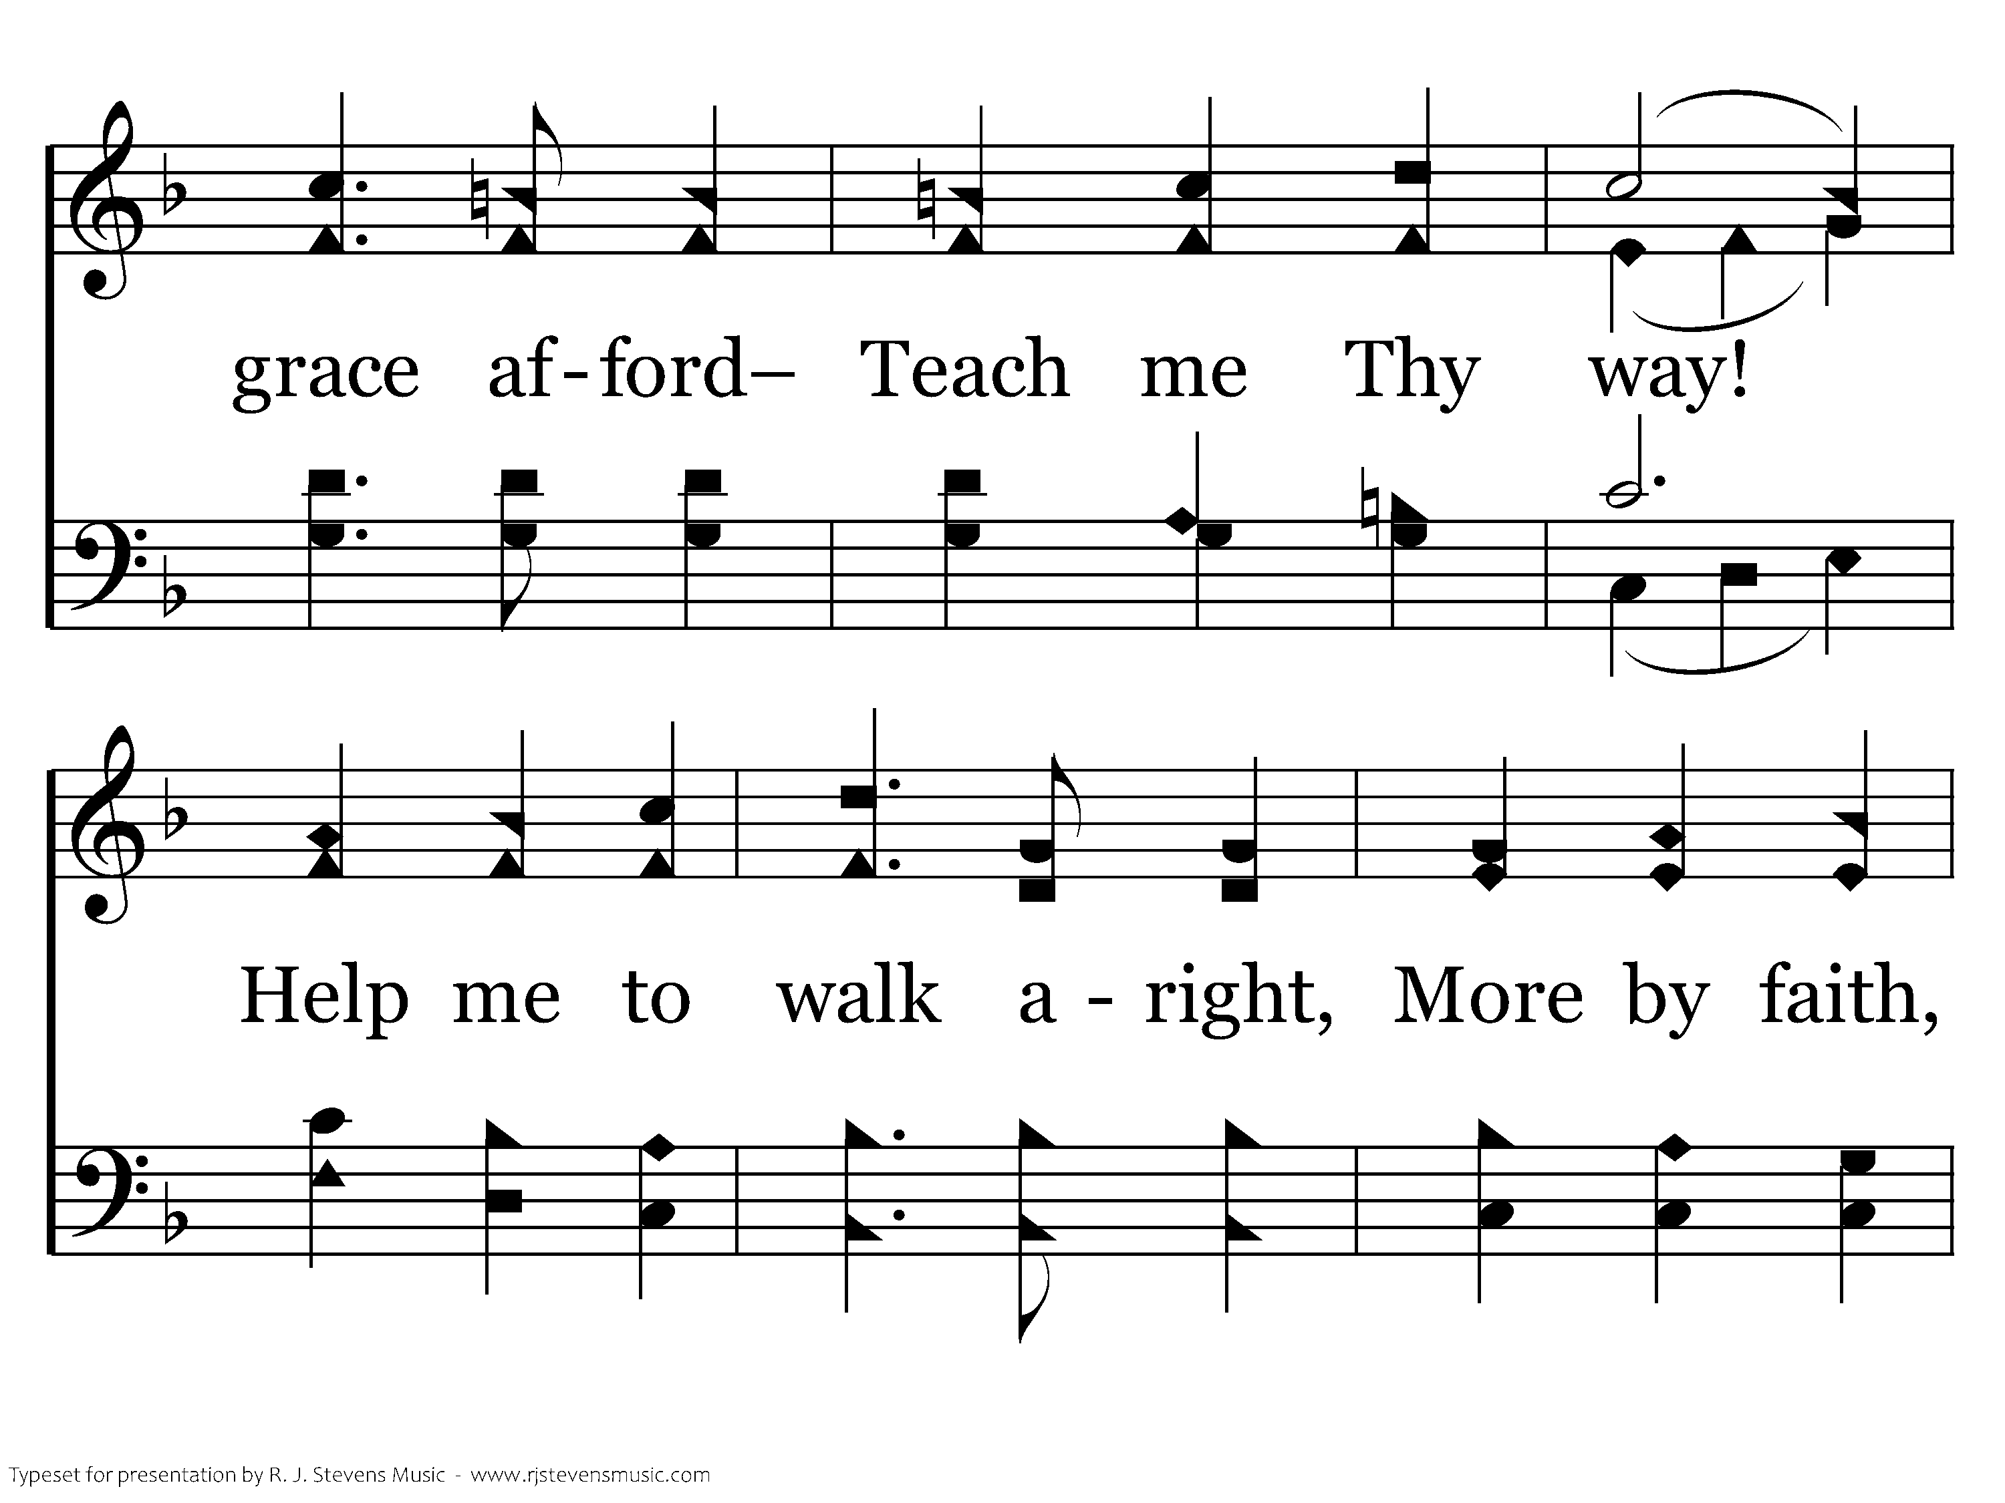
112 - Teach Me Thy Way - 1.2

Slide 5
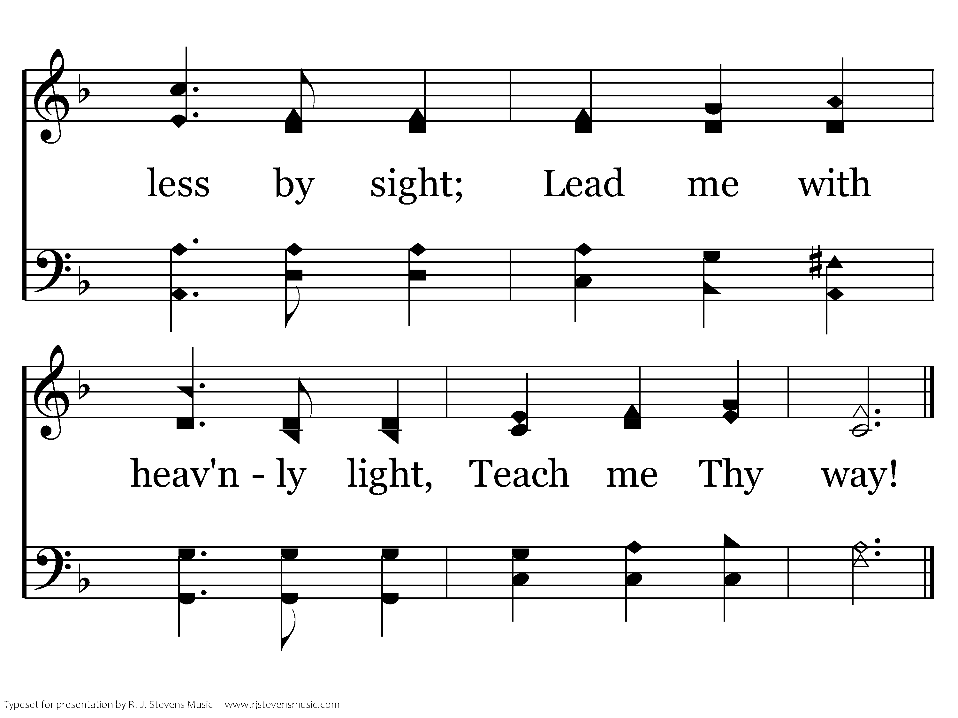
112 - Teach Me Thy Way - 1.3
End of Verse 1

Slide 6
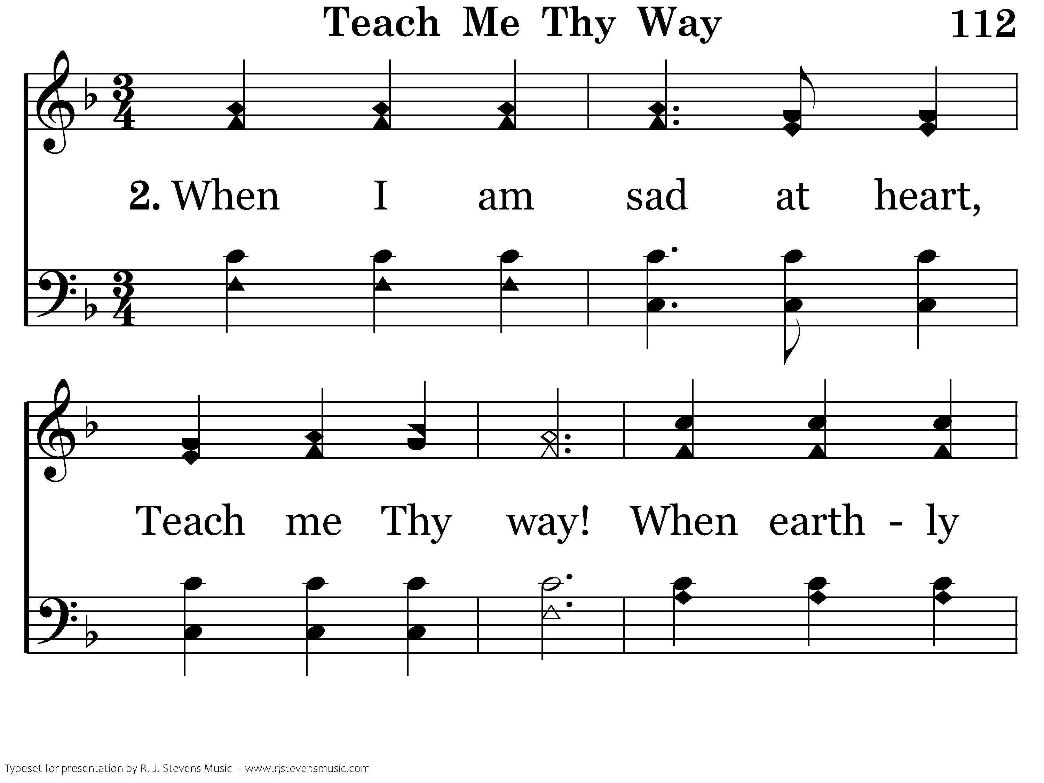
112 - Teach Me Thy Way - 2.1

Slide 7
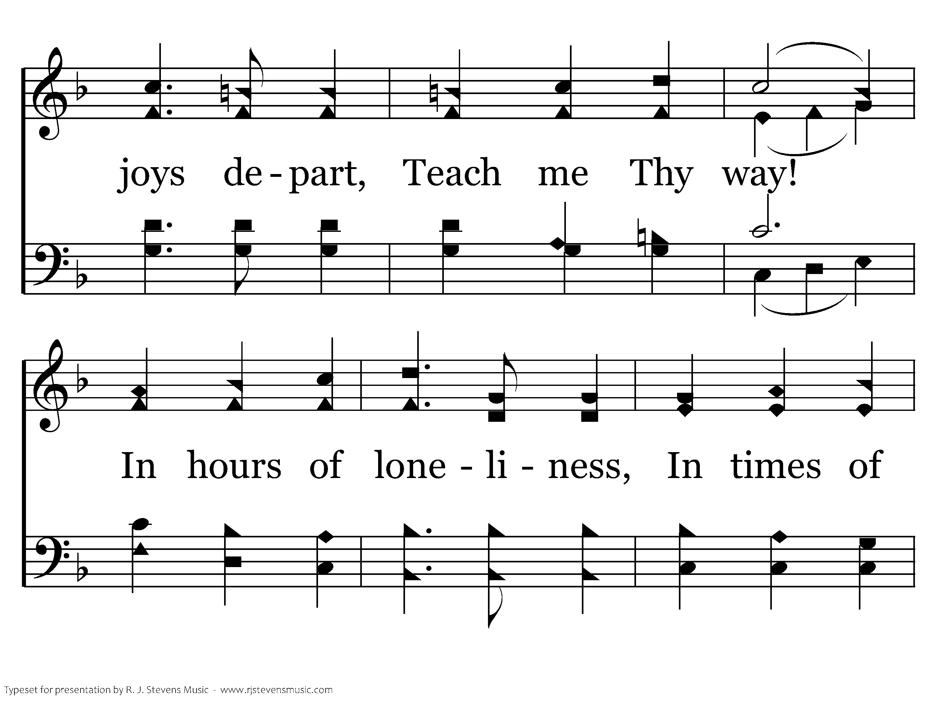
112 - Teach Me Thy Way - 2.2

Slide 8
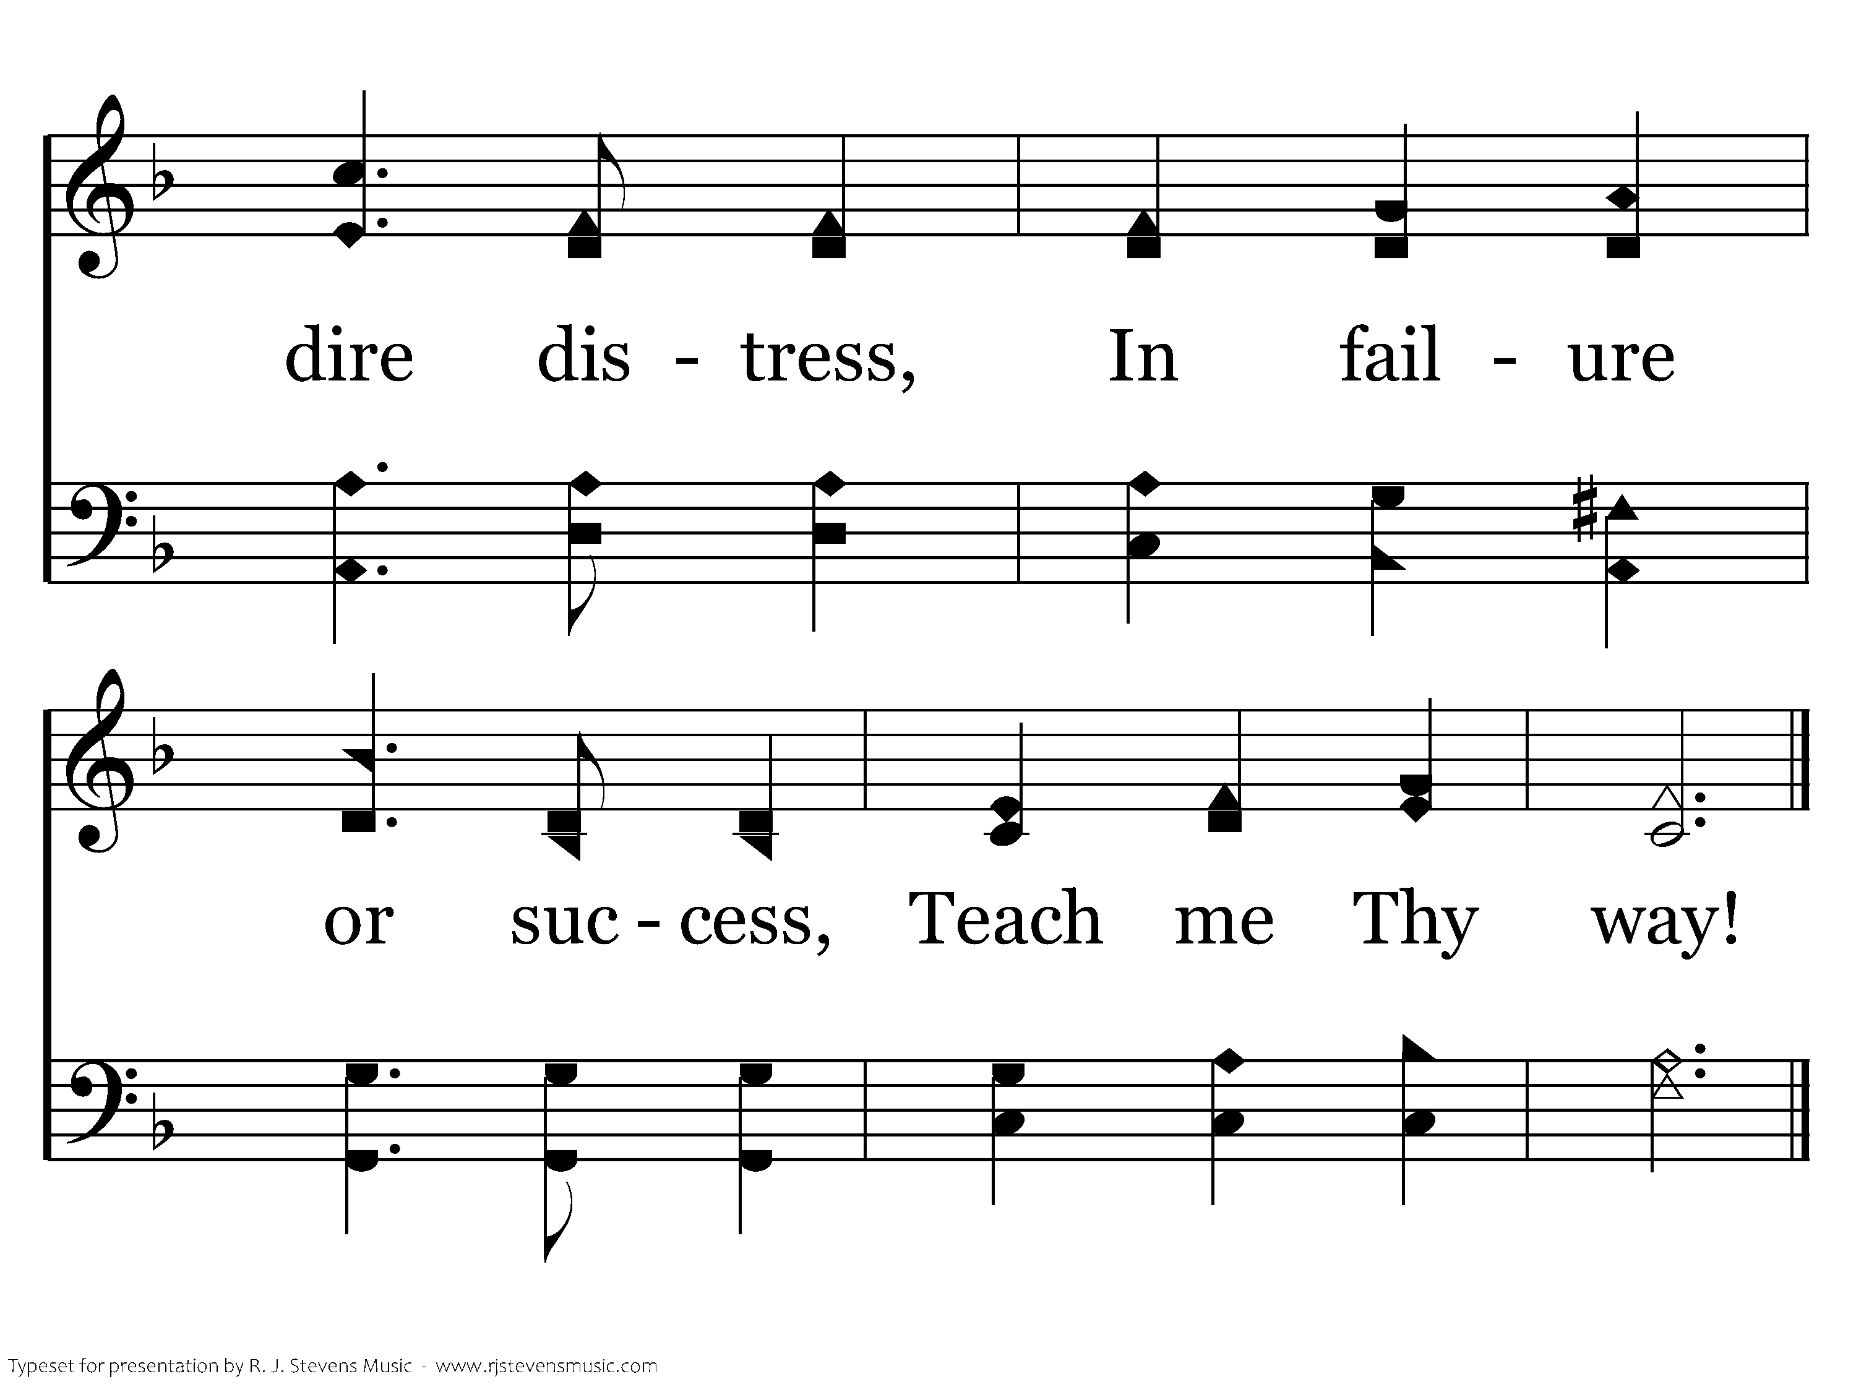
112 - Teach Me Thy Way - 2.3
End of Verse 2

Slide 9
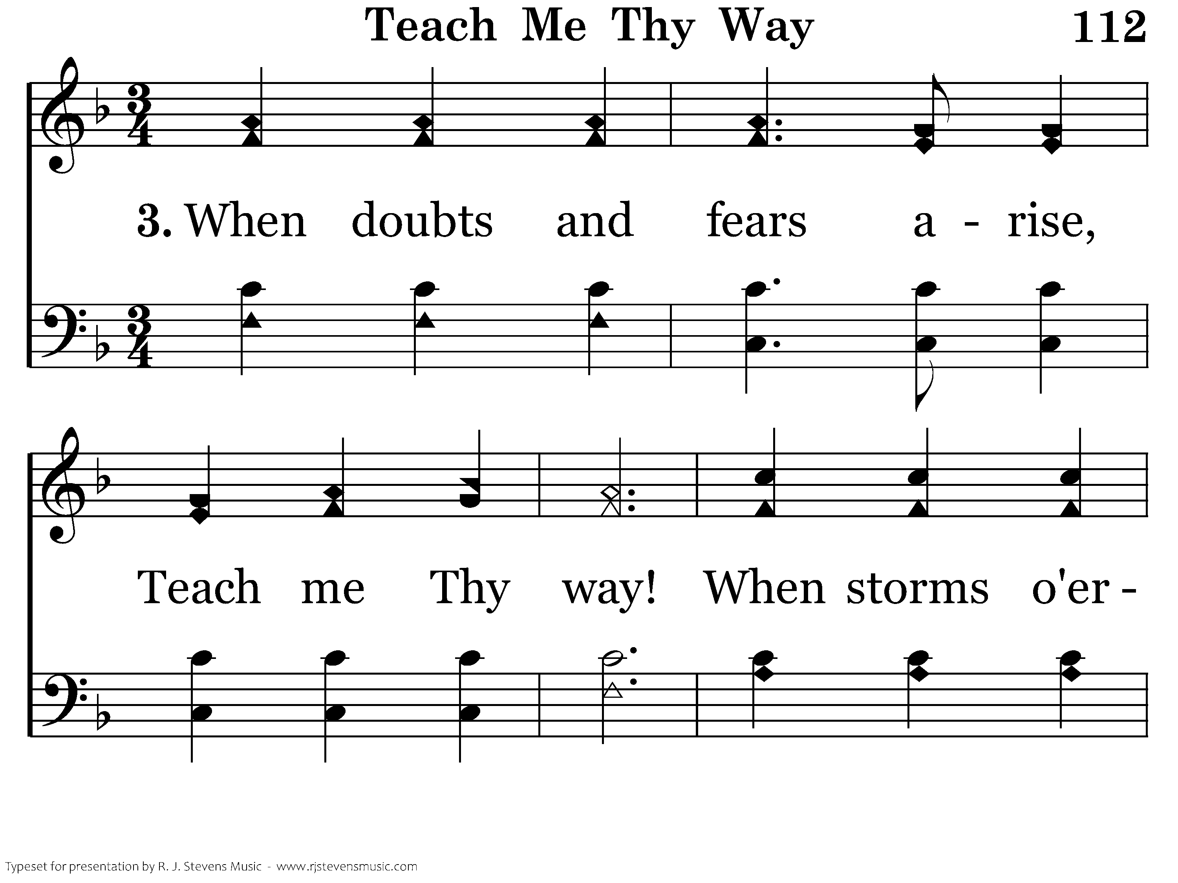
112 - Teach Me Thy Way - 3.1

Slide 10
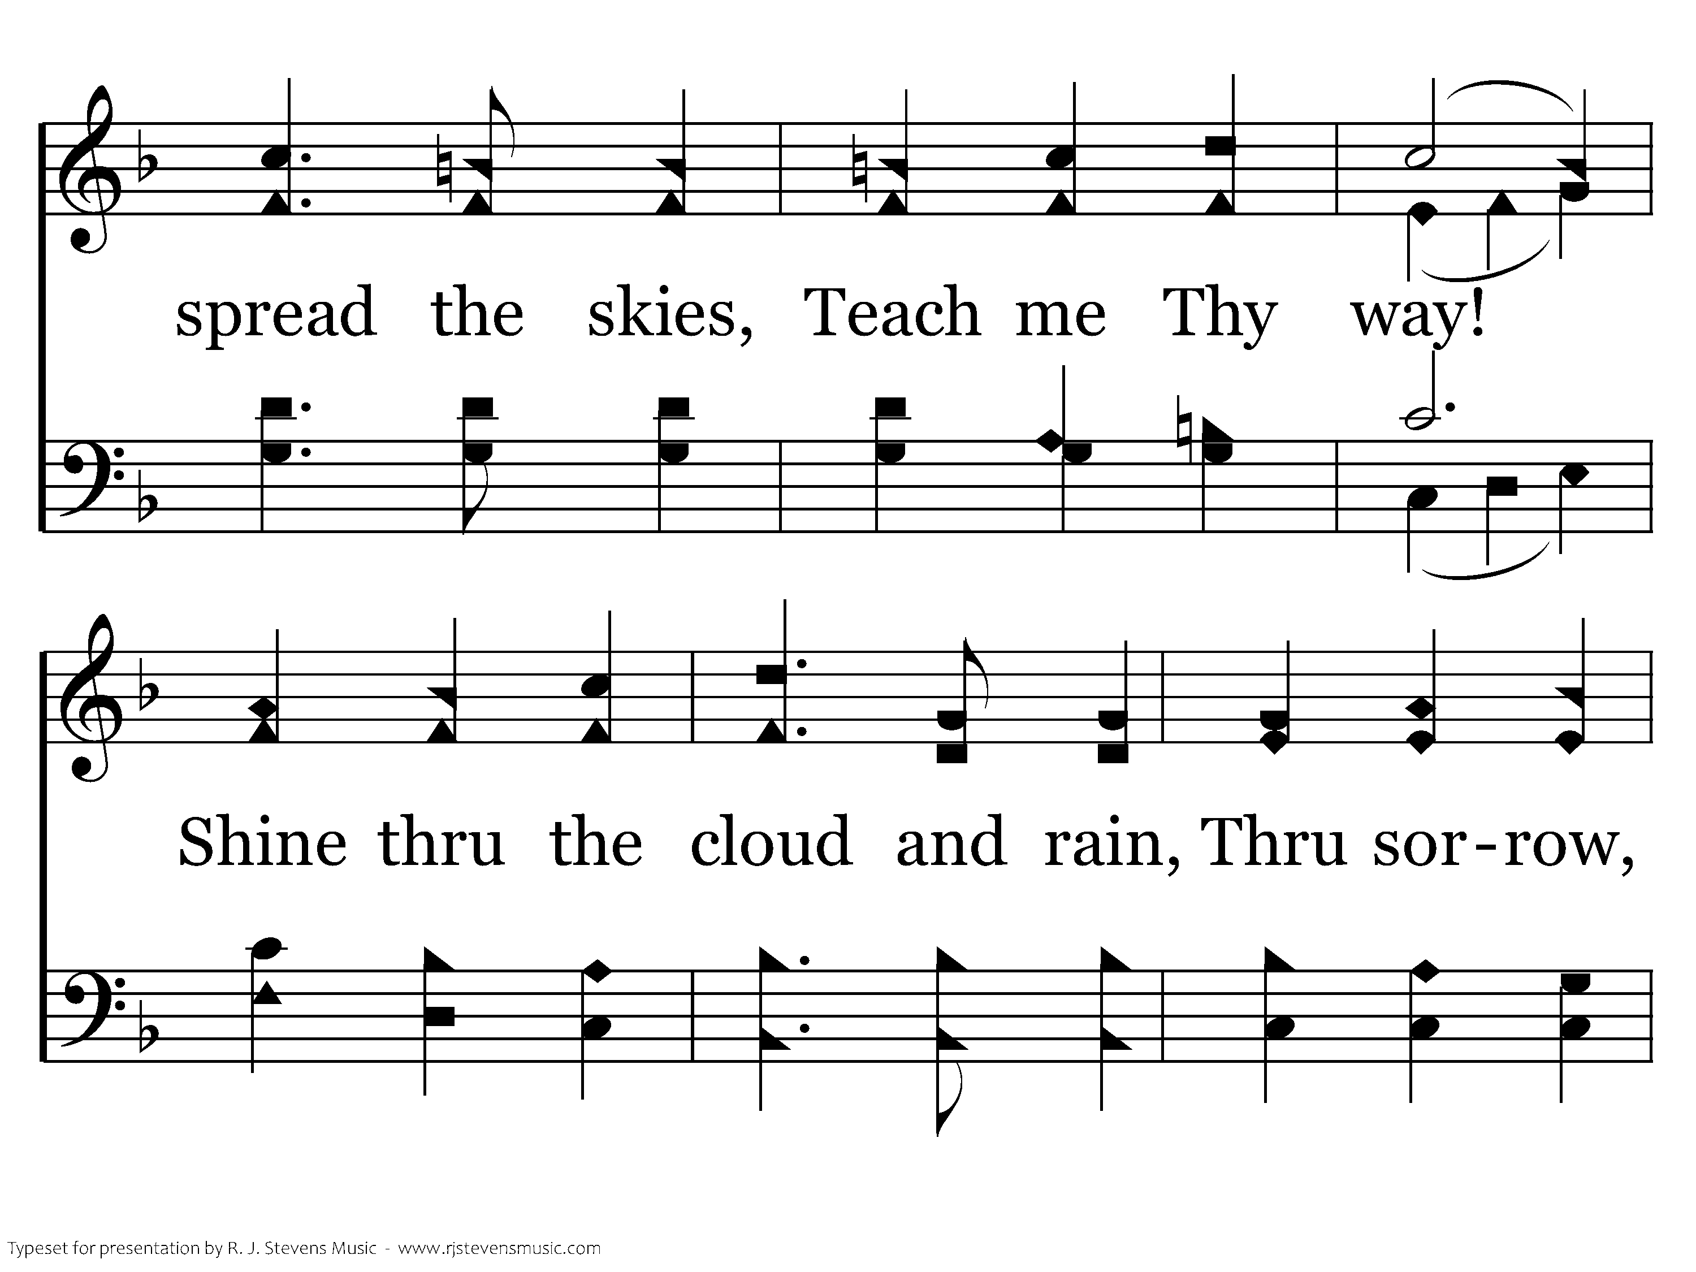
112 - Teach Me Thy Way - 3.2

Slide 11
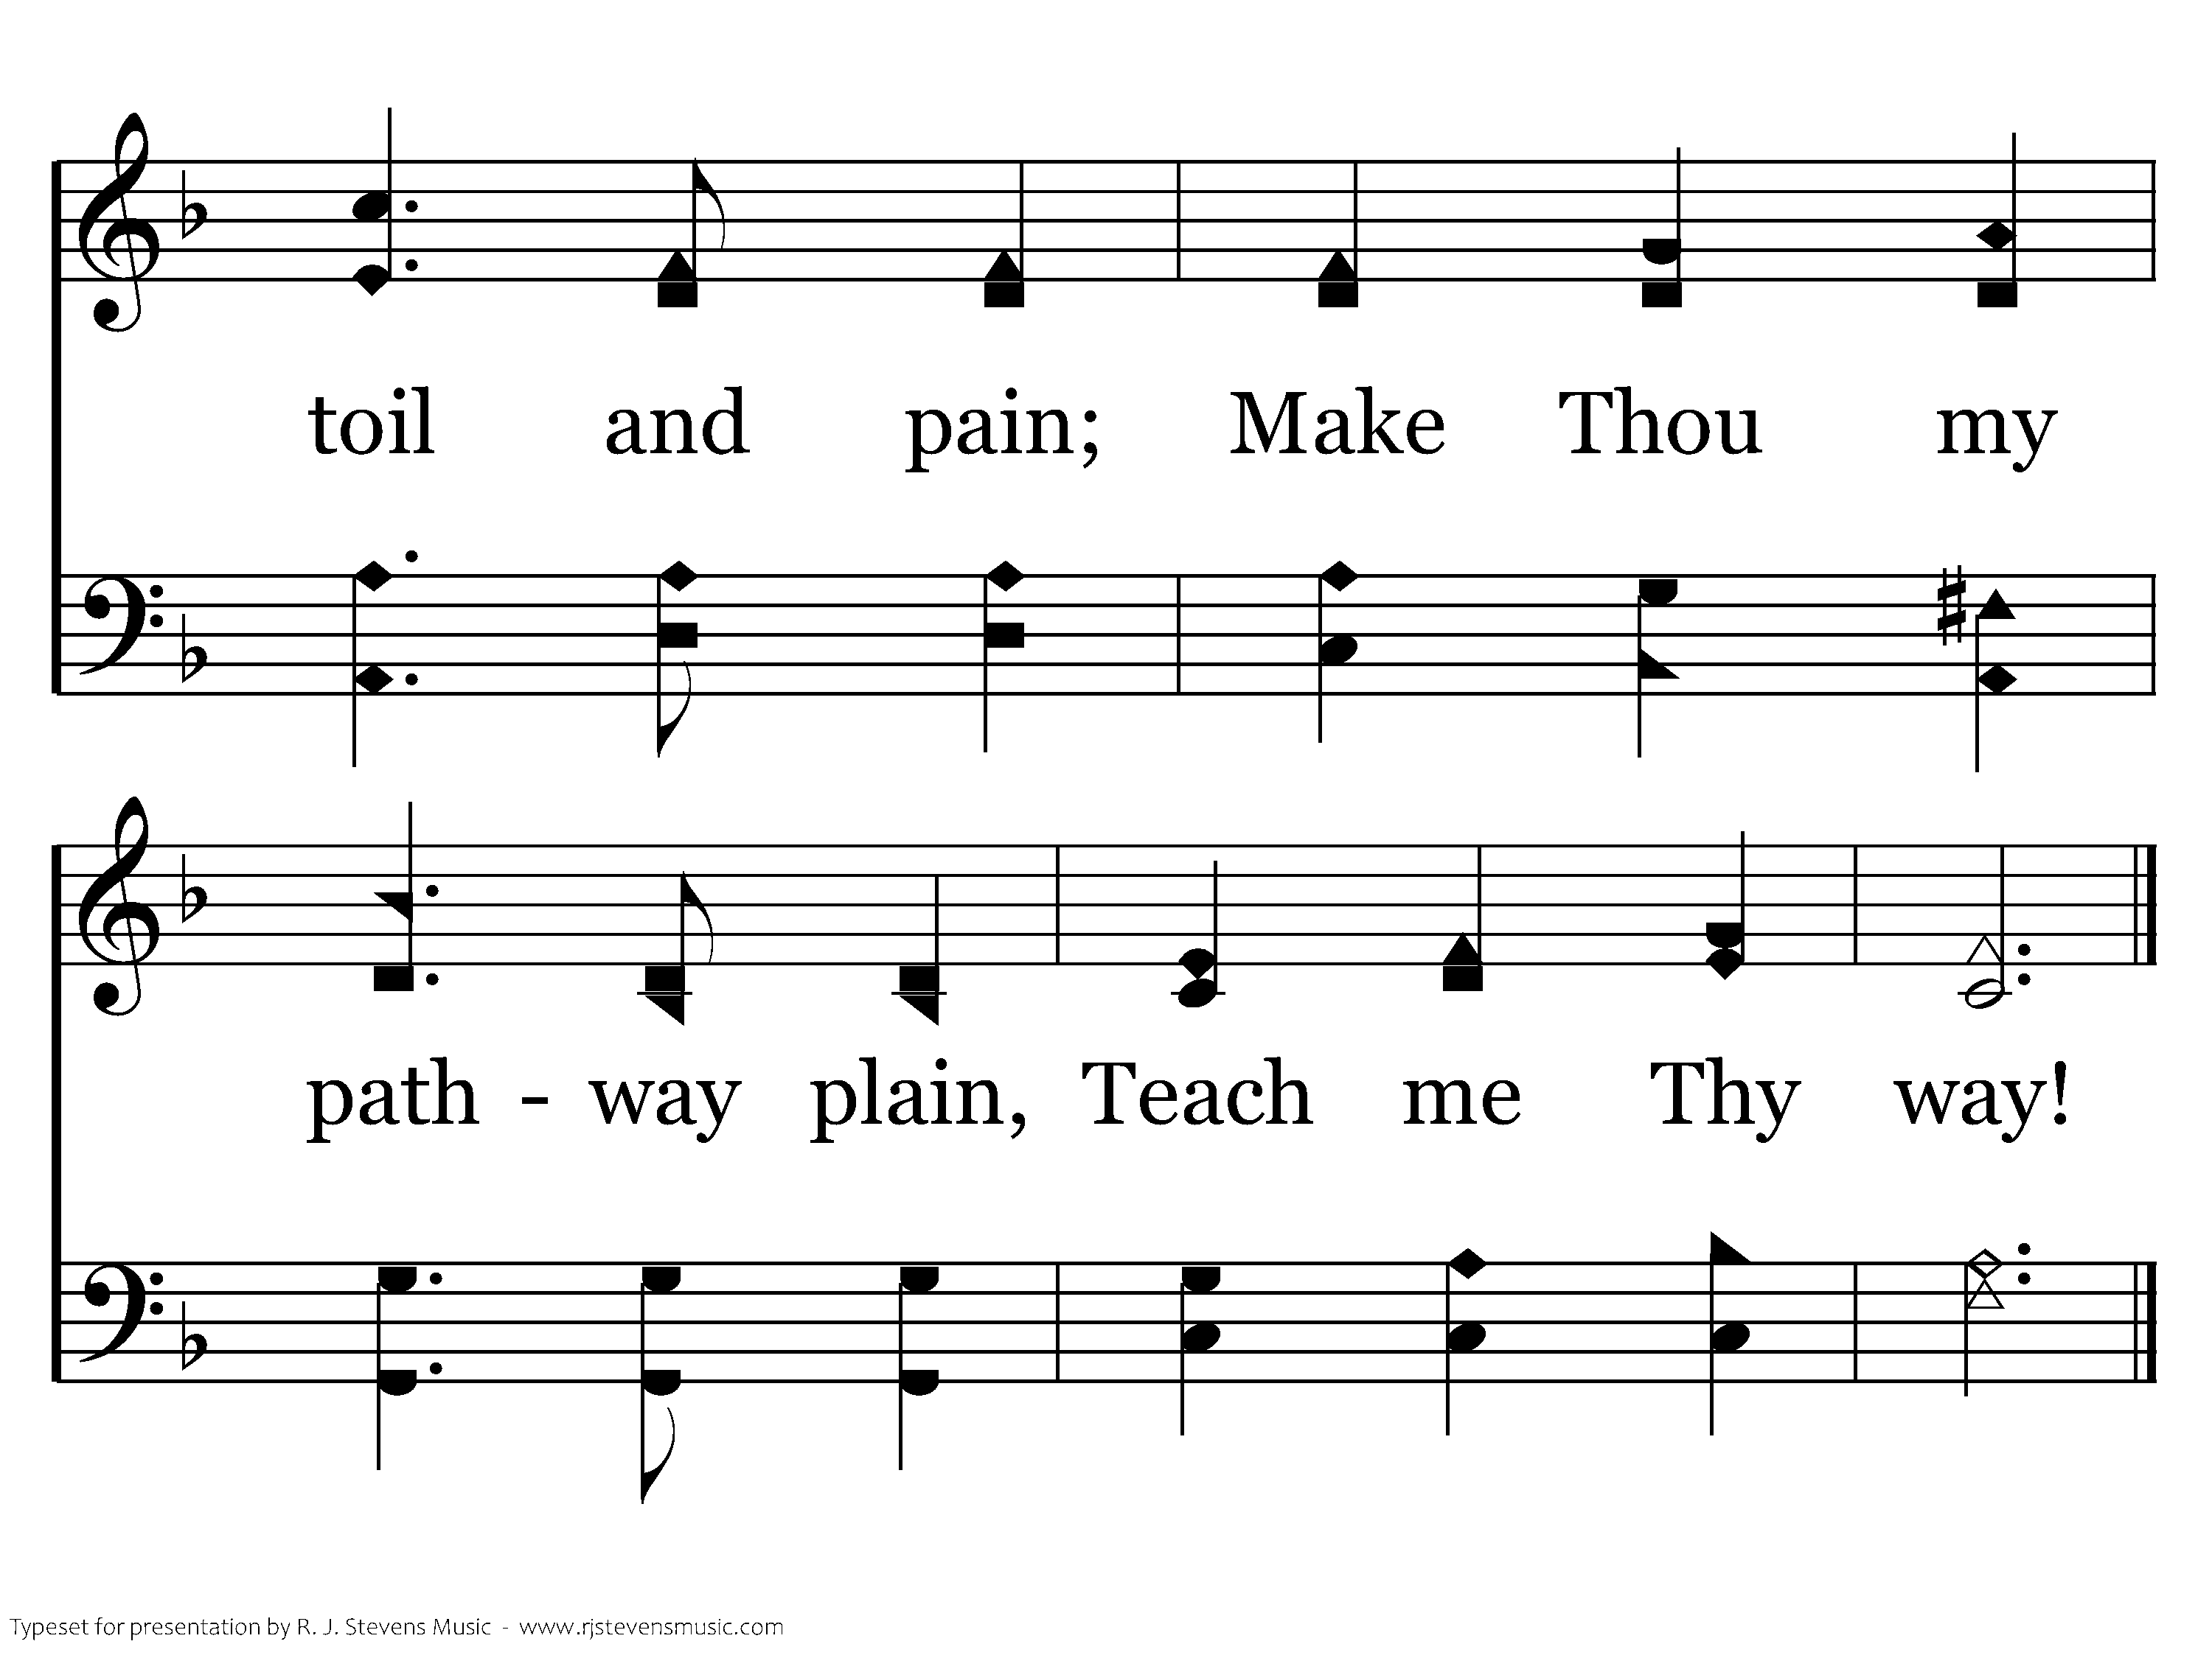
112 - Teach Me Thy Way - 3.3
End of Verse 3

Slide 12
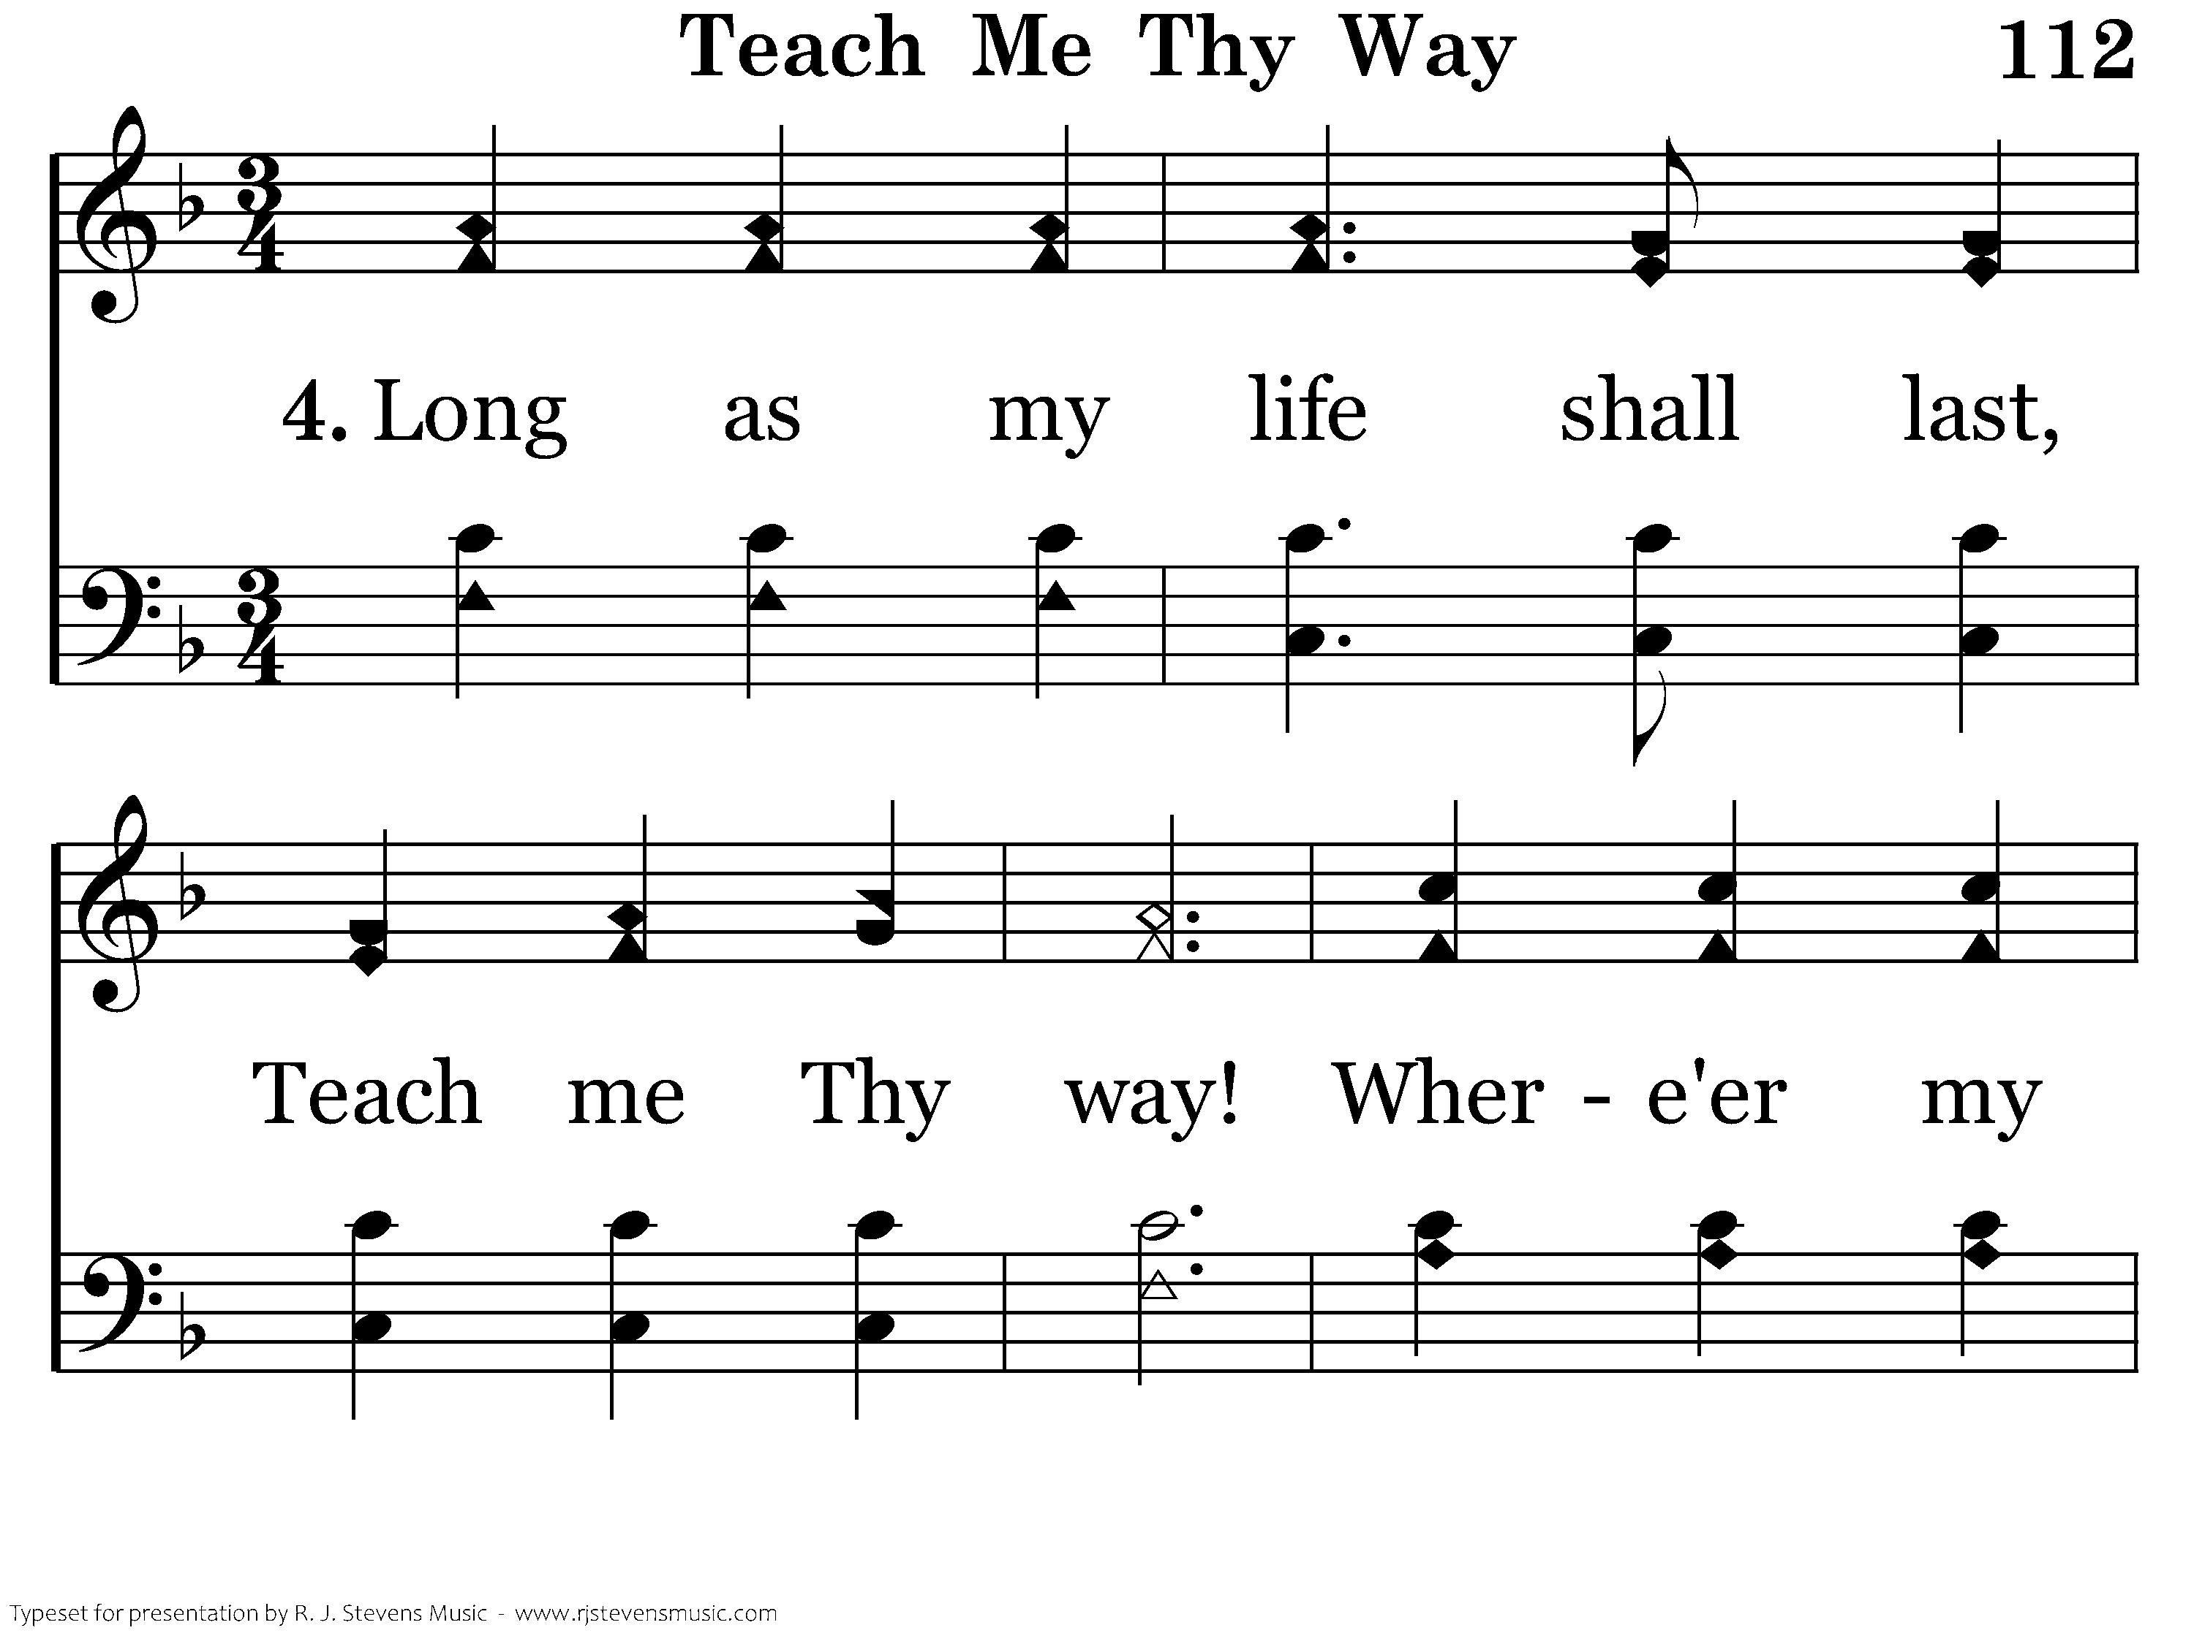
112 - Teach Me Thy Way - 4.1

Slide 13
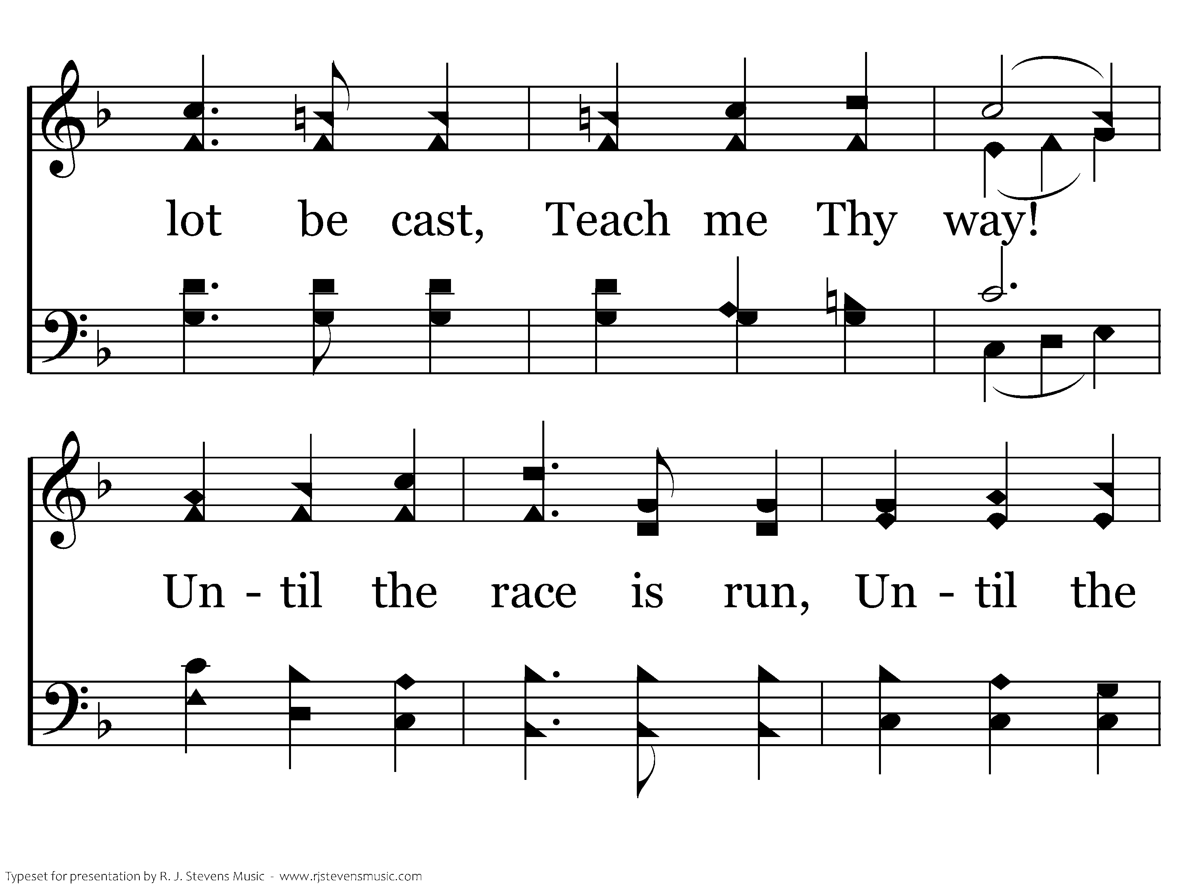
112 - Teach Me Thy Way - 4.2

Slide 14
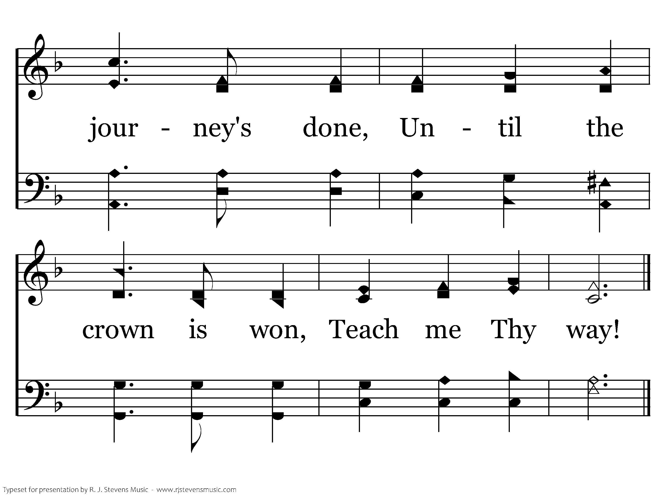
112 - Teach Me Thy Way - 4.3
End of Song

Slide 15
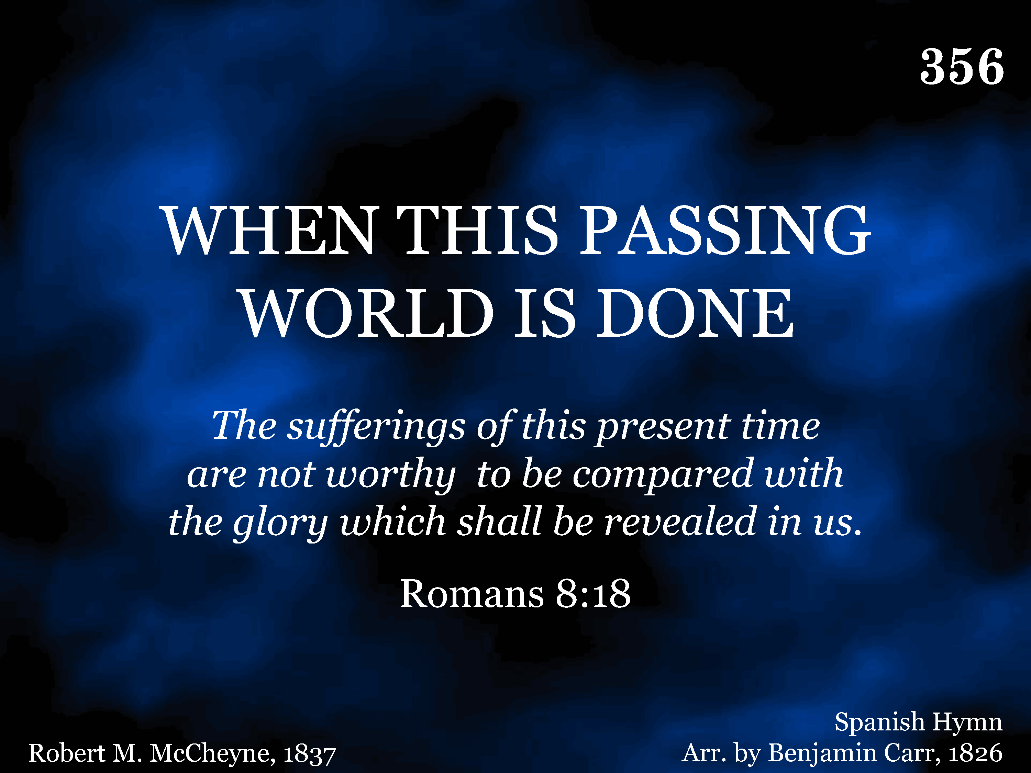
20356 - WHEN THIS PASSING WORLD IS DONE - Title

Slide 16
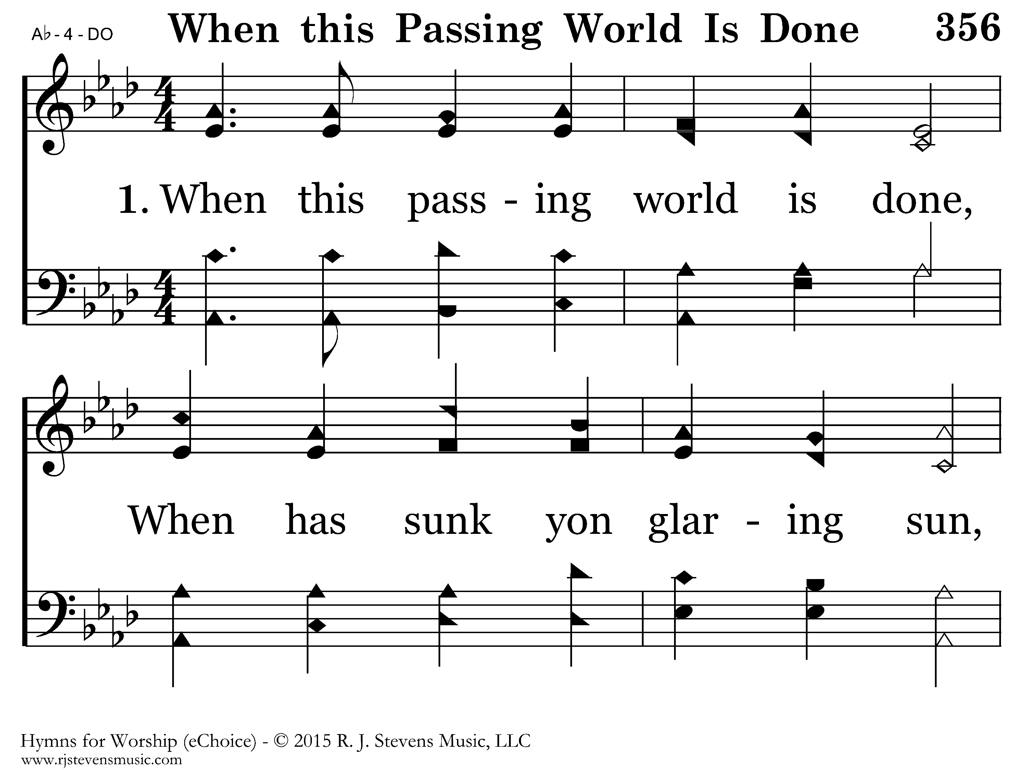
20356 - WHEN THIS PASSING WORLD IS DONE - 1.1

Slide 17
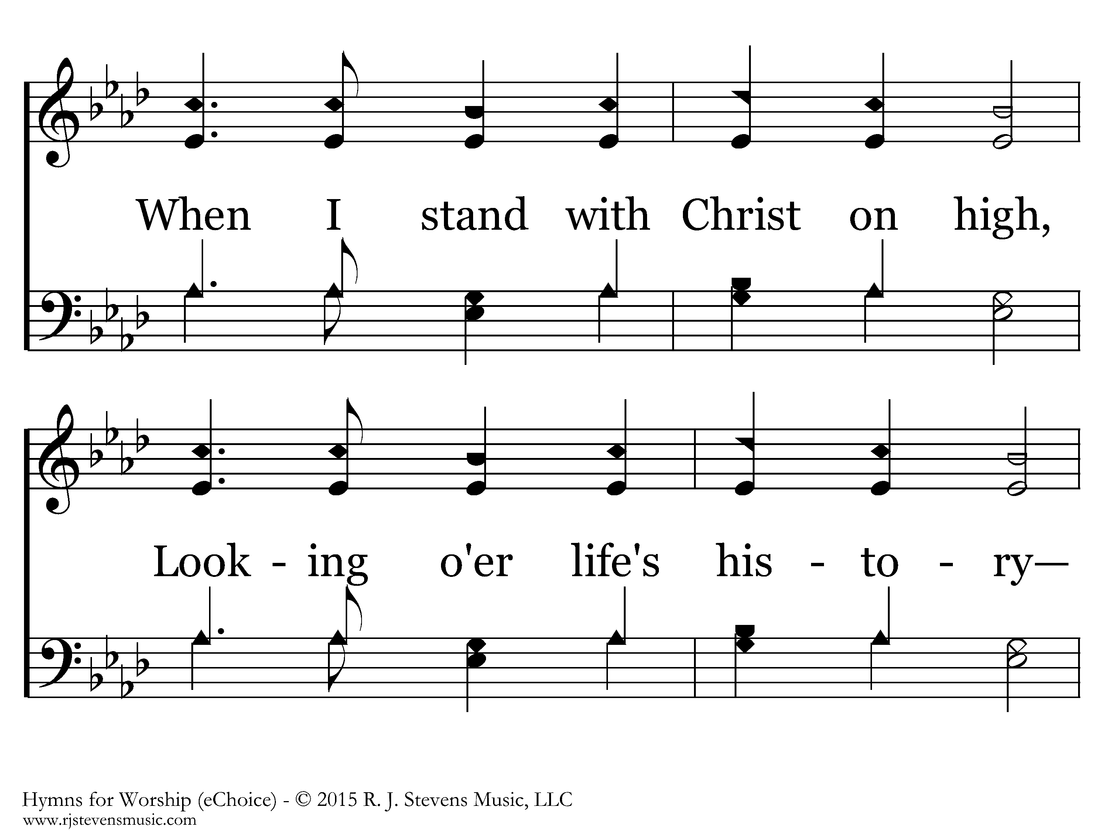
20356 - WHEN THIS PASSING WORLD IS DONE - 1.2

Slide 18
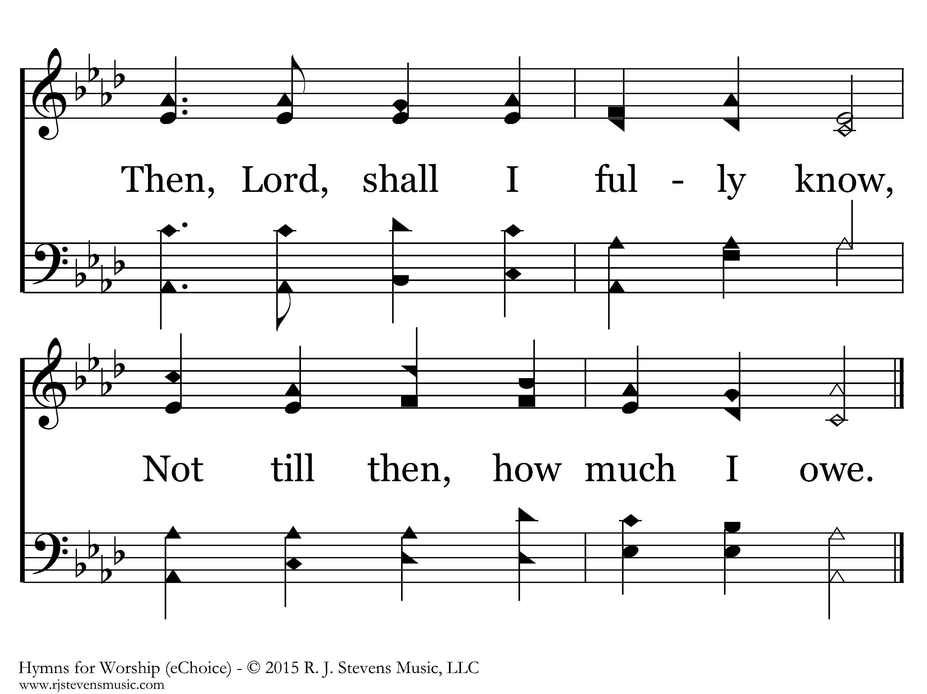
20356 - WHEN THIS PASSING WORLD IS DONE - 1.3
End of Verse 1

Slide 19
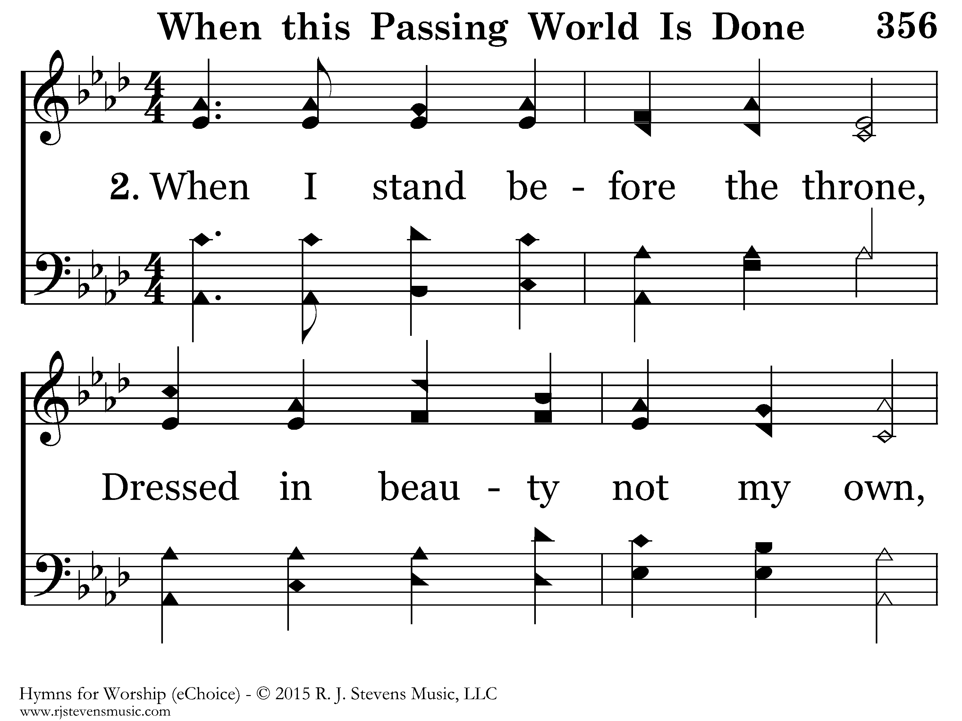
20356 - WHEN THIS PASSING WORLD IS DONE - 2.1

Slide 20
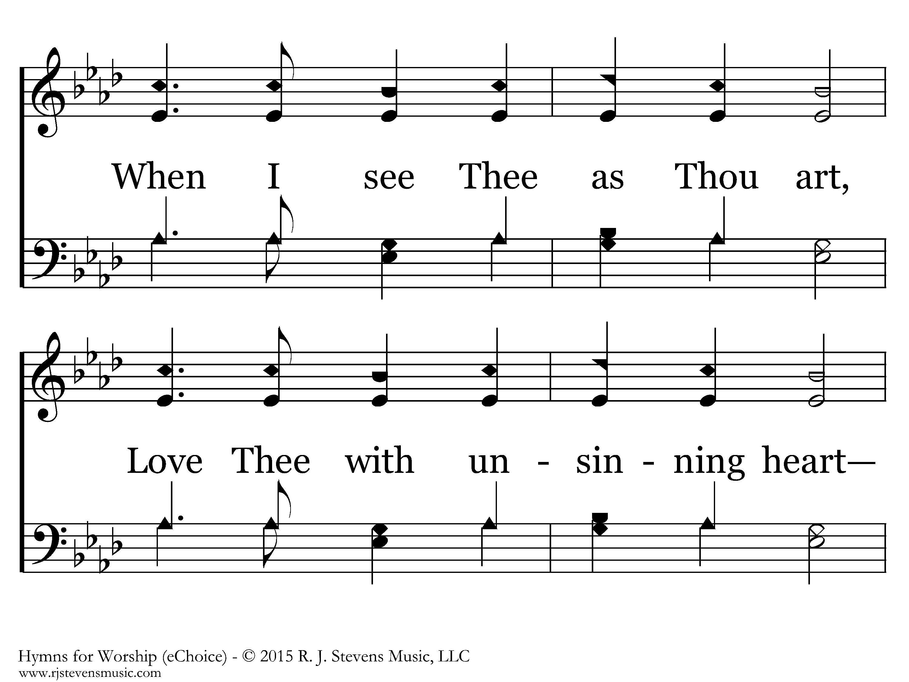
20356 - WHEN THIS PASSING WORLD IS DONE - 2.2

Slide 21
20356 - WHEN THIS PASSING WORLD IS DONE - 2.3
End of Verse 2

Slide 22
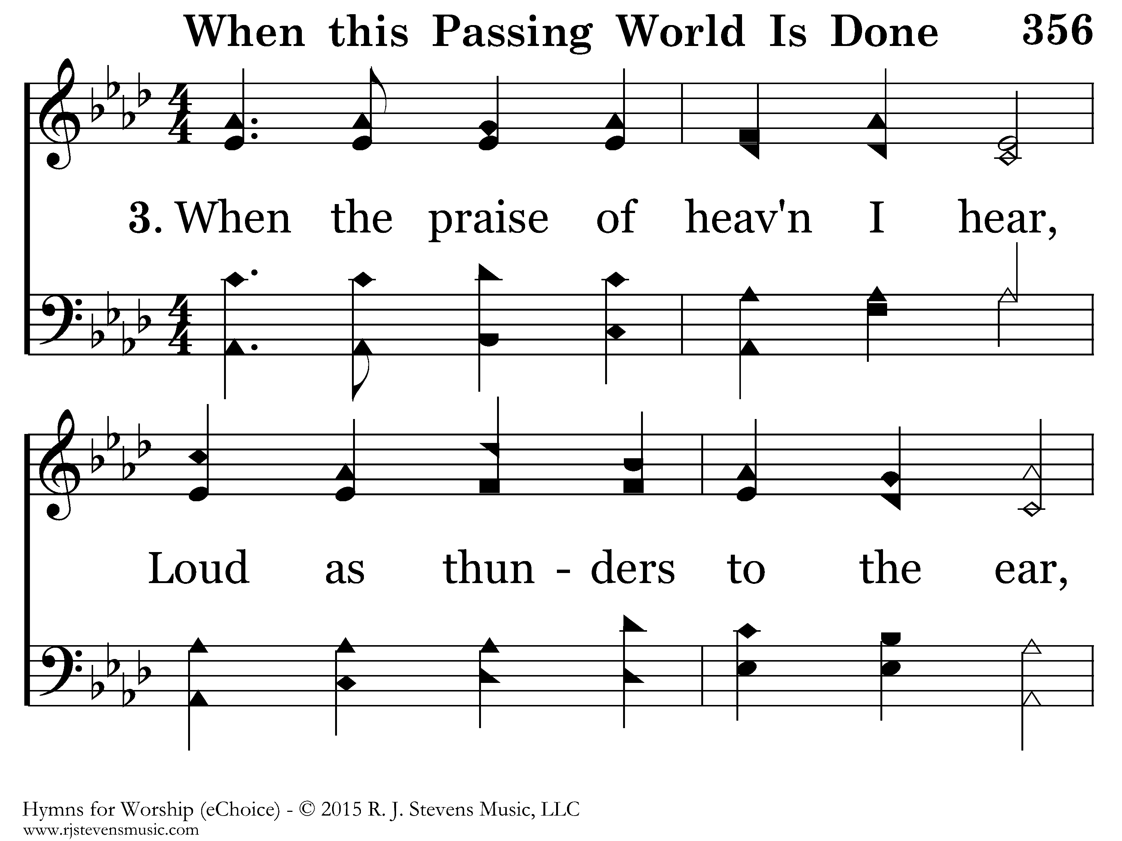
20356 - WHEN THIS PASSING WORLD IS DONE - 3.1

Slide 23
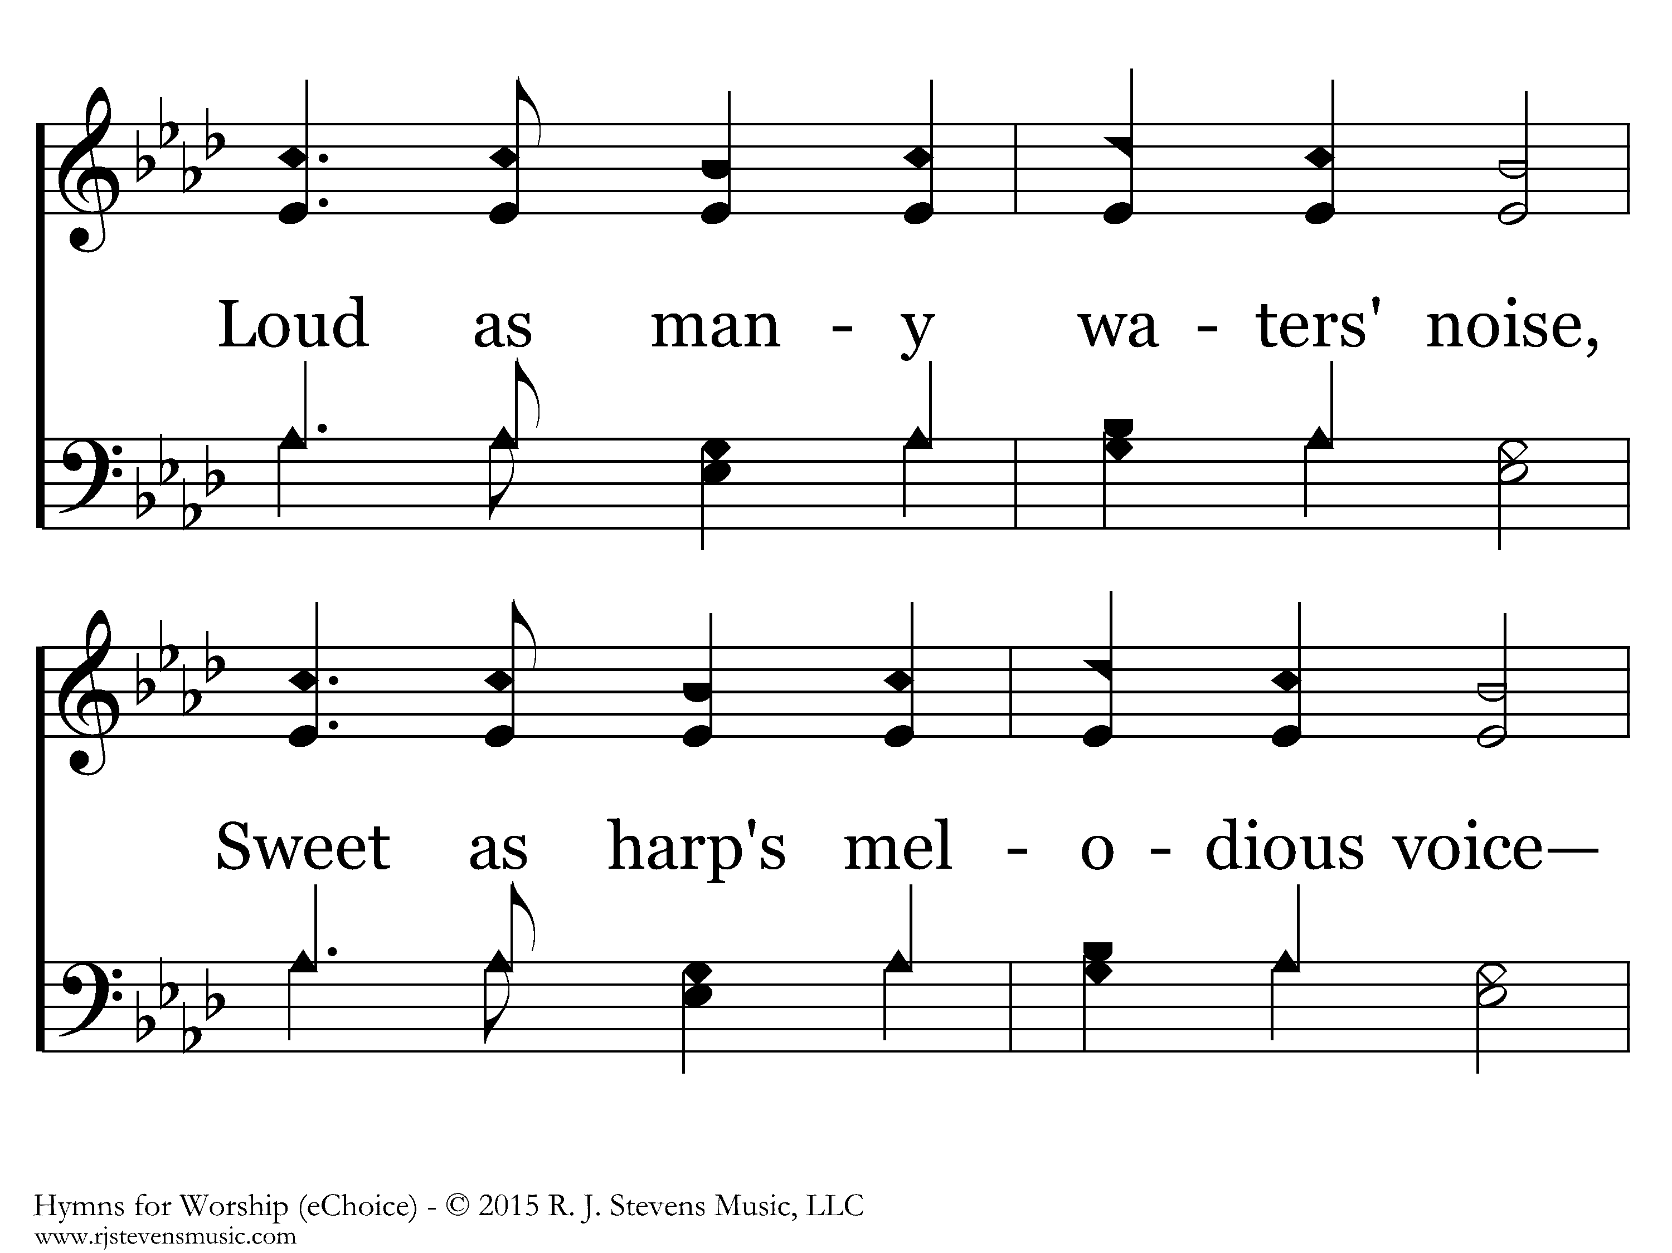
20356 - WHEN THIS PASSING WORLD IS DONE - 3.2

Slide 24
20356 - WHEN THIS PASSING WORLD IS DONE - 3.3
End of Verse 3

Slide 25
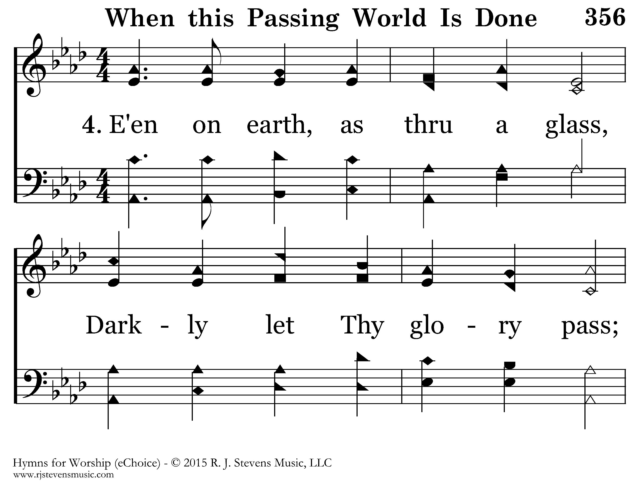
20356 - WHEN THIS PASSING WORLD IS DONE - 4.1

Slide 26
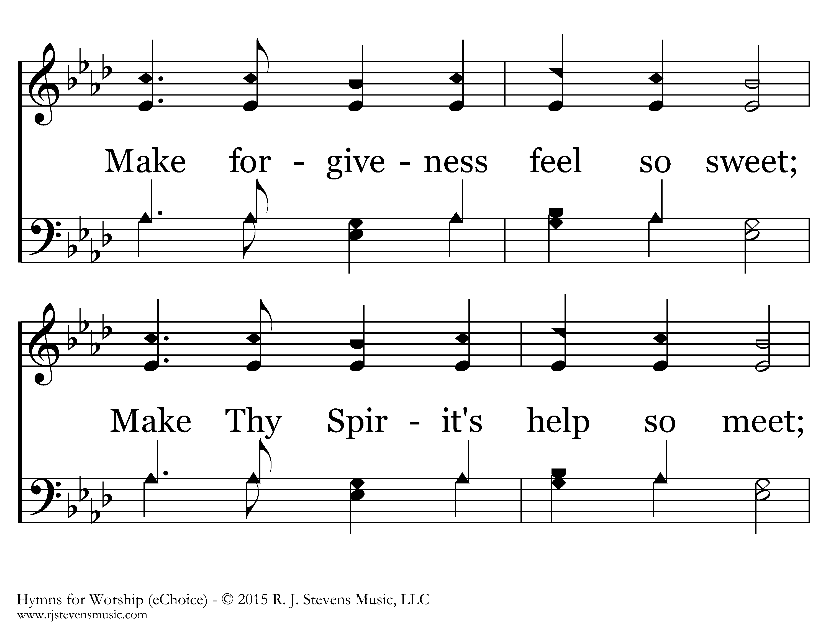
20356 - WHEN THIS PASSING WORLD IS DONE - 4.2

Slide 27
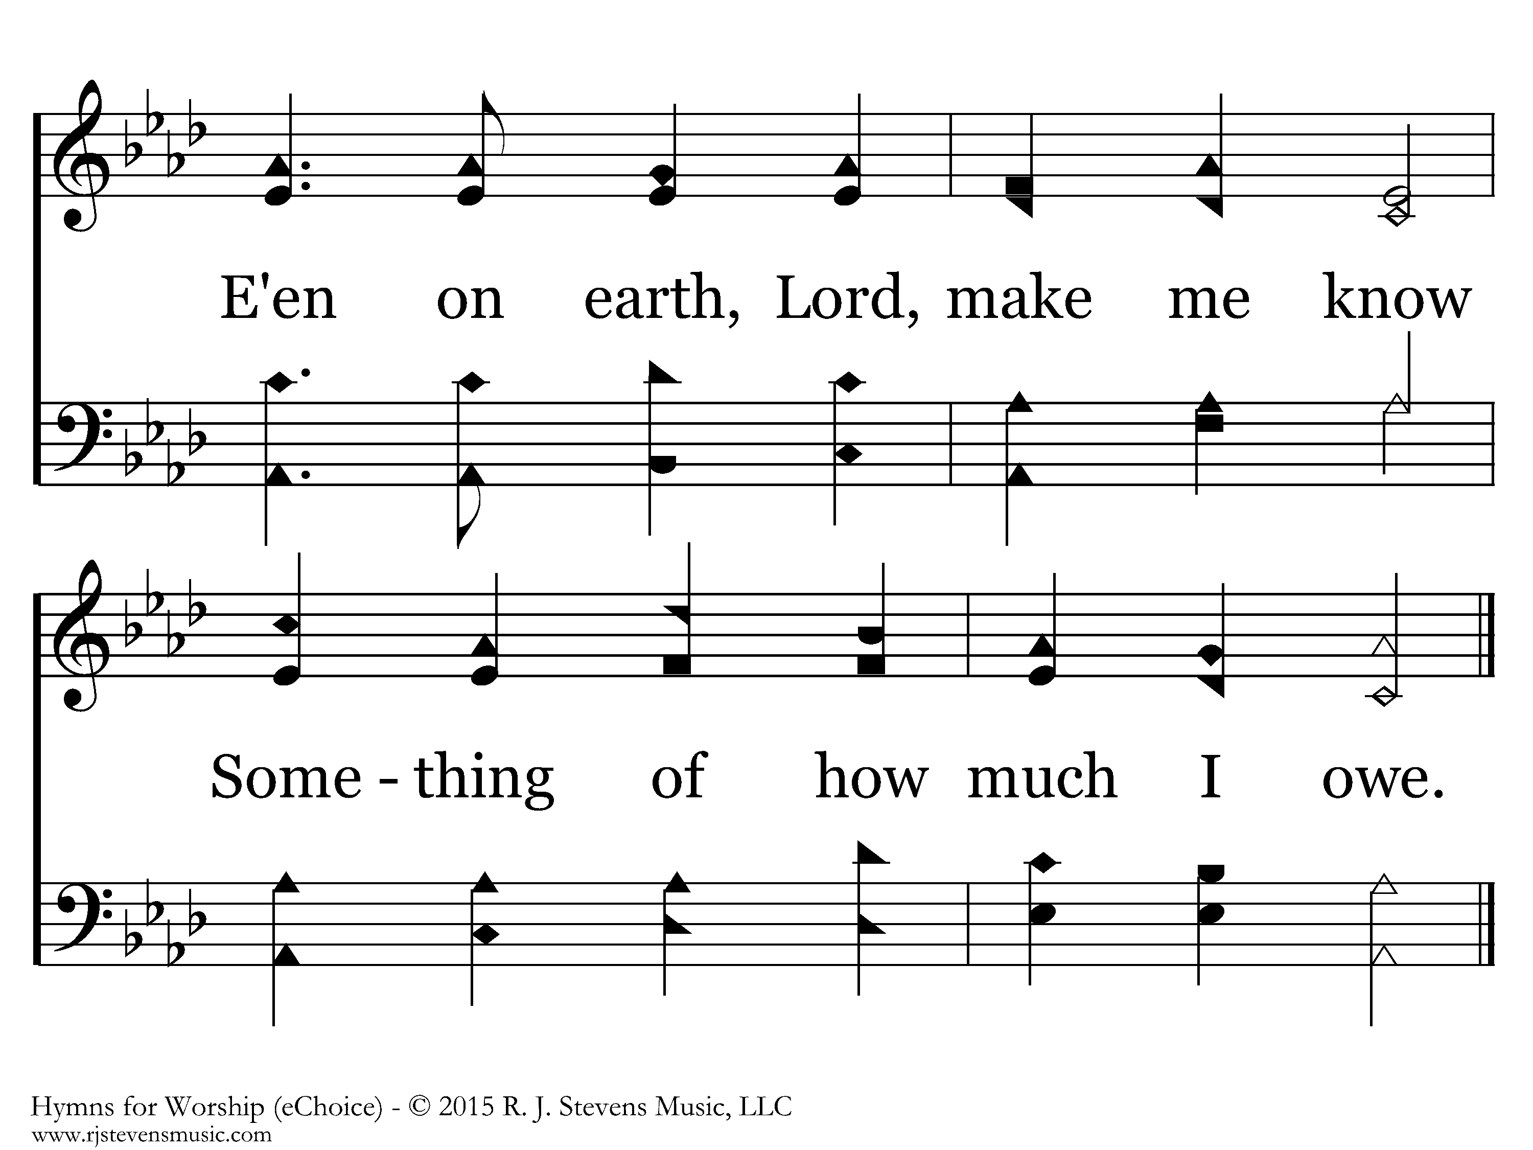
20356 - WHEN THIS PASSING WORLD IS DONE - 4.3
End of Song

Slide 28


Slide 29
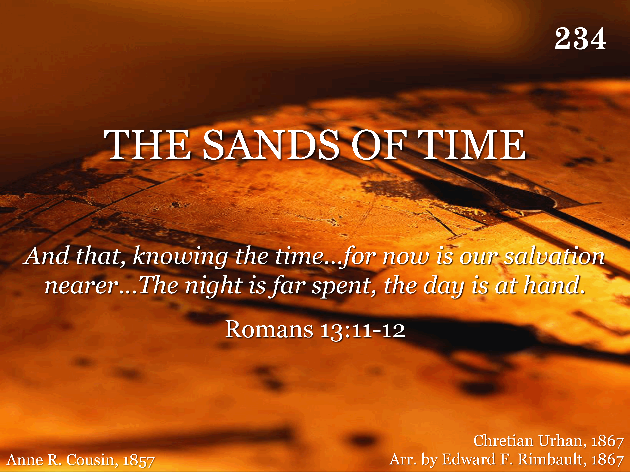
234 - The Sands Of Time - Title

Slide 30
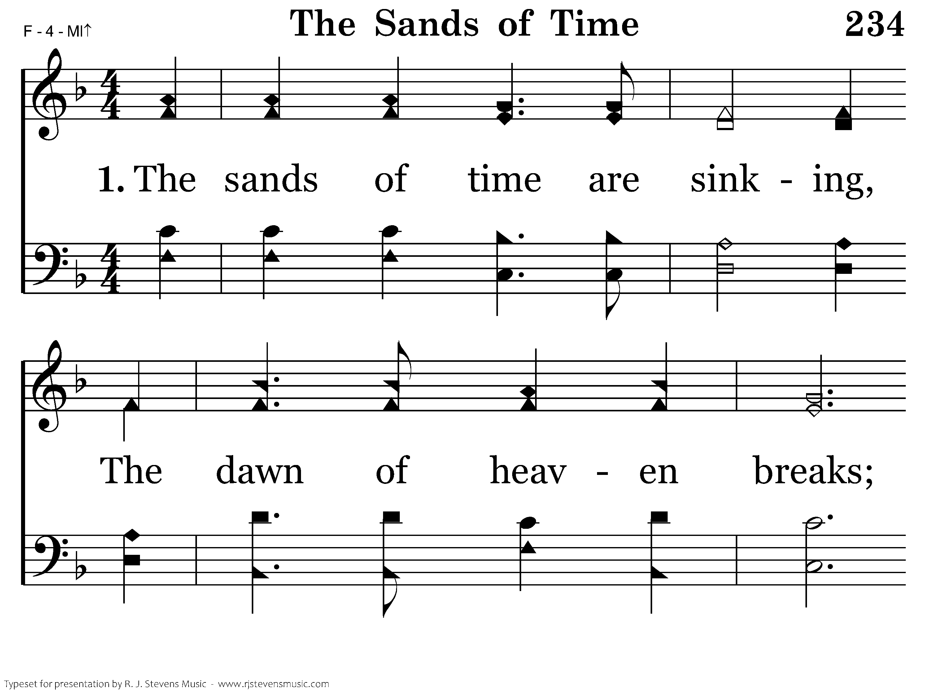
234 - The Sands Of Time - 1.1

Slide 31
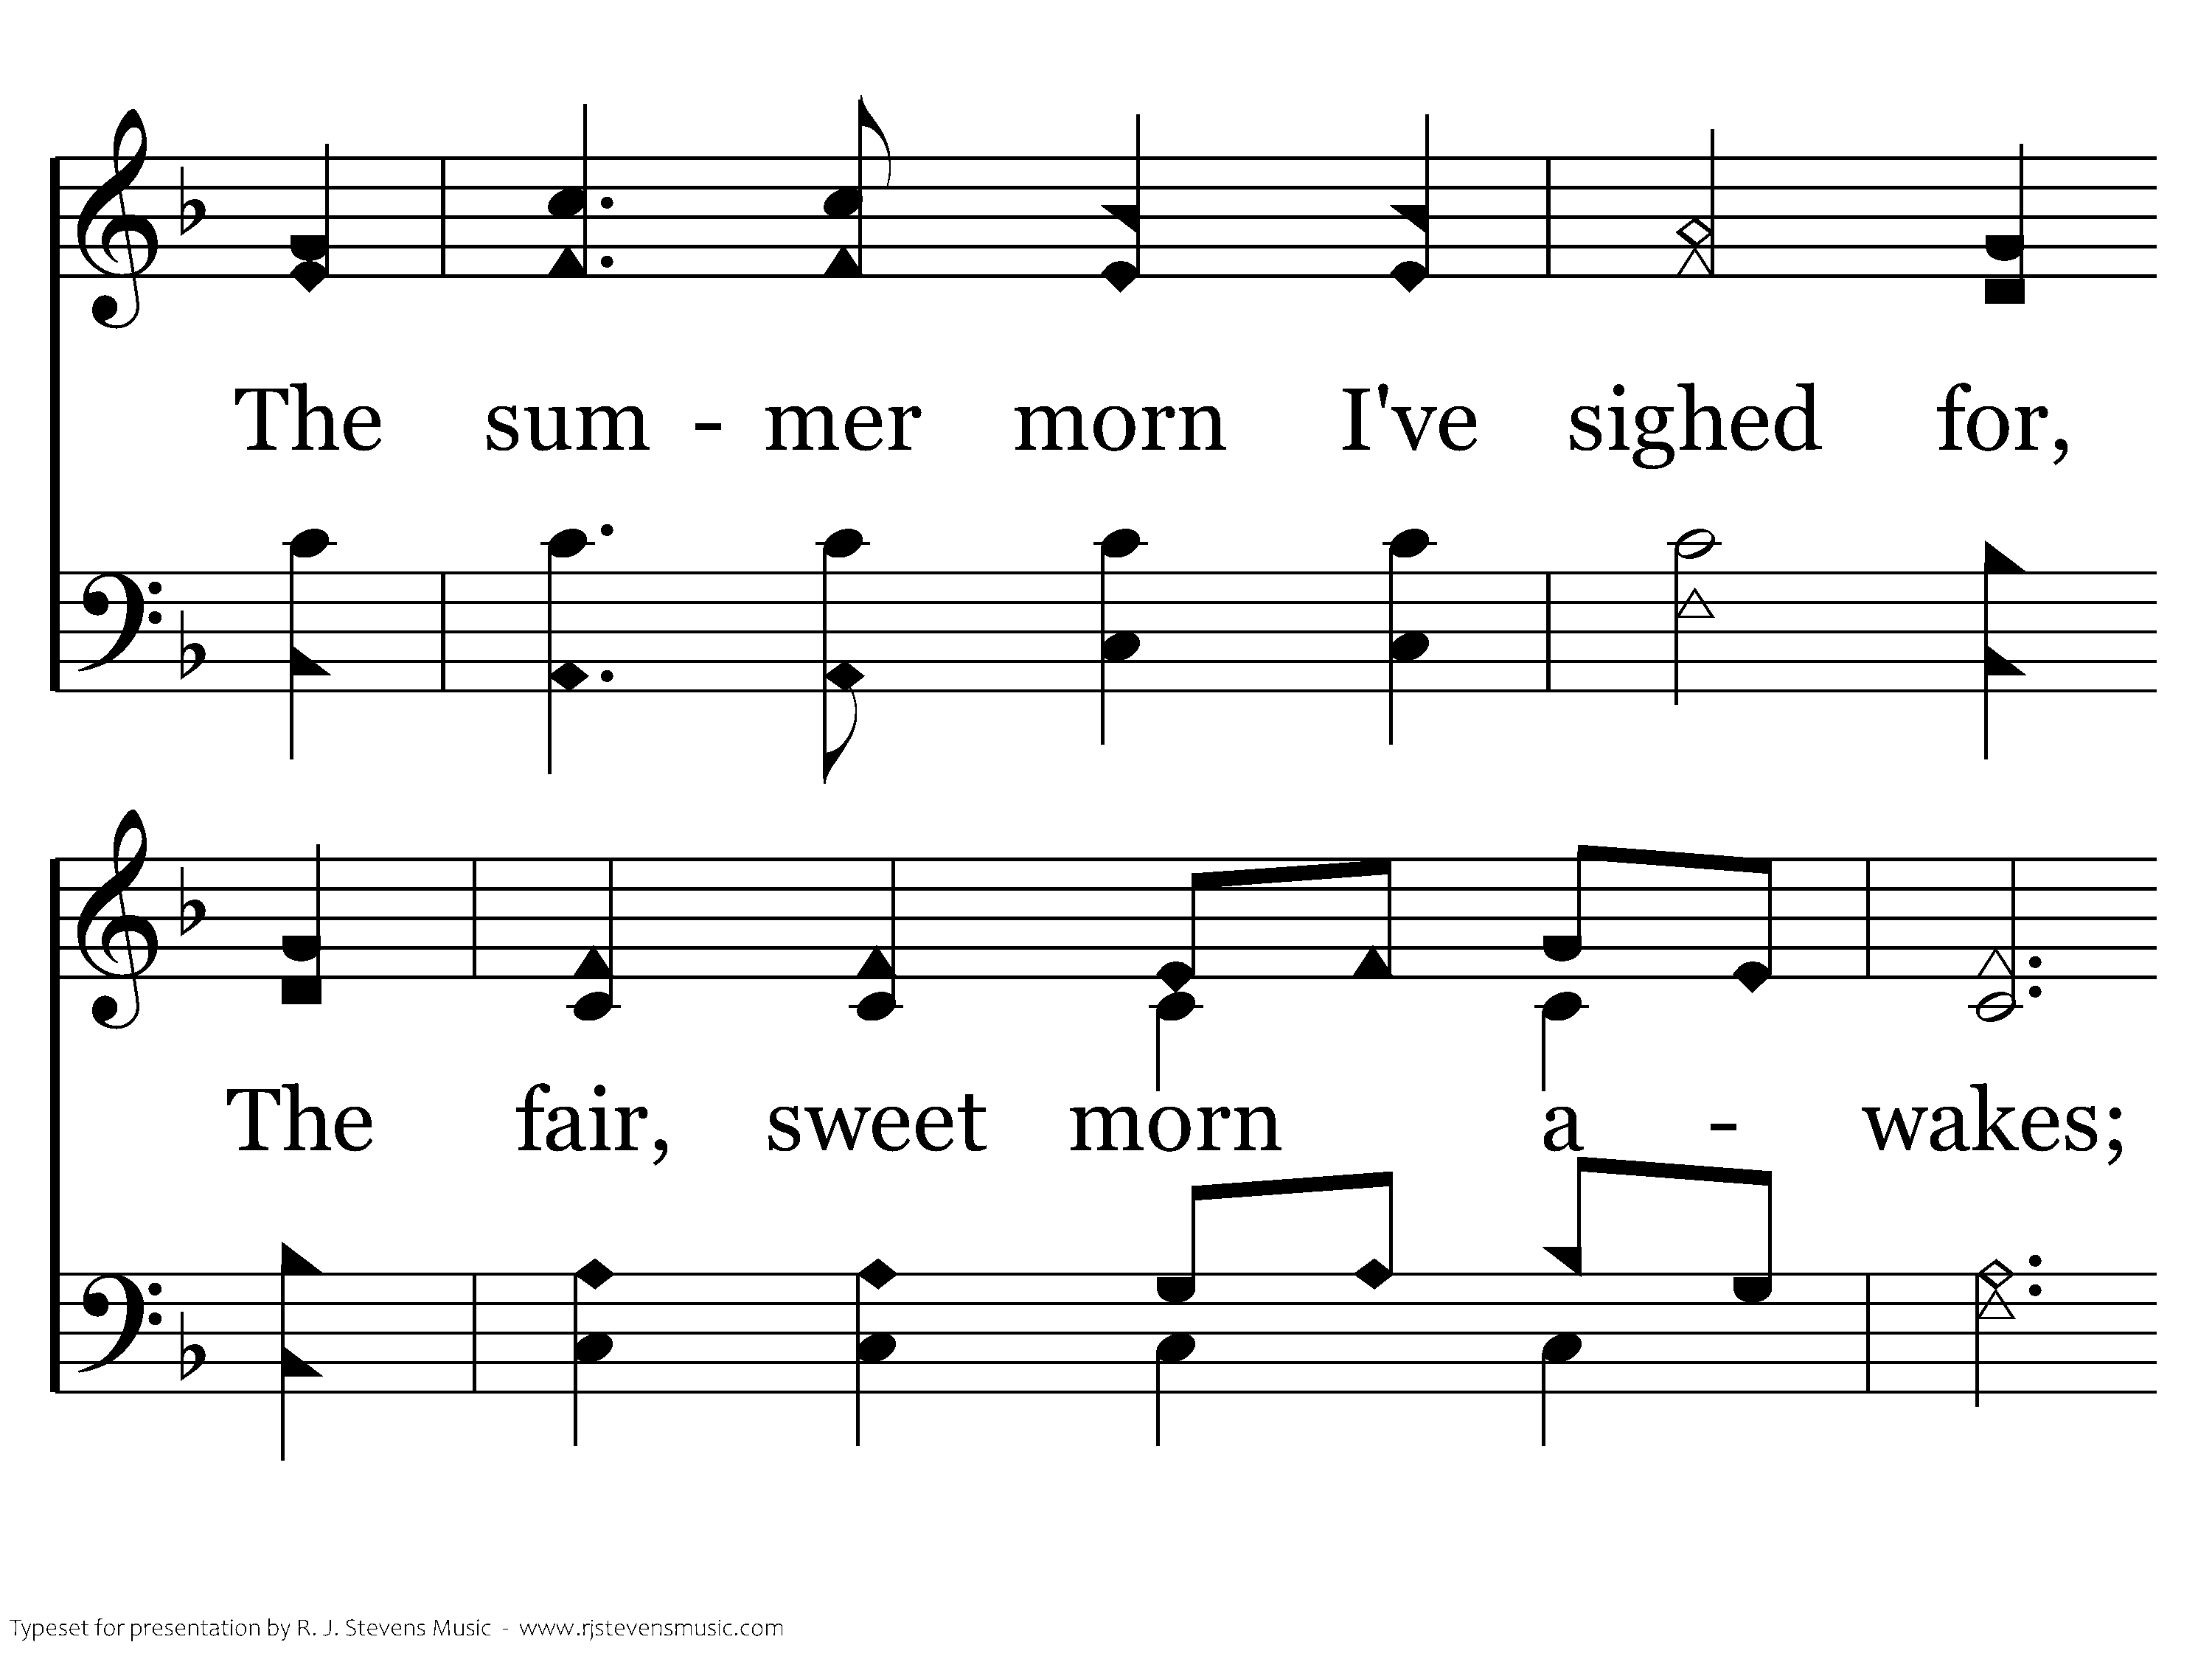
234 - The Sands Of Time - 1.2

Slide 32
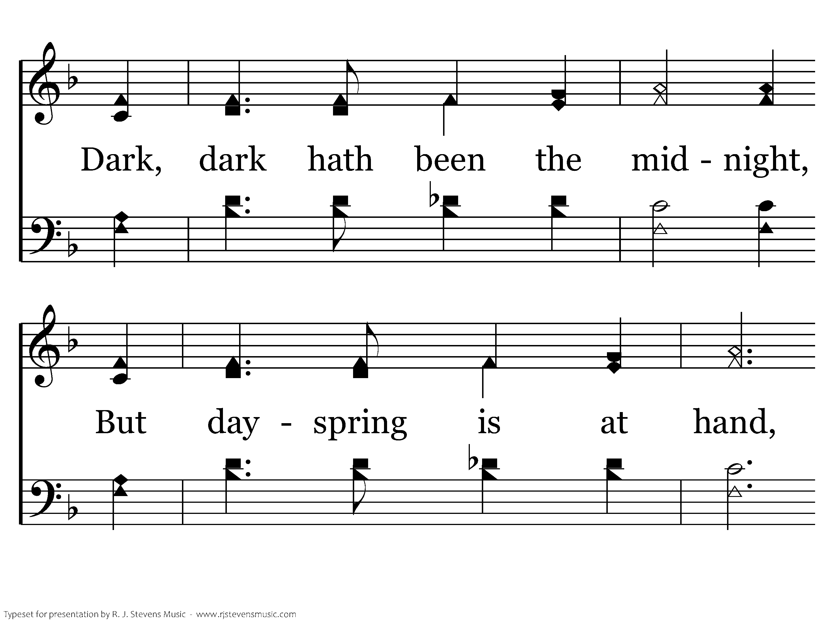
234 - The Sands Of Time - 1.3

Slide 33
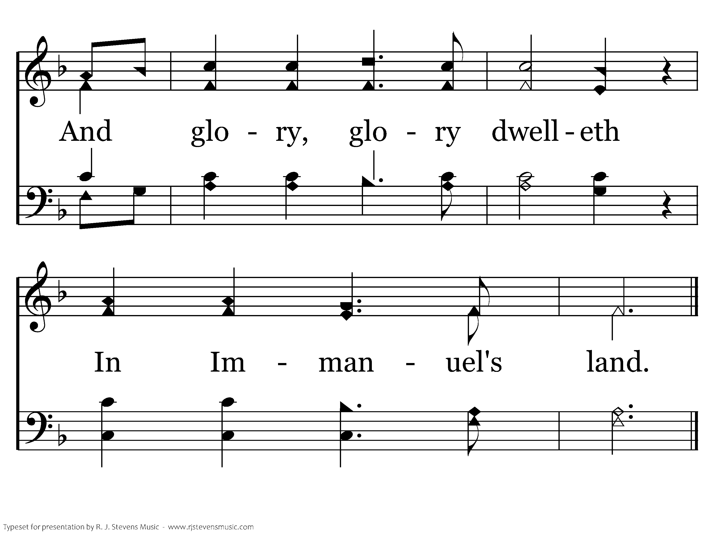
234 - The Sands Of Time - 1.4
End of Verse 1

Slide 34
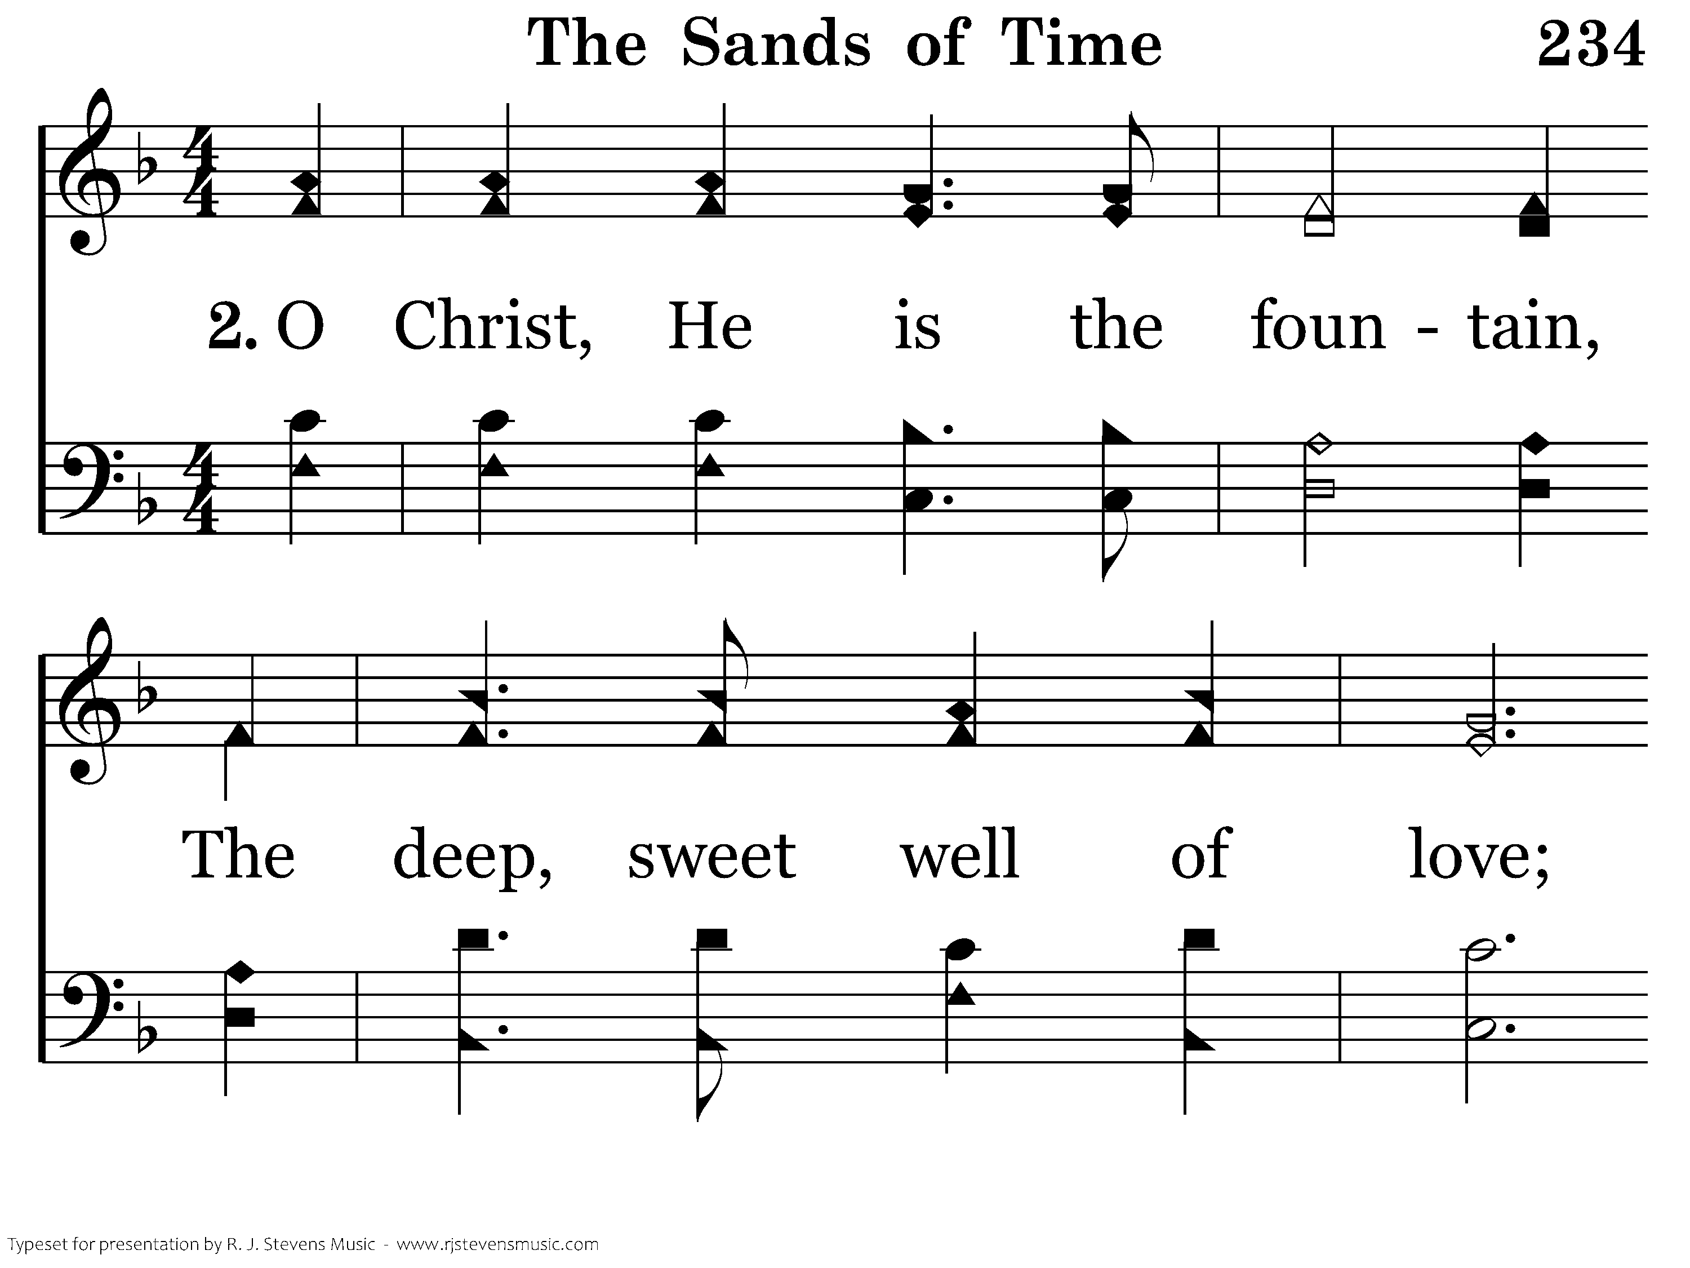
234 - The Sands Of Time - 2.1

Slide 35
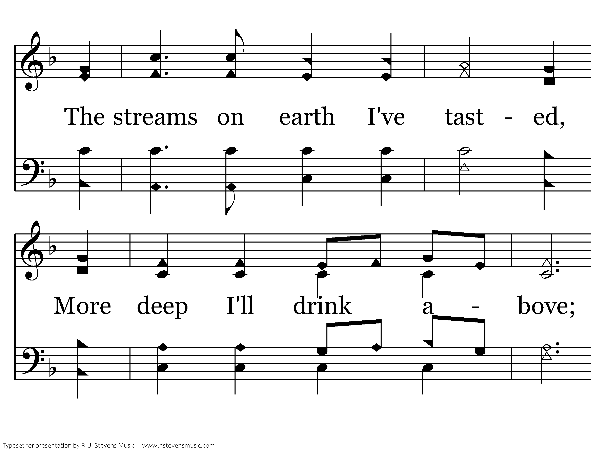
234 - The Sands Of Time - 2.2

Slide 36
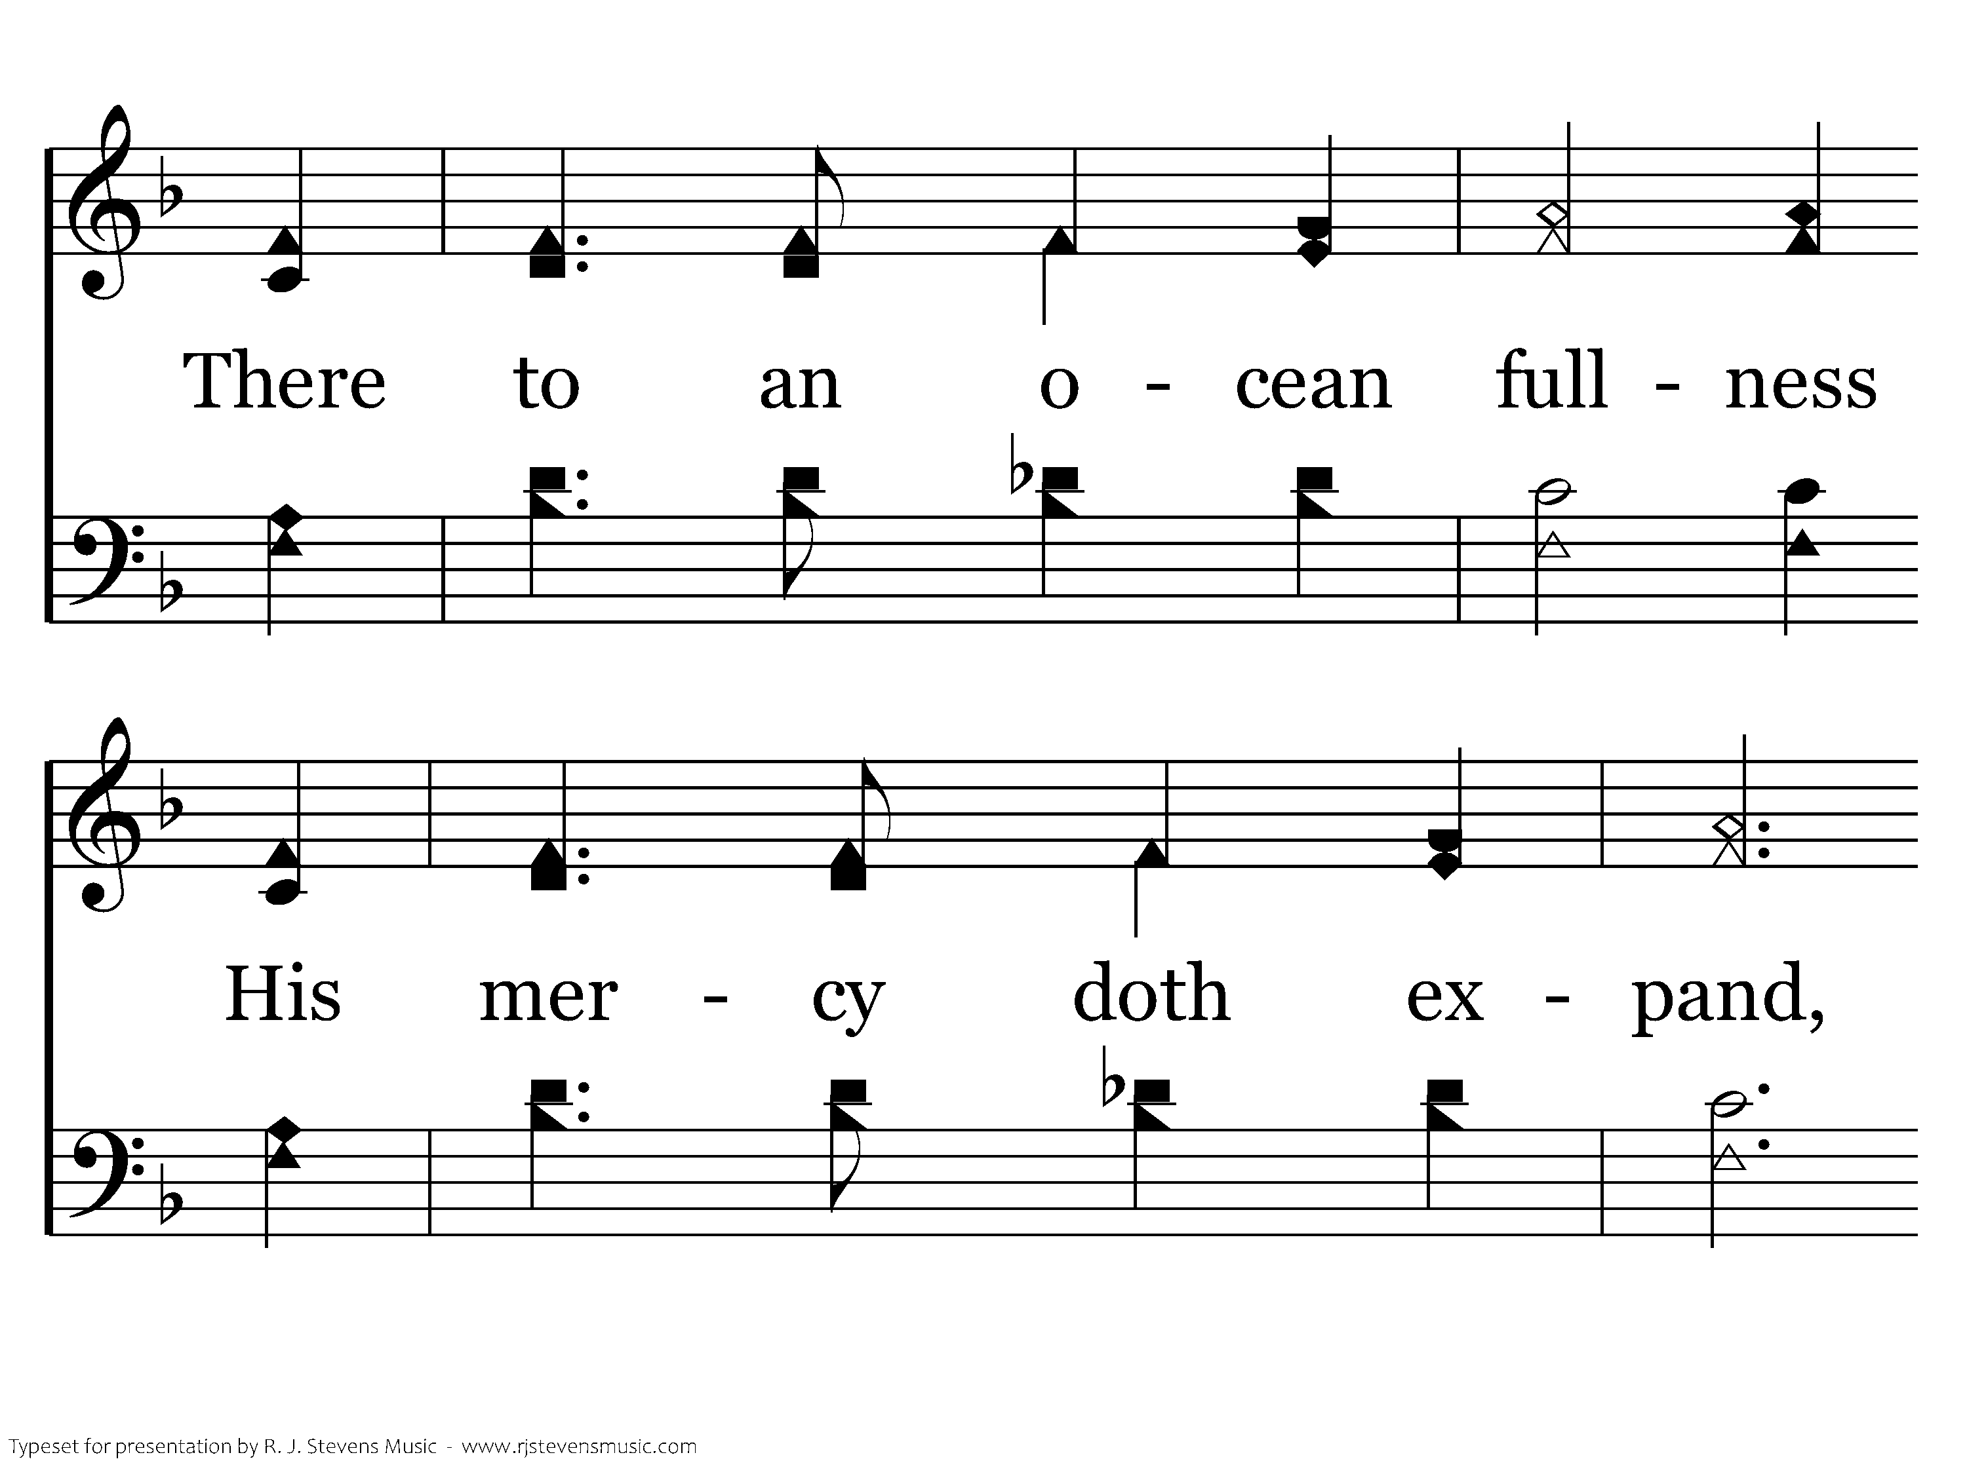
234 - The Sands Of Time - 2.3

Slide 37

234 - The Sands Of Time - 2.4
End of Verse 2

Slide 38
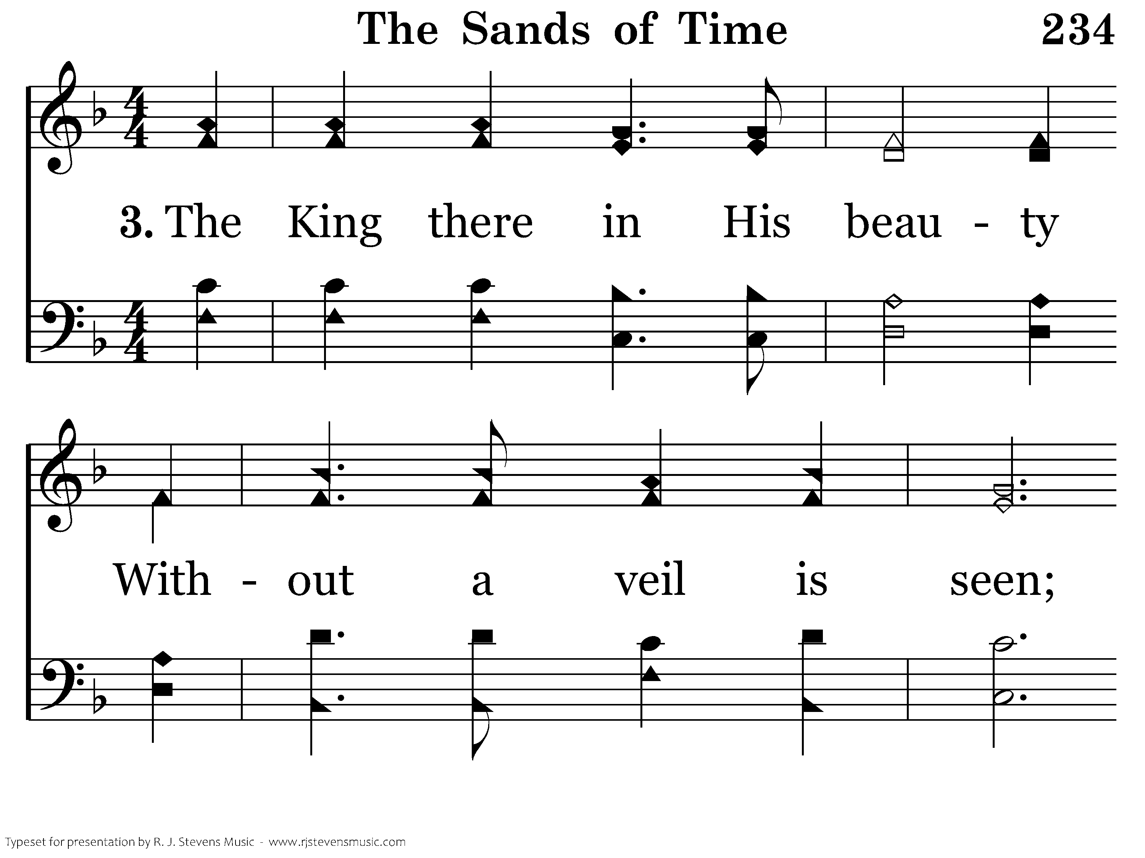
234 - The Sands Of Time - 3.1

Slide 39
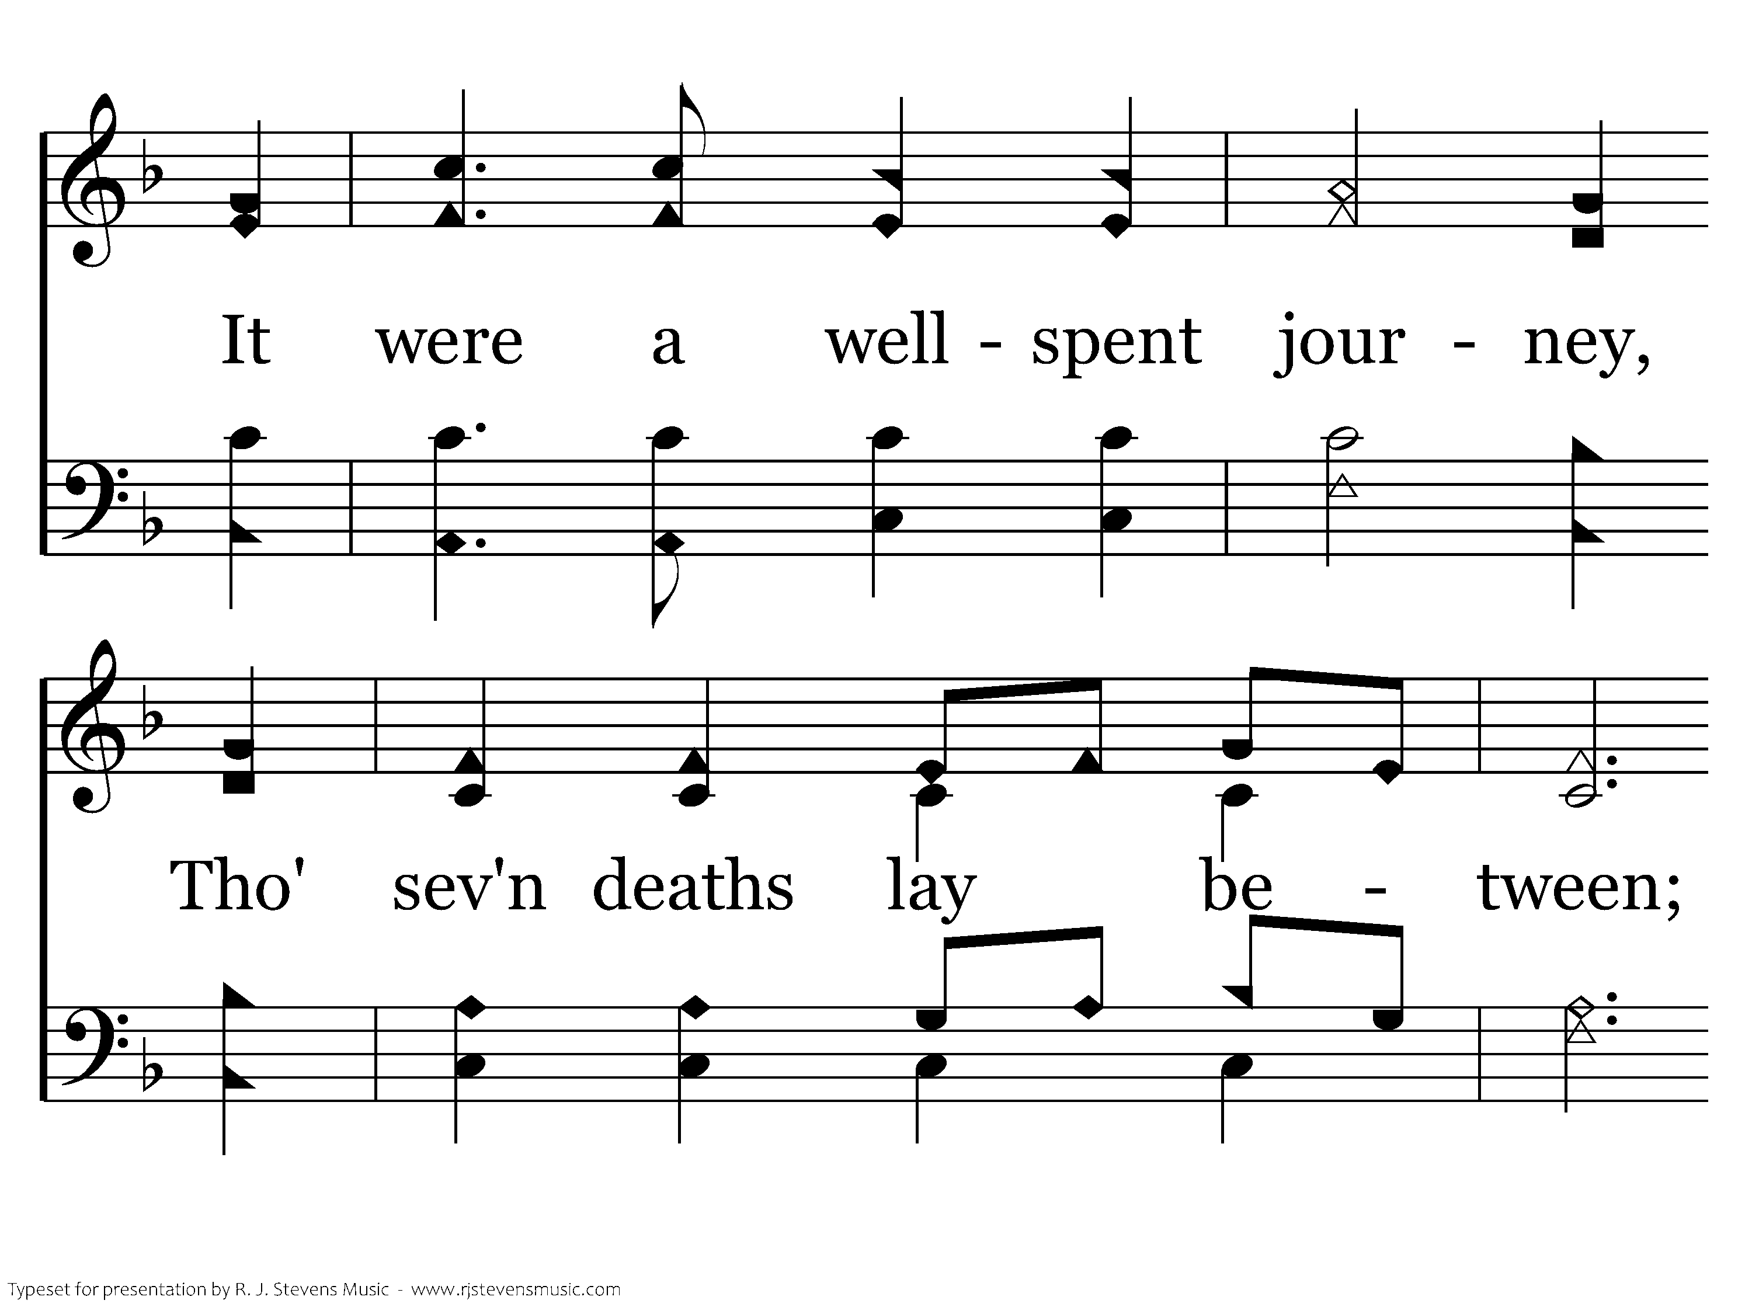
234 - The Sands Of Time - 3.2

Slide 40
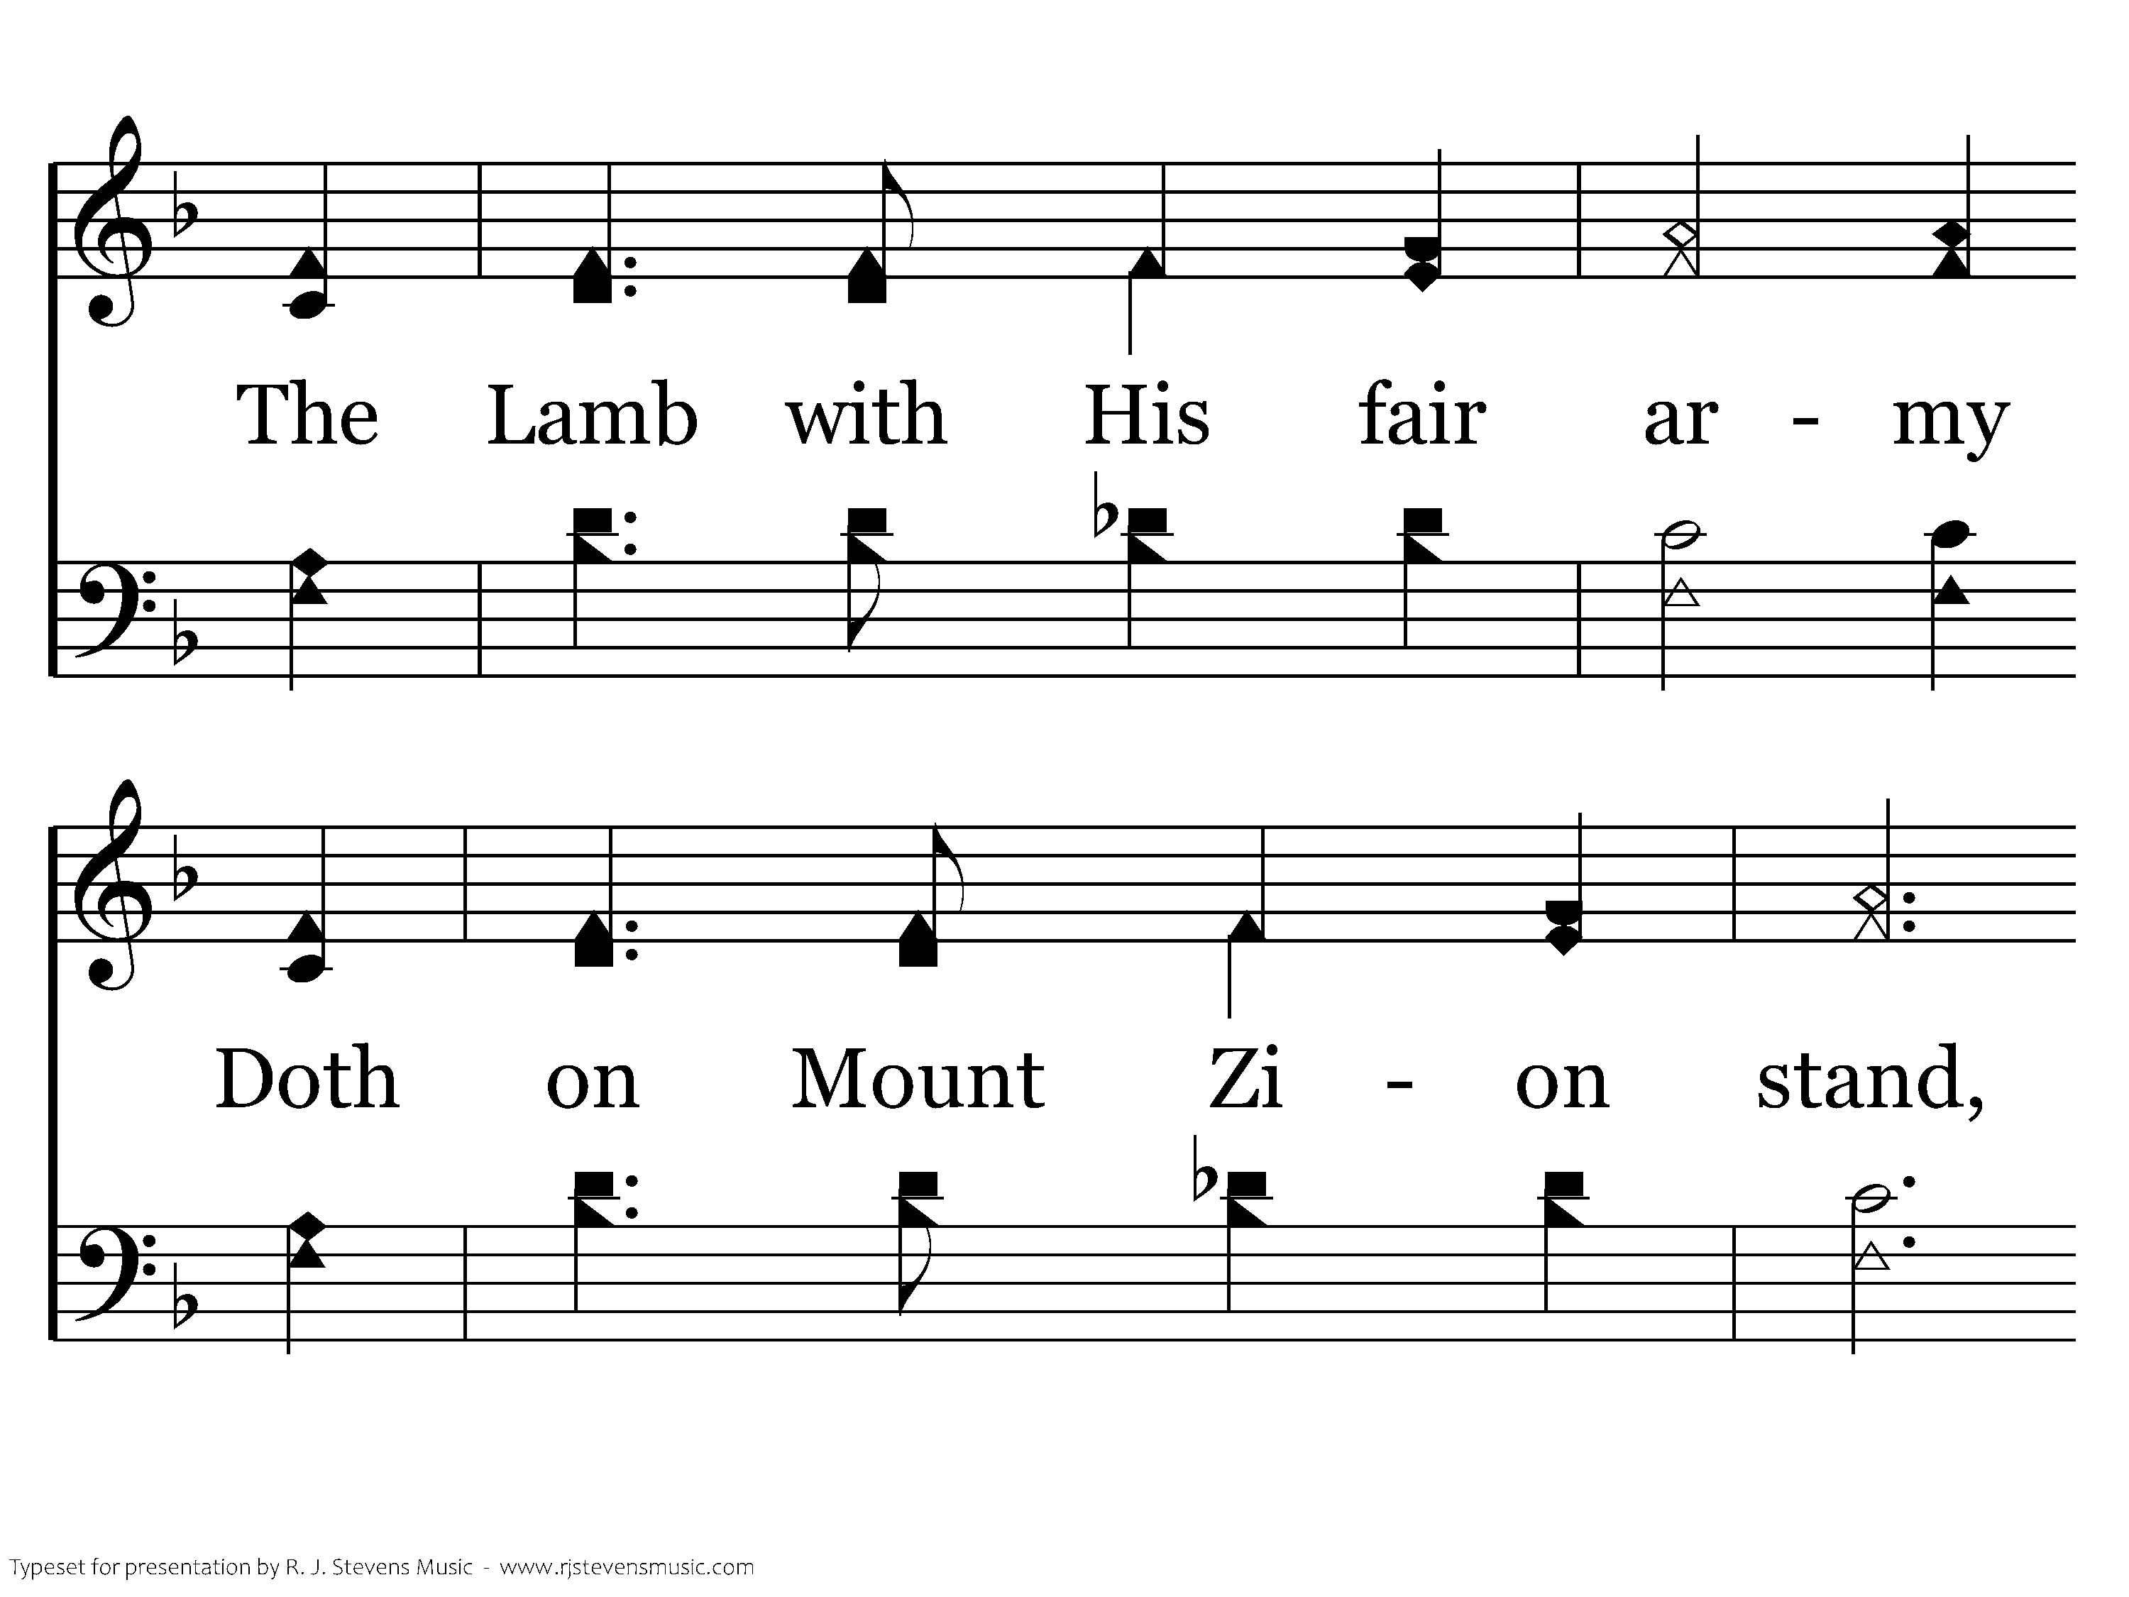
234 - The Sands Of Time - 3.3

Slide 41

234 - The Sands Of Time - 3.4
End of Song

Slide 42


Slide 43
“Now thanks be unto God, which always causes us to triumph in Christ” (2 Cor. 2:14).
Hupernikao
= “to gain a decisive victory”
Huper - over, above or beyond
Nikao - to subdue, or to get the victory

Slide 44
I. How Do We Know That We Are More than Conquerors?
God is for us (ver. 31)
We have been justified (ver. 33)
Christ makes intercession for us (ver. 34)
Christ loves us (ver. 35)

Slide 45
II. Living the Life of a Conqueror – How do we do it?
By living in Christ
Rom 3:24
Being justified freely by his grace through the REDEMPTION that is in Christ Jesus

Slide 46
II. Living the Life of a Conqueror – How do we do it?
rethren
By living in Christ
BUM
By laboring for Christ
nwilling
TO
ake an effort

Slide 47
II. Living the Life of a Conqueror – How do we do it?
By living in Christ
By laboring for Christ
2 Cor 5:9
Wherefore we labor, that, whether present or absent, we may be accepted of him.

Slide 48
II. Living the Life of a Conqueror – How do we do it?
By living in Christ
By laboring for Christ
Phil 1:22
But if I live in the flesh, this is the fruit of my labor: yet what I shall choose I wot not.

Slide 49
II. Living the Life of a Conqueror – How do we do it?
By living in Christ
By laboring for Christ
Col 1:29
Whereunto I also labor, striving according to his working, which worketh in me mightily.

Slide 50
II. Living the Life of a Conqueror – How do we do it?
By living in Christ
By laboring for Christ
Heb 4:11
Let us labor therefore to enter into that rest, lest any man fall after the same example of unbelief.

Slide 51
II. Living the Life of a Conqueror – How do we do it?
By living in Christ
By laboring for Christ
Rev 14:13
… Blessed are the dead which die in the Lord from henceforth: Yea, saith the Spirit, that they may rest from their labors; and their works do follow them.

Slide 52
II. Living the Life of a Conqueror – How do we do it?
By living in Christ
By laboring for Christ
By leaning on Christ
Prov 3:5
Trust in the LORD with all thine heart; and lean not unto thine own understanding.

Slide 53

II. Living the Life of a Conqueror – How do we do it?
By living in Christ
By laboring for Christ
By leaning on Christ
1 Peter 5:7
Casting all your care upon him; for he careth for you.

Slide 54
II. Living the Life of a Conqueror – How do we do it?
By living in Christ
By laboring for Christ
By leaning on Christ
1 John 5:4-5
For whatsoever is born of God overcomes the world: and this is the victory that overcomes the world, even our faith. Who is he that overcomes the world, but he that believeth that Jesus is the Son of God?

Slide 55
II. Living the Life of a Conqueror – How do we do it?
By living in Christ
By laboring for Christ
By leaning on Christ
1 John 5:4-5
For whatsoever is born of God overcomes the world: and this is the victory that overcomes the world, even our faith. Who is he that overcomes the world, but he that believeth that Jesus is the Son of God?

Slide 57
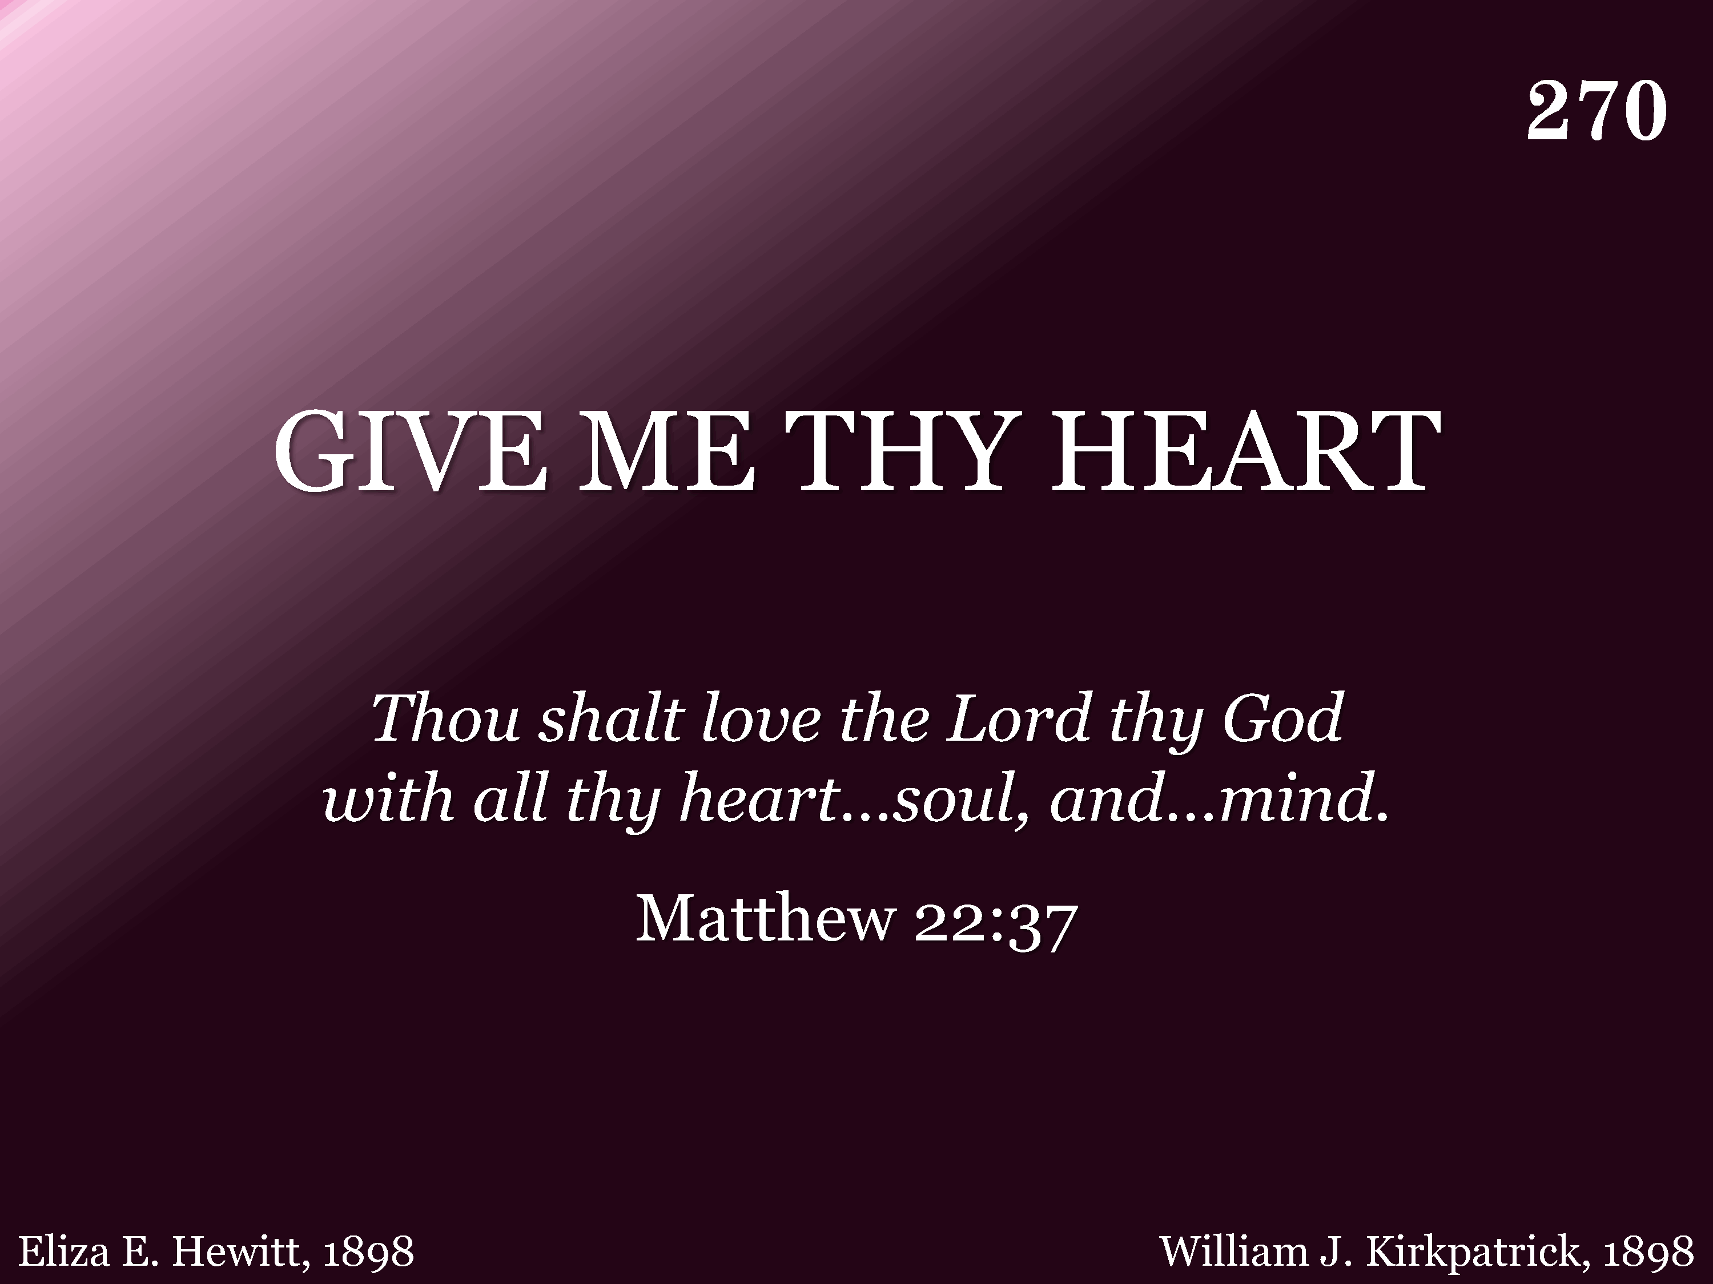
270 - Give Me Thy Heart - Title

Slide 58
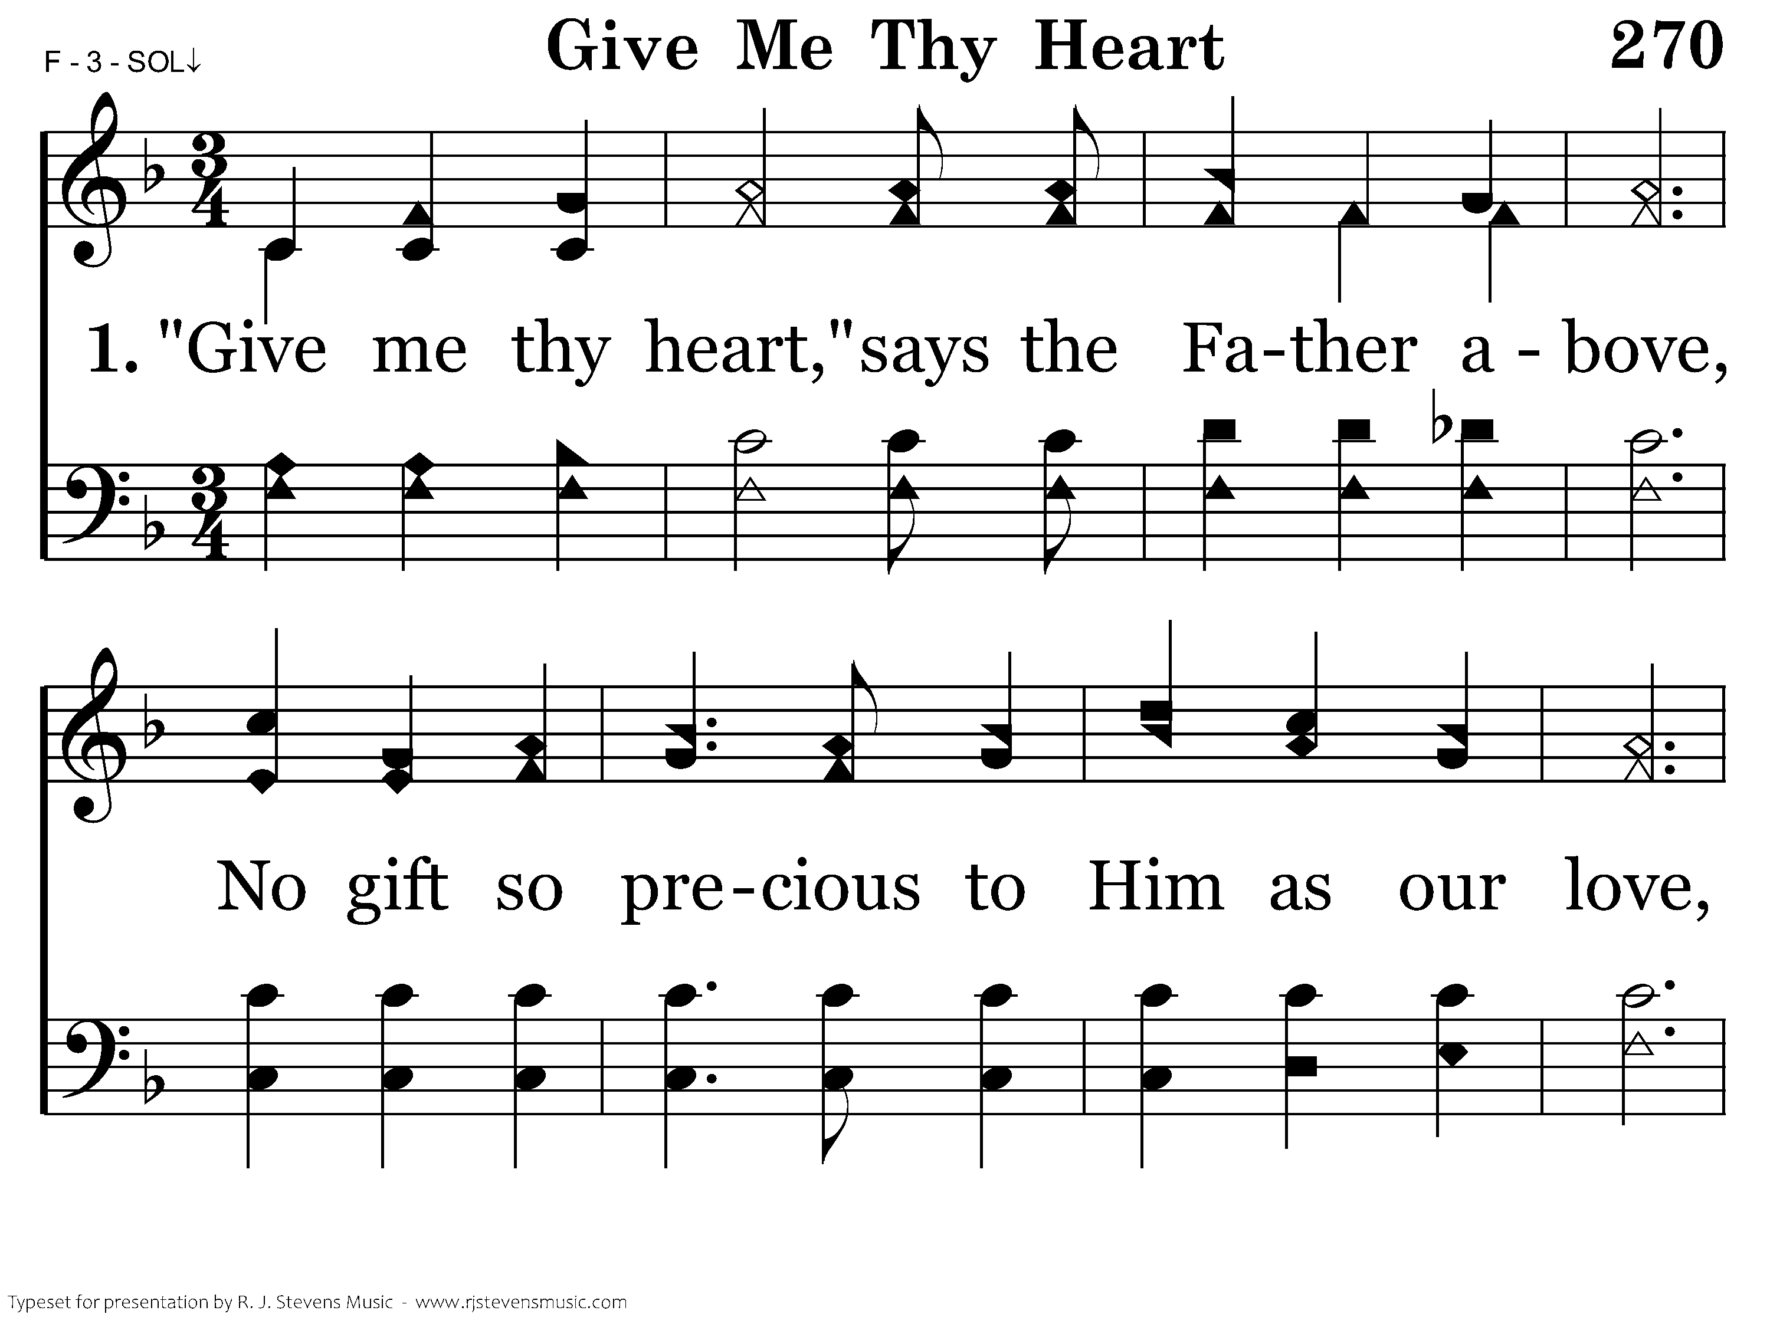
270 - Give Me Thy Heart - 1.1

Slide 59
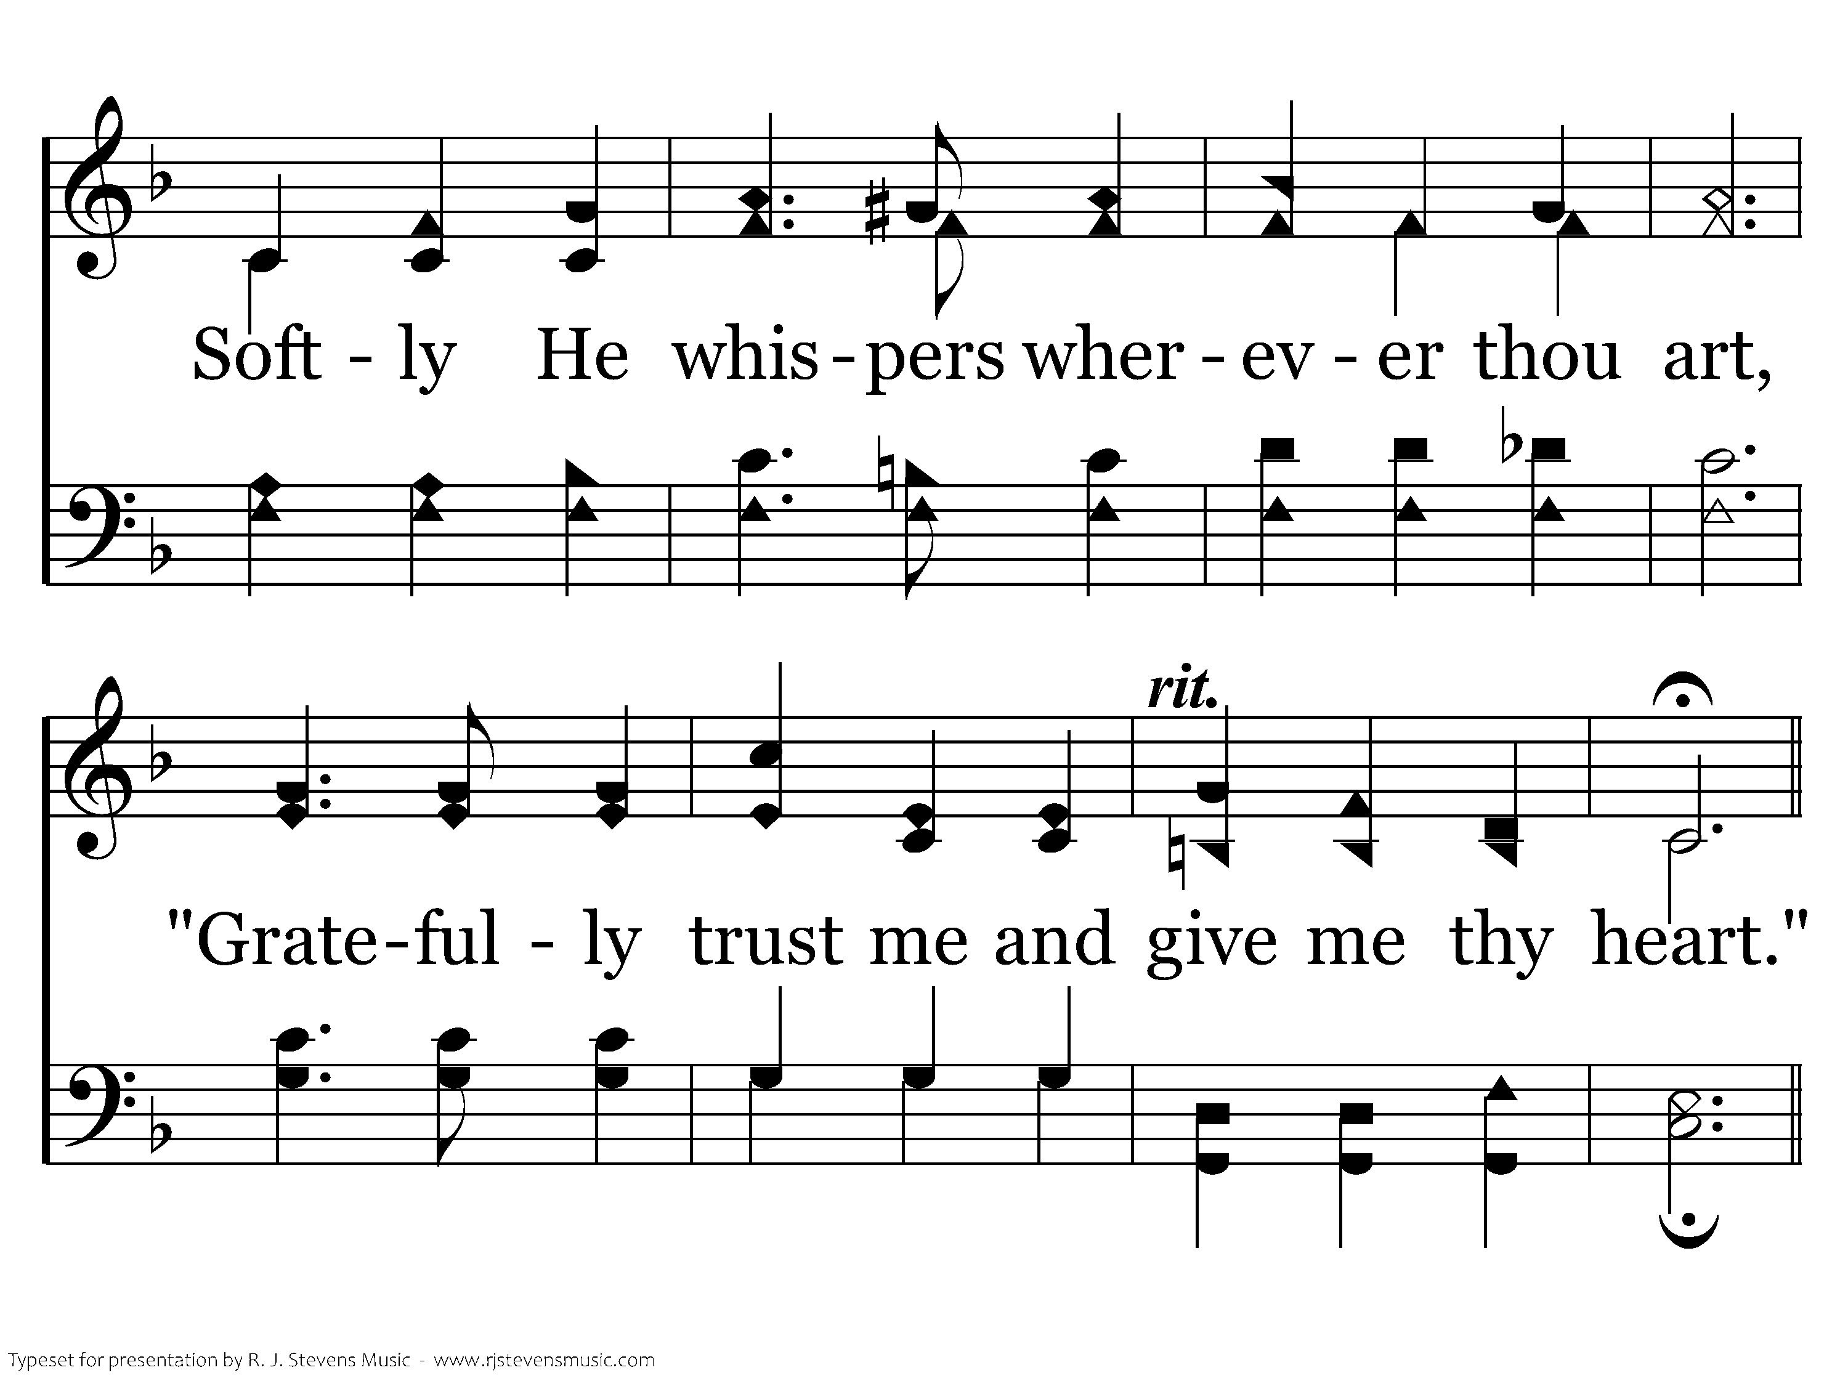
270 - Give Me Thy Heart - 1.2

Slide 60
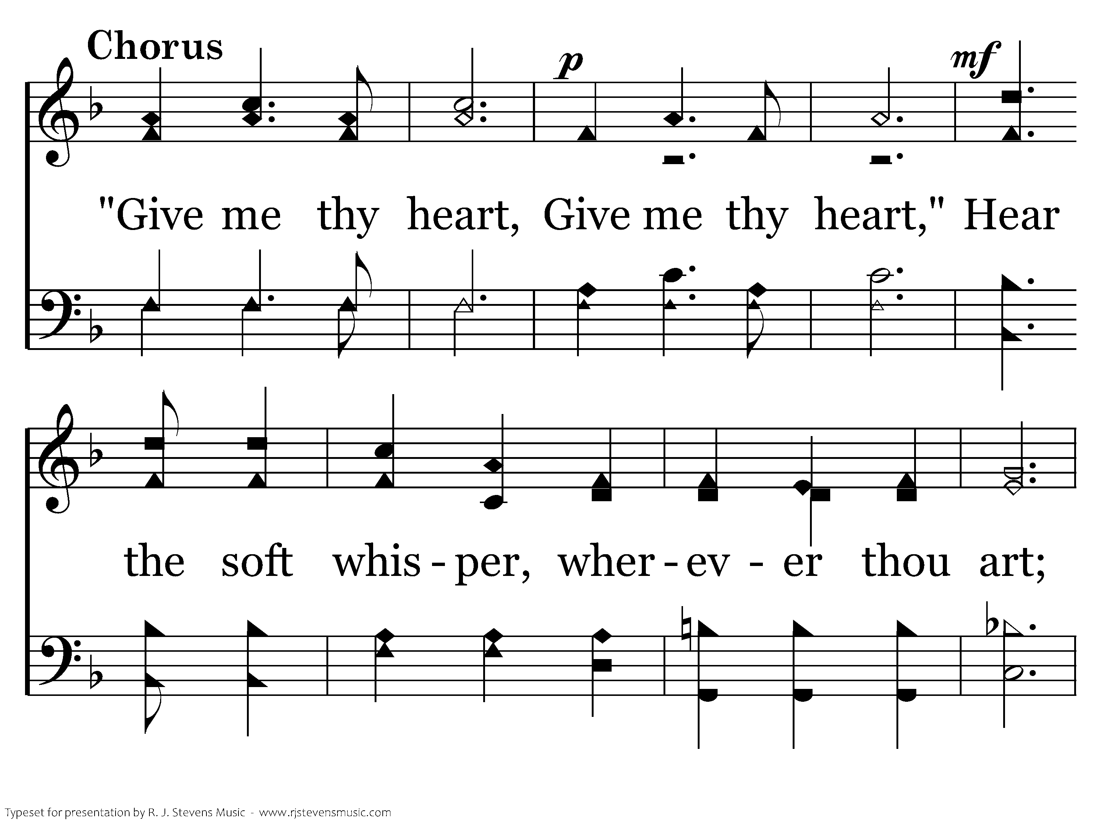
270 - Give Me Thy Heart - C.1

Slide 61
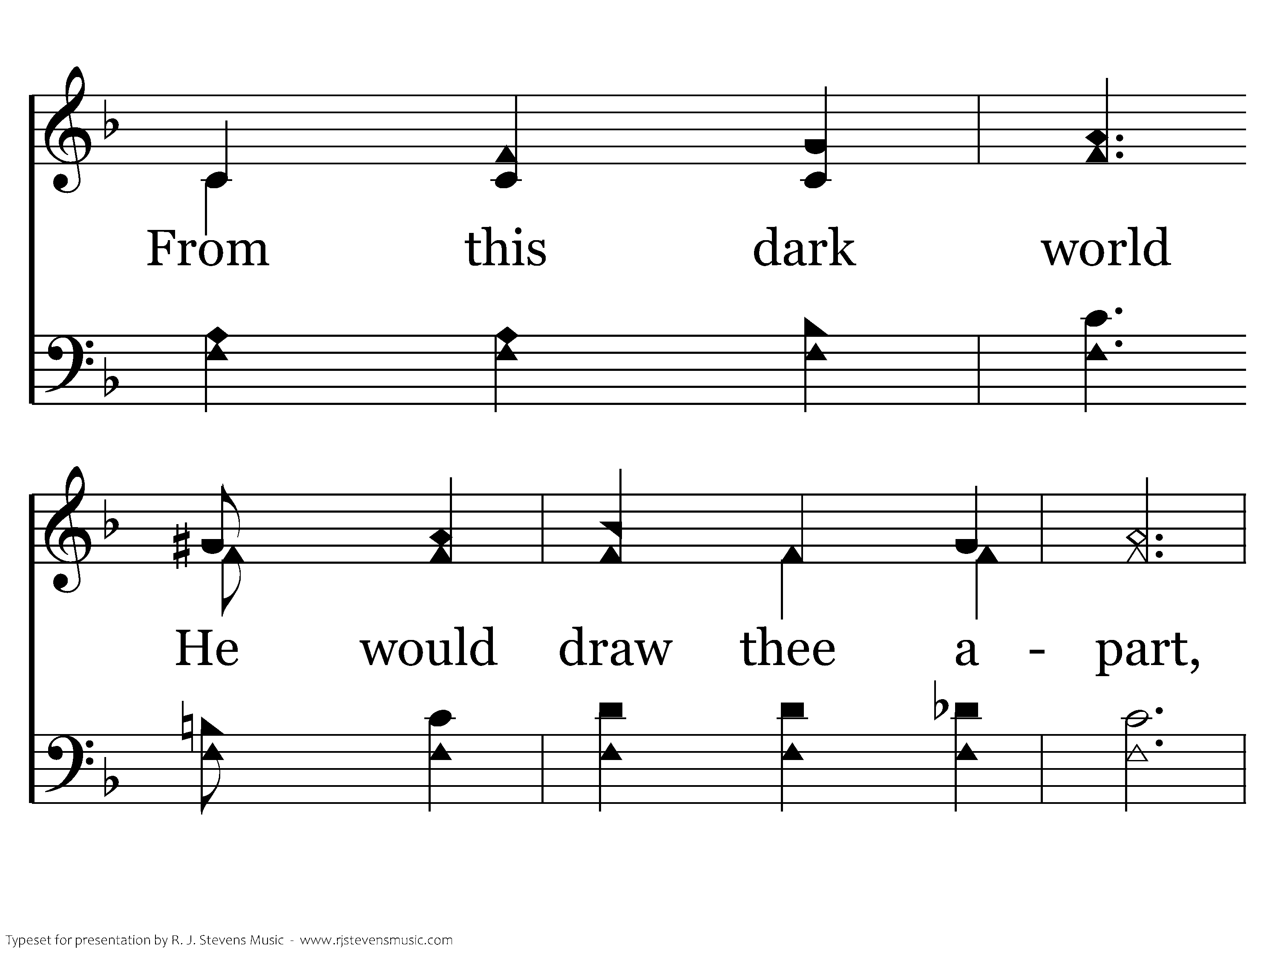
270 - Give Me Thy Heart - C.2

Slide 62
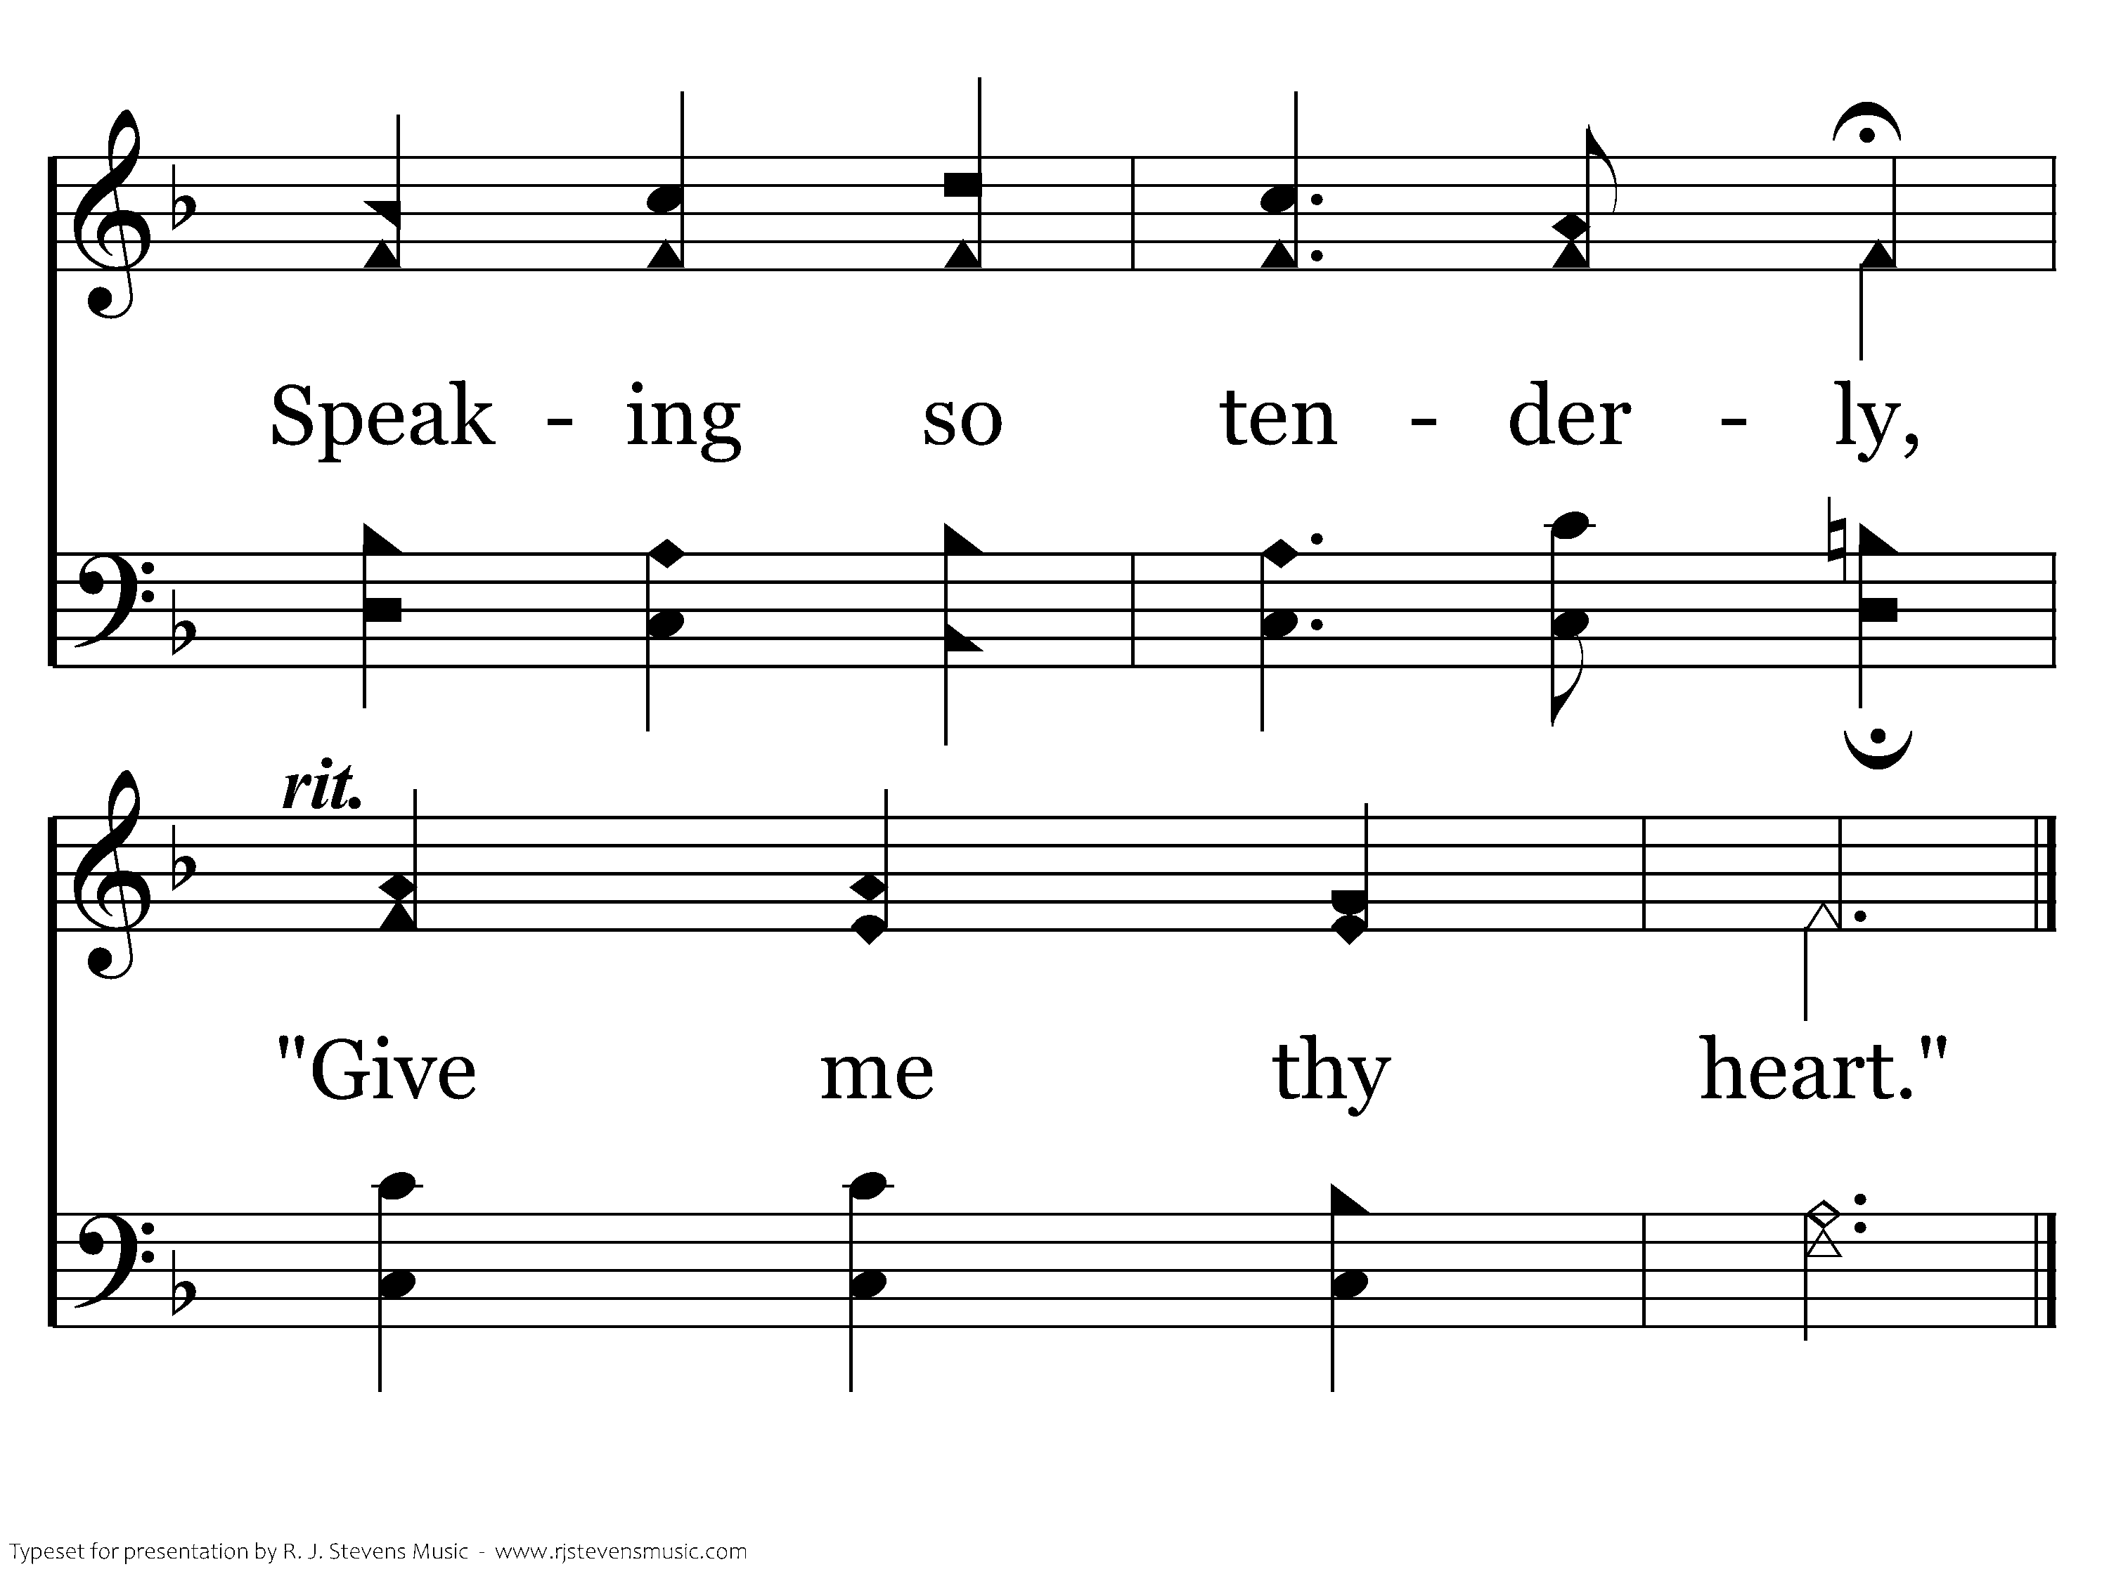
270 - Give Me Thy Heart - C.3
End of Verse 1

Slide 63
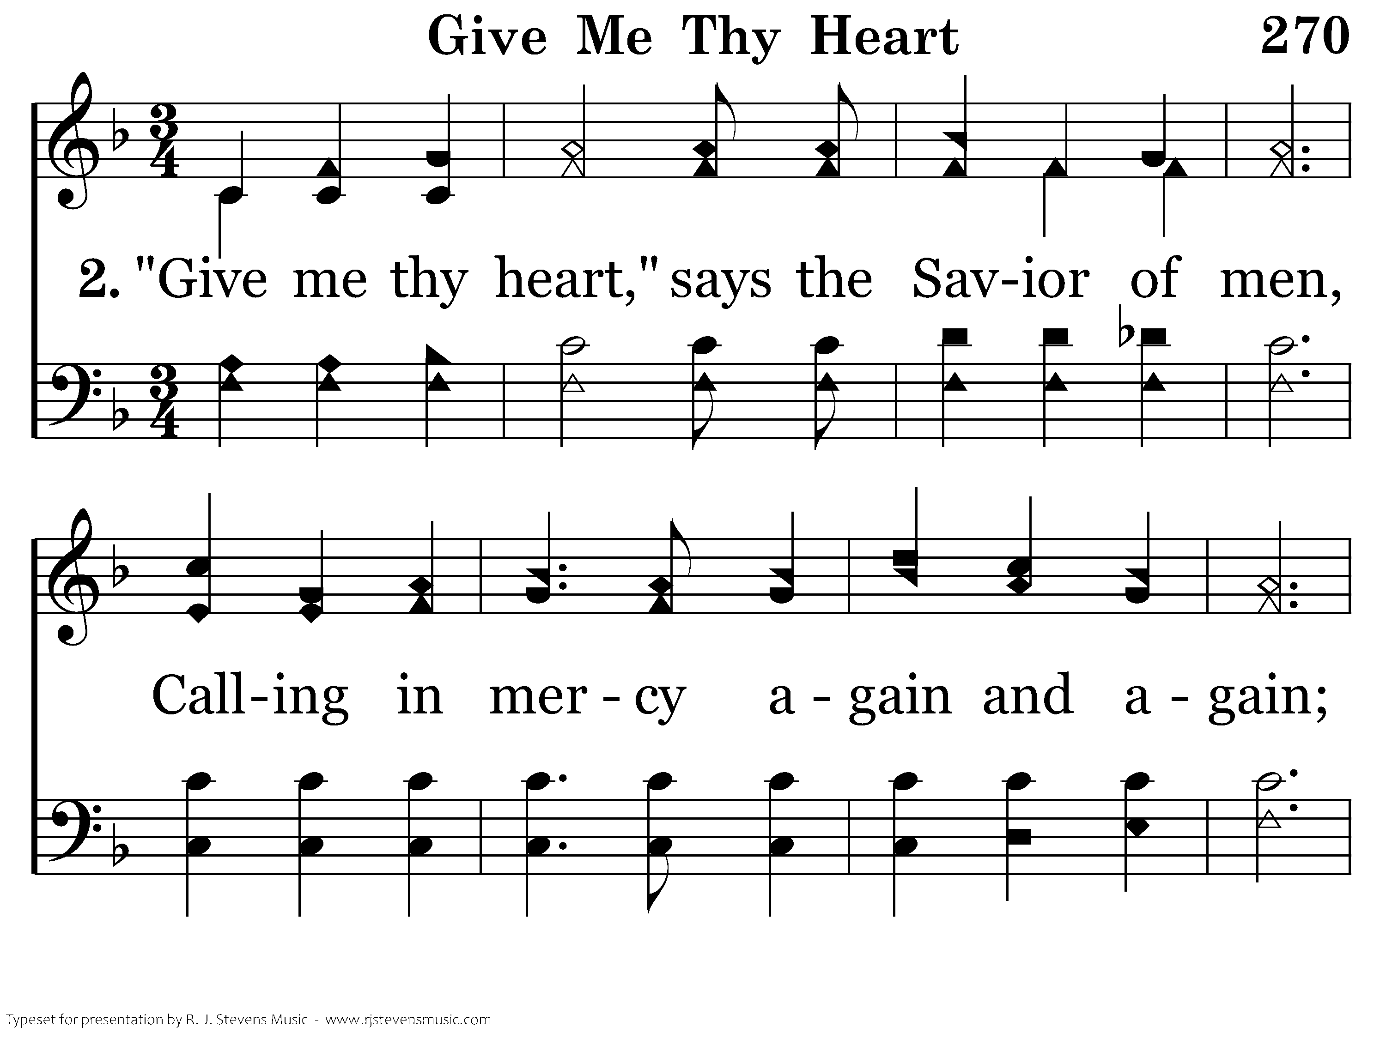
270 - Give Me Thy Heart - 2.1

Slide 64
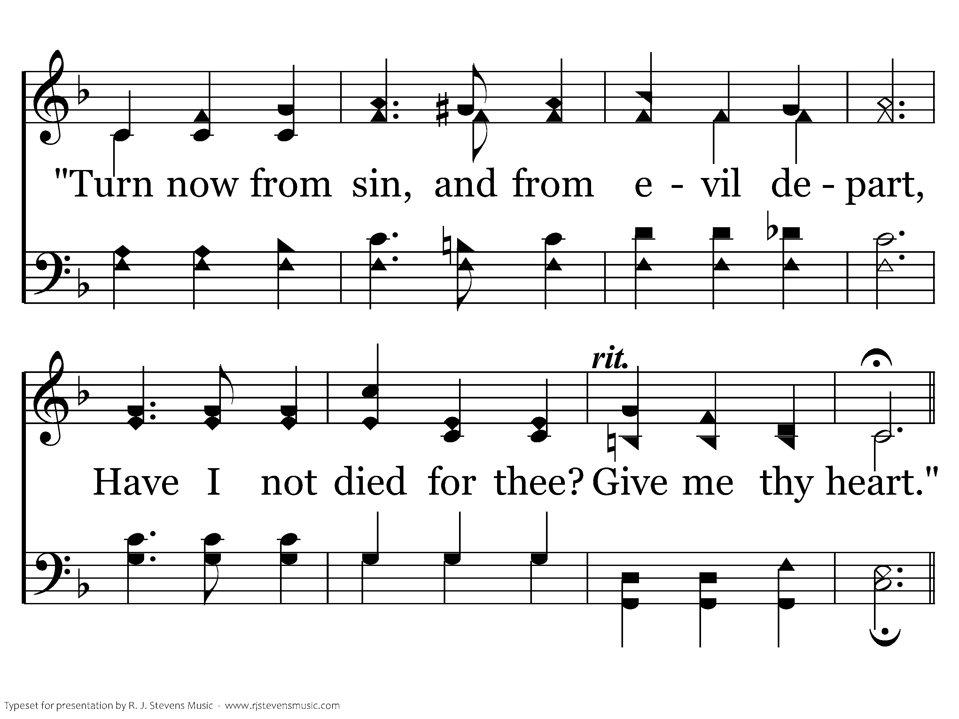
270 - Give Me Thy Heart - 2.2

Slide 65
270 - Give Me Thy Heart - C.1

Slide 66
270 - Give Me Thy Heart - C.2

Slide 67
270 - Give Me Thy Heart - C.3
End of Verse 2

Slide 68
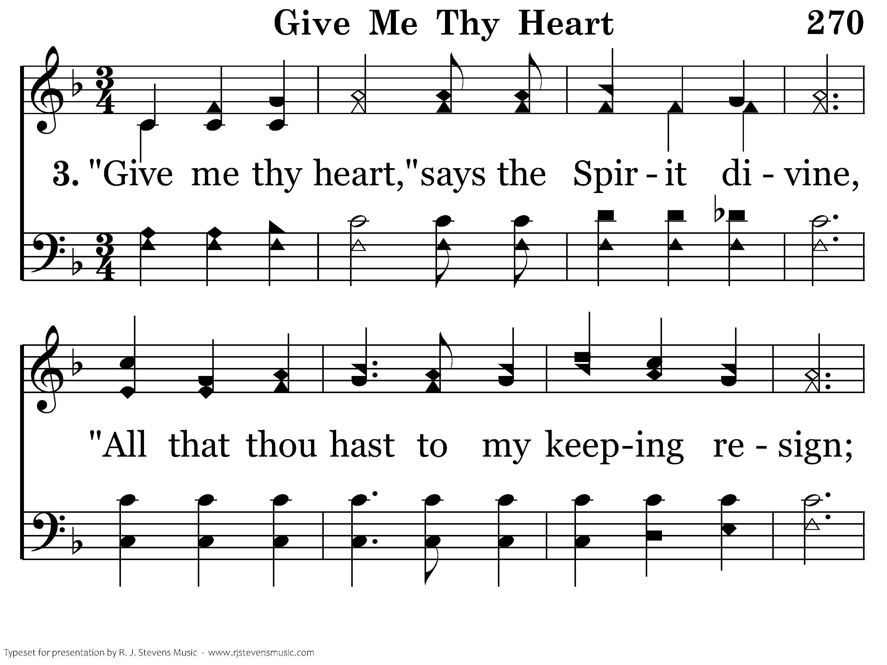
270 - Give Me Thy Heart - 3.1

Slide 69
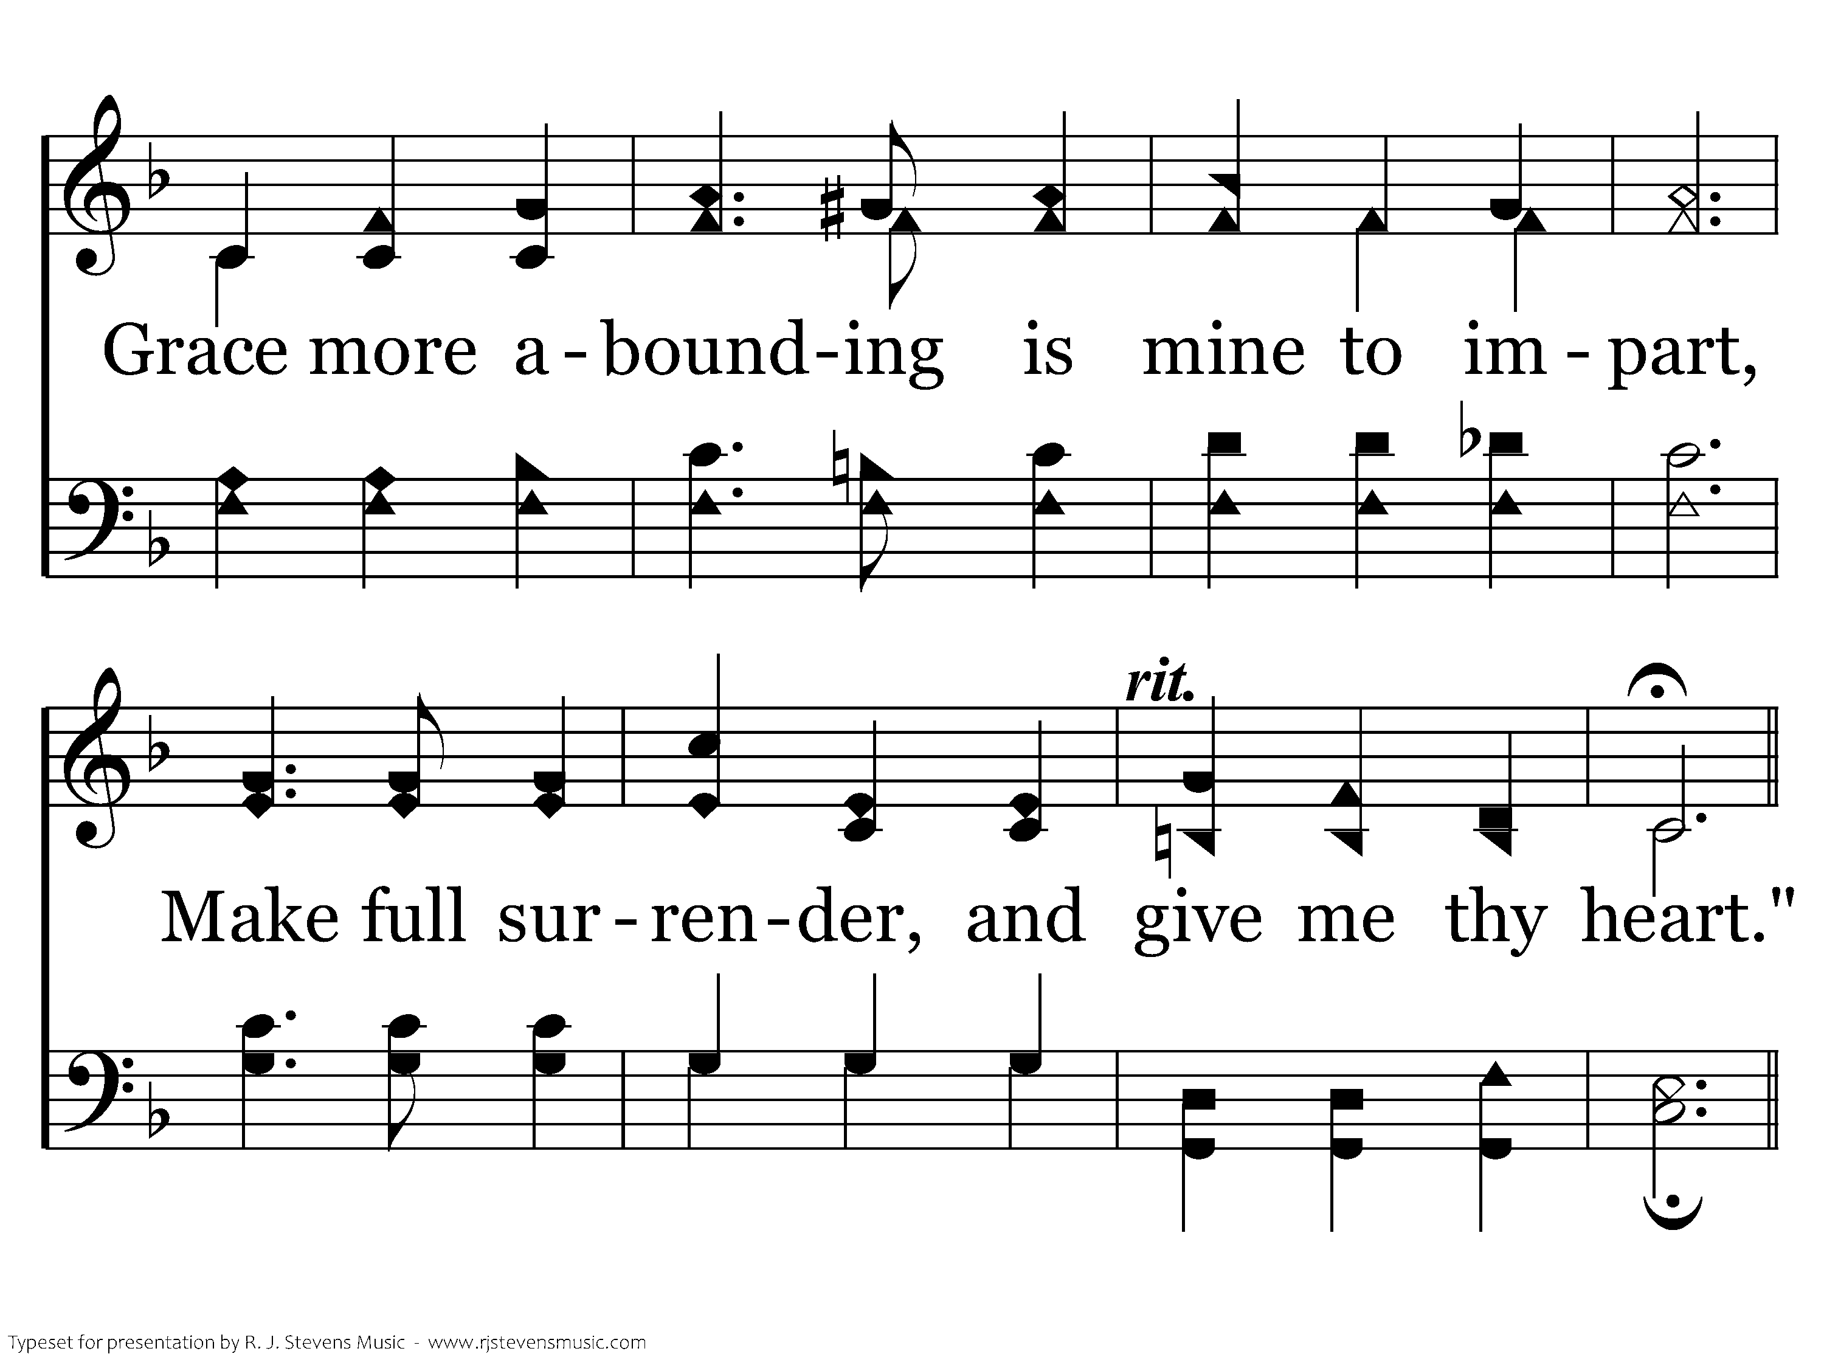
270 - Give Me Thy Heart - 3.2

Slide 70
270 - Give Me Thy Heart - C.1

Slide 71
270 - Give Me Thy Heart - C.2

Slide 72
270 - Give Me Thy Heart - C.3
End of Song

