Slide 2

John Saw a Throne (ver. 11a)
A JUDGMENT DAY IS COMING
THE STANDARD OF JUDGMENT IS THE WORD OF GOD (JN. 12:48)

Slide 3
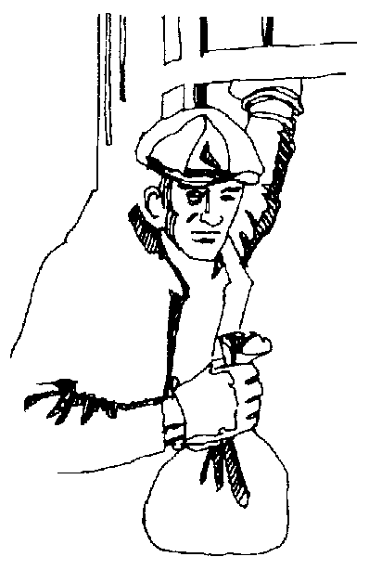
Curtis's Code
I will not kill anyone unless I have to.
2. I will take cash and food stamps - no checks.
3. I will rob only at night.
4. I will not wear a mask.
5. I will not rob mini-marts or 7-Eleven stores.
6. If I get chased by cops on foot, I will get away. If chased by a vehicle, I will not put the lives of innocent civilians on the line.
7. I will rob only seven months out of the year.
8. I will enjoy robbing from the rich to give to the poor.

Slide 4
John Saw A Throne (ver. 11a)
John Saw Someone on the Throne (ver. 11b)

Slide 5
Christ on the Throne
Hair white as wool and snow
Eyes like a flame of fire
Feet like brass burned in a furnace
Voice as of many waters
From His mouth, a two-edged sword

Slide 6
John Saw a Throne (ver. 11a)
John Saw Someone On the Throne (ver. 11b)
John Saw All the Dead Standing before the Throne (ver. 12a)

Slide 7
John Saw A Throne (ver. 11a)
John Saw Someone On the Throne (ver. 11b)
John Saw All the Dead Standing Before The Throne (ver. 12a)
John Saw Books Being Opened (ver. 12b)

Slide 8

Rev 21:27
And there shall in no wise enter into it any thing that defiles, neither whatsoever works abomination, or makes a lie: but they which are written in the Lamb's book of life.

Slide 9
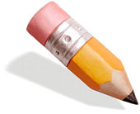
Rev 22:19
And if any man shall take away from the words of the book of this prophecy, God shall take away his part out of the book of life, and out of the holy city, and from the things which are written in this book.

Slide 10
John Saw A Throne (ver. 11a)
John Saw Someone On The Throne (ver. 11b)
John Saw All The Dead Standing Before The Throne (ver. 12a)
John Saw Books Being Opened (ver. 12b)

