Slide 2
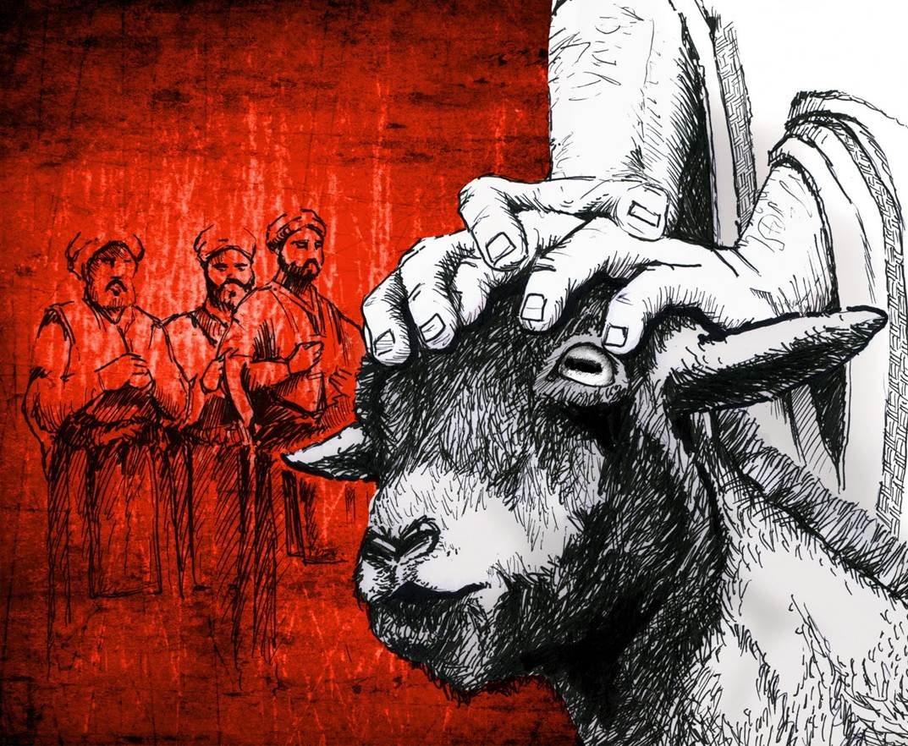
The Day of Atonement
Leviticus 16

Slide 3
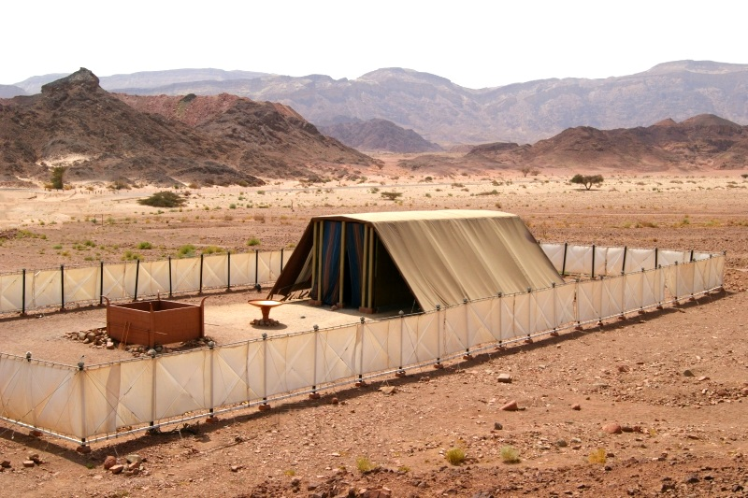

Slide 4
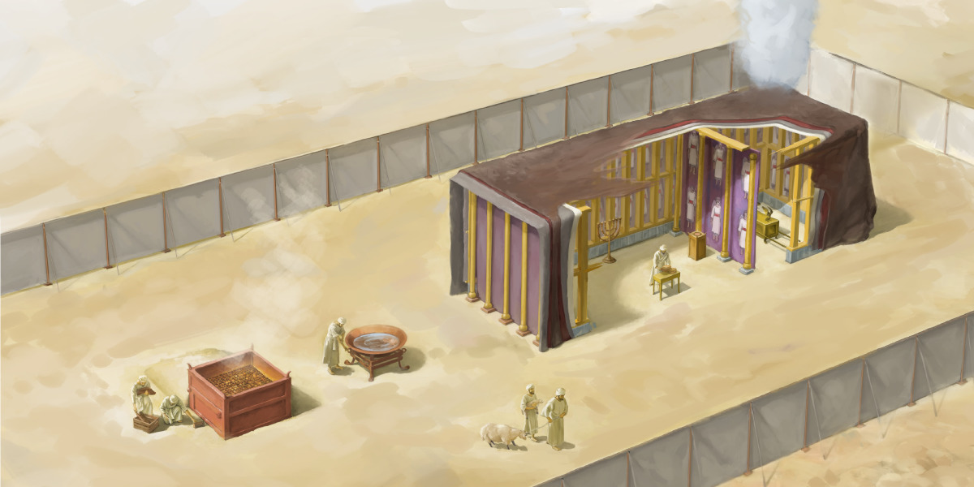

Slide 6
Purpose of the Day of Atonement
Was not a day of celebration and thanksgiving.
It was a day of seeking God’s forgiveness and cleansing the nation of its sins.
To avert God’s wrath and insure His continued dwelling among them.

Slide 7
God’s Holiness Must Be Taken Seriously

Slide 8
God’s Holiness Must Be Taken Seriously
Now the Lord spoke to Moses after the death of the two sons of Aaron, when they offered profane fire before the Lord, and died;
and the Lord said to Moses: “Tell Aaron your brother not to come at just any time into the Holy Place inside the veil, before the mercy seat which is on the ark, lest he die; for I will appear in the cloud above the mercy seat.”
Leviticus 16:1-2

Slide 9
God’s Holiness Must Be Taken Seriously
The High Priest first washed himself and put on clean, white linen clothes (v. 4).
Those who participated had to be prepared
(v. 21).
All the people, even the foreigners in the land, had to rest from work and fast (vs. 29, 31).

Slide 10
Our Sin Must Be Taken Seriously
He offered a bull for himself and his family (v. 6).
He killed a goat for the sins of the people (15).
He cleansed the Holy of Holies and the altar
(vs. 16-19).
He confessed all the iniquities, transgressions, and sins of the people (v. 21).
He offered burnt offerings for himself and for the people (v. 24).

Slide 11
Our Sin Must Be Taken Seriously
He offered a bull for himself and his family (v. 6).
He killed a goat for the sins of the people (15).
He cleansed the Holy of Holies and the altar
(vs. 16-19).
He confessed all the iniquities, transgressions, and sins of the people (v. 21).
He would offer burnt offerings for himself and for the people (v. 24).
All those blood sacrifices were constant reminders that someone had to make atonement for our sins:
“But in those sacrifices there is a reminder of sins every year. For it is not possible that the blood of bulls and goats could take away sins” (Hebrews 10:3-4).

Slide 12
Our Sin Must Be Taken Seriously
He offered a bull for himself and his family (v. 6).
He killed a goat for the sins of the people (15).
He cleansed the Holy of Holies and the altar
(vs. 16-19).
He confessed all the iniquities, transgressions, and sins of the people (v. 21).
He would offer burnt offerings for himself and for the people (v. 24).
Then He took the cup, and gave thanks, and gave it to them, saying, “Drink from it, all of you.
For this is My blood of the new covenant, which is shed for many for the remission of sins.”
Matthew 26:27-28

Slide 13
The Day of Atonement Points to Jesus
Jesus is the sin offering.
  Hebrews 10:10-14
Jesus is the scapegoat.
  Hebrews 9:28; John 1:29
Jesus is the High Priest
  Hebrews 9:11-12, 24

Slide 14
Yet it pleased the Lord to bruise Him; He has put Him to grief. When You make His soul an offering for sin, He shall see His seed, He shall prolong His days, and the pleasure of the Lord shall prosper in His hand.
He shall see the labor of His soul, and be satisfied. By His knowledge My righteous Servant shall justify many, for He shall bear their iniquities.
Therefore I will divide Him a portion with the great, and He shall divide the spoil with the strong, because He poured out His soul unto death, and He was numbered with the transgressors, and He bore the sin of many, and made intercession for the transgressors.
Isaiah 53:10-12

Slide 15
Yet it pleased the Lord to bruise Him; He has put Him to grief. When You make His soul an offering for sin, He shall see His seed, He shall prolong His days, and the pleasure of the Lord shall prosper in His hand.
He shall see the labor of His soul, and be satisfied. By His knowledge My righteous Servant shall justify many, for He shall bear their iniquities.
Therefore I will divide Him a portion with the great, and He shall divide the spoil with the strong, because He poured out His soul unto death, and He was numbered with the transgressors, and He bore the sin of many, and made intercession for the transgressors.
Isaiah 53:10-12

Slide 16
Yet it pleased the Lord to bruise Him; He has put Him to grief. When You make His soul an offering for sin, He shall see His seed, He shall prolong His days, and the pleasure of the Lord shall prosper in His hand.
He shall see the labor of His soul, and be satisfied. By His knowledge My righteous Servant shall justify many, for He shall bear their iniquities.
Therefore I will divide Him a portion with the great, and He shall divide the spoil with the strong, because He poured out His soul unto death, and He was numbered with the transgressors, and He bore the sin of many, and made intercession for the transgressors.
Isaiah 53:10-12

Slide 17
Yet it pleased the Lord to bruise Him; He has put Him to grief. When You make His soul an offering for sin, He shall see His seed, He shall prolong His days, and the pleasure of the Lord shall prosper in His hand.
He shall see the labor of His soul, and be satisfied. By His knowledge My righteous Servant shall justify many, for He shall bear their iniquities.
Therefore I will divide Him a portion with the great, and He shall divide the spoil with the strong, because He poured out His soul unto death, and He was numbered with the transgressors, and He bore the sin of many, and made intercession for the transgressors.
Isaiah 53:10-12

Slide 18
The Day of Atonement
Better understanding of God’s holiness.
Helps us take our sin more seriously.
Better appreciate what Jesus did on the cross and continues to do for us today as our High Priest.

