Slide 2
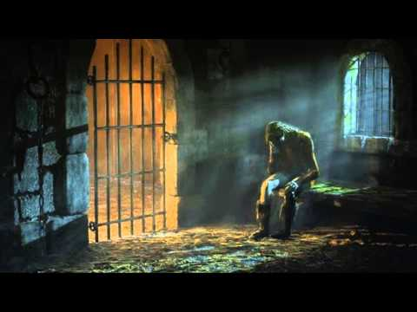
The Parable of the Unforgiving Servant
Matthew 18:21-35

Slide 3
Peter’s Number vs. the Lord’s Number
Peter – “seven times”
Jesus – “seventy times seven”
Peter was looking for a limit.
Our willingness to forgive must be
without limit.

Slide 4
The Two Debts
10,000 talents ($2 million)
  He had no hope of repaying this debt!
100 denarii ($6,840)
  There is no comparison between the debt we owe God and the debts owed to us by our brethren.

Slide 5
The Two Creditors
The master had mercy and compassion.
  Psalm 103:1-4, 11-14
  1 John 1:9
The forgiven servant was heartless and hypocritical.
  James 2:13
  Luke 6:37-38

Slide 6
The Master’s Treatment of the Servant
First time: he showed mercy.
Second time:
  “You wicked servant!” (v. 32)
  “moved with anger” (v. 34 NASU)
  “delivered him to the torturers”

Slide 7
“How often shall my brother sin against me and I forgive him?”
How often do I want God to forgive me when I sin?
“For if you forgive men their trespasses, your heavenly Father will also forgive you. But if you do not forgive men their trespasses, neither will your Father forgive your trespasses.”
Matthew 6:14-15

