Slide 2
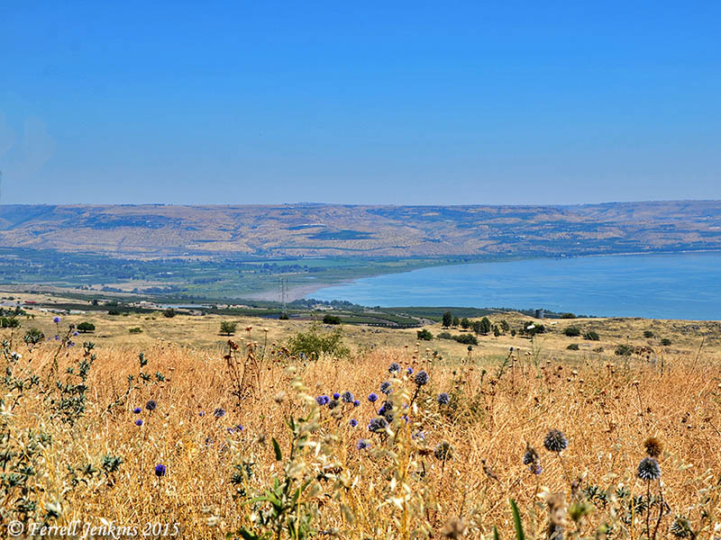
Jesus Feeds the 5,000

Slide 3
Then the apostles gathered to Jesus and told Him all things, both what they had done and what they had taught.
And He said to them, “Come aside by yourselves to a deserted place and rest a while.” For there were many coming and going, and they did not even have time to eat.
So they departed to a deserted place in the boat by themselves.
Mark 6:30-32

Slide 4
And the apostles, when they had returned, told Him all that they had done. Then He took them and went aside privately into a deserted place belonging to the city called Bethsaida (Luke 9:10).

Slide 5
But the multitudes saw them departing, and many knew Him and ran there on foot from all the cities. They arrived before them and came together to Him (Mark 6:33).

Slide 6
1. Jesus Made Time for Those Who Needed Him
“And Jesus, when He came out, saw a great multitude and was moved with compassion for them, because they were like sheep not having a shepherd…” (Mark 6:34).
“…and He received them and spoke to them about the kingdom of God, and healed those who had need of healing. When the day began to wear away, the twelve came and said to Him…”
(Luke 9:11-12).

Slide 7
2. Jesus Increased the Faith of His Apostles

Slide 8
2. Jesus Increased the Faith of His Apostles
Then Jesus lifted up His eyes, and seeing a great multitude coming toward Him, He said to Philip, “Where shall we buy bread, that these may eat?”
But this He said to test him, for He Himself knew what He would do.
Philip answered Him, “Two hundred denarii worth of bread is not sufficient for them, that every one of them may have a little.”
John 6:5-7

Slide 9
2. Jesus Increased the Faith of His Apostles
When it was evening, His disciples came to Him, saying, “This is a deserted place, and the hour is already late. Send the multitudes away, that they may go into the villages and buy themselves food.”
But Jesus said to them, “They do not need to go away. You give them something to eat.”
Matthew 14:15-16

Slide 10
2. Jesus Increased the Faith of His Apostles
When it was evening, His disciples came to Him, saying, “This is a deserted place, and the hour is already late. Send the multitudes away, that they may go into the villages and buy themselves food.”
But Jesus said to them, “They do not need to go away. You give them something to eat.”
Matthew 14:15-16
Luke 9:13-17

Slide 11
3. Jesus Made Use of the Smallest Contribution

Slide 12
3. Jesus Made Use of the Smallest Contribution
One of His disciples, Andrew, Simon Peter’s brother, said to Him,
“There is a lad here who has five barley loaves and two small fish, but what are they among so many?”
John 6:8-9

Slide 13
4. Jesus Blessed in Abundance

Slide 14
4. Jesus Blessed in Abundance
So when they were filled, He said to His disciples, “Gather up the fragments that remain, so that nothing is lost.”
Therefore they gathered them up, and filled twelve baskets with the fragments of the five barley loaves which were left over by those who had eaten.
John 6:12-13

Slide 15
4. Jesus Blessed in Abundance
Now to Him who is able to do exceedingly abundantly above all that we ask or think, according to the power that works in us,
to Him be glory in the church by Christ Jesus to all generations, forever and ever. Amen.
Ephesians 3:20-21

Slide 16
Lessons We Learn About Jesus
Jesus always has time for us.
Jesus challenges us to increase our faith.
Jesus makes great use of our smallest sacrifices.
Jesus always gives us more than we need.

