Slide 2
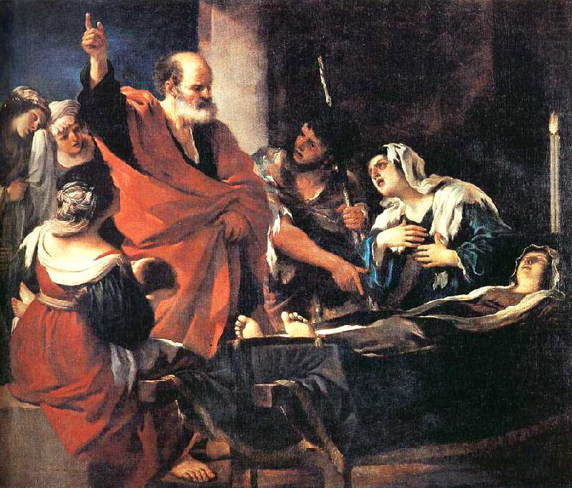
Peter Raises Dorcas from the Dead
Acts 9:36-43

Slide 3
1. The Value of a Charitable Life

Slide 4
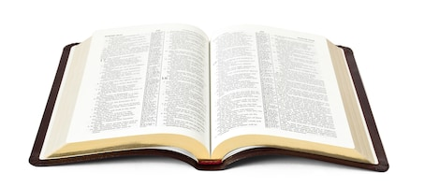
1. The Value of a Charitable Life
“…this woman was abounding with deeds of kindness and charity which she continually did.”
Acts 9:36, NASU

Slide 5
1. The Value of a Charitable Life
“Then I heard a voice from heaven saying to me, ‘Write: “Blessed are the dead who die in the Lord from now on.”’ ‘Yes,’ says the Spirit, ‘that they may rest from their labors, and their works follow them.’”
Revelation 14:13

Slide 6
1. The Value of a Charitable Life
“This is a faithful saying, and these things I want you to affirm constantly, that those who have believed in God should be careful to maintain good works. These things are good and profitable to men.”
Titus 3:8

Slide 7
2. The Appropriate Response to Death

Slide 8
2. The Appropriate Response to Death
“To everything there is a season, a time for every purpose under heaven:
A time to be born, and a time to die; a time to plant, and a time to pluck what is planted…
A time to weep, and a time to laugh; a time to mourn, and a time to dance.”
Ecclesiastes 3:1-4

Slide 9
3. The Importance of Time and Opportunity

Slide 10
3. The Importance of Time and Opportunity
“Then Peter arose and went with them. When he had come, they brought him to the upper room. And all the widows stood by him weeping, showing the tunics and garments which Dorcas had made while she was with them.”
Acts 9:39

Slide 11
3. The Importance of Time and Opportunity
“Whatever your hand finds to do, do it with your might; for there is no work or device or knowledge or wisdom in the grave where you are going.”
Ecclesiastes 9:10

Slide 12
4. The Nature and Purpose of This Miracle

Slide 13
4. The Nature and Purpose of This Miracle
“And it became known throughout all Joppa, and many believed on the Lord.”
Acts 9:42

Slide 14
4. The Nature and Purpose of This Miracle
“How shall we escape if we neglect so great a salvation, which at the first began to be spoken by the Lord, and was confirmed to us by those who heard Him,
God also bearing witness both with signs and wonders, with various miracles, and gifts of the Holy Spirit, according to His own will?”
Hebrews 2:3-4

Slide 15
Important Lessons
God would have us live so that we are blessings to others.
Death is a time for mourning and remembering.
We must take advantage of time and opportunity.
We must remember the purpose for miracles and believe in the Gospel.

