Slide 2
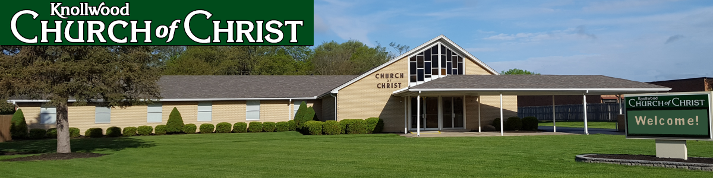
Thankful for the Lord’s Church
Special Sermon Series

Slide 3
Thankful for Unity in the Local Church
Ephesians 4:1-6

Slide 4
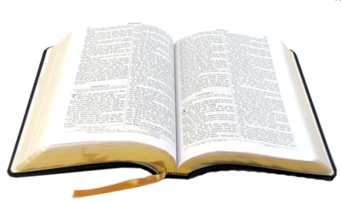
Our Call To Unity
I, therefore, the prisoner of the Lord, beseech you to walk worthy of the calling with which you were called.
Ephesians 4:1

Slide 5
“Behold, how good and how pleasant it is for brethren to dwell together in unity!”
Psalm 133:1

Slide 6
“These six things the Lord hates, yes, seven are an abomination to Him…
A false witness who speaks lies, and one who sows discord among brethren.”
Proverbs 6:16-19

Slide 7
“Now I urge you, brethren, note those who cause divisions and offenses, contrary to the doctrine which you learned, and avoid them.”
Romans 16:17

Slide 8
“I do not pray for these alone, but also for those who will believe in Me through their word;
that they all may be one, as You, Father, are in Me, and I in You; that they also may be one in Us, that the world may believe that You sent Me.”
John 17:20-21

Slide 9

The Basis for Our Unity
Body
Spirit
Hope
Lord
Faith
Baptism
God
Ephesians 4:4-6

Slide 10
Attitudes That Maintain Unity
With all lowliness and gentleness, with longsuffering,
bearing with one another in love.
Ephesians 4:2

Slide 11
Attitudes That Maintain Unity
With all lowliness and gentleness, with longsuffering,
bearing with one another in love.
Ephesians 4:2

Slide 12
Attitudes That Maintain Unity
With all lowliness and gentleness, with longsuffering,
bearing with one another in love.
Ephesians 4:2

Slide 13
Attitudes That Maintain Unity
With all lowliness and gentleness, with longsuffering,
bearing with one another in love.
Ephesians 4:2

Slide 14
Attitudes That Maintain Unity
With all lowliness and gentleness, with longsuffering,
bearing with one another in love.
Ephesians 4:2

Slide 15
Attitudes That Maintain Unity
With all lowliness and gentleness, with longsuffering,
bearing with one another in love.
Ephesians 4:2

Slide 16
Attitudes That Maintain Unity
With all lowliness and gentleness, with longsuffering,
bearing with one another in love.
Ephesians 4:2

Slide 17
Thankful for the Unity in the Local Church
God has made it possible!
God has established the way!!
God allows me to participate!!!

