Slide 2
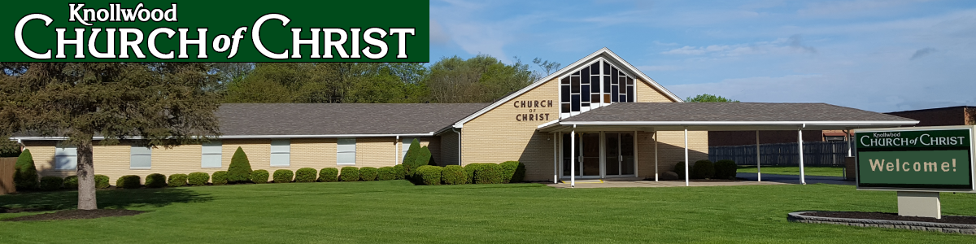
Thankful for the Lord’s Church
Special Sermon Series

Slide 3
Thankful for the Local Church
First Timothy 3:14-15

Slide 4
The Church

Slide 5

The Church
Universal Church –
all the saved joined together in the spiritual body of Christ.

Slide 6

The Church
Universal Church –
all the saved joined together in the spiritual body of Christ.
Local Church –
all the saved in a physical location who have joined themselves to work and worship together.

Slide 7
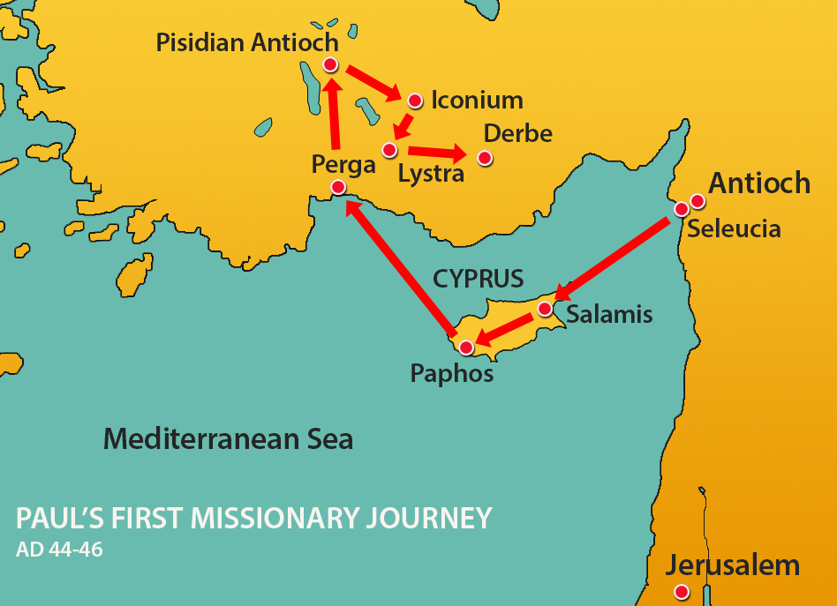
1. A Place to Be Safe
Acts 14:21-23

Slide 8
1. A Place to Be Safe
Autonomous – “functioning independently without control by others” (Webster’s).
Elders oversee the local church (1 Pet. 5:2).
Their authority is limited to the local church of which they are members.
This arrangement allows each congregation to take care of its needs and protects them from apostasy (Rev. 2-3).

Slide 9
2. A Place to Belong
“And when Saul had come to Jerusalem, he tried to join the disciples; but they were all afraid of him, and did not believe that he was a disciple” (Acts 9:26).
  A sense of community - Acts 2:44-47; 4:32
  A sense of family - 1 Tim. 3:15; 5:1-2
  A support system - 1 Cor. 12:25-27; Gal. 6:2

Slide 10
3. A Place to Serve and Grow
“That you may walk worthy of the Lord, fully pleasing Him, being fruitful in every good work and increasing in the knowledge of God;
strengthened with all might, according to His glorious power, for all patience and longsuffering with joy.”
Colossians 1:10-11

Slide 11
3. A Place to Serve and Grow
The local church is where…
I can find sound Bible teaching - 1 Tim. 3:15
I can find people who can help me understand the Scriptures and how to serve others - 2 Tim. 2:2
I find good examples to imitate - Phil. 3:17
I can get involved - Eph. 4:16; 1 Thess. 5:14

Slide 12
4. A Place to Worship God
“And they continued steadfastly in the apostles’ doctrine and fellowship, in the breaking of bread, and in prayers.”
Acts 2:42
“Let the word of Christ dwell in you richly in all wisdom, teaching and admonishing one another in psalms and hymns and spiritual songs, singing with grace in your hearts to the Lord.”
Colossians 3:16

Slide 13
4. A Place to Worship God
“And let us consider one another in order to stir up love and good works,
not forsaking the assembling of ourselves together, as is the manner of some, but exhorting one another, and so much the more as you see the Day approaching.”
Hebrews 10: 24-25

Slide 14
The Local Church is a Place Where…
I Am Safe Spiritually
I Belong to a Support System
I Can Grow and Get Involved
I Can Worship God in Spirit and Truth

