Slide 2

Fighting an Invisible Enemy
Ephesians 6:10-17

Slide 3
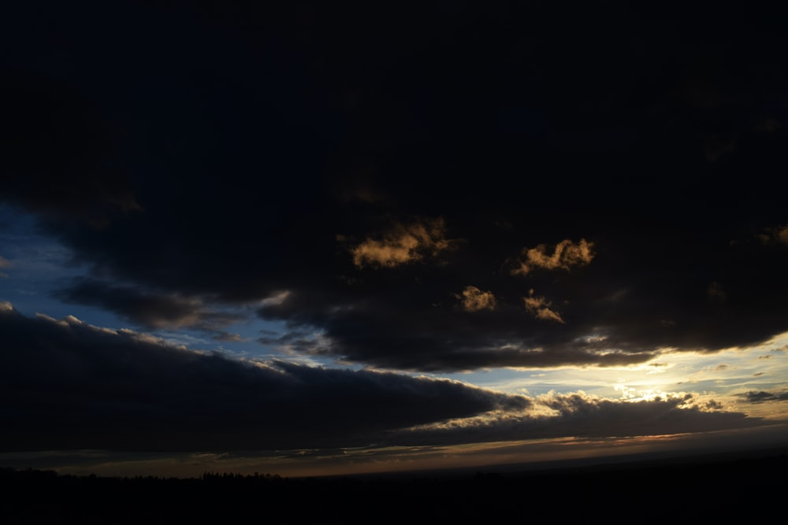
The Prince of the Power of the Air
Ephesians 2:2
“For we do not wrestle against flesh and blood, but against principalities, against powers, against the rulers of the darkness of this age, against spiritual hosts of wickedness in the heavenly places.”
Ephesians 6:12

Slide 4
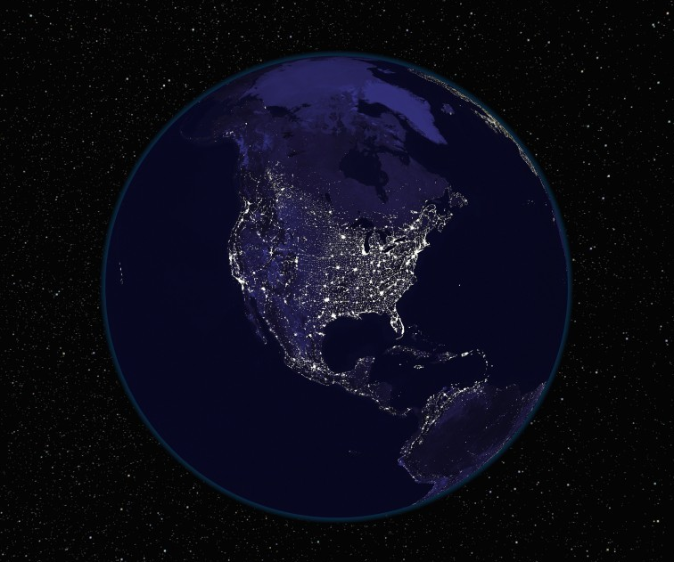
The Ruler of This World
John 14:30; 16:11
“We know that we are of God, and the whole world lies under the sway of the wicked one.”
1 John 5:19

Slide 5
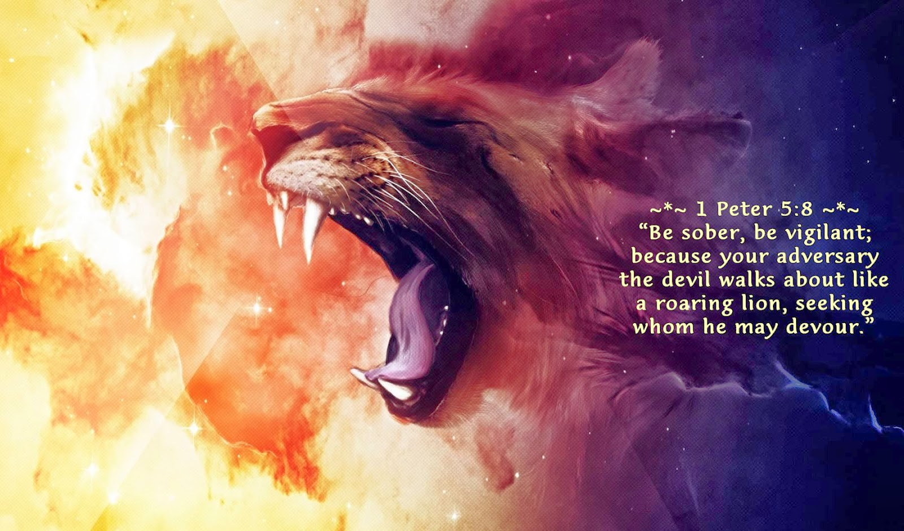

Slide 6
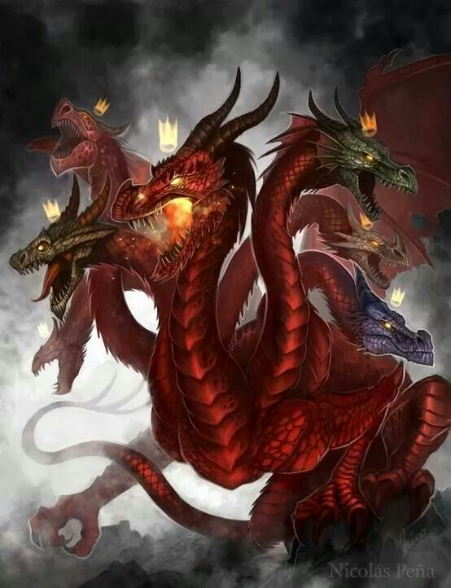
“And another sign appeared in heaven: behold, a great, fiery red dragon having seven heads and ten horns, and seven diadems on his heads...
So the great dragon was cast out, that serpent of old, called the Devil and Satan, who deceives the whole world; he was cast to the earth, and his angels were cast out with him.”
Revelation 12:3, 9

Slide 7
“Woe to the inhabitants of the earth and the sea! For the devil has come down to you, having great wrath, because he knows that he has a short time…
And the dragon was enraged with the woman, and he went to make war with the rest of her offspring, who keep the commandments of God and have the testimony of Jesus Christ.”
Revelation 12:12, 17

Slide 8
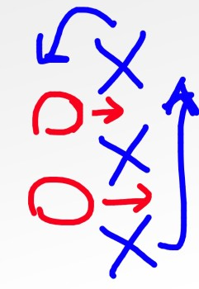
How Our Enemy Operates
Deception - John 8:44
Doubt - Genesis 3:1-5
Fear - Numbers 13:26-14:10
Guilt - Matthew 27:3-5
Lust and Pride - 1 John 2:16

Slide 9
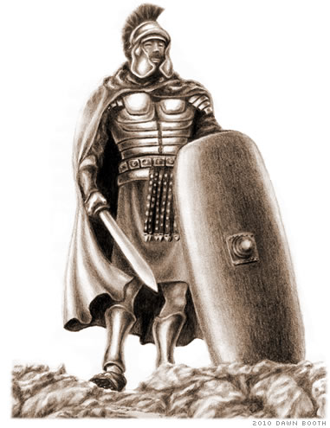
How We Overcome Our
Invisible Enemy
Acknowledge Him - 1 Peter 5:8
Resist Him - 1 Peter 5:9
Stand Firm Against Him -
Eph. 6:10-17

