Slide 2
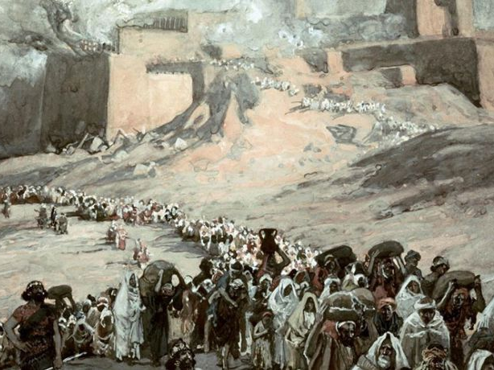
“If Only You Had Paid Attention to My Commandments”
Isaiah 48:18

Slide 3
“If only” moments from the Old Testament
Adam and Eve - Gen. 3:1-5
Cain - Gen. 4:3-7
King Saul - 1 Sam. 15:3, 8-9, 26
David moving the ark - 1 Chron. 15:2, 12-13

Slide 4
“If only” we would pay attention to God’s Word today.
Role of Government - Rom. 13:1-7
Marriage and Family - Gen. 2:24
  Eph. 5:22-6:4; Titus 2:4-5
The Church - Matt. 16:18; Eph. 4:11-16

Slide 5

“Join the Church of Your Choice!”
Patterson Park Church
LifeSpring Church
Beavercreek Christian Church
St. Andrew United Methodist Church
Beavercreek Baptist Church
Peace Evangelical Lutheran Church
St. Luke Catholic Church
Beavercreek Church of the Brethren
Be Hope Church
Beavercreek Seventh-day Adventist Church

Slide 6
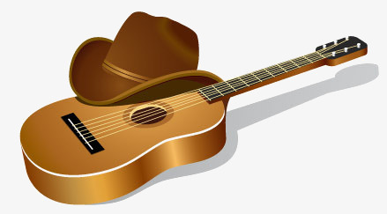
Welcome to Cowboy Church
Join us every Tuesday at 7 PM in the Arena for good Gospel music, encouragement, fun and fellowship
We only a have service on Tuesday Nights in the Arena at 7PM at Harvest Ranch, however You can check Our events page for other Cowboy Church services we have scheduled at other horse events or church events.
Our Services are a little over an hour long, but people stay late to fellowship and listen to the cowboy band jam.
The dress is come as you are. Some will
come straight from the fields and factory.
We do not pass an offering plate.
Middletown, Ohio

Slide 7
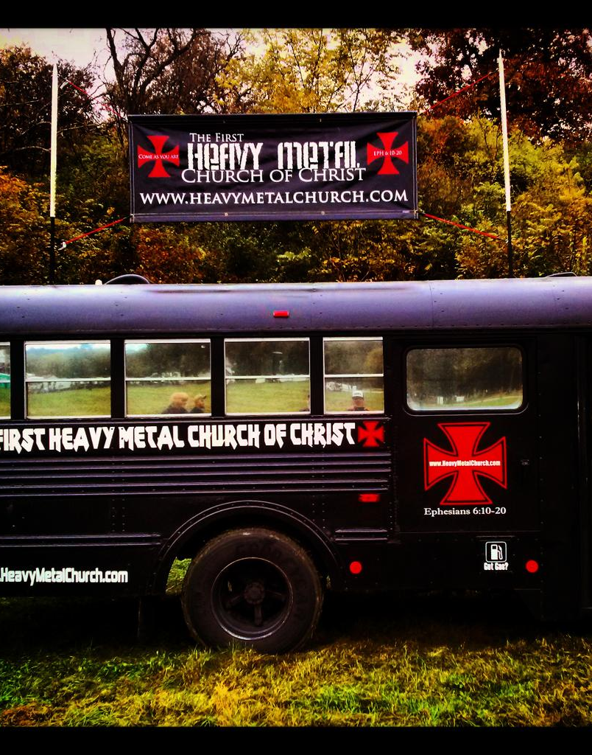
Come As You Are!
“A Holy Spirit freak of nature.”
Meets in Dayton, OH
Every Sunday at noon.
Doors open at 11:00 for free coffee and donuts.

Slide 8
“If only” we would pay attention to God’s Word today.
Role of Government - Rom. 13:1-7
Marriage and Family - Gen. 2:24
  Eph. 5:22-6:4; Titus 2:4-5
The Church - Matt. 16:18; Eph. 4:11-16

Slide 9
“If only” we would pay attention to God’s Word today.
Role of Government - Rom. 13:1-7
Marriage and Family - Gen. 2:24
  Eph. 5:22-6:4; Titus 2:4-5
The Church - Matt. 16:18; Eph. 4:11-16
Our Lives - Matt. 7:21

