Slide 2
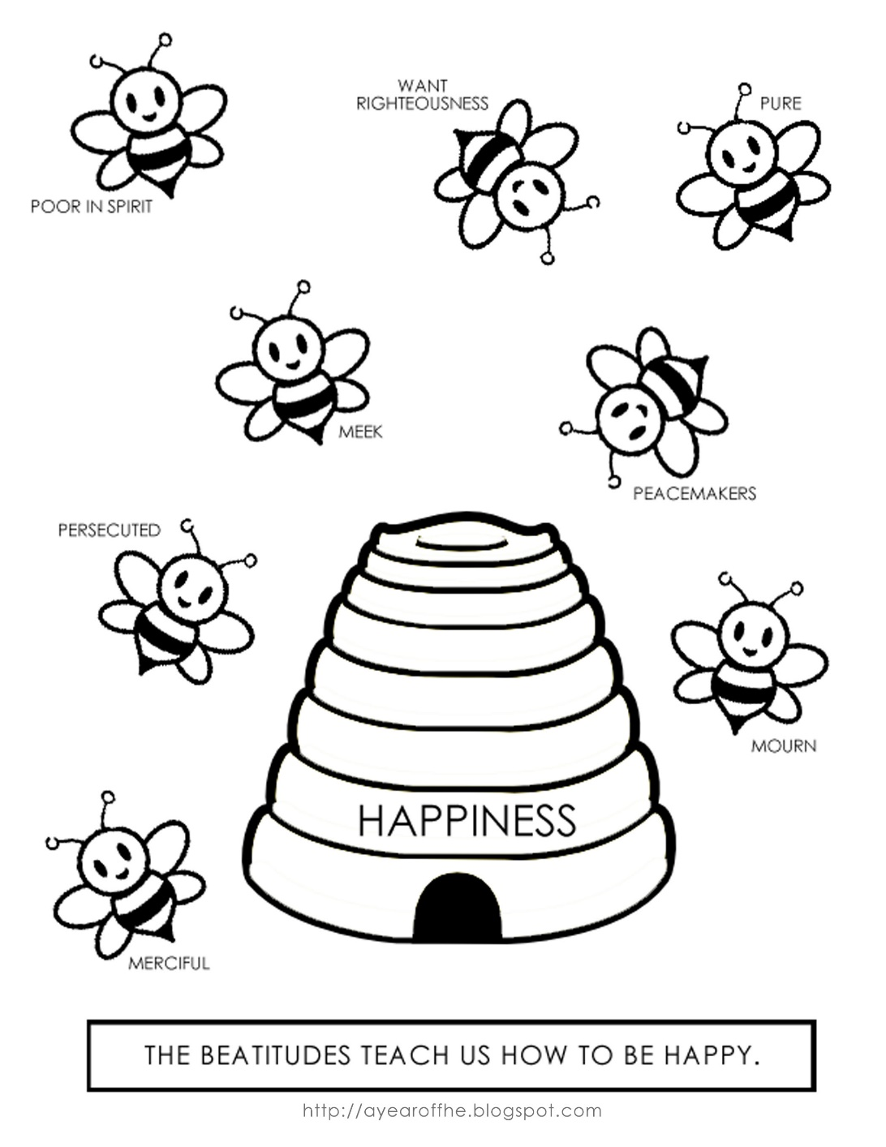
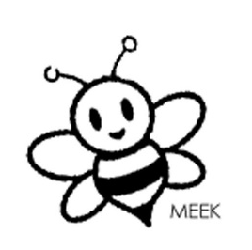

Bee-Attitudes for
Beginners
Matthew 5:3-12

Slide 3
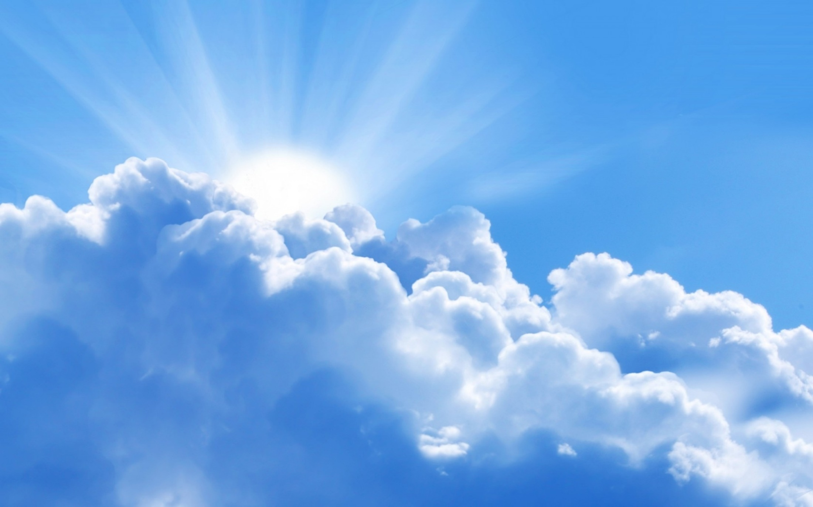
“Blessed”
means “happy”
The feeling that we know God is pleased with us.

Slide 4
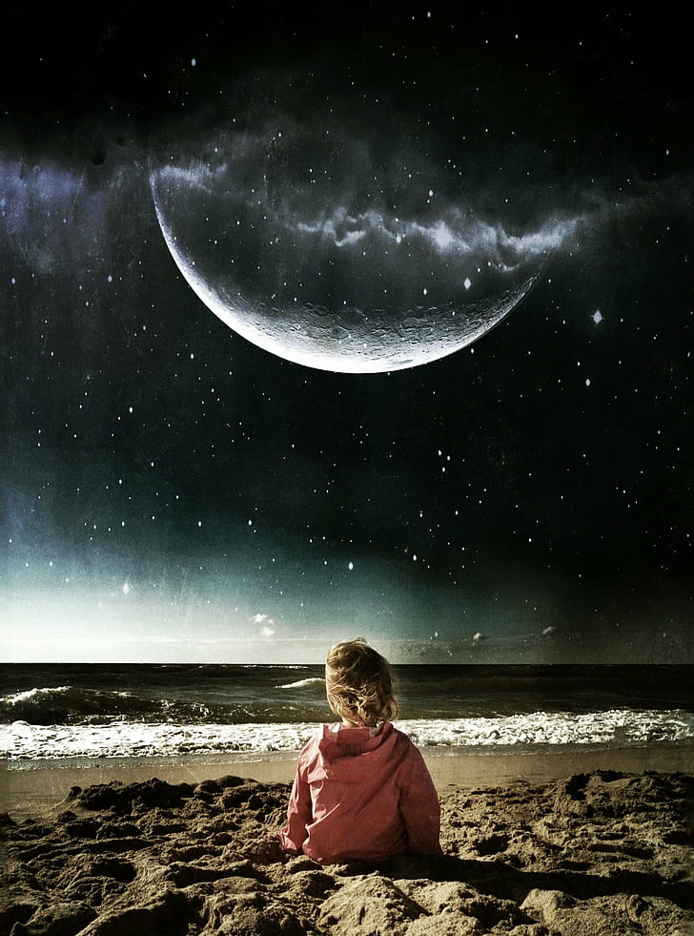
1. The poor in spirit
Theirs is the
kingdom of heaven.

Slide 5
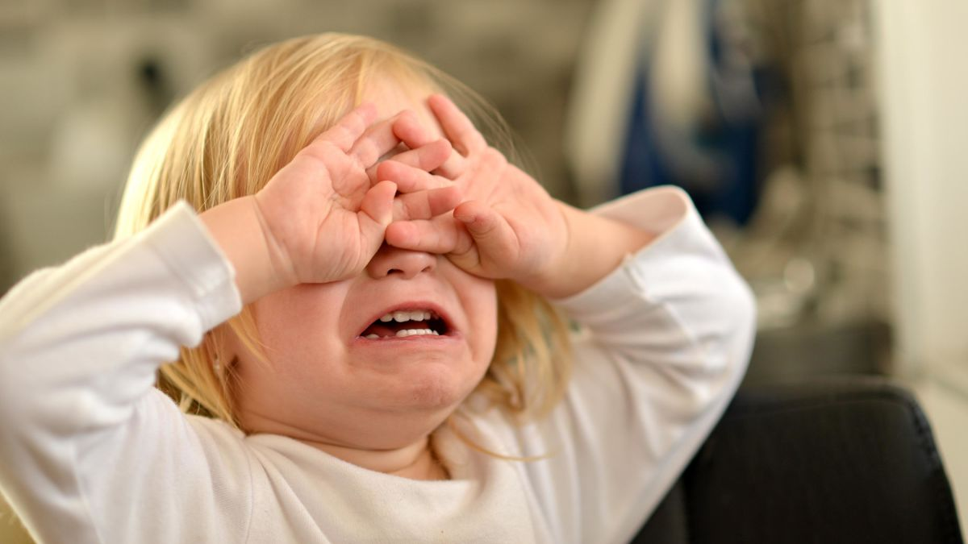
2. Those who mourn
They shall be
comforted.

Slide 6
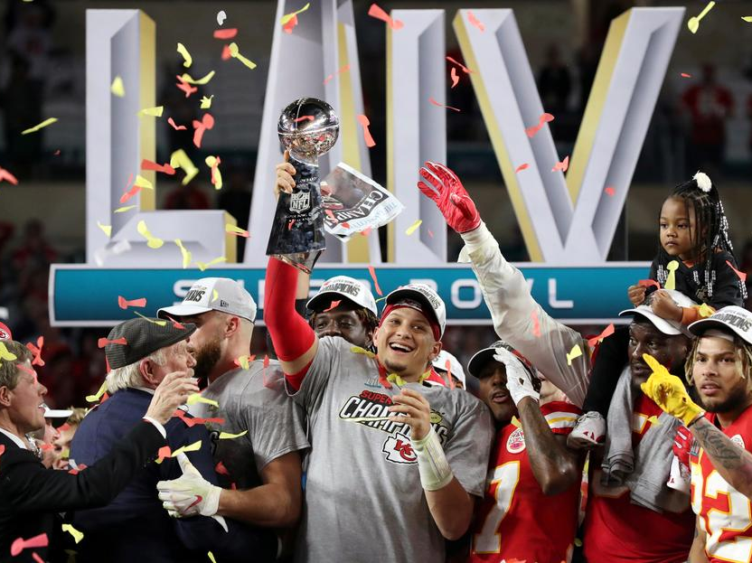
3. The meek
They shall inherit the earth.

Slide 7
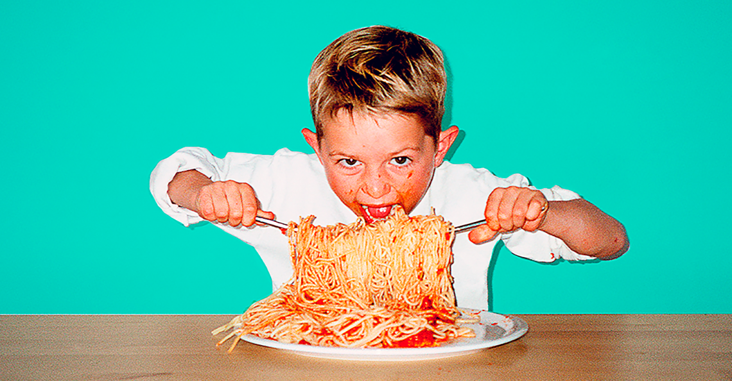
4. Those who hunger and thirst for righteousness
They shall be filled.

Slide 8
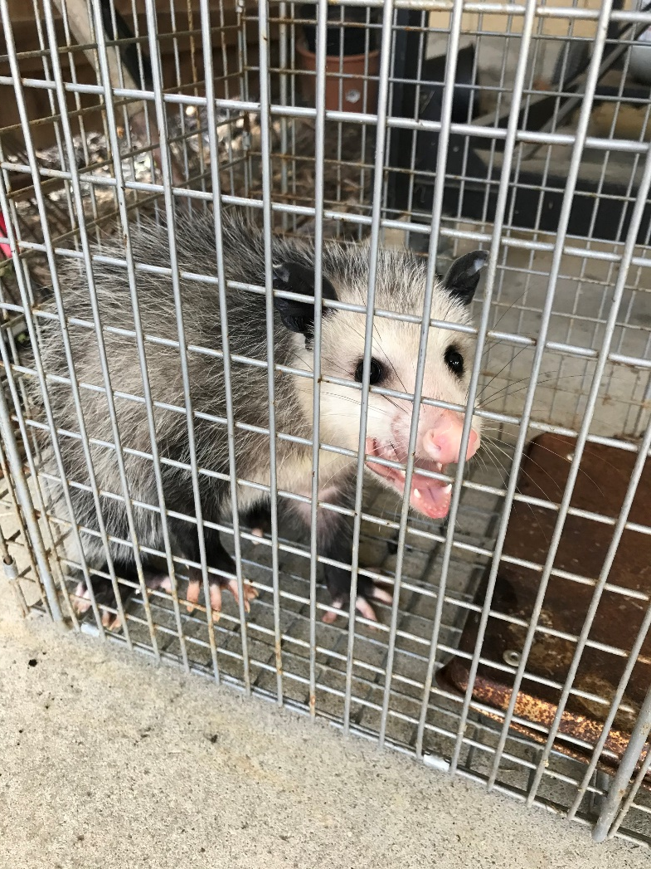
5. The merciful
They shall receive
mercy.

Slide 9
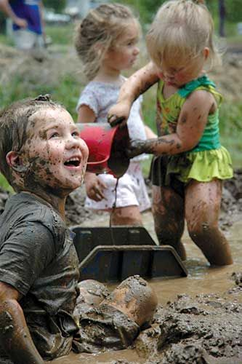
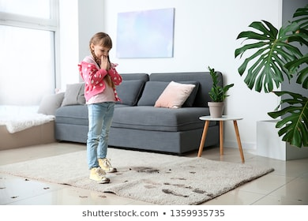
6. The pure in heart
They shall see God.

Slide 10
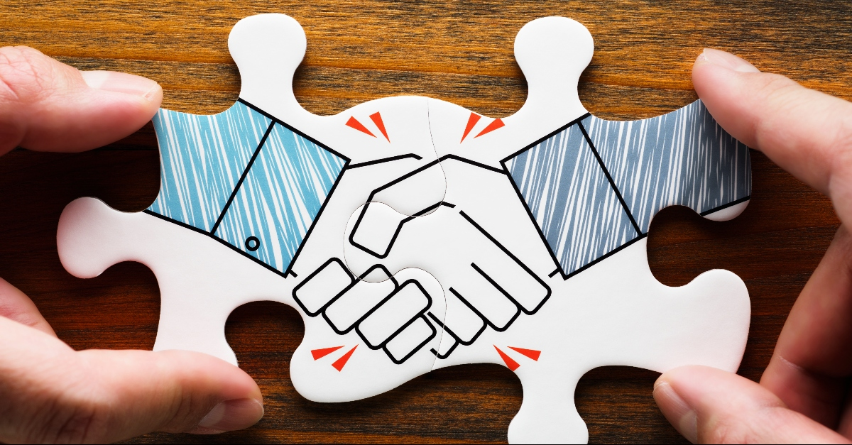
7. The peacemakers
They shall be called sons of God.

Slide 11
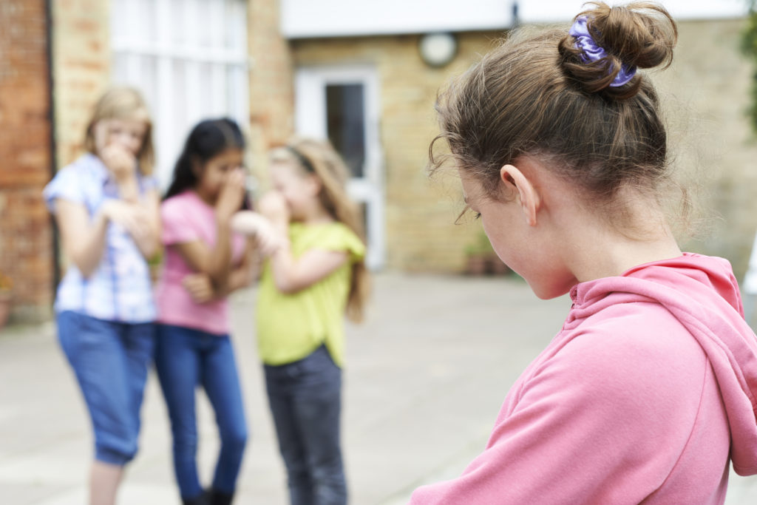
8. Those who are persecuted for righteousness’ sake
Theirs is the kingdom of heaven.

