Slide 2


Slide 3
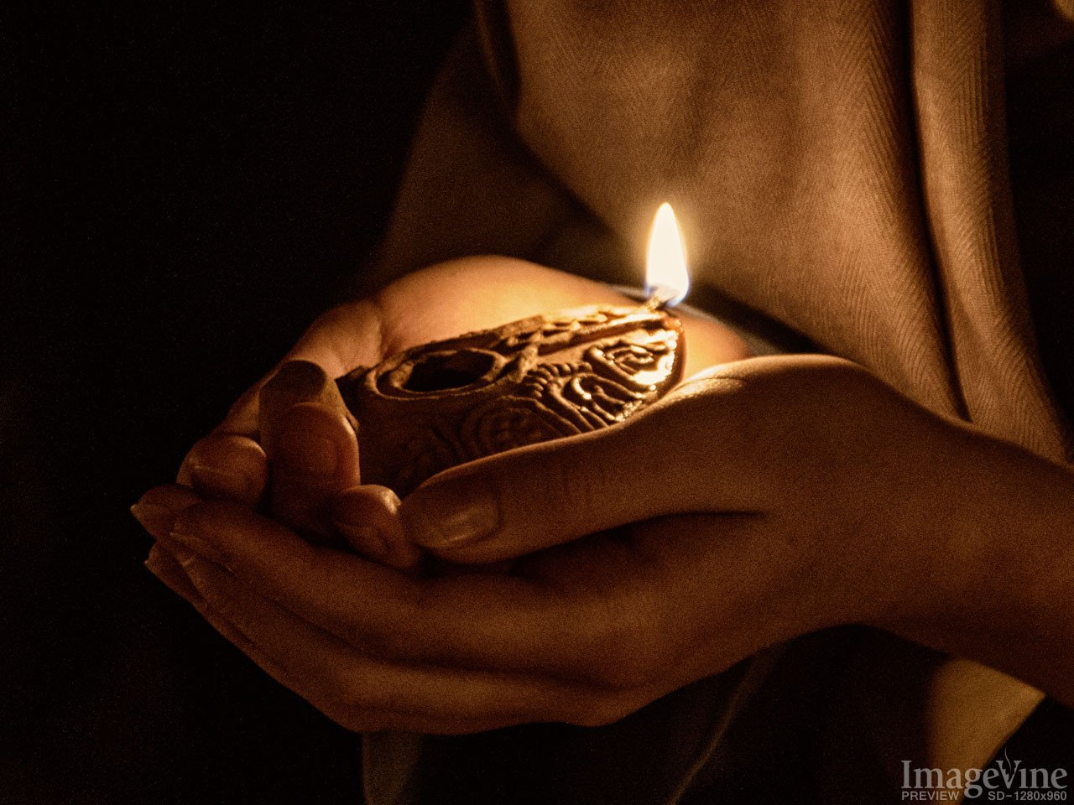

Slide 4
Watch and Be Ready
- Things We Cannot Do -
Neglect Preparation and Be Ready
At the Lord’s Coming
Borrow What Must Be Bought
Recall Lost Opportunities

