Slide 2
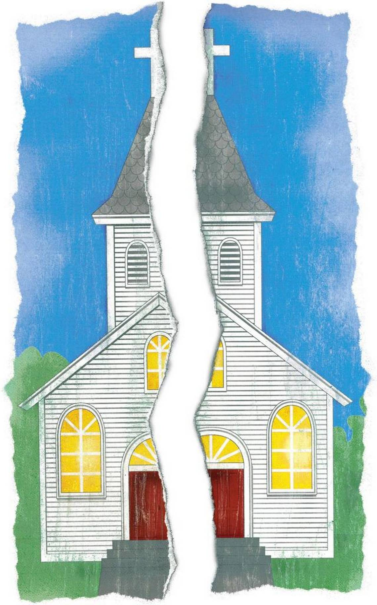
The Impact of Pride on the
Local Church
Proverbs 16:18

Slide 3
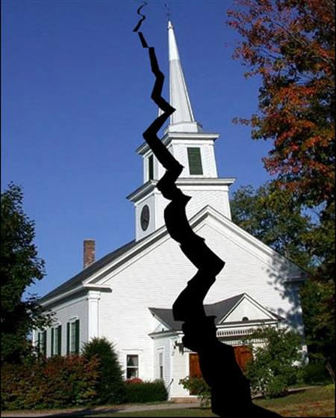
Pride Destroys A Church When…
Members Put Themselves First
Members Show Partiality and Preference
Members Refuse to Forgive One Another
Elders Exhibit Pride

