Slide 2
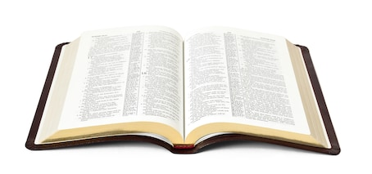
How Do We Know the Bible is Inspired by God?

Slide 3
1. The Unity of the Bible

Slide 4
1. The Unity of the Bible
66 individual books
3 different languages
40 writers from different backgrounds
3 different continents
1,600 years

Slide 5
2. Historical and Geographical Accuracy
The Bible records hundreds of incidents that can be checked against secular history and archeology for accuracy.
The Bible passes the test every time!
  The Hittites (Gen. 23:10; 26:34)
  The book of Acts mentions 32 countries, 54 cities, 9 islands, 95 individuals.

Slide 6
3. Fulfilled Prophecy
Remember the former things of old, for I am God, and there is no other; I am God, and there is none like Me,
Declaring the end from the beginning, and from ancient times things that are not yet done, saying, “My counsel shall stand,
And I will do all My pleasure.”
Isaiah 46:9-10

Slide 7
3. Fulfilled Prophecy
King Cyrus was named 150 years before he was born (Is. 44:28-45:1).
King Josiah’s work was foretold more than 300 years before his birth (1 Kings 13:2).
There are 332 Messianic prophecies in the Old Testament fulfilled in the life of Jesus of Nazareth.

Slide 8
4. Scientific Foreknowledge
Life is in the blood (Lev. 17:11).
Shape of the earth (Is. 40:22).
Number of stars (Jer. 33:22).
Sanitation laws of Leviticus.
Psalm 8:8 led Matthew Maury to discover and chart ocean currents.

Slide 9
5. The Brevity of the Bible

Slide 10
5. The Brevity of the Bible
Where did God come from?
What does Jesus look like?
What happened to Noah’s ark?
What happened to Jesus between the ages of 12-30?
What happened to Joseph and Mary?
What happened to the apostles?
etc., etc., etc., etc.?

Slide 11
6. The Impartiality of the Bible
Noah
Abraham
Moses
David
Peter

Slide 12
6. The Impartiality of the Bible
Noah… the drunkard.
Abraham… the liar.
Moses… the coward and disobedient.
David… the adulterer and murderer.
Peter… denied the Lord.

Slide 13
The Bible Passes the Test!
If we accept the Bible’s claim of inspiration, we are faced with an important decision to make:
What will we do with its message?

