Slide 2
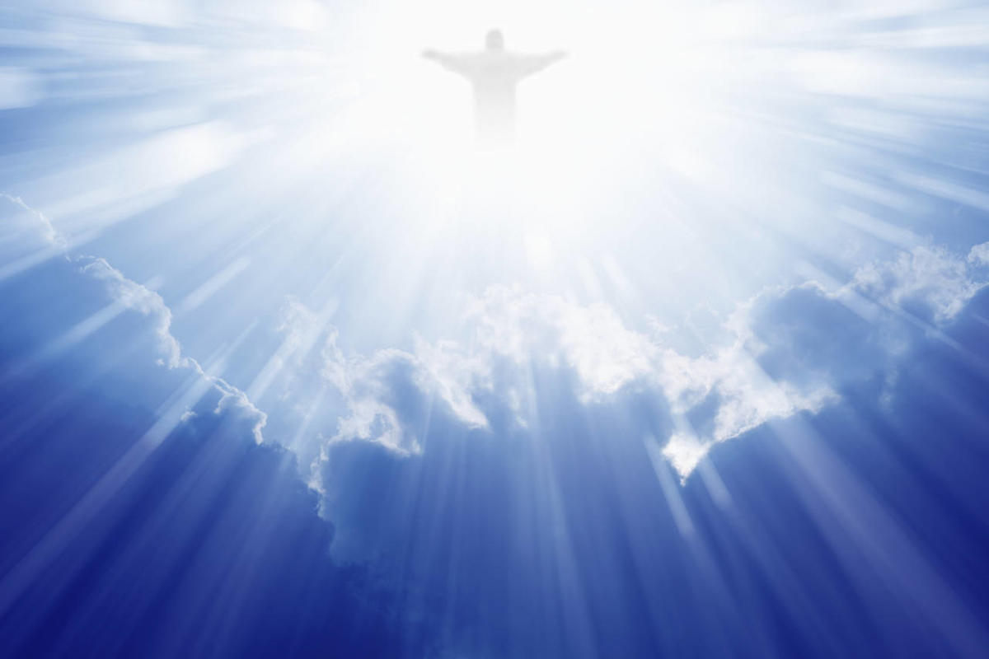
As We Wait for
His Return

Slide 3
As We Wait for His Return
We Must Expect His Return
  Matt. 24:45-51
We Must Long for His Return
  Heb. 9:27-28; Rev. 22:20
We Must Prepare for His Return
  2 Thess. 1:7-8; 1 John 3:2-3; John 12:48
We Must Proclaim His Return
  1 Cor. 11:26

Slide 4
Are You Prepared?
Do you believe Jesus is the Son of God?
  John 8:24
Have you repented of your sins?
  Acts 17:30
Have you confessed your faith in Jesus?
  Rom. 10:9-10
Have you been baptized?
  Mark 16:16
Are you remaining faithful?
  Heb. 10:36

