Slide 2
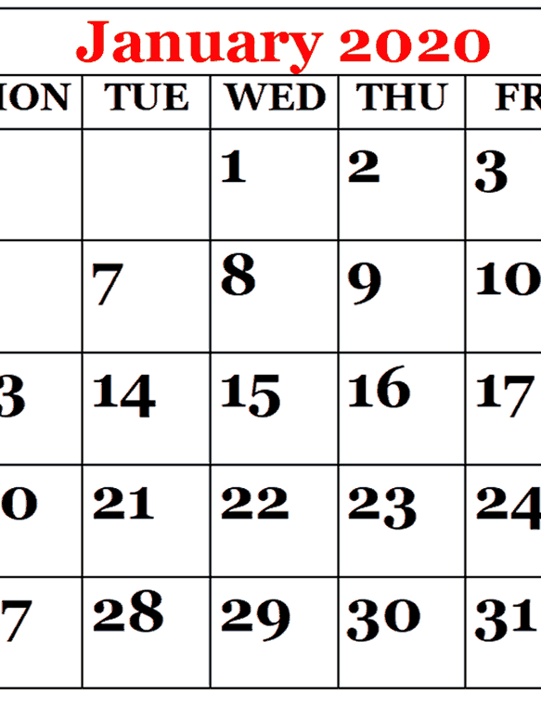
A New Year
A New You

Slide 3
Intellectual
Physical
Spiritual
Social
“And Jesus increased in wisdom and stature, and in favor with God and men” (Luke 2:52).

Slide 4
God Wants To Be Involved
In Your Life

Slide 5

God Wants To Be Involved
In Your Life
“Am I a God near at hand,” says the Lord, “And not a God afar off?
“Can anyone hide himself in secret places, so I shall not see him?” says the Lord; “Do I not fill heaven and earth?” says the Lord.
Jeremiah 23:23-24

Slide 6
God Wants To Be Involved
In Your Life
So that they should seek the Lord, in the hope that they might grope for Him and find Him, though He is not far from each one of us;
for in Him we live and move and have our being…
Acts 17:27-28

Slide 7
God Wants To Be Involved
In Your Life
Jesus answered and said to him, “If anyone loves Me, he will keep My word; and My Father will love him, and We will come to him and make Our home with him.”
John 14:23

Slide 8
God Wants To Be Involved
In Your Life
Behold, I stand at the door and knock. If anyone hears My voice and opens the door, I will come in to him and dine with him, and he with Me.
Revelation 3:20

Slide 9
1. Listen to Him

Slide 10
1. Listen to Him
All Scripture is given by inspiration of God, and is profitable for doctrine, for reproof, for correction, for instruction in righteousness,
that the man of God may be complete, thoroughly equipped for every good work.
2 Timothy 3:16-17

Slide 11
2. Trust Him

Slide 12
2. Trust Him
But without faith it is impossible to please Him, for he who comes to God must believe that He is, and that He is a rewarder of those who diligently seek Him.
Hebrews 11:6

Slide 13
3. Talk to Him

Slide 14
3. Talk to Him
Be anxious for nothing, but in everything by prayer and supplication, with thanksgiving, let your requests be made known to God;
and the peace of God, which surpasses all understanding, will guard your hearts and minds through Christ Jesus.
Philippians 4:6-7

Slide 15
4. Worship Him

Slide 16
4. Worship Him
But the hour is coming, and now is, when the true worshipers will worship the Father in spirit and truth; for the Father is seeking such to worship Him.
God is Spirit, and those who worship Him must worship in spirit and truth.
John 4:23-24

Slide 17
5. Follow Him

Slide 18
5. Follow Him
The two disciples heard him speak, and they followed Jesus.
Then Jesus turned, and seeing them following, said to them, “What do you seek?” They said to Him, “Rabbi” (which is to say, when translated, Teacher), “where are You staying?”
He said to them, “Come and see.”
John 1:37-39

Slide 19
6. Share Him

Slide 20
6. Share Him
One of the two who heard John speak, and followed Him, was Andrew, Simon Peter’s brother.
He first found his own brother Simon, and said to him, “We have found the Messiah” (which is translated, the Christ).
And he brought him to Jesus.
John 1:40-42

Slide 21
6. Share Him
Philip found Nathanael and said to him, “We have found Him of whom Moses in the law, and also the prophets, wrote - Jesus of Nazareth, the son of Joseph.”
And Nathanael said to him, “Can anything
good come out of Nazareth?” Philip said to
him, “Come and see.”
John 1:45-46

Slide 22
Intellectual
Physical
Spiritual
Social
“And Jesus increased in wisdom and stature, and in favor with God and men” (Luke 2:52).

Slide 23

How We Let God Into Our Lives
Listen to Him
Trust Him
Talk to Him
Worship Him
Follow Him
Share Him

