Slide 2
The Anointing at Bethany
Mark 14:3-9; John 12:1-8

Slide 3
The Anointing at Bethany
There was Celebrating
There was Worship

Slide 4
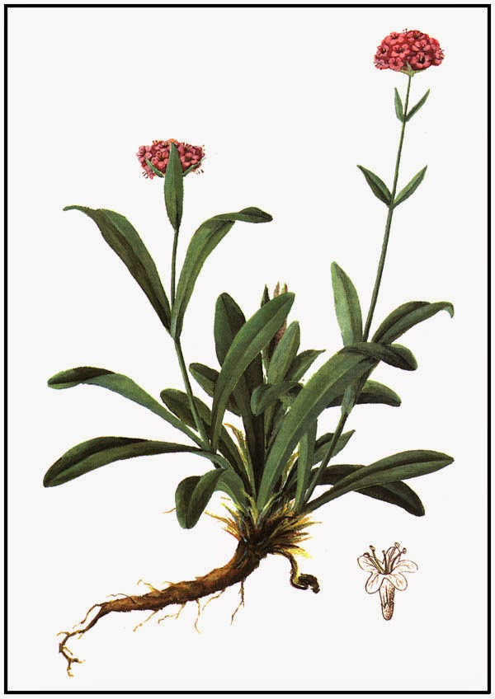
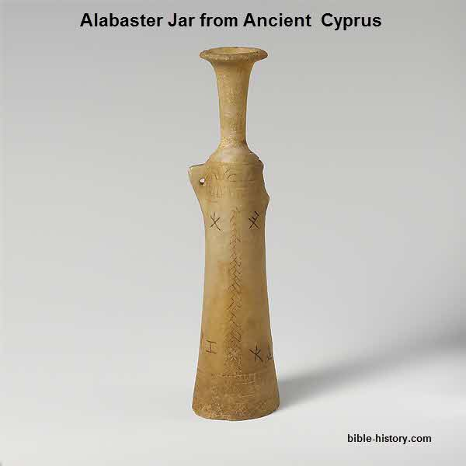
Mary’s Worship
It was Expensive

Slide 5
Mary’s Worship
It was Expensive
It was Beautiful

Slide 6
Mary’s Worship
It was Expensive
It was Beautiful
It was Timely

Slide 7
The Anointing at Bethany
There was Celebrating
There was Worship
There was Complaining

Slide 8
What About Us?
Are we giving the Lord our best?
Are we giving it all – pouring out every drop?
Are we doing it now, while we can – or are we taking tomorrow for granted?
Are we concerned with what others will think or say?

