Slide 2

The Work of Teachers in the Local Church

Slide 3
Teaching God’s Word Has
Always Been Important
Patriarchs - Gen. 18:19
Law of Moses - Deut. 31:9-13; Neh. 8:1-8
Gospel Age - Matt. 28:19-20; Eph. 4:11-12
Not everyone is a teacher - James 3:1
Good teachers are trained - 2 Tim. 2:2

Slide 4
Things Good Teachers
Need To Understand
They Are Stewards of God’s Word
  1 Cor. 4:1-2; Matt. 13:51-52
They Are Co-Workers in God’s Vineyard
  1 Cor. 3:5-7; Eph. 6:4
They Are Shaping Hearts Headed for Eternity
  2 Tim. 3:14-15; Matt. 16:26

Slide 5
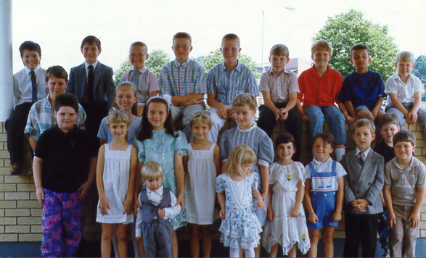

Slide 6
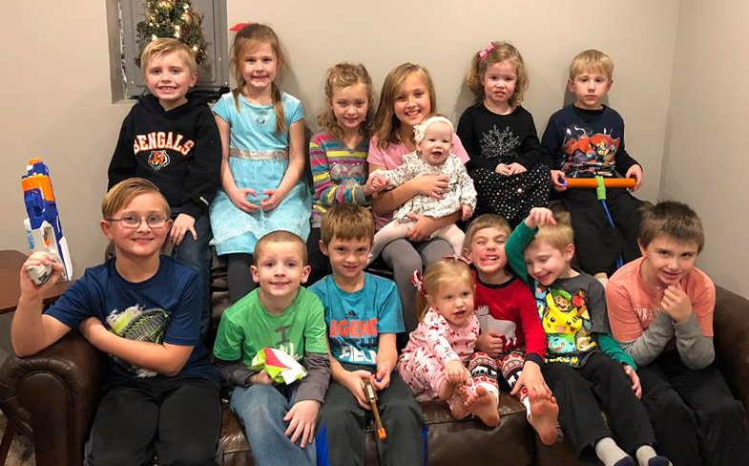
1991
2018

Slide 7
Things Good Teachers
Need To Understand
They Are Stewards of God’s Word
  1 Cor. 4:1-2; Matt. 13:51-52
They Are Co-Workers in God’s Vineyard
  1 Cor. 3:5-7; Eph. 6:4
They Are Shaping Hearts Headed for Eternity
  2 Tim. 3:14-15; Matt. 16:26
The Importance of Preparation
  Ezra 7:10; 1 Tim. 4:16

Slide 8

The Importance of Preparation
Prepare Yourself
Prepare the Lesson
Prepare the Classroom
Prepare a Substitute

Slide 9
Things Good Teachers
Need To Understand
They Are Stewards of God’s Word
  1 Cor. 4:1-2; Matt. 13:51-52
They Are Co-Workers in God’s Vineyard
  1 Cor. 3:5-7; Eph. 6:4
They Are Shaping Hearts Headed for Eternity
  2 Tim. 3:14-15; Matt. 16:26
The Importance of Preparation
  Ezra 7:10; 1 Tim. 4:16
Not to Grow Weary in Doing Good
  Gal. 6:9

Slide 10
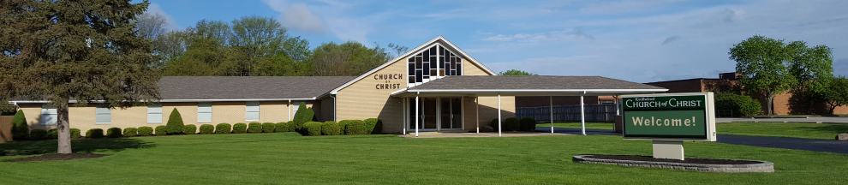
Our Bible Classes Need…
Elders who will oversee the work!
Teachers who volunteer their time and talents!
Students who are present and prepared!
Parents who make sure their children are present and prepared!
Members who will pray for and support the effort!

