Slide 1


Slide 2
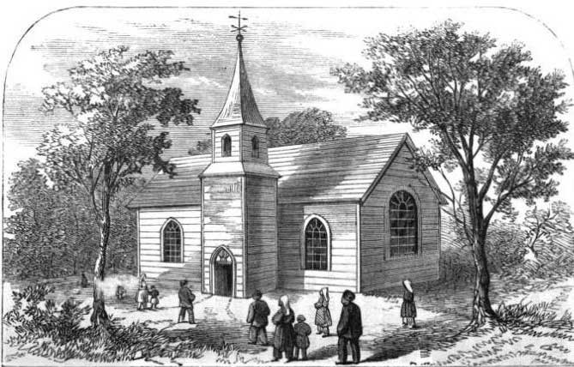
The Privilege of Worshiping God

Slide 3
Worship is an Opportunity…

Slide 4
Worship is an Opportunity…
To Satisfy Our Thirst and Longing for God

Slide 5
Worship is an Opportunity…
To Satisfy Our Thirst and Longing for God
As the deer pants for the water brooks,
So pants my soul for You, O God.
My soul thirsts for God, for the living God.
When shall I come and appear before God?
Psalm 42:1-2

Slide 6
Worship is an Opportunity…
To Satisfy Our Thirst and Longing for God
How lovely is Your tabernacle,
O Lord of hosts!
My soul longs, yes, even faints
For the courts of the Lord;
My heart and my flesh cry out for the living God.
Psalm 84:1-2

Slide 7
Worship is an Opportunity…
To Commune with God and His People

Slide 8
Worship is an Opportunity…
To Commune with God and His People
How lovely is Your tabernacle,
O Lord of hosts!
My soul longs, yes, even faints
For the courts of the Lord;
My heart and my flesh cry out for the living God.
Psalm 84:1-2

Slide 9
Worship is an Opportunity…
To Commune with God and His People
Even the sparrow has found a home,
And the swallow a nest for herself,
Where she may lay her young -
Even Your altars, O Lord of hosts,
My King and my God.
Psalm 84:3

Slide 10
Worship is an Opportunity…
To Commune with God and His People
Blessed are those who dwell in Your house;
They will still be praising You.
For a day in Your courts is better than a thousand.
I would rather be a doorkeeper in the house of my
God than dwell in the tents of wickedness.
Psalm 84:4, 10

Slide 11
Worship is an Opportunity…
To Commune with God and His People
So I have looked upon you in the sanctuary,
beholding your power and glory.
Psalm 63:2, ESV

Slide 12
Worship is an Opportunity…
To Be Edified by Those of Like Precious Faith

Slide 13
Worship is an Opportunity…
To Be Edified by Those of Like Precious Faith
When I remember these things,
I pour out my soul within me.
For I used to go with the multitude;
I went with them to the house of God,
With the voice of joy and praise,
With a multitude that kept a pilgrim feast.
Psalm 42:4

Slide 14
Worship is an Opportunity…
To Be Edified by Those of Like Precious Faith
I was glad when they said to me,
“Let us go into the house of the Lord.”
Psalm 122:1

Slide 15
Worship is an Opportunity…
To Be Edified by Those of Like Precious Faith
And let us consider one another in order to stir up love and good works,
not forsaking the assembling of ourselves together, as is the manner of some, but exhorting one another, and so much the more as you see the Day approaching.
Hebrews 10:24-25

Slide 16
Worship is an Opportunity…
To Escape Our Hardships and Trials

Slide 17
Worship is an Opportunity…
To Escape Our Hardships and Trials
My tears have been my food day and night,
While they continually say to me,
“"Where is your God?”
As with a breaking of my bones,
My enemies reproach me,
While they say to me all day long,
“Where is your God?”
Psalm 42:3, 10

Slide 18
Worship is an Opportunity…
To Draw Strength to Face Our Trials
Psalm 43
    Deliverance (v. 1)
    Guidance (v. 3)
    Hope (v. 5)
    Strength (v. 5)

Slide 19
The Privilege of Worship
Worship is an Opportunity…
To Satisfy Our Thirst and Longing for God
To Commune with God and His People
To Be Edified by Those of Like Precious Faith
To Escape Our Hardships and Trials
To Draw Strength to Face
Our Hardships and Trials

