Slide 2
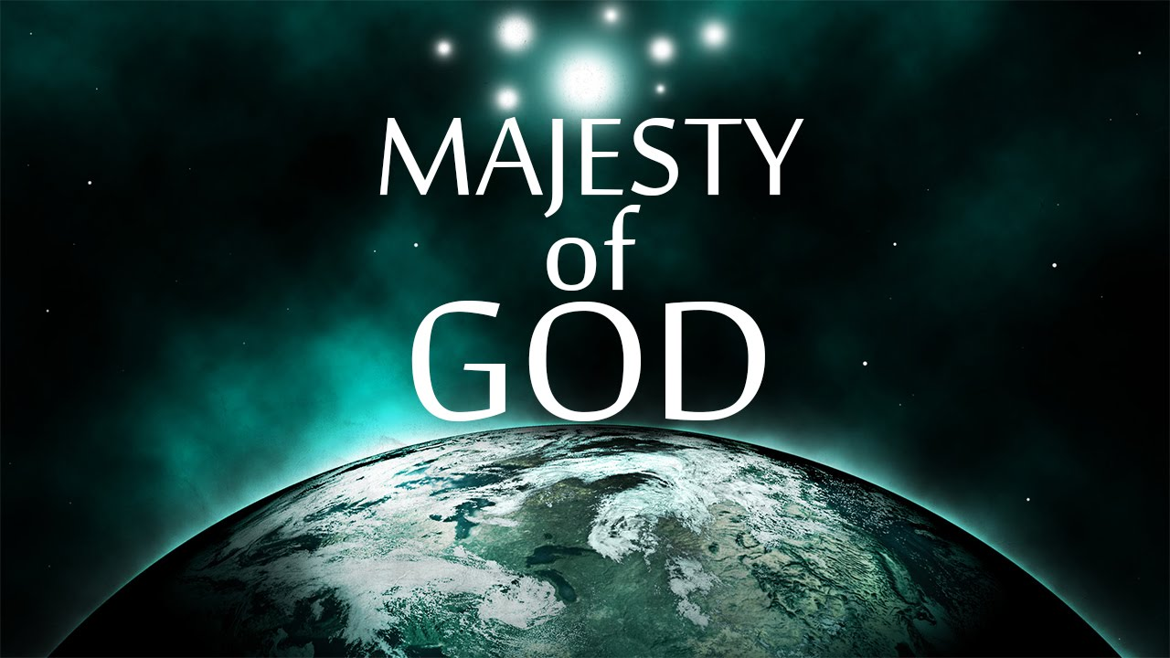

Slide 3
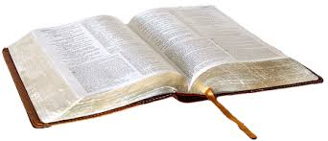
“I will meditate on the glorious splendor of Your majesty, and on Your wondrous works.”
Psalm 145:5

Slide 4
“Majesty”
Comes from the Latin majestas.
The words major and magnus come from this word.
The word majesty means greatness.
It speaks of the dignity and power ascribed to a sovereign.

Slide 5
“Majesty”
In the NT, majesty is translated from the Greek word megalosune.
The word means great or greatness.
We use the prefix in our language today (mega).
In the OT, majesty is translated from a number of Hebrew words.
One means “splendor.”
One refers to lifting up or things that are lifted up.

Slide 6
“Majesty”
When speaking of God, majesty is used to express the greatness of God.
It is a word of praise acknowledging the attributes of God.
  That which makes God who He is.
  That which makes Him greater than, lifted up above, man.
It is also associated with an invitation to worship God because He is great.

Slide 7
“Majesty”
God is “lifted up” on “on high.”
This does not mean that God is far from us, out of our reach.
  He is near to us (Jer. 23:23; Acts 17:27).
It means that God is far above us in greatness and is to be adored and respected.
  God is not our equal. He is of higher rank.
  He is the major, the magnus, the mega.

Slide 8
The Proper Response to God’s Majesty
- Psalm 145 -
Praise Him - vs. 1-9
Proclaim His Greatness to Others - vs. 4-13
Trust Him - vs. 14-20

