Slide 2
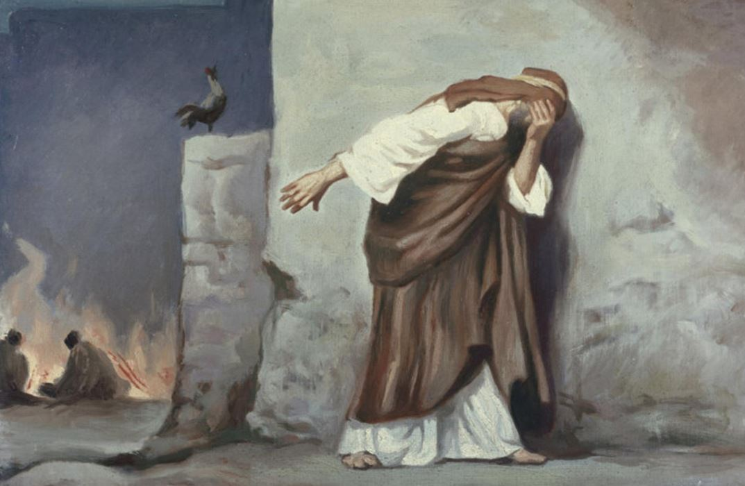
How To Deny the Lord

Slide 3
1. Insist It Could Never Happen To You
“Peter answered and said to Him, ‘Even if all are made to stumble because of You, I will never be made to stumble’” (Matt. 26:33).
“But he spoke more vehemently, ‘If I have to die with You, I will not deny You!’” (Mark 14:31).
Peter’s sincerity cannot be questioned, but his overconfidence set the stage for his failure.

Slide 4

1. Insist It Could Never Happen To You
“Therefore let him who thinks he stands take heed lest he fall” (1 Cor. 10:12).
“Pride goes before destruction, and a haughty spirit before a fall” (Prov. 16:18).
“Watch and pray, lest you enter into temptation. The spirit indeed is willing, but the flesh is weak” (Matt. 26:41).

Slide 5
2. Follow the Lord at a Distance
Matthew 26:58; Mark 14:54; Luke 22:54
Peter purposely placed distance between himself and the Lord.
Why? Fear of being associated with the Lord.
Any distance we place between ourselves and the Lord is dangerous.

Slide 6
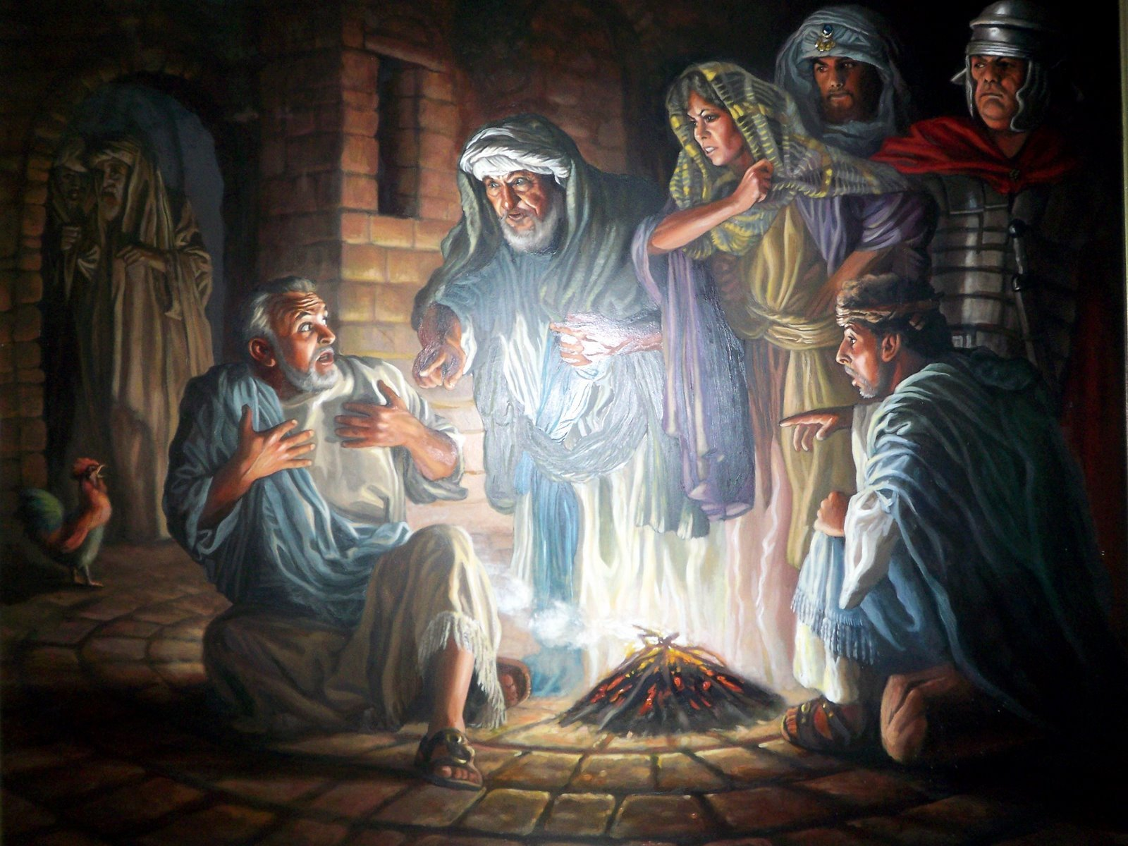
3. Warm Yourself at a Stranger’s Fire
John 18:15-18

Slide 7
3. Warm Yourself at a Stranger’s Fire
“Blessed is the man who walks not in the counsel of the ungodly, nor stands in the path of sinners, nor sits in the seat of the scornful” (Psalm 1:1).
“Do not be deceived: ‘Evil company corrupts good habits’” (1 Cor. 15:33).
“Do not enter the path of the wicked, and do not walk in the way of evil” (Prov. 4:14).
“He who walks with wise men will be wise,
but the companion of fools will be destroyed” (Prov. 13:20).

Slide 8
4. Expose Yourself To Strong Emotional Temptations
Mark 14:66-71; John 18:25-27
Strong emotions are doorways to sin:
  Fear - Matt. 25:25
  Anger - Gen. 4:6-7; Eph. 4:26-27
  Lust - 1 Cor. 6:18
  Pride - Prov. 16:18

Slide 9
How Can We Do the Unthinkable?
Insist It Could Never Happen To Us
Follow the Lord at a Distance
Warm Ourselves at a Stranger’s Fire
Expose Ourselves to
Strong Emotional
Temptations

