Slide 1


Slide 3
Mary’s life was interrupted

Slide 4
Mary was the first follower of Jesus

Slide 5
Christ in me produces a blessed life
“And blessed is she who believed that there would be a fulfillment of what was spoken to her from the Lord.”
Luke 1:45
“And he came to her and said, “Greetings, O favored one, the Lord is with you!”
Luke 1:28
“And the angel said to her, ‘Do not be afraid, Mary, for you have found favor with God.’”
Luke 1:30
“for he has looked on the humble estate of his servant.
For behold, from now on all generations will call me blessed”
Luke 1:48

Slide 6
The Blessed Life:
Is not an easy life

Slide 7
“And Simeon blessed them and said to Mary his mother, ‘Behold, this child is appointed for the fall and rising of many in Israel, and for a sign that is opposed (and a sword will pierce through your own soul also), so that thoughts from many hearts may be revealed.’”
Luke 2:34-35

Slide 8
The Blessed Life:
Is a humble life
  God uses
  unexpected places
  unexpected people

Slide 9
“But God chose what is foolish in the world to shame the wise; God chose what is weak in the world to shame the strong; God chose what is low and despised in the world, even things that are not, to bring to nothing things that are, so that no human being might boast in the presence of God.”
1 Corinthians 1:27-29

Slide 10
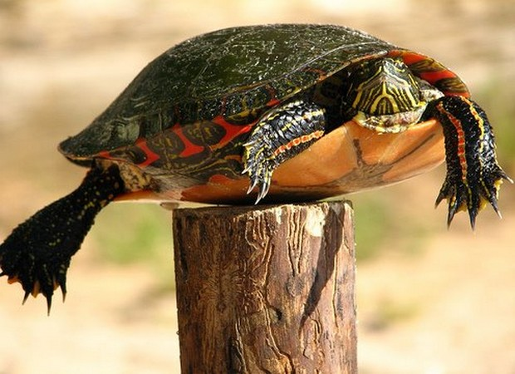

Slide 11
The Blessed Life:
Believes in the power of God

Slide 12
“And we all, with unveiled face, beholding the glory of the Lord, are being transformed into the same image from one degree of glory to another. For this comes from the Lord who is the Spirit.”
2 Corinthians 3:18

Slide 13
The Blessed Life:
Makes a difference

