Slide 1


Slide 2
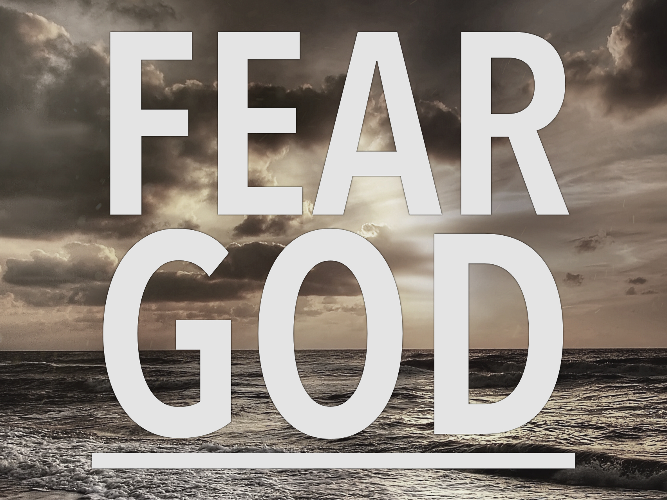

Slide 3
Acts 9:31
So the church throughout all Judea and Galilee and Samaria had peace and was being built up. And walking in the fear of the Lord and in the comfort of the Holy Spirit, it multiplied.

Slide 4
1 Peter 2:17
Honor everyone. Love the brotherhood. Fear God. Honor the emperor.

Slide 5
Job 1:1
There was a man in the land of Uz whose name was Job, and that man was blameless and upright, one who feared God and turned away from evil.

Slide 6
Where the fear of God is ABSENT evil ABOUNDS

Slide 7
Genesis 20:11
Abraham said, ‘I did it because I thought, There is no fear of God at all in this place, and they will kill me because of my wife.’

Slide 8
Exodus 9:30
But as for you and your servants, I know that you do not yet fear the LORD God.

Slide 9
Where the fear of God is PRESENT blessings ABOUND

Slide 10
Proverbs 15:16
Better is a little with the fear of the LORD than great treasure and trouble with it.

Slide 11
Proverbs 22:4
The reward for humility and fear of the LORD is riches and honor and life.

Slide 12
FEAR OF GOD PRODUCES:
Awe of His majesty

Slide 13
Jonah 1:9
And he said to them, ‘I am a Hebrew, and I fear the LORD, the God of heaven, who made the sea and the dry land.’
Jonah 1:9

Slide 14
Revelation 15:4
Who will not fear, O LORD, and glorify Your name? For You alone are holy. All nations will come and worship You, for Your righteous acts have been revealed.

Slide 15
Psalm 89:6-7
For who in the skies can be compared to the LORD? Who among the heavenly beings is like the LORD, a God greatly to be feared in the council of the holy ones, and awesome above all who are around Him?

Slide 16
FEAR OF GOD PRODUCES:
Obedience to His commands

Slide 17
Ecclesiastes 12:13
The end of the matter; all has been heard. Fear God and keep His commandments, for this is the whole duty of man.

Slide 18
FEAR OF GOD PRODUCES:
Respect for His wrath

Slide 19
Psalm 76:7
But You, You are to be feared!
Who can stand before You when once Your anger is roused?

Slide 20
Matthew 10:28
And do not fear those who kill the body but cannot kill the soul. Rather fear Him who can destroy both soul and body in hell.

Slide 21
FEAR OF GOD PRODUCES:
Trust in His love

Slide 22
Psalm 33:18
Behold, the eye of the LORD is on those who fear him, on those who hope in his steadfast love

Slide 23
Psalm 118:4
Let those who fear the LORD say, His steadfast love endures forever.

Slide 24
Psalm 130:3-4
If you, O LORD, should mark iniquities, O Lord, who could stand? But with You there is forgiveness, that You may be feared.

