Slide 2
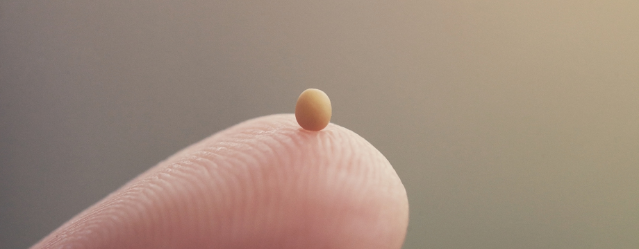
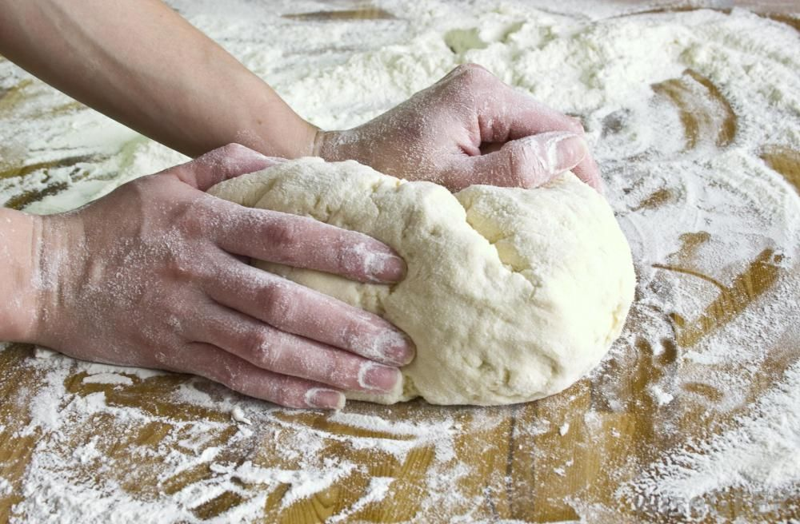
Parables of the Mustard Seed and the Leaven
Matthew 13:31-33

Slide 3
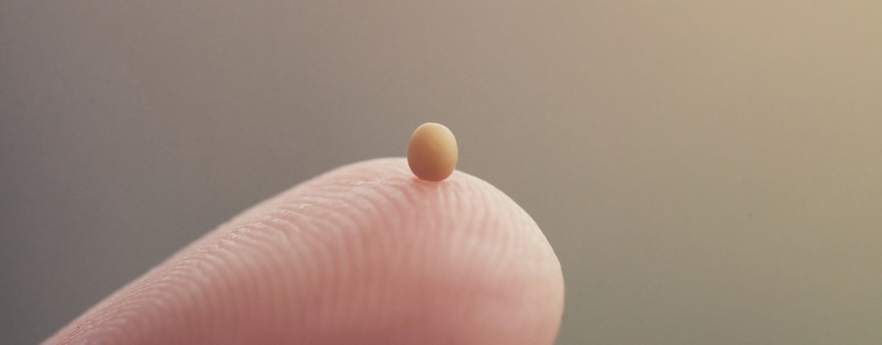
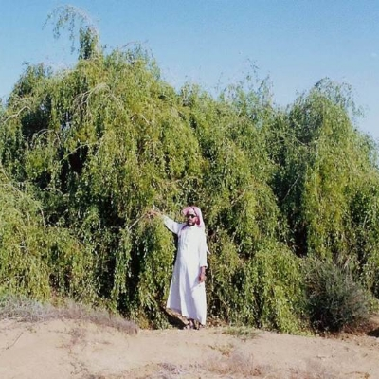
The Mustard Seed
The kingdom would have a humble beginning, but would become great!

Slide 4
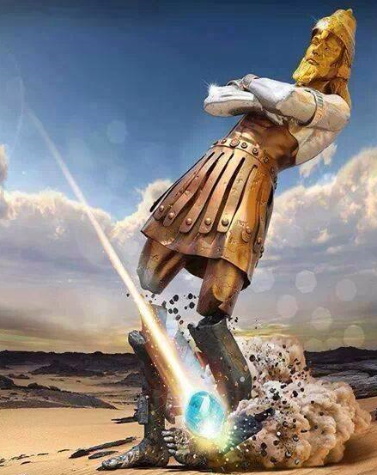
Nebuchadnezzar’s Dream
Daniel 2:31-35, 44

Slide 5
Leaven
The manner in which His kingdom will grow from a humble beginning to become the greatest kingdom of the world.
The influence of the Gospel upon this world.

Slide 6
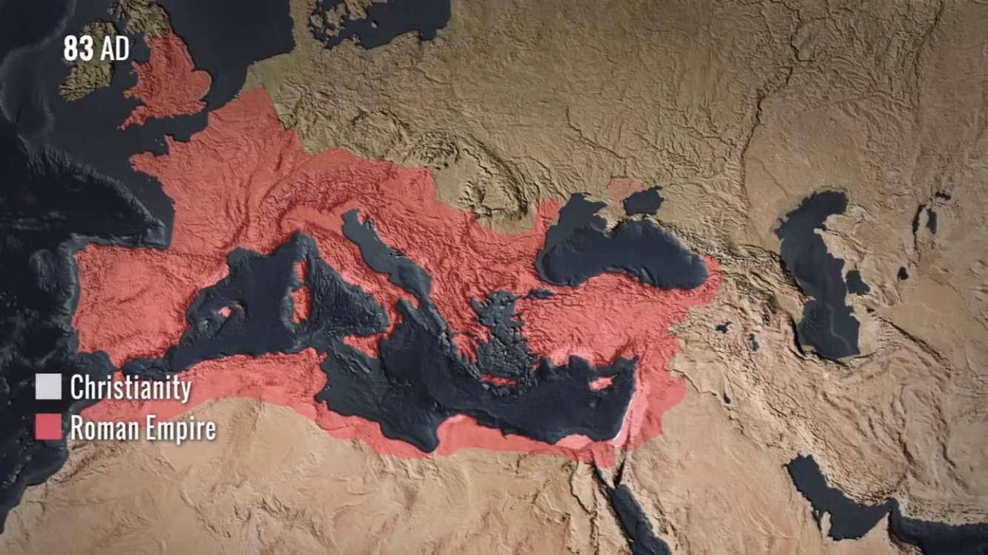

Slide 7
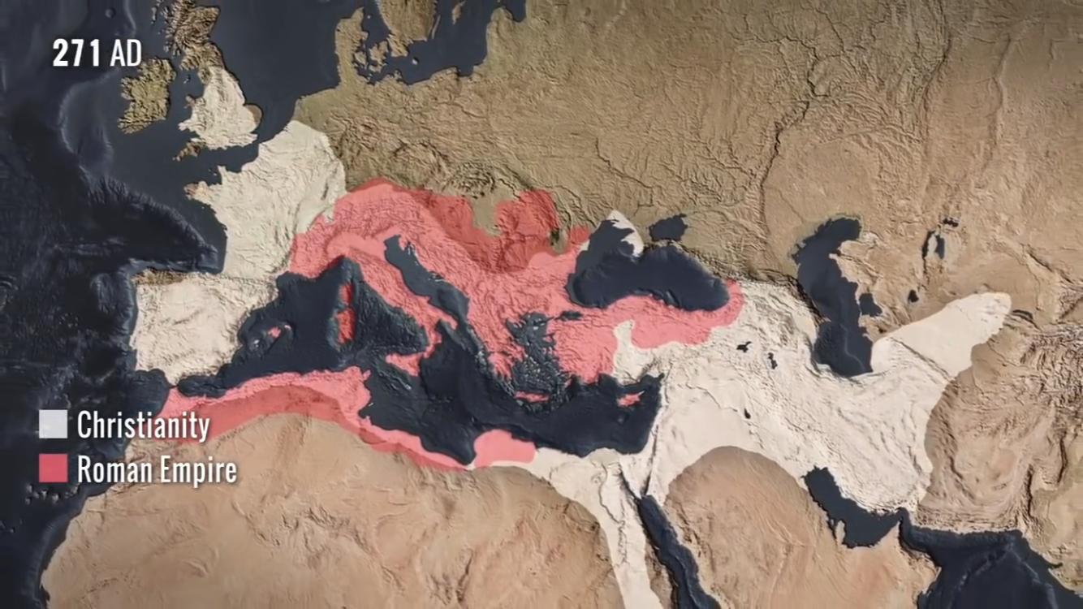

Slide 8
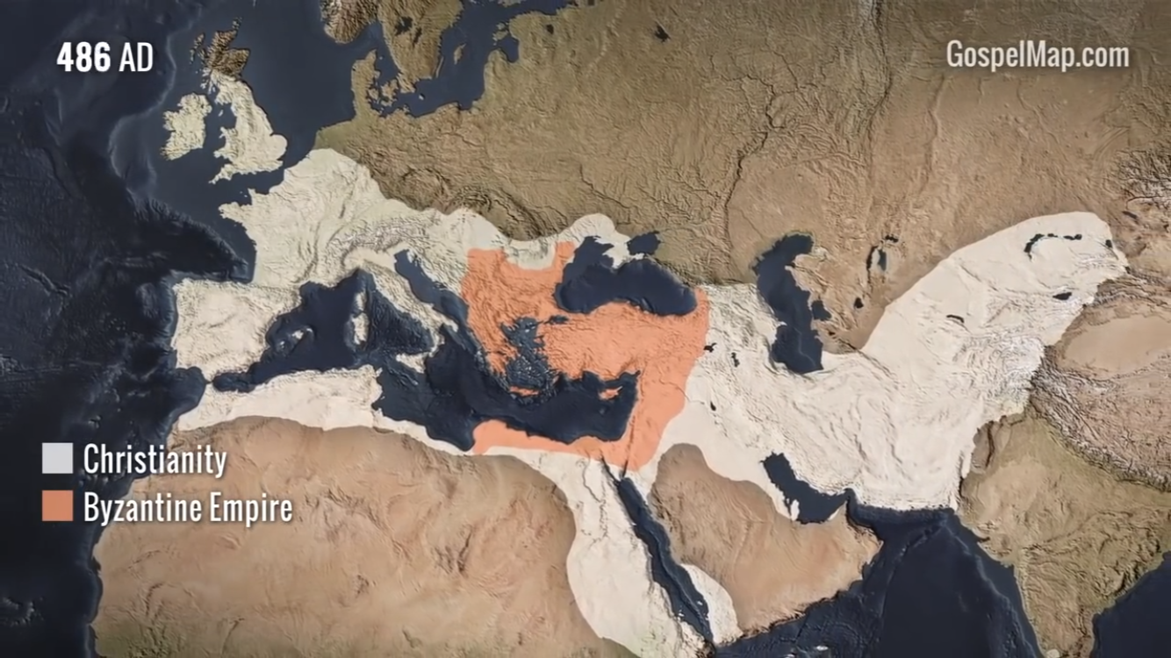

Slide 9
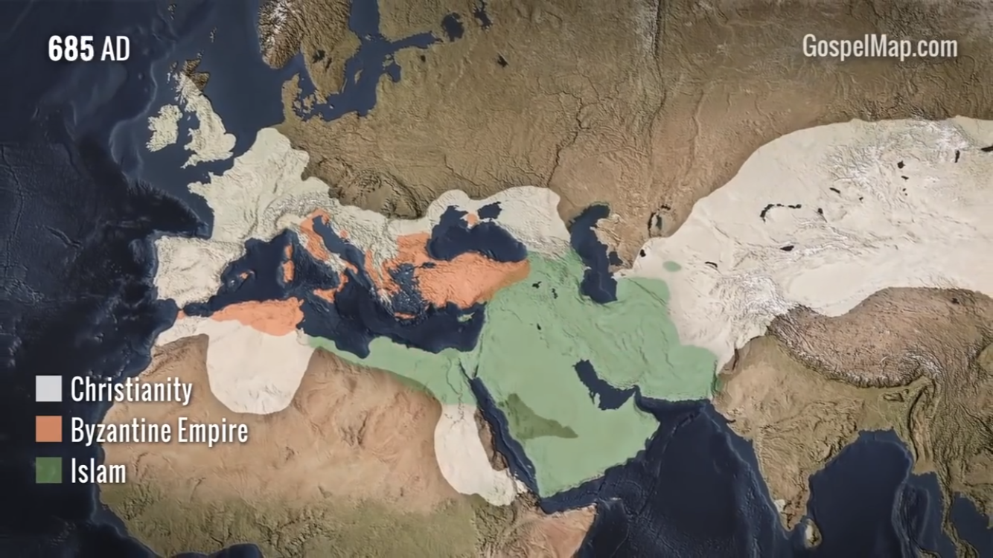

Slide 10
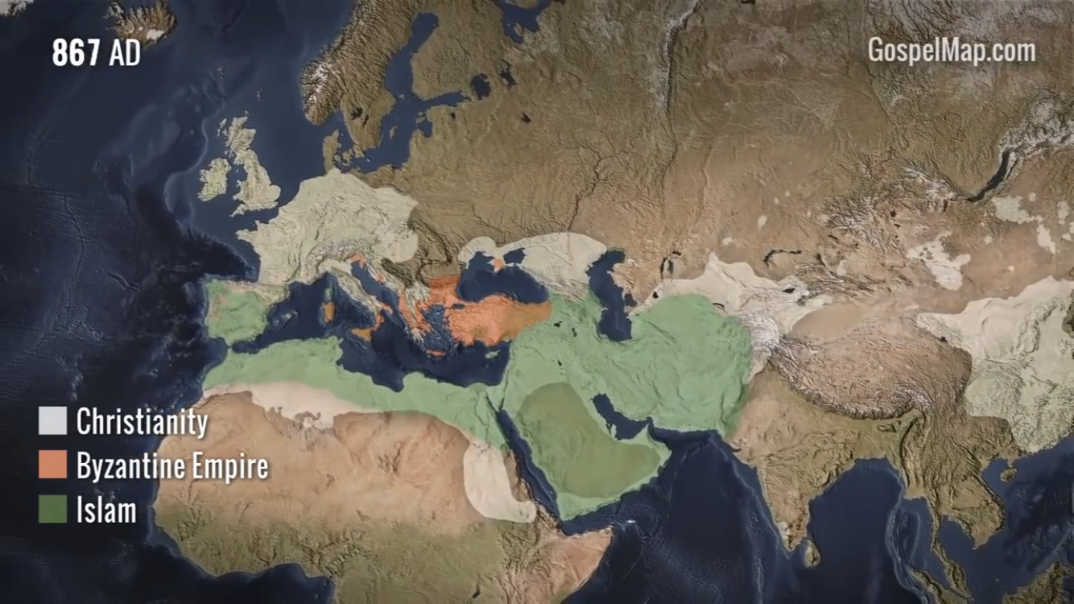

Slide 11
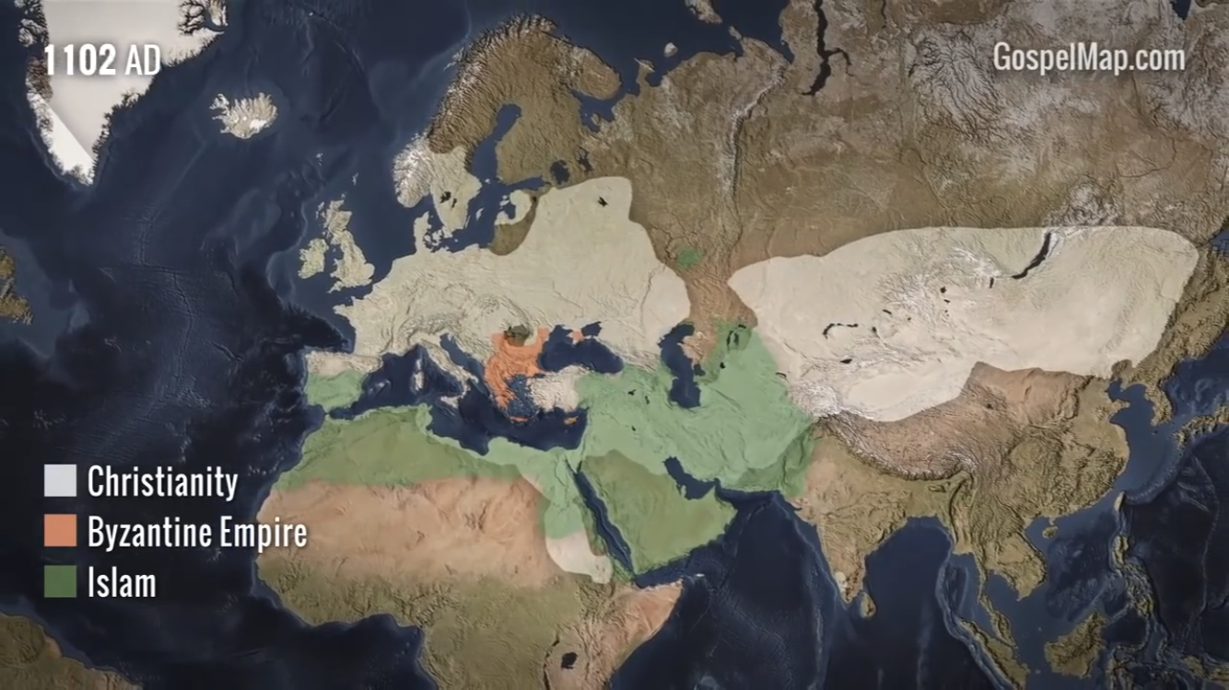

Slide 12
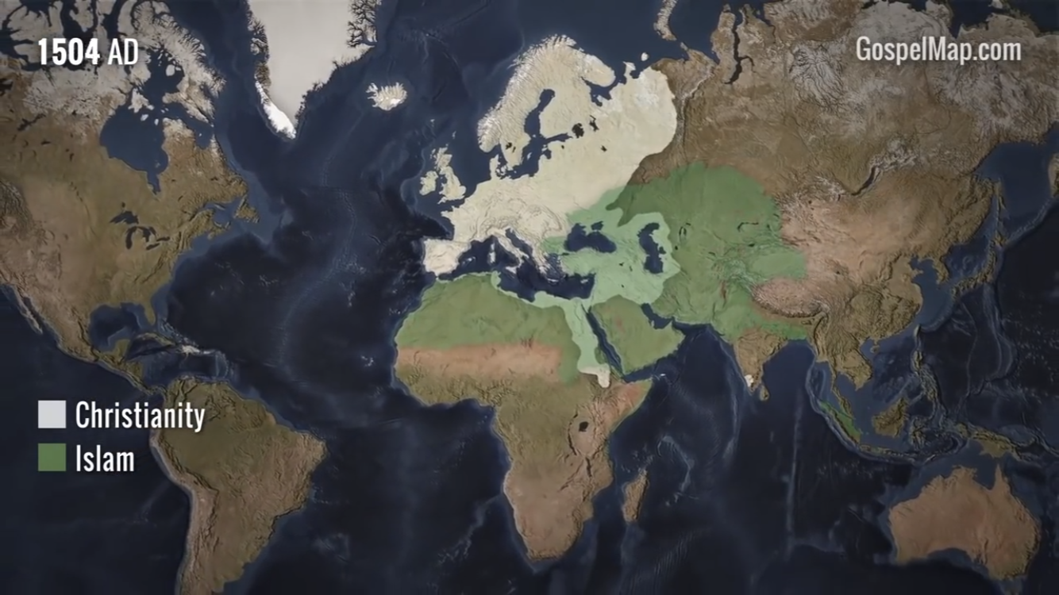

Slide 13
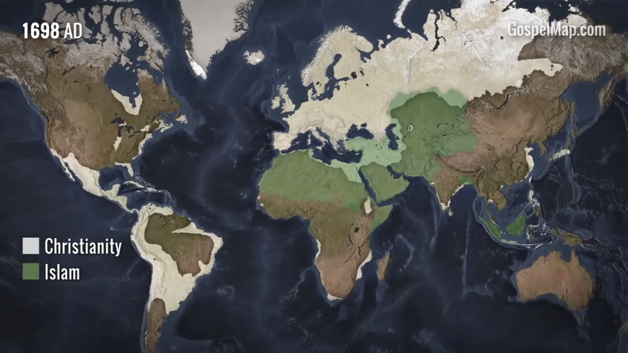

Slide 14
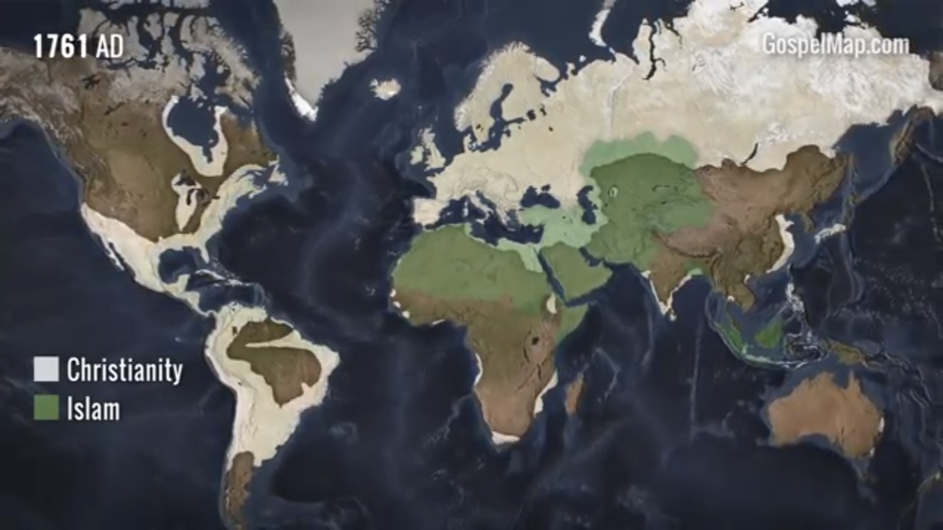

Slide 15
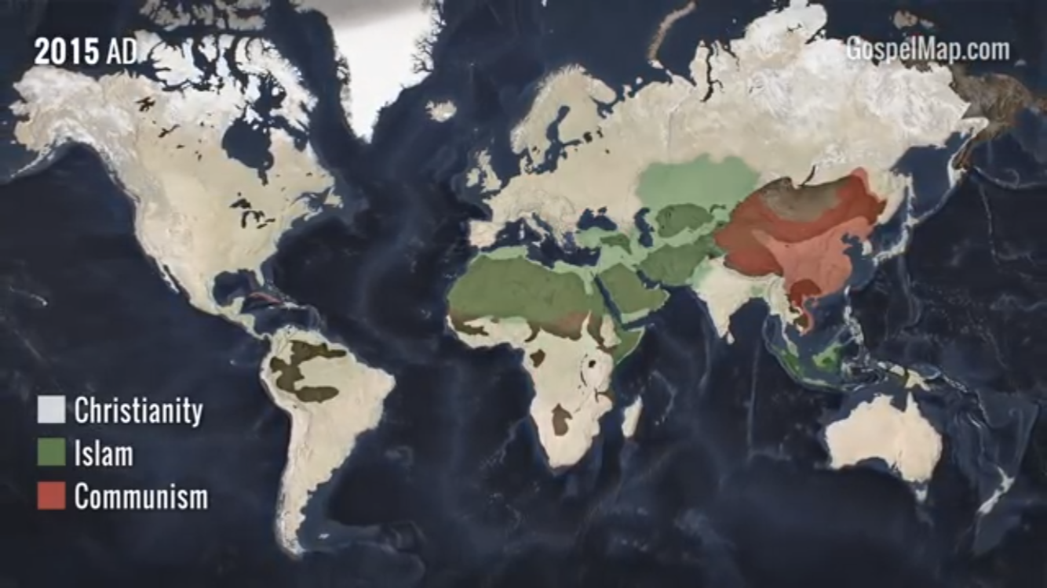

Slide 16
“till it was all leavened” (Matt. 13:33)

Slide 17
Applications
We dare not despise the small things of the Lord.
  Zechariah 4:10
The gospel works from within.
  Matthew 13:19
The Kingdom grows gradually.
  Romans 1:16-17

