Slide 2

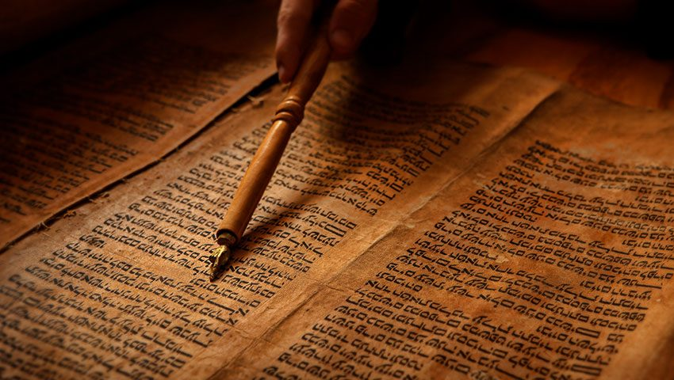
The Importance of the Old Testament

Slide 3
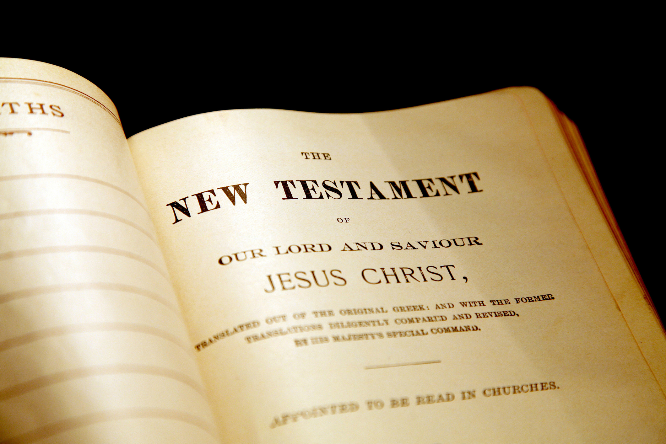
“Be diligent to present yourself approved to God, a worker who does not need to be ashamed, rightly dividing the word of truth.”
2 Timothy 2:15, NKJV

Slide 4
“Having wiped out the handwriting of requirements that was against us, which was contrary to us. And He has taken it out of the way, having nailed it to the cross.”
Colossians 2:14

Slide 5
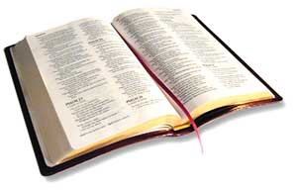
1. They Are Profitable
All Scripture is given by inspiration of God, and is profitable for doctrine, for reproof, for correction, for instruction in righteousness,
that the man of God may be complete, thoroughly equipped for every good work.
2 Timothy 3:16-17

Slide 6
2. They Are for Our Learning
For whatever things were written before were written for our learning, that we through the patience and comfort of the Scriptures might have hope.
Romans 15:4

Slide 7
3. They Are Our Examples
Now all these things happened to them as examples, and they were written for our admonition, upon whom the ends of the ages
have come.
1 Corinthians 10:11

Slide 8
4. The New Testament Assumes We Know the Old Testament
OT is the backdrop for the NT
NT quotes OT over 700 times
Hebrews relies heavily upon the OT
Over 75% of Revelation alludes to the OT
James 5:10-11
Luke 11:29-32

Slide 9
5. Jesus and His Apostles Used the Old Testament
Jesus constantly referred his listeners back to the OT (Luke 10:25-26; 24:27)
Peter’s sermon in Acts 2 is based on Joel 2; Psalm 16; 110
James used Amos 9:11-12 to settle question over uncircumcised Gentiles in Acts 15
Acts 8:35; 17:2-3; 28:23

Slide 10
The Importance of the Old Testament
But He answered and said, “It is written, ‘Man shall not live by bread alone, but by every word that proceeds from the mouth of God.’”
Matthew 4:4

