Slide 1


Slide 2
How Shall The Young Secure Their Hearts?
Psalm 119:9-16

Slide 3
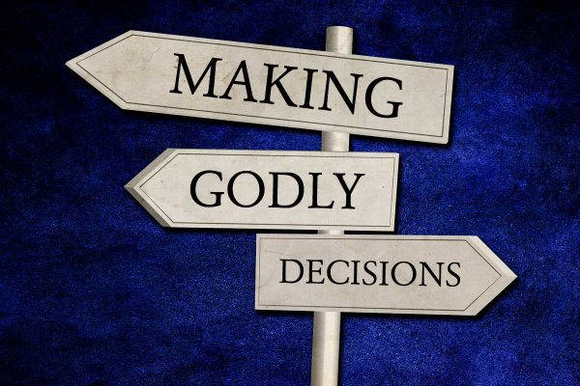
Decisions
determine
your

Slide 4

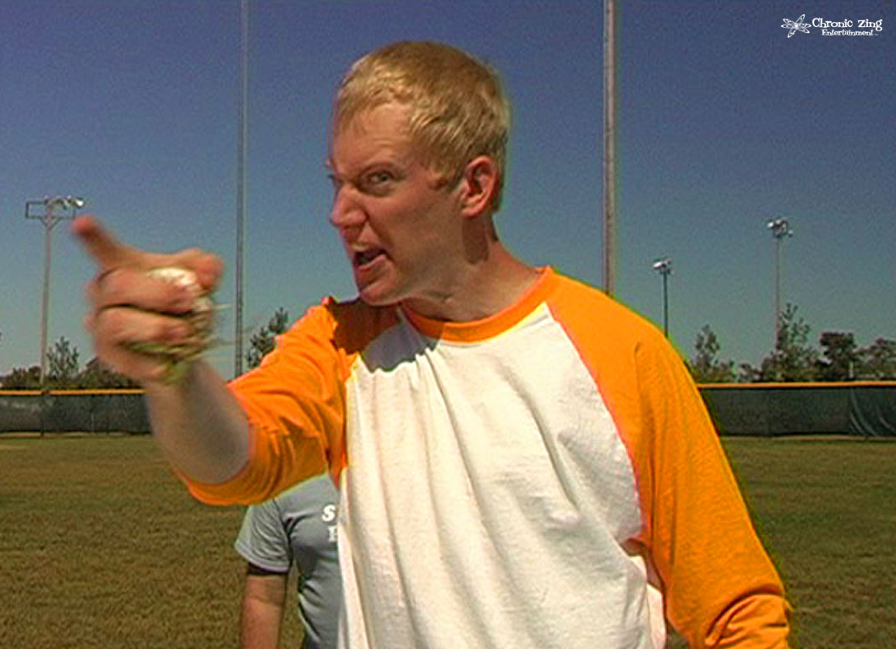
Have you ever had to deal with someone’s poor decisions?

Slide 5
Dealing With Other’s Decisions
Biblical Examples
Joseph
Esther
Daniel
Moses' parents
Paul
Notes:
What are some decisions others will make that will have (or already have had) an impact on you?
Are these answers any different if we reversed the question?

Slide 6
Dealing With The Consequences
What are the possible consequences of my decisions?
How many poor decisions are permanent?
Notes:
Review Reverse Brainstorming

Slide 7
Dealing With The Consequences
What was Jesus’ consequence for my sinful decisions?
Do we treat others as if their decision were permanent?
Notes:
“For our sake he made him to be sin who knew no sin, so that in him we might become the righteousness of God.” 2 Cor. 5:21
Forgiveness, for us is key - Matt. 6:14-15, Col. 3:13

