Slide 2
How Shall The Young Secure Their Hearts?
Psalm 119:9-16

Slide 3
What do you like to listen to?

Slide 4
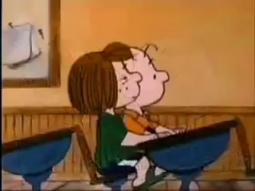
What do you like to listen to?
Country
Classical
Rap
Bluegrass
Oldies
Parents
Heath

Slide 5
Jesus’ Statements
Matthew 11:15
Matthew 13:9, 43
Revelation 2:7, 11, 17, 29
Revelation 3:6, 13, 22
What do these mean?

Slide 6
Reverse Brainstorming
What can we do to make sure that we do not hear and can easily ignore Jesus and God?

Slide 7
What do you do when you don’t like what you’re hearing?

Slide 8

Decisions
determine
your

