Slide 1


Slide 2
Why I DO Believe in Evolution!
Not - “The General Theory of Evolution.”
But - “Species Specific Evolution”.

Slide 3
evo·lu·tion
1 : one of a set of prescribed movements
2 a : a process of change in a certain direction : unfolding b : the action or an instance of forming and giving something off : emission c (1) : a process of continuous change from a lower, simpler, or worse to a higher, more complex, or better state : growth (2) : a process of gradual and relatively peaceful social, political, and economic advance d : something evolved
3 : the process of working out or developing
4 a : the historical development of a biological group (as a race or species) : phylogeny b : a theory that the various types of animals and plants have their origin in other preexisting types and that the distinguishable differences are due to modifications in successive generations; also : the process described by this theory
5 : the extraction of a mathematical root
6 : a process in which the whole universe is a progression of interrelated phenomena

Slide 4
God set in order natural laws that will be obeyed.
Ge 1:11 Then God said, "Let the earth bring forth grass, the herb that yields seed, and the fruit tree that yields fruit according to its kind, whose seed is in itself, on the earth"; and it was so.
Ge 1:21 So God created great sea creatures and every living thing that moves, with which the waters abounded, according to their kind, and every winged bird according to its kind. And God saw that it was good.

Slide 5
the·o·ry
1 : the analysis of a set of facts in their relation to one another
2 : abstract thought : speculation
3 : the general or abstract principles of a body of fact, a science, or an art <music theory>
4 a : a belief, policy, or procedure proposed or followed as the basis of action <her method is based on the theory that all children want to learn> b : an ideal or hypothetical set of facts, principles, or circumstances —often used in the phrase in theory<in theory, we have always advocated freedom for all>
5 : a plausible or scientifically acceptable general principle or body of principles offered to explain phenomena <the wave theory of light>
6 a : a hypothesis assumed for the sake of argument or investigation b : an unproved assumption : conjecture c : a body of theorems presenting a concise systematic view of a subject <theory of equations>

Slide 6
The General Theory of Evolution
Charles Darwin
“The Origen of The Species” 1859
Idea was believed in ancient Greece
Darwin official “Naturalist” on H.M.S. Beagle 1831-1836
Brought him to Galapagos
Later observed pigeons & poultry

Slide 7
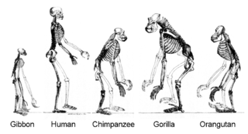
Common Descent
All organisms on Earth are descended from a common ancestor or ancestral gene pool.[190] [wikipedia]
.The hominoids are descendants of a common ancestor.

Slide 8
Common Descent
Darwin’s theory of common descent is a basic theory in modern biology which states that different species of living organisms can ultimately be traced to a single common ancestor. Ultimately, at least in theory, it leads to the conclusion that all forms of life-bacteria,fungi,plants, and animals-can be traced back to a single universal common ancestor.Over hundreds of millions of years, life branches from a single species into multiple ones through natural selection. From: www.actforlibraries.org

Slide 9


Slide 10


Slide 11
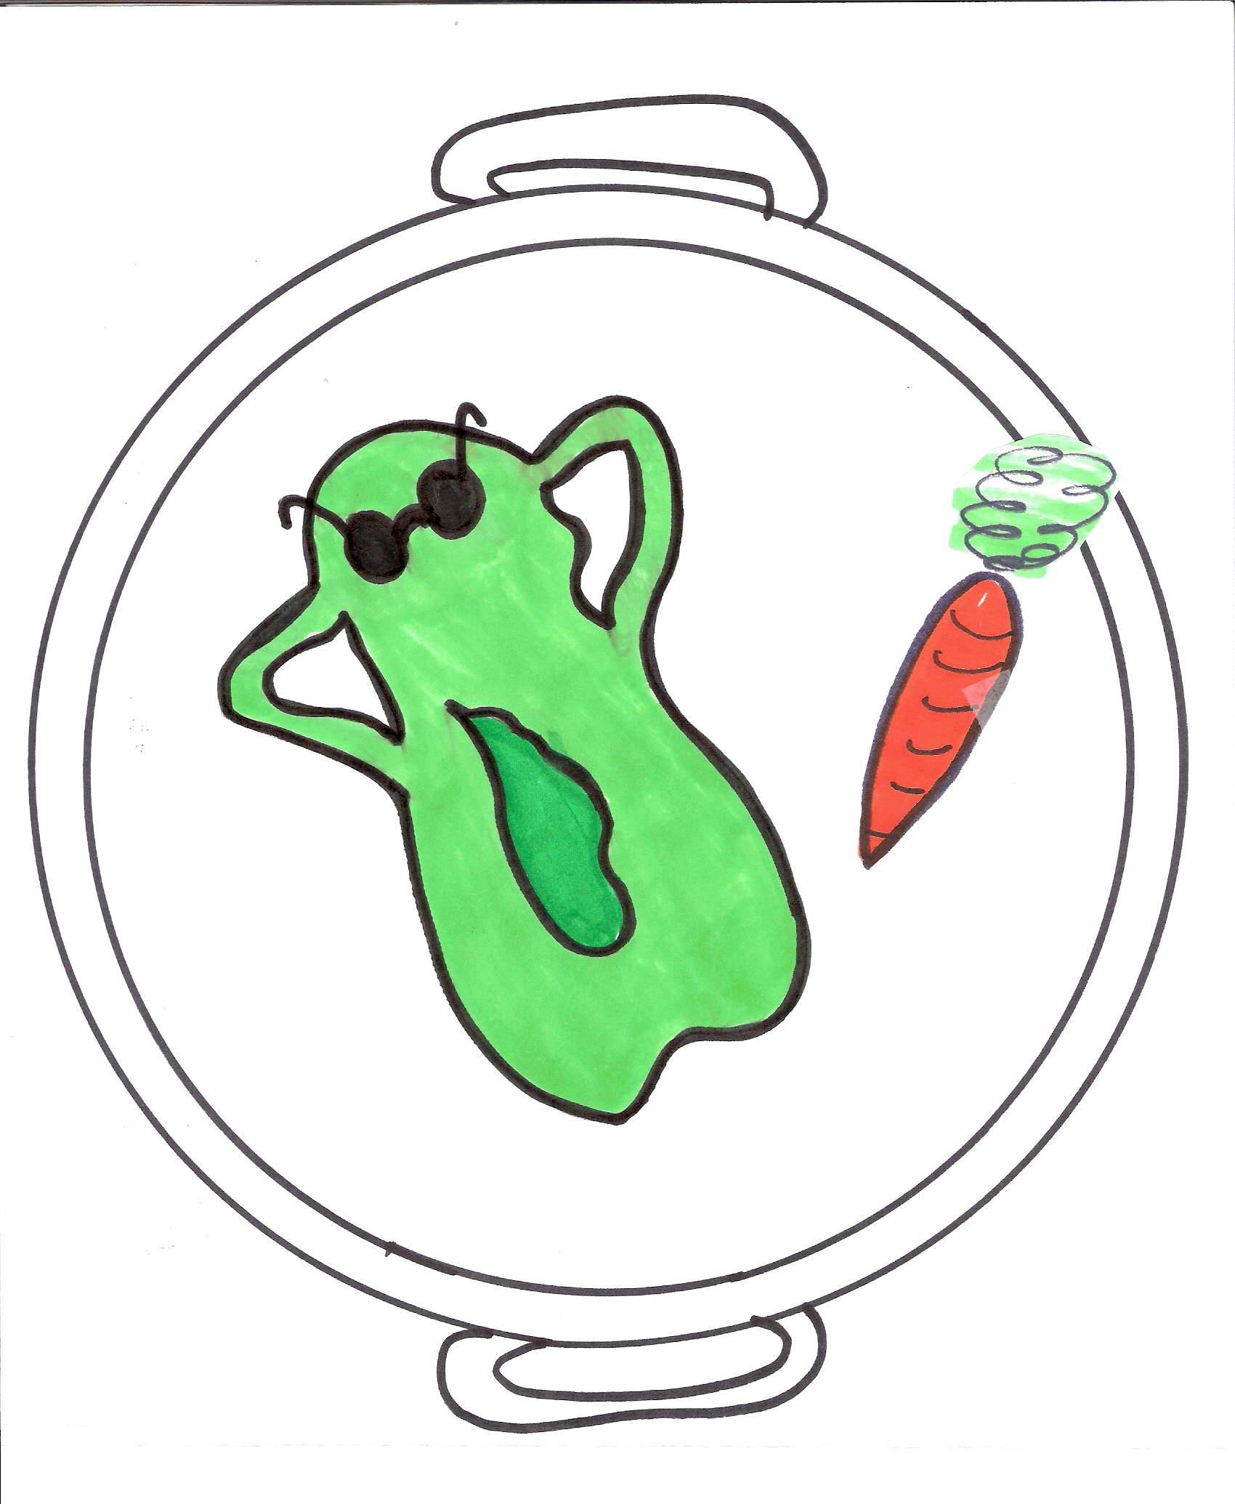

Slide 12
The Beginning is near!

Slide 14
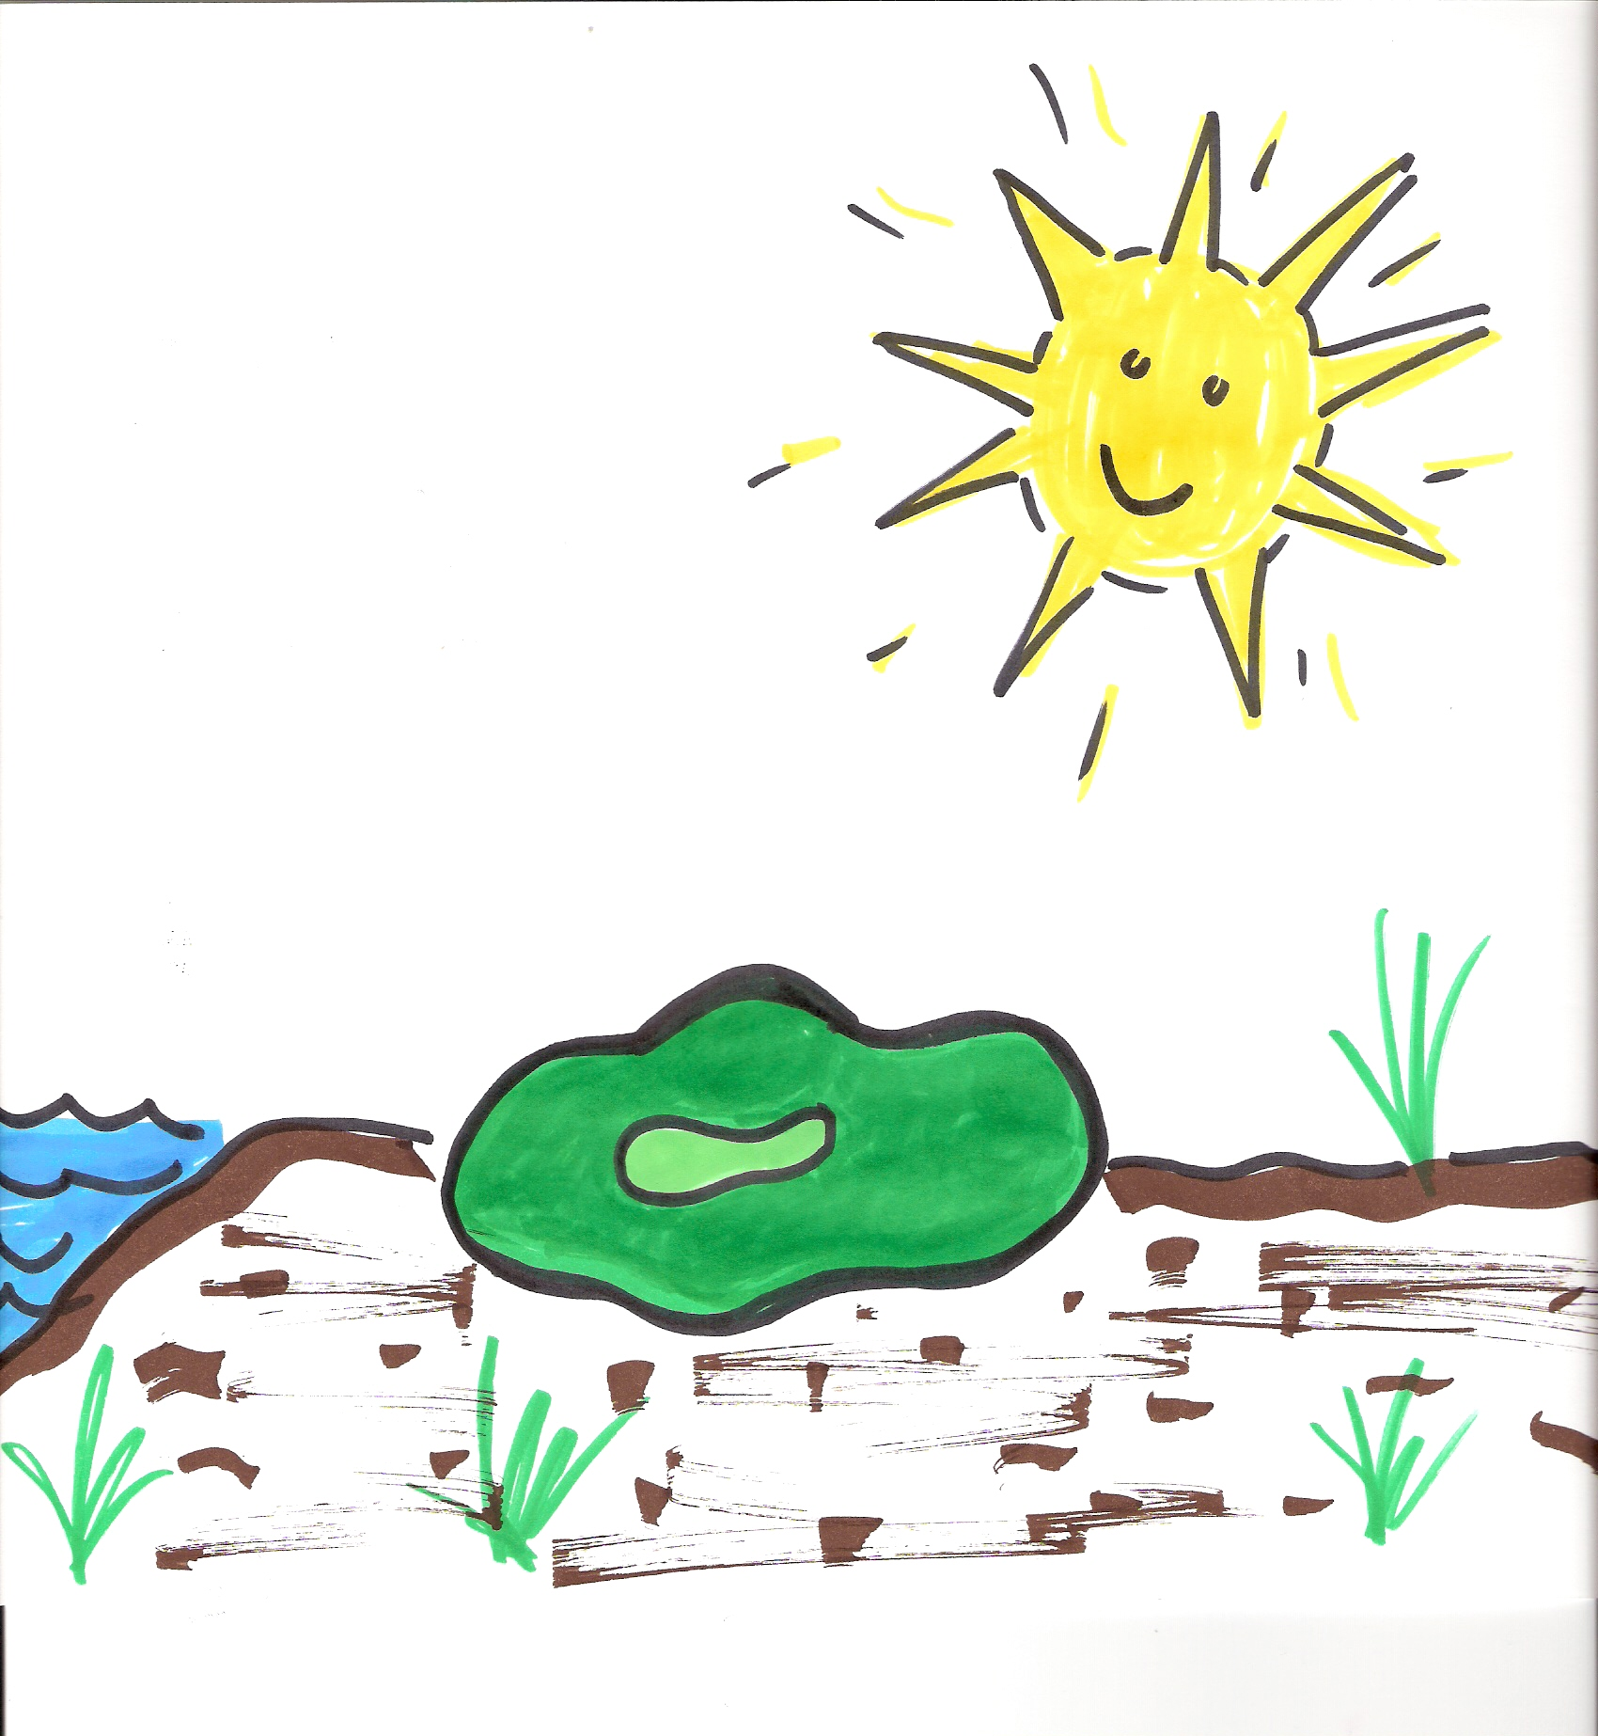

Slide 15
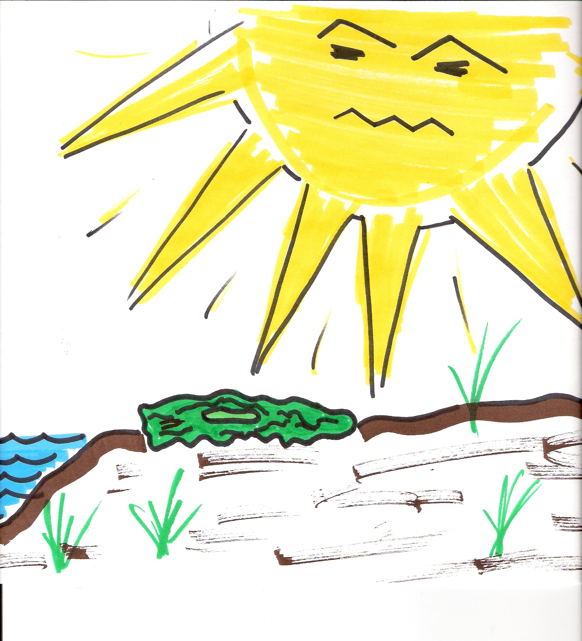

Slide 16
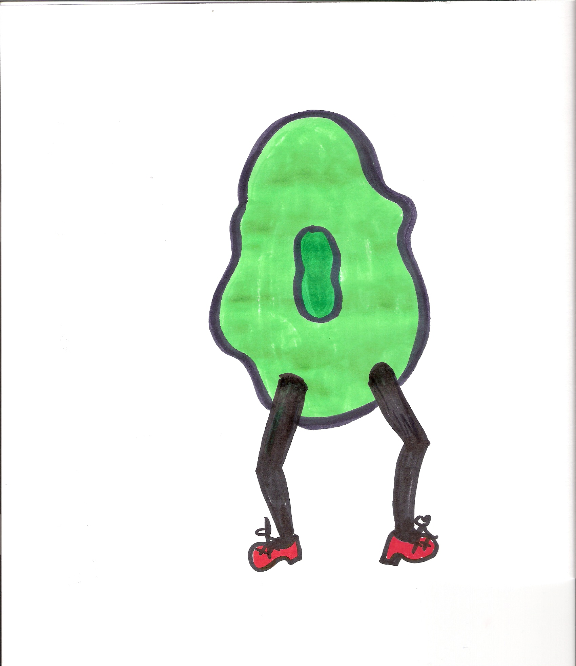

Slide 17
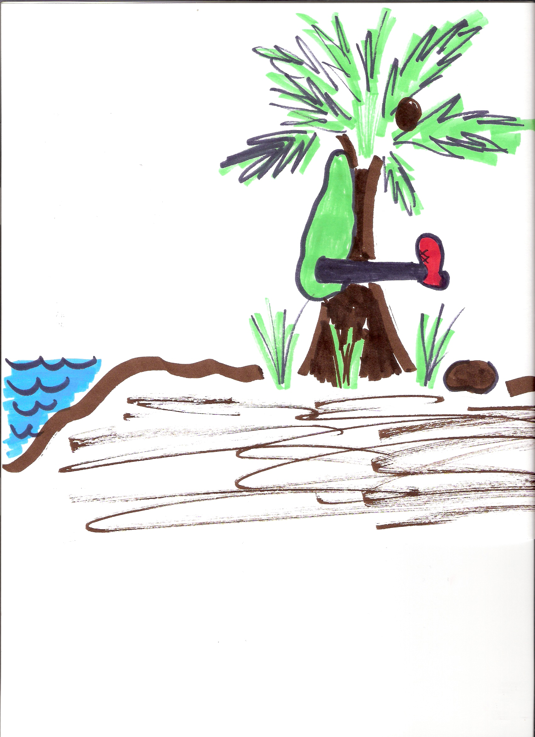

Slide 18


Slide 19
Deviation
From the website www.carm.org ( Christian Apologetics & Research Ministry)
From The Myth of Natural Origins; How Science Points to Divine Creation
Ashby Camp, Ktisis Publishing, Tempe, Arizona, 1994, pp. 53-57,
Even on a theoretical level, it does not seem possible for mutations to account for the diversity of life on earth, at least not in the time available. According to Professor Ambrose, the minimum number of mutations necessary to produce the simplest new structure in an organism is five (Davis, 67-68; Bird, 1:88), but these five mutations must be the proper type and must affect five genes that are functionally related. Davis, 67-68. In other words, not just any five mutations will do. The odds against this occurring in a single organism are astronomical.

Slide 20
From The Myth of Natural Origins; How Science Points to Divine Creation
The odds of a single cell possessing non-harmful mutations of five specific (functionally related) genes is the product of their separate probabilities. Morris, 63. In other words, the probability is 1 in 108 X 108 X 108 X 108 X 108, or 1 in 1040. If one hundred trillion (1014) bacteria were produced every second for five billion years (1017 seconds), the resulting population (1031) would be only 1/1,000,000,000 of what was needed!

Slide 21
Science
Must be observable
Must be repeatable
Unless you are speaking of Evolution
Common Descent can not be observed or repeated

Slide 22
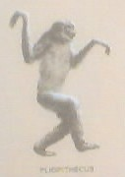
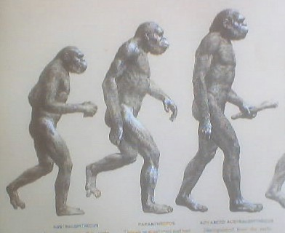
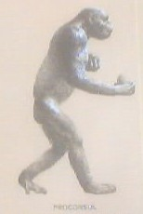
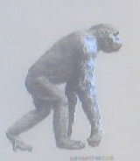
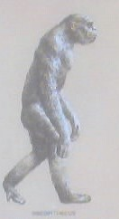
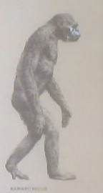
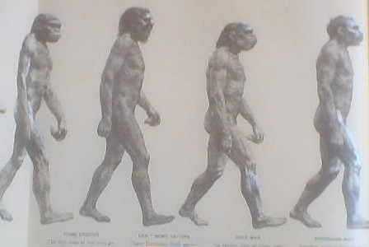
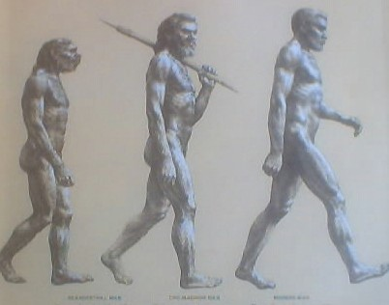
Howell, F.C., Early Man, Time Life Books, New York 1970

Slide 23
What God Created
Ne 9:6 You alone are the LORD; You have made heaven, The heaven of heavens, with all their host, The earth and everything on it, The seas and all that is in them, And You preserve them all. The host of heaven worships You.
Ge 1:11 Then God said, "Let the earth bring forth grass, the herb that yields seed, and the fruit tree that yields fruit according to its kind, whose seed is in itself, on the earth"; and it was so.
Ge 1:21 So God created great sea creatures and every living thing that moves, with which the waters abounded, according to their kind, and every winged bird according to its kind. And God saw that it was good.

Slide 24
What God Created
God allowed for advancement of a species
It can be observed and repeated
No species can “cross” to any other “according to its kind, whose seed is in itself, on the earth"; and it was so.”

Slide 25
What “YOU” must do
Hear the Gospel Romans 10:17
Believe Jesus is the Christ Jn 8:24
Repent of Your Sins Luke 13:3
Confess Jesus as Lord Rom 10:10
Be Baptized Mark 16:16, Acts 2:38
Faithfully Serve Jesus Rev. 2:10

