Slide 1


Slide 2

Why the Day of Judgment?

Slide 3
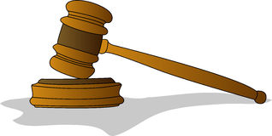
1. It Will Be a Day of Reckoning
A Time To Give Account
Matthew 25:19
Preachers - James 3:1; 2 Tim. 2:15
Elders - Hebrews 13:17
Everyone - Romans 14:10-12
  deeds (2 Cor. 5:10) and words (Matt. 12:36-37)
Why the Day of Judgment?

Slide 4
2. It Will Be a Day of Recompense
A Time To Receive Payment
Matthew 25:21, 23, 26-30
Righteous will be rewarded - 2 Tim. 4:6-8
Wicked will receive their wages - death
Rom. 6:23; Rev. 20:11-15
Why the Day of Judgment?

Slide 5
3. It Will Be a Day of Rectifying
A Time To Make Everything Right
Not all wrongs and injustices are made right in this life.
  Psalm 73:1-14, 17-24
Everyone will be judged in righteousness by the Lord - Acts 17:30-31
God’s people will be avenged - 2 Thess. 1:4-10
Why the Day of Judgment?

Slide 6
This will not be a time for us to argue our case before God - Matt. 25:32
There will only be two possible outcomes - Matt. 25:46
We don’t know when this Day will come -
Matt. 24:42-44
We prepare for this Day by obeying the Gospel of Jesus Christ - 2 Thess. 1:8
What We Need To Know About the Day of Judgment

