Slide 1
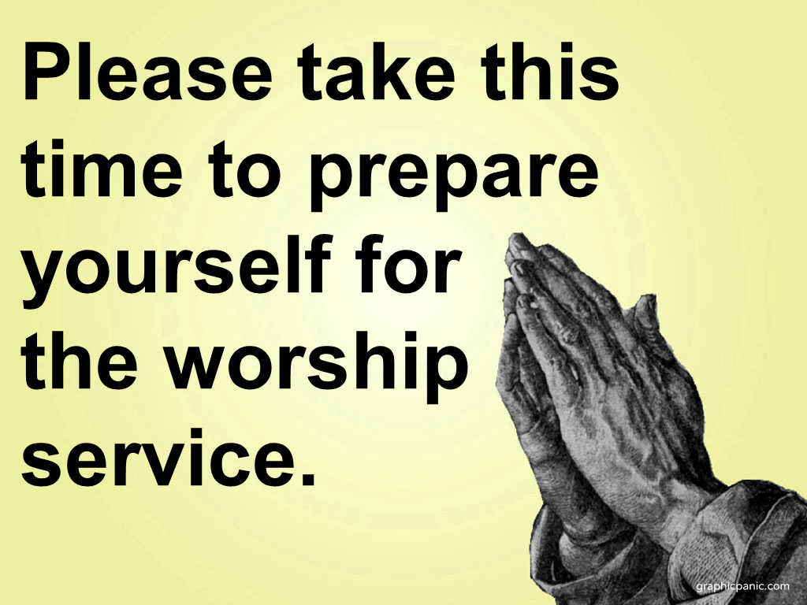

Slide 2
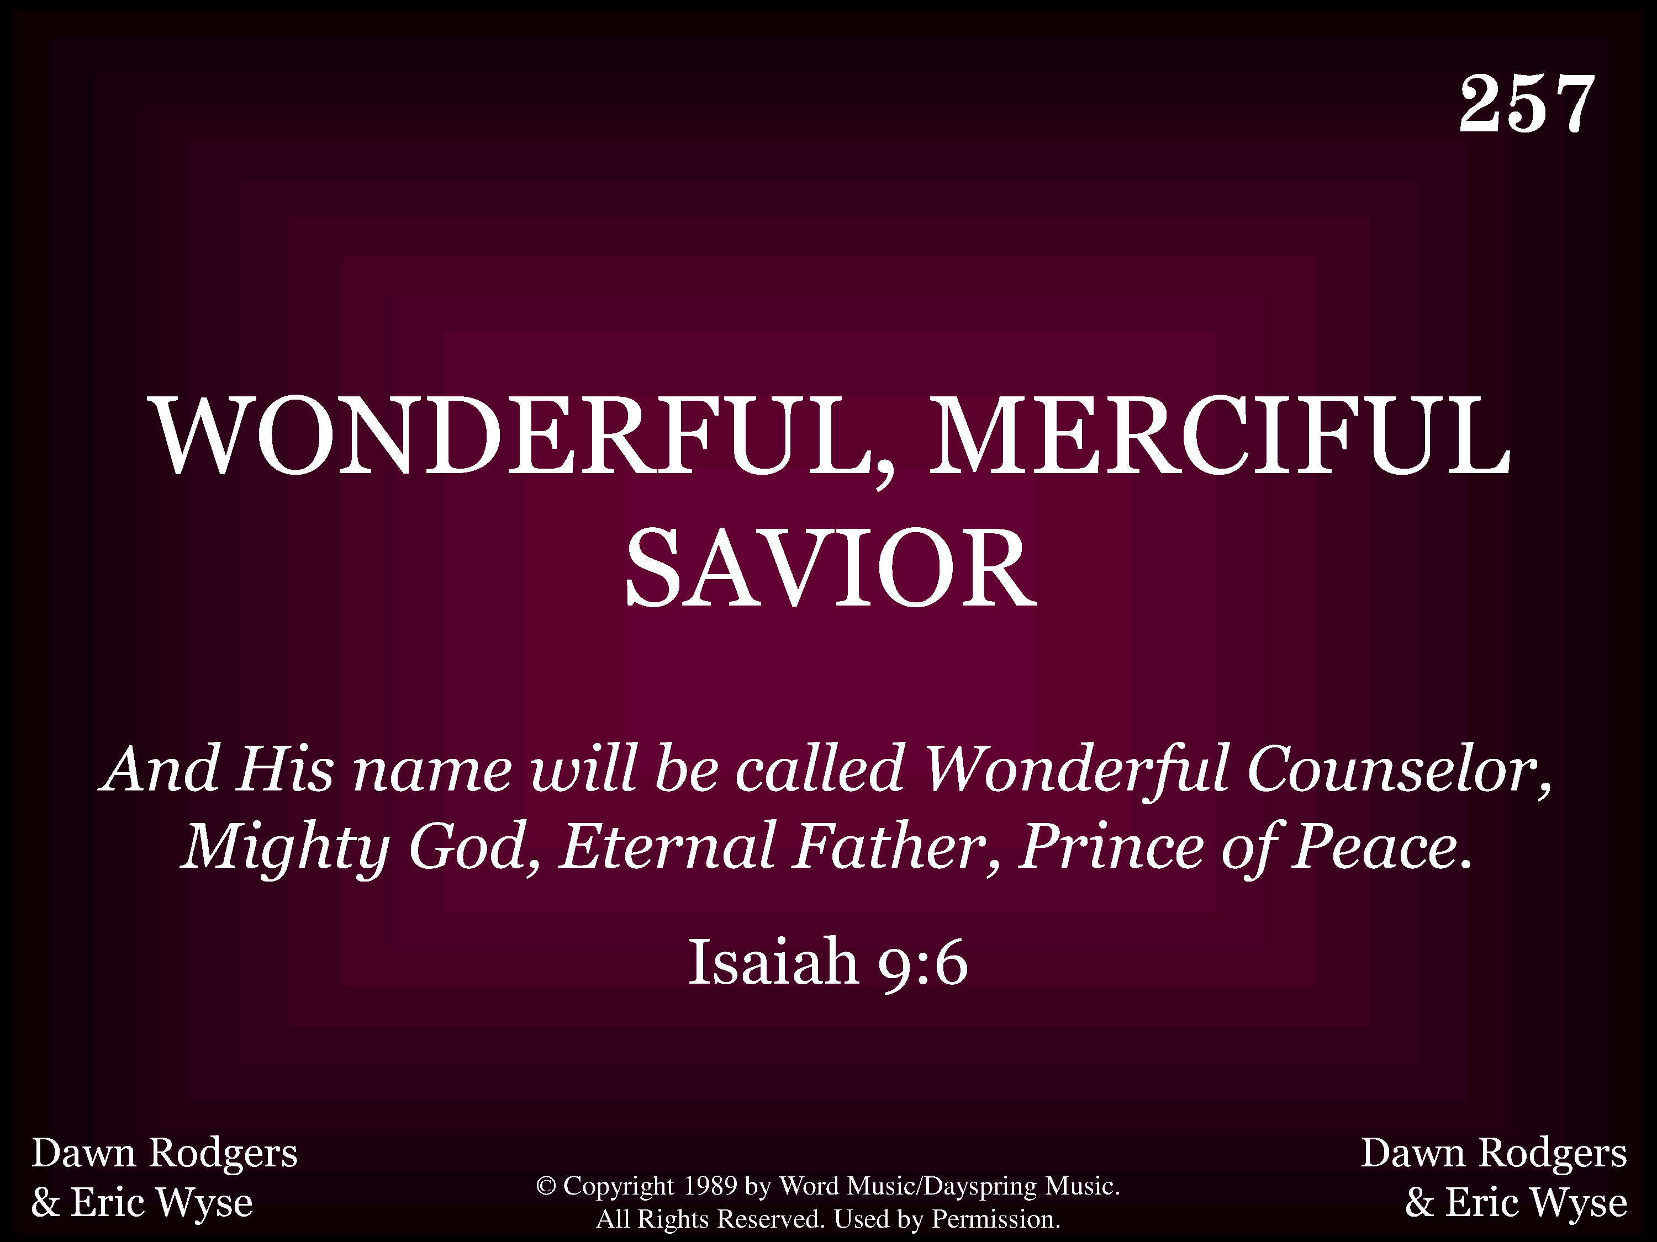
20257 - WONDERFUL, MERCIFUL, SAVIOR - Title

Slide 3
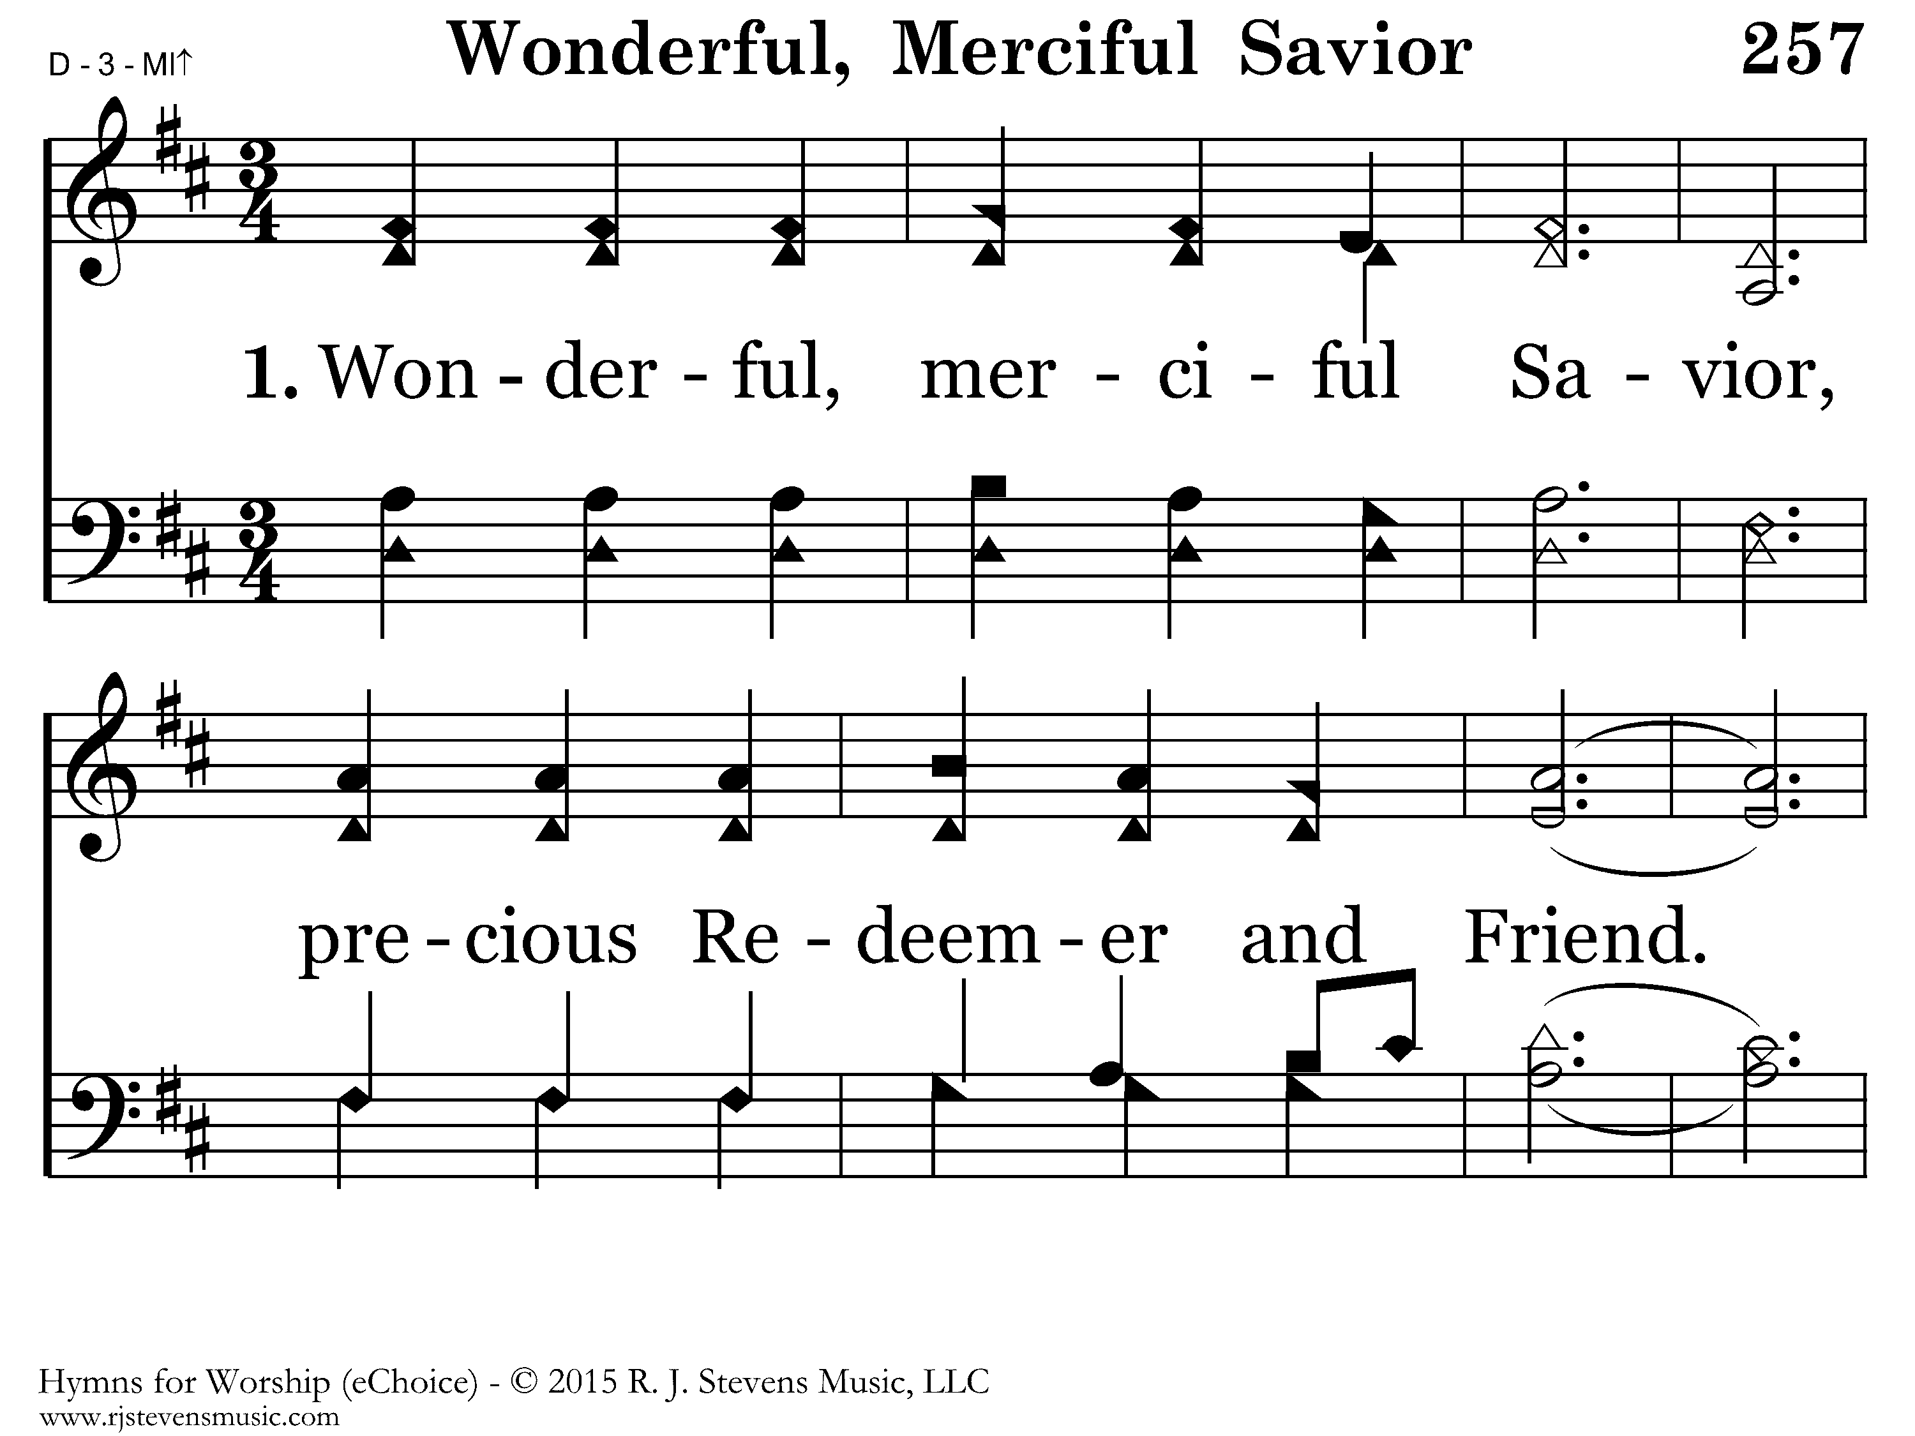
20257 - WONDERFUL, MERCIFUL, SAVIOR - 1.1

Slide 4
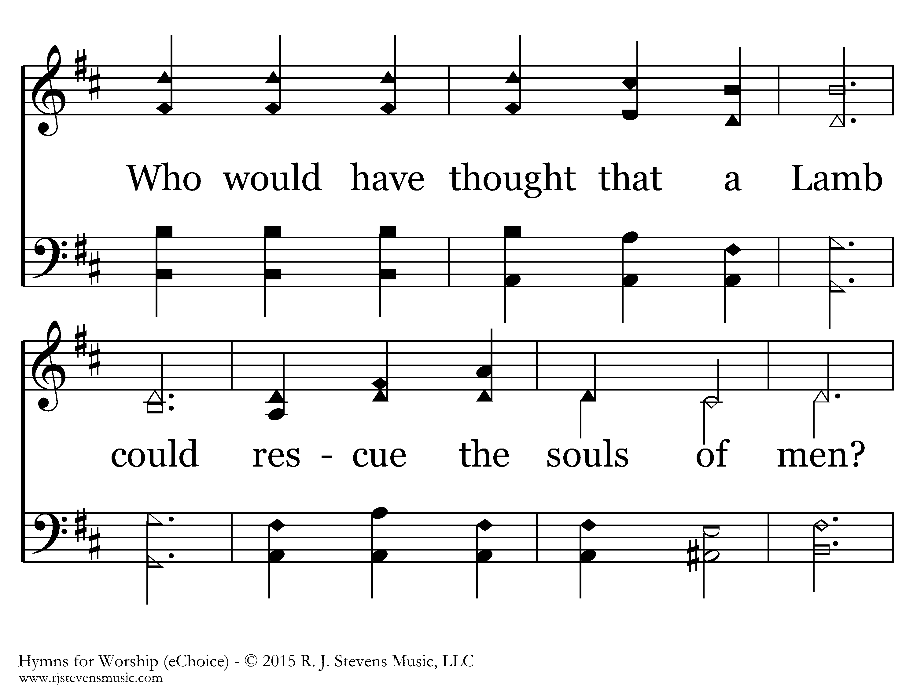
20257 - WONDERFUL, MERCIFUL, SAVIOR - 1.2

Slide 5
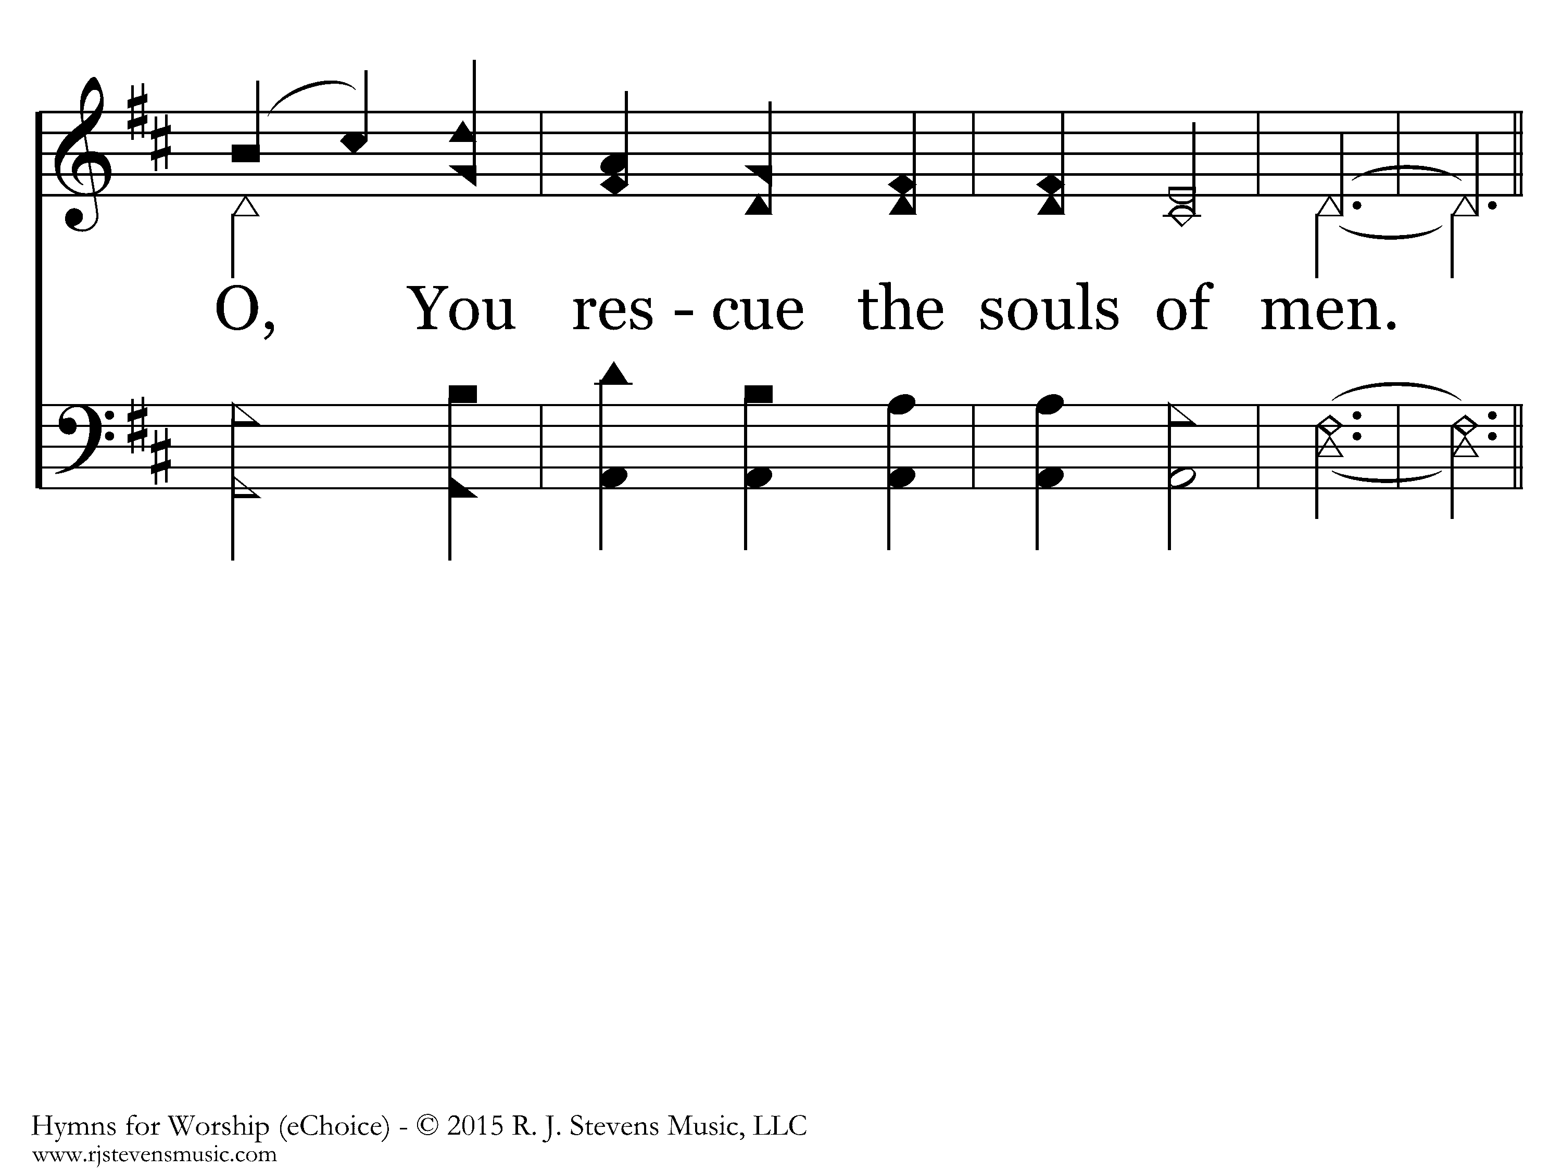
20257 - WONDERFUL, MERCIFUL, SAVIOR - 1.3

Slide 6
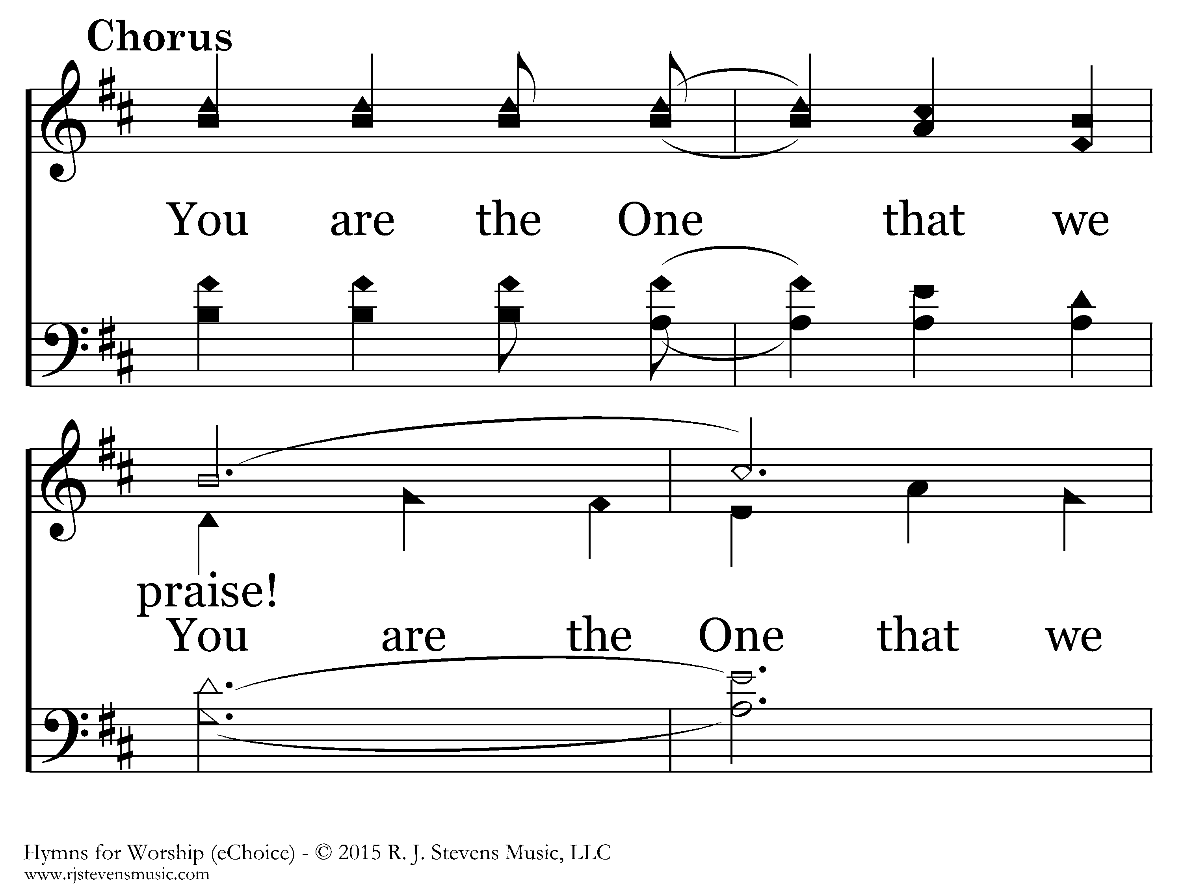
20257 - WONDERFUL, MERCIFUL, SAVIOR - C.1

Slide 7
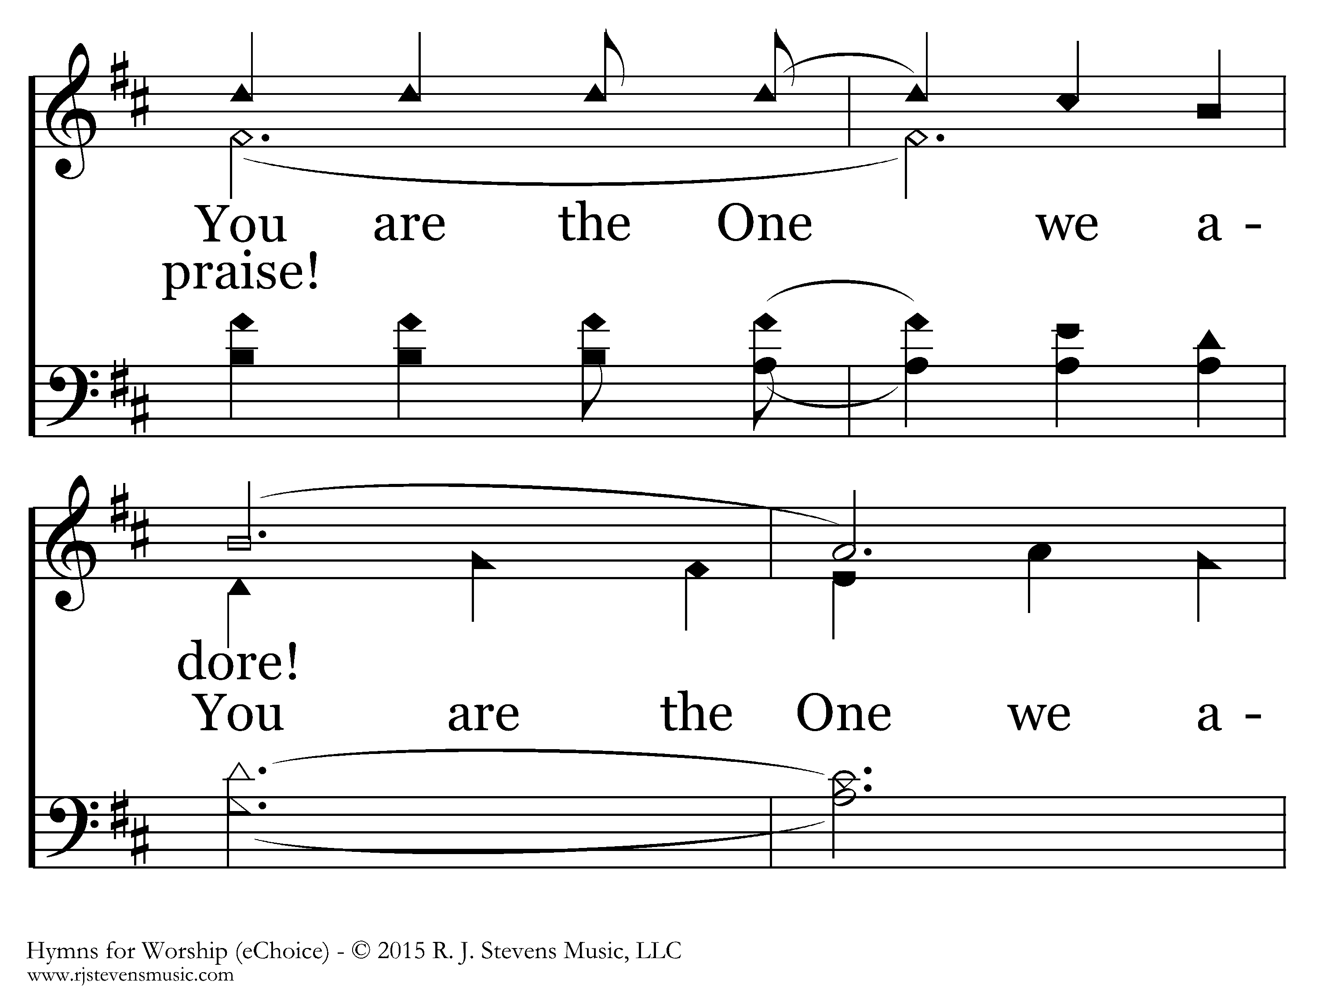
20257 - WONDERFUL, MERCIFUL, SAVIOR - C.2

Slide 8
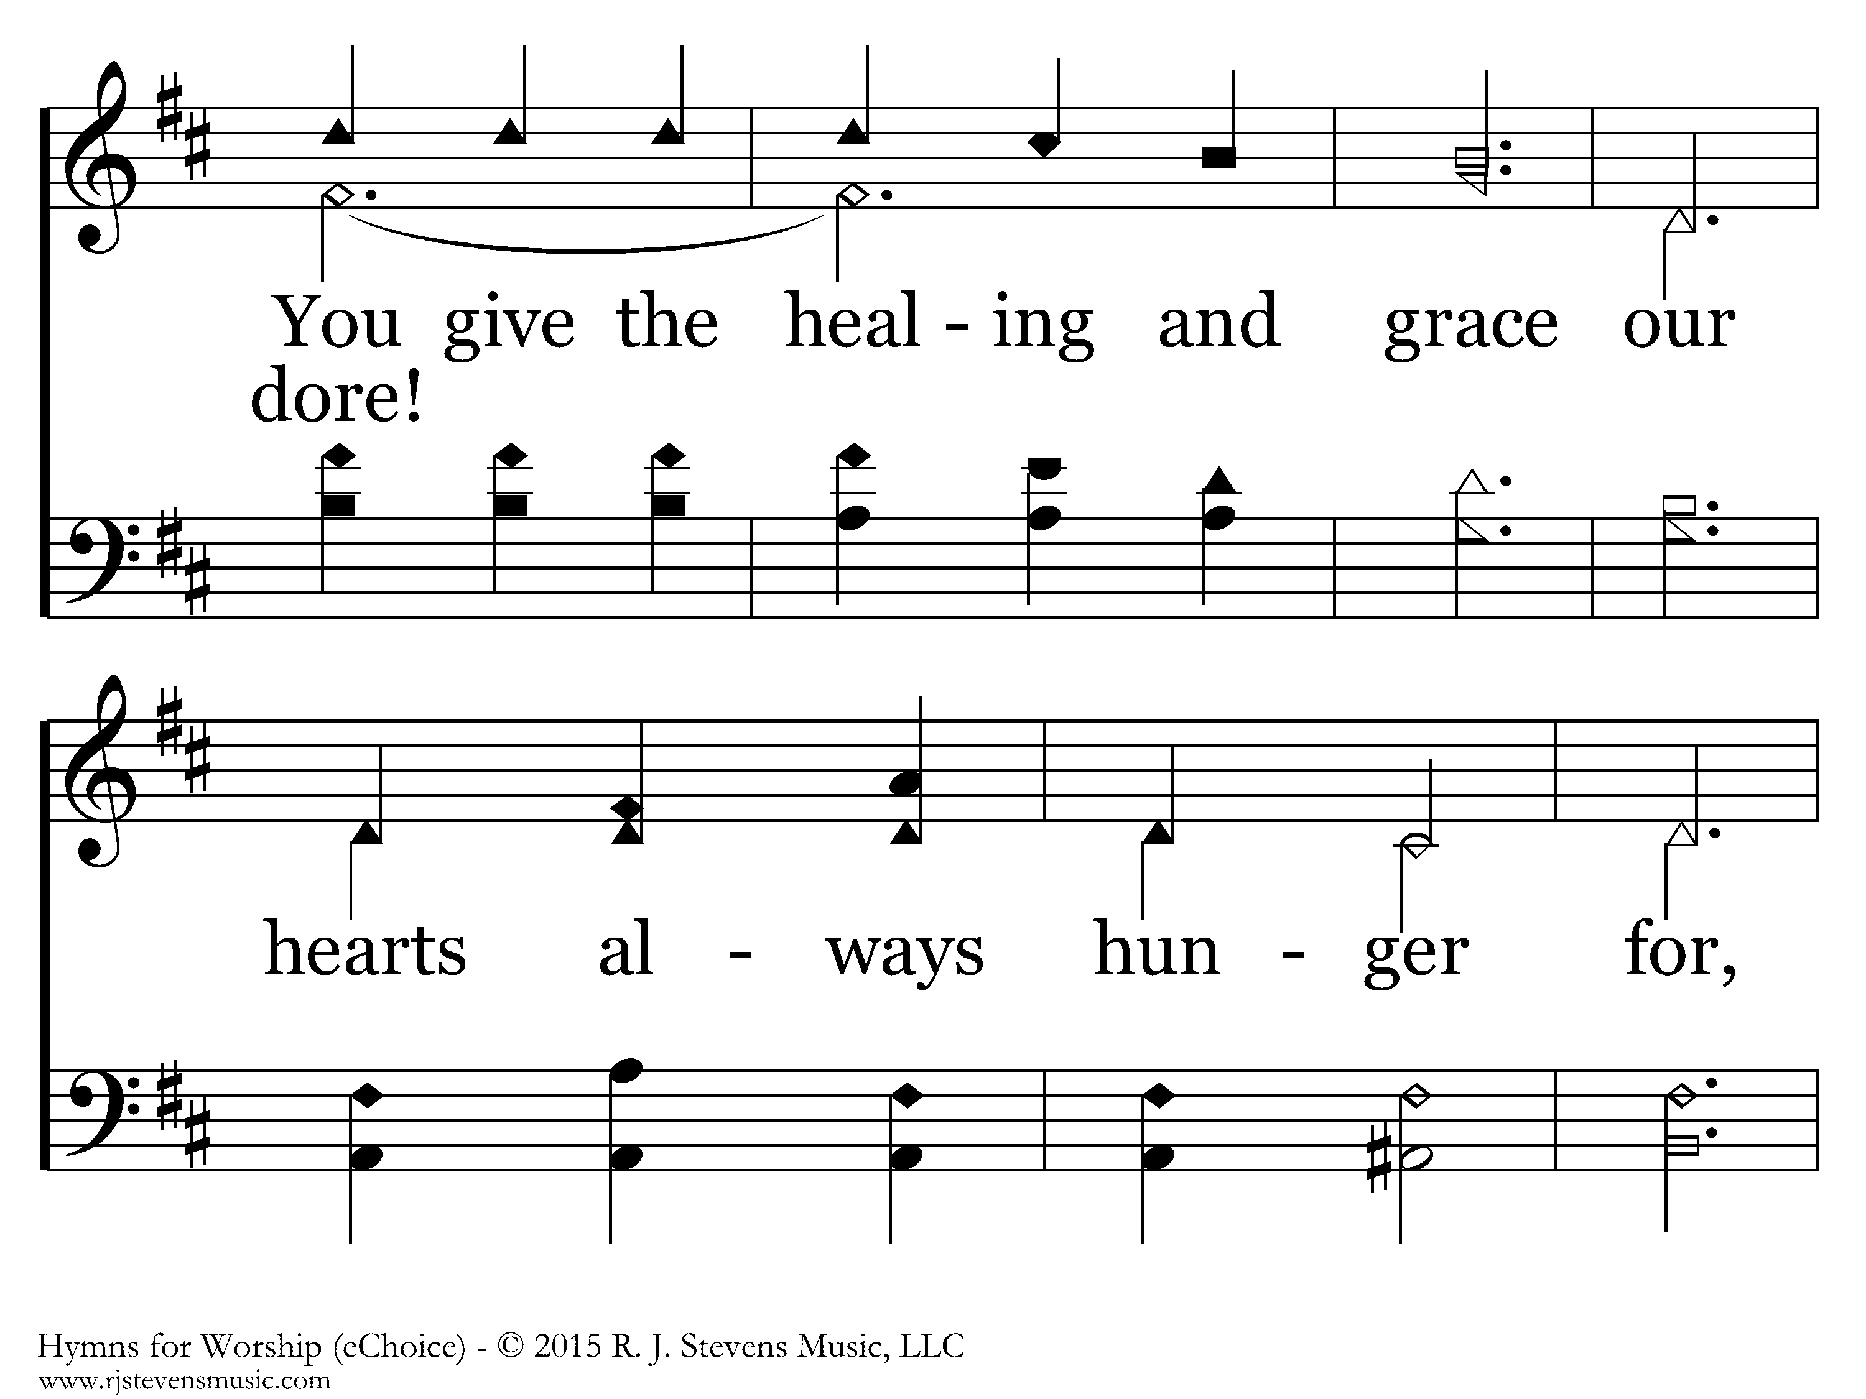
20257 - WONDERFUL, MERCIFUL, SAVIOR - C.3

Slide 9
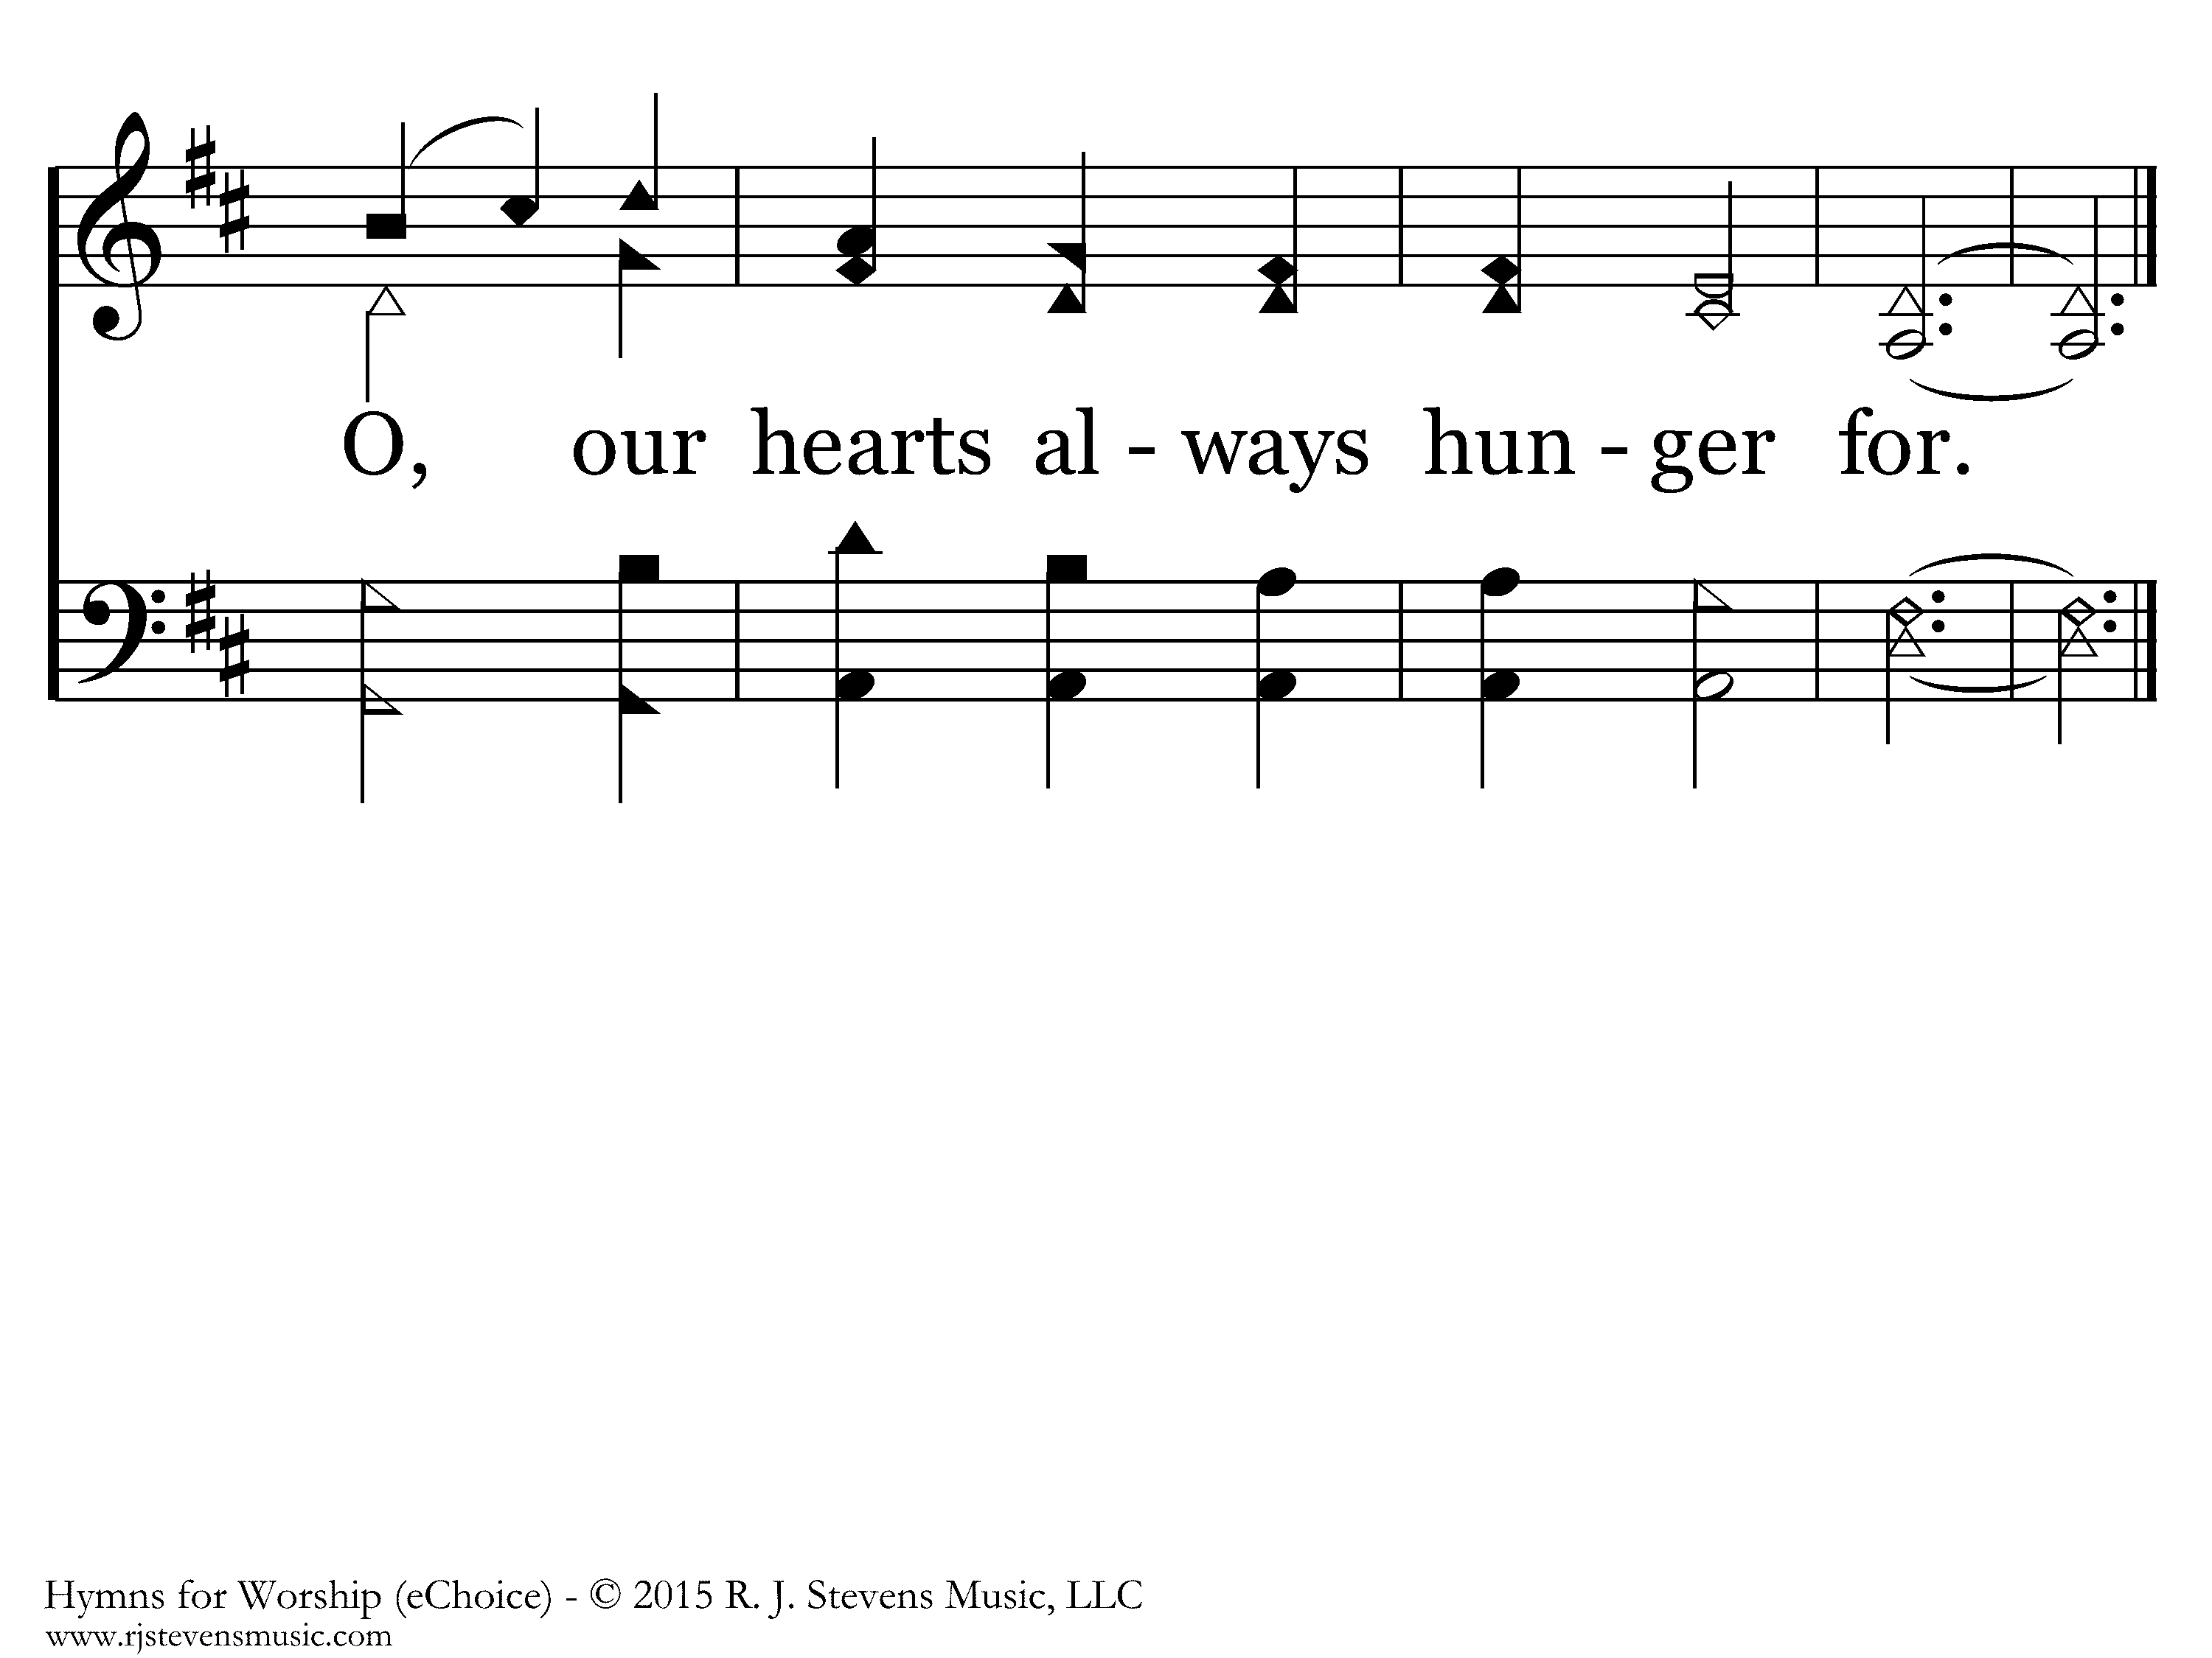
20257 - WONDERFUL, MERCIFUL, SAVIOR - C.4
End of Verse 1

Slide 10
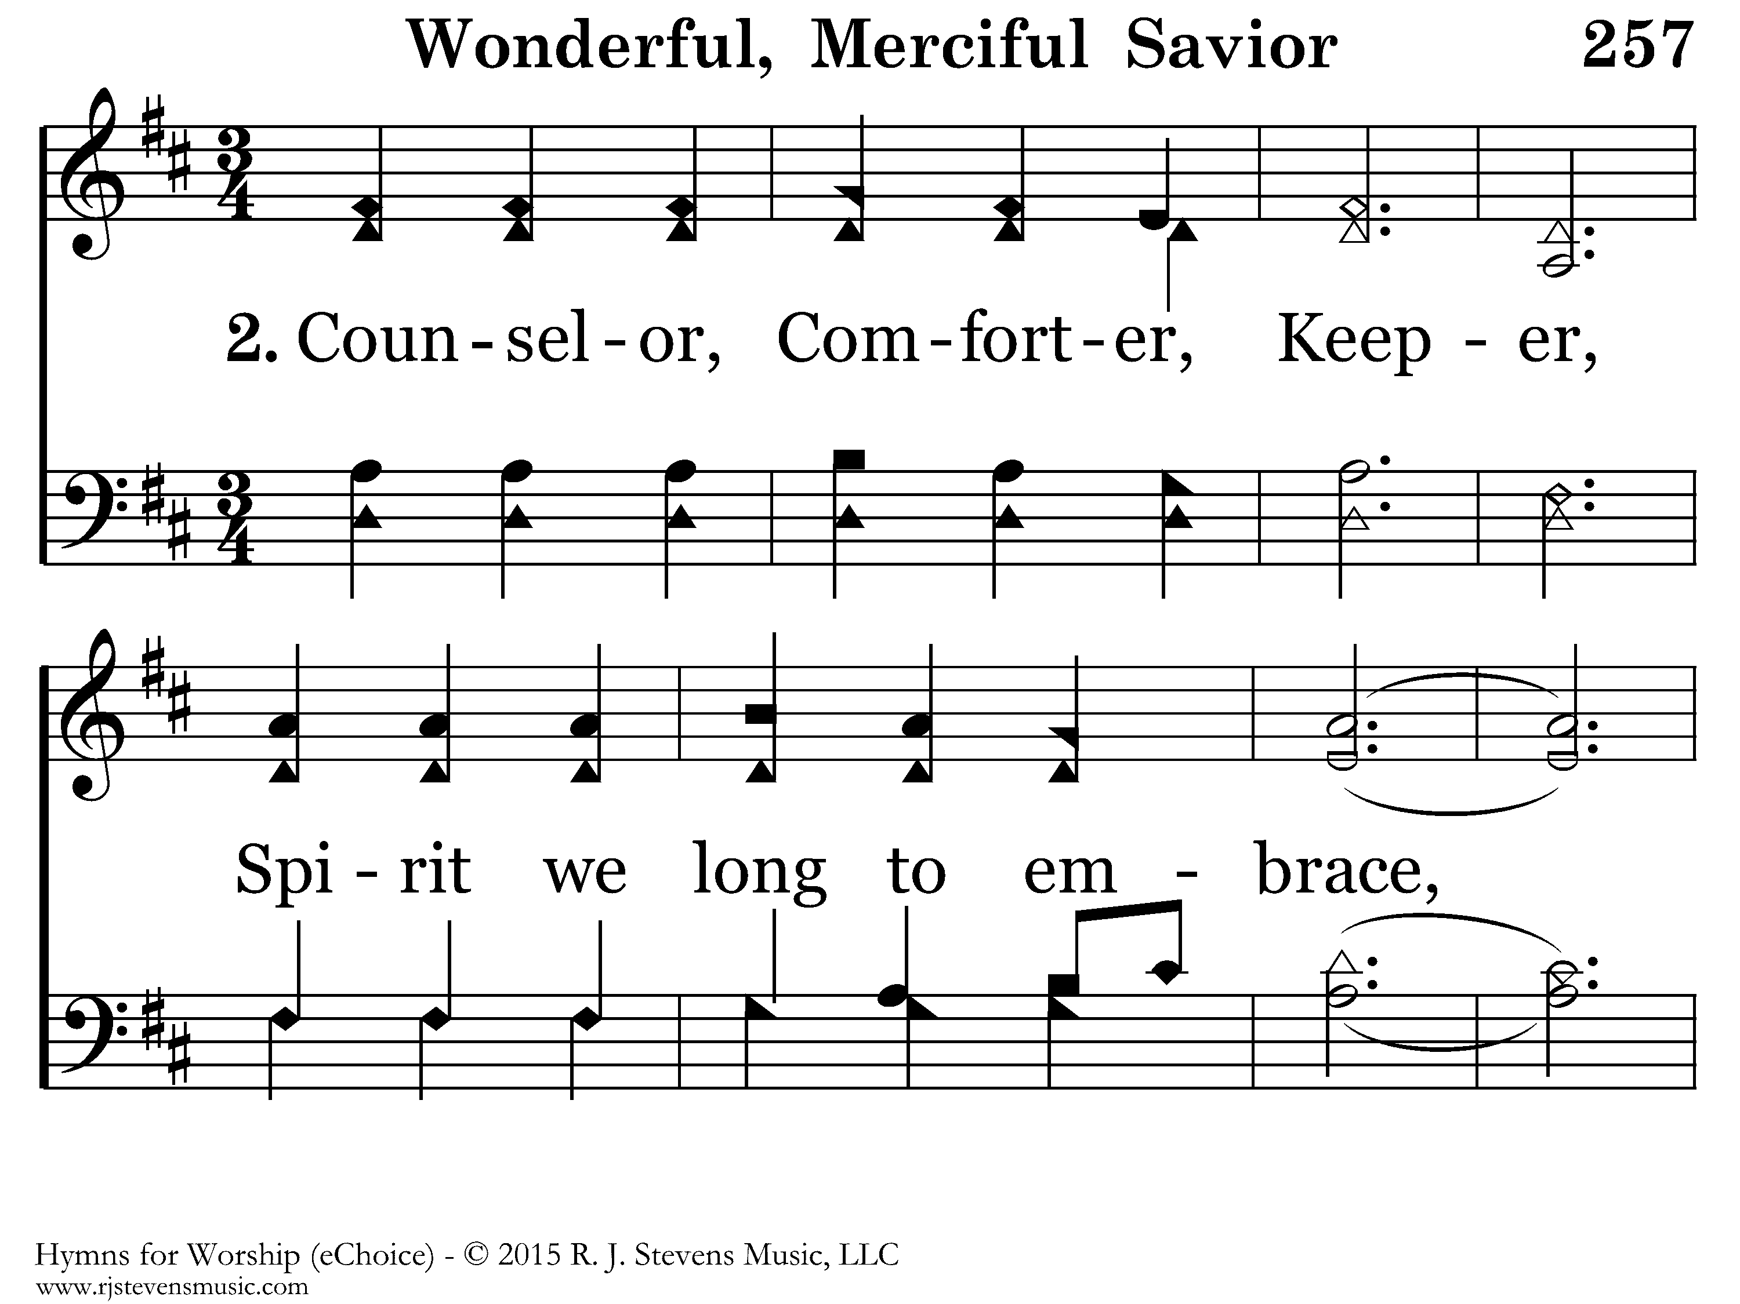
20257 - WONDERFUL, MERCIFUL, SAVIOR - 2.1

Slide 11
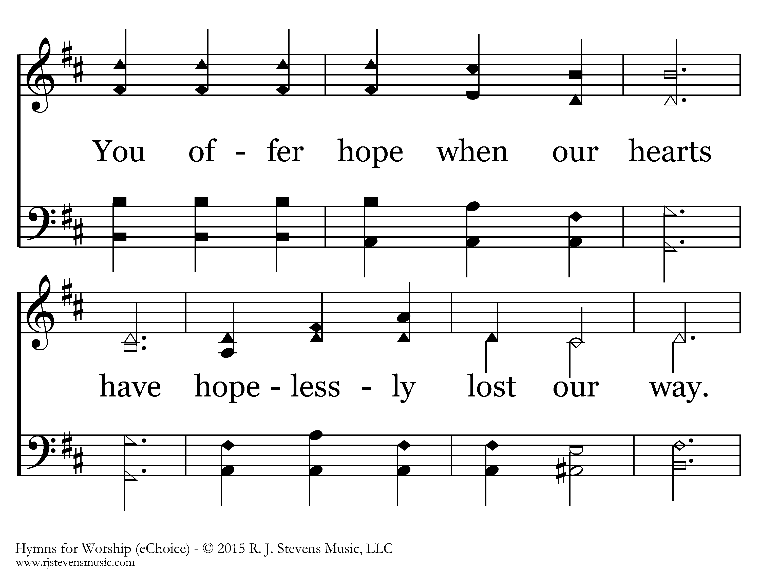
20257 - WONDERFUL, MERCIFUL, SAVIOR - 2.2

Slide 12
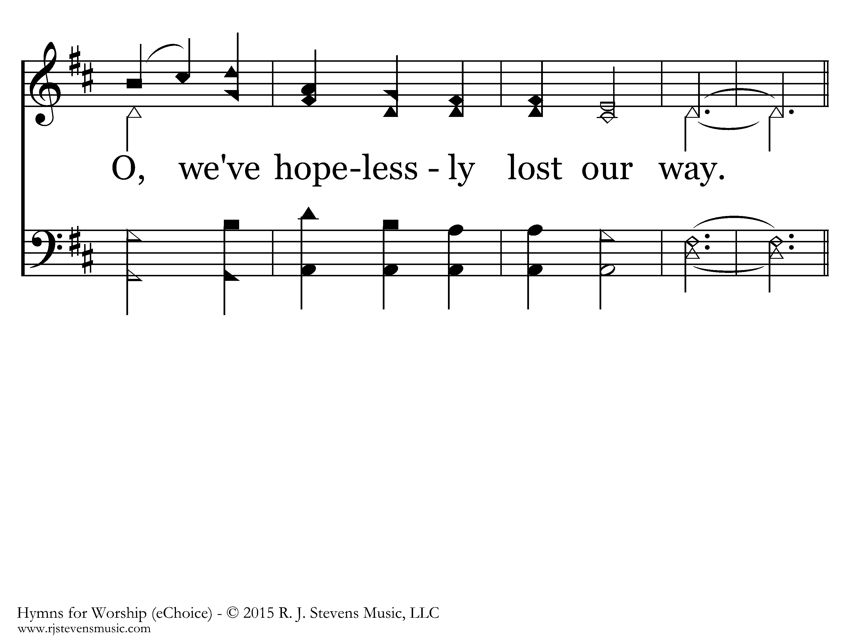
20257 - WONDERFUL, MERCIFUL, SAVIOR - 2.3

Slide 13
20257 - WONDERFUL, MERCIFUL, SAVIOR - C.1

Slide 14
20257 - WONDERFUL, MERCIFUL, SAVIOR - C.2

Slide 15
20257 - WONDERFUL, MERCIFUL, SAVIOR - C.3

Slide 16
20257 - WONDERFUL, MERCIFUL, SAVIOR - C.4
End of Verse 2

Slide 17
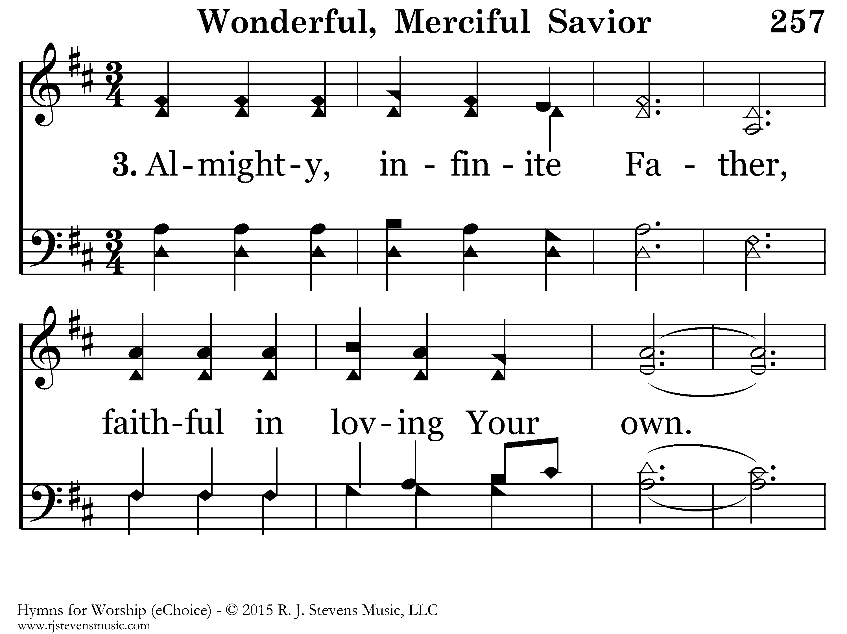
20257 - WONDERFUL, MERCIFUL, SAVIOR - 3.1

Slide 18
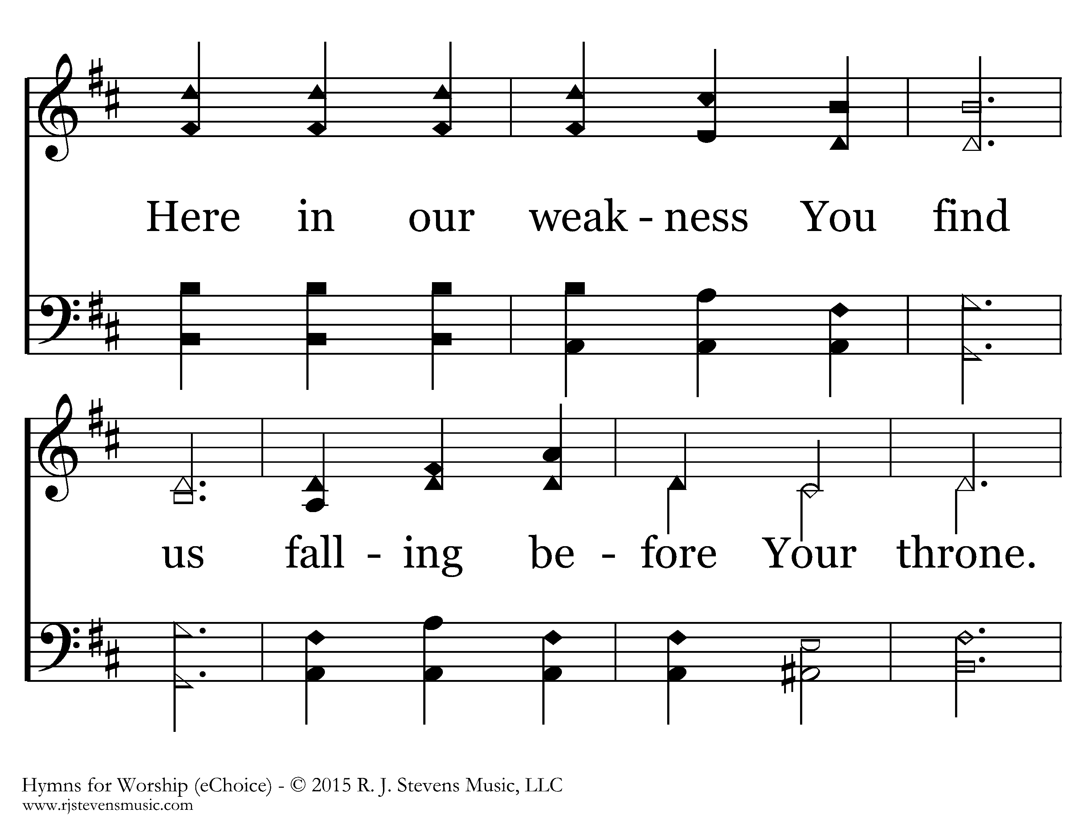
20257 - WONDERFUL, MERCIFUL, SAVIOR - 3.2

Slide 19
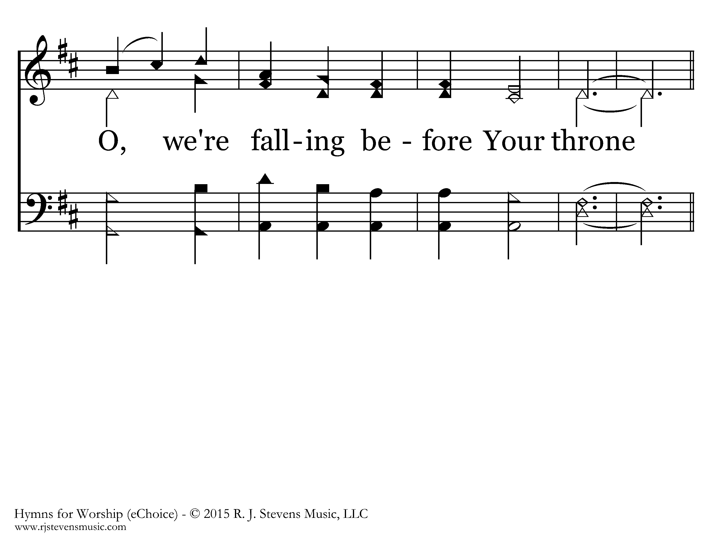
20257 - WONDERFUL, MERCIFUL, SAVIOR - 3.3

Slide 20
20257 - WONDERFUL, MERCIFUL, SAVIOR - C.1

Slide 21
20257 - WONDERFUL, MERCIFUL, SAVIOR - C.2

Slide 22
20257 - WONDERFUL, MERCIFUL, SAVIOR - C.3

Slide 23
20257 - WONDERFUL, MERCIFUL, SAVIOR - C.4
End of Song

Slide 24
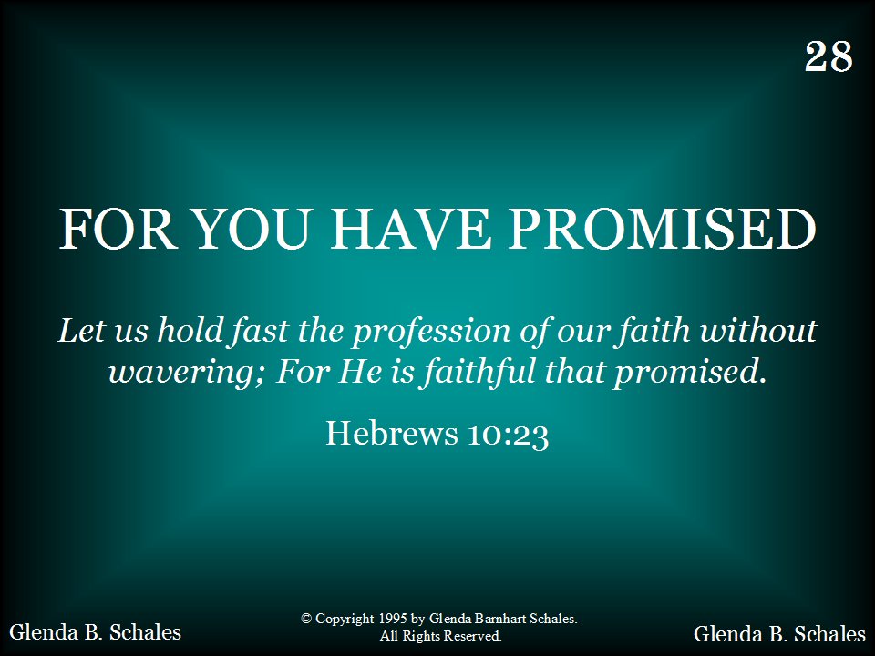
028 - For You Have Promised - Title

Slide 25
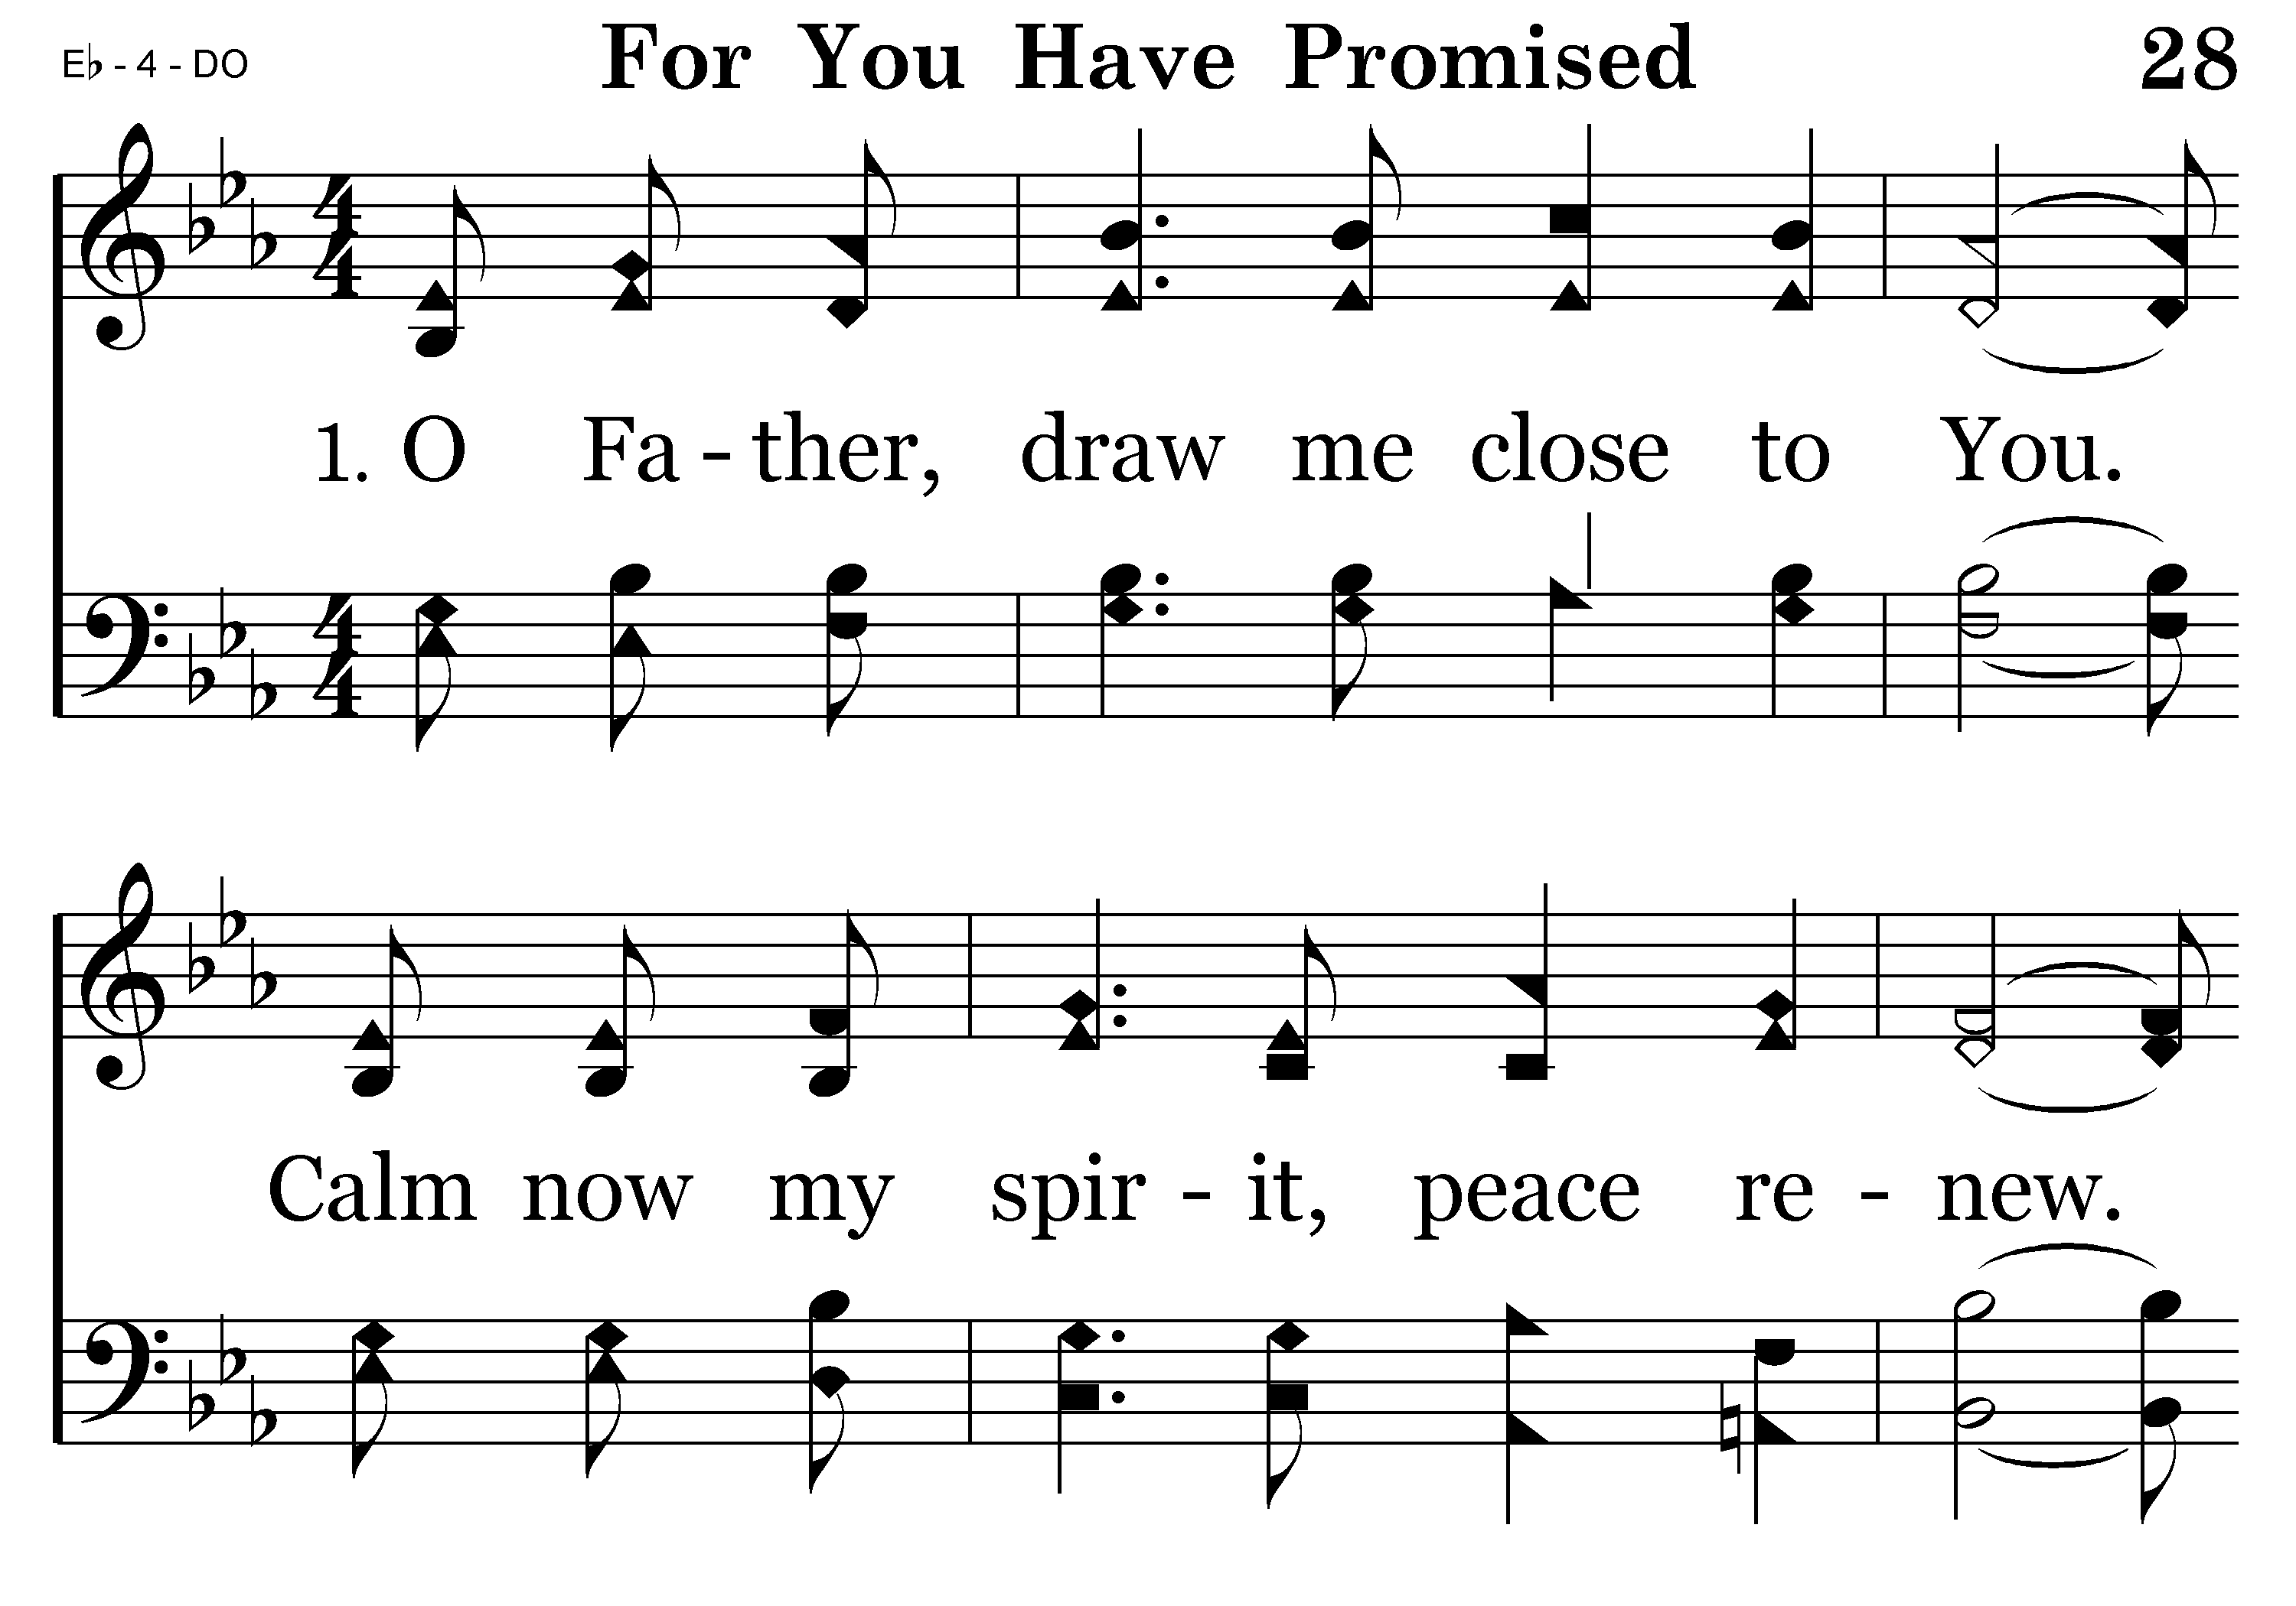
028 - For You Have Promised - 1.1

Slide 26
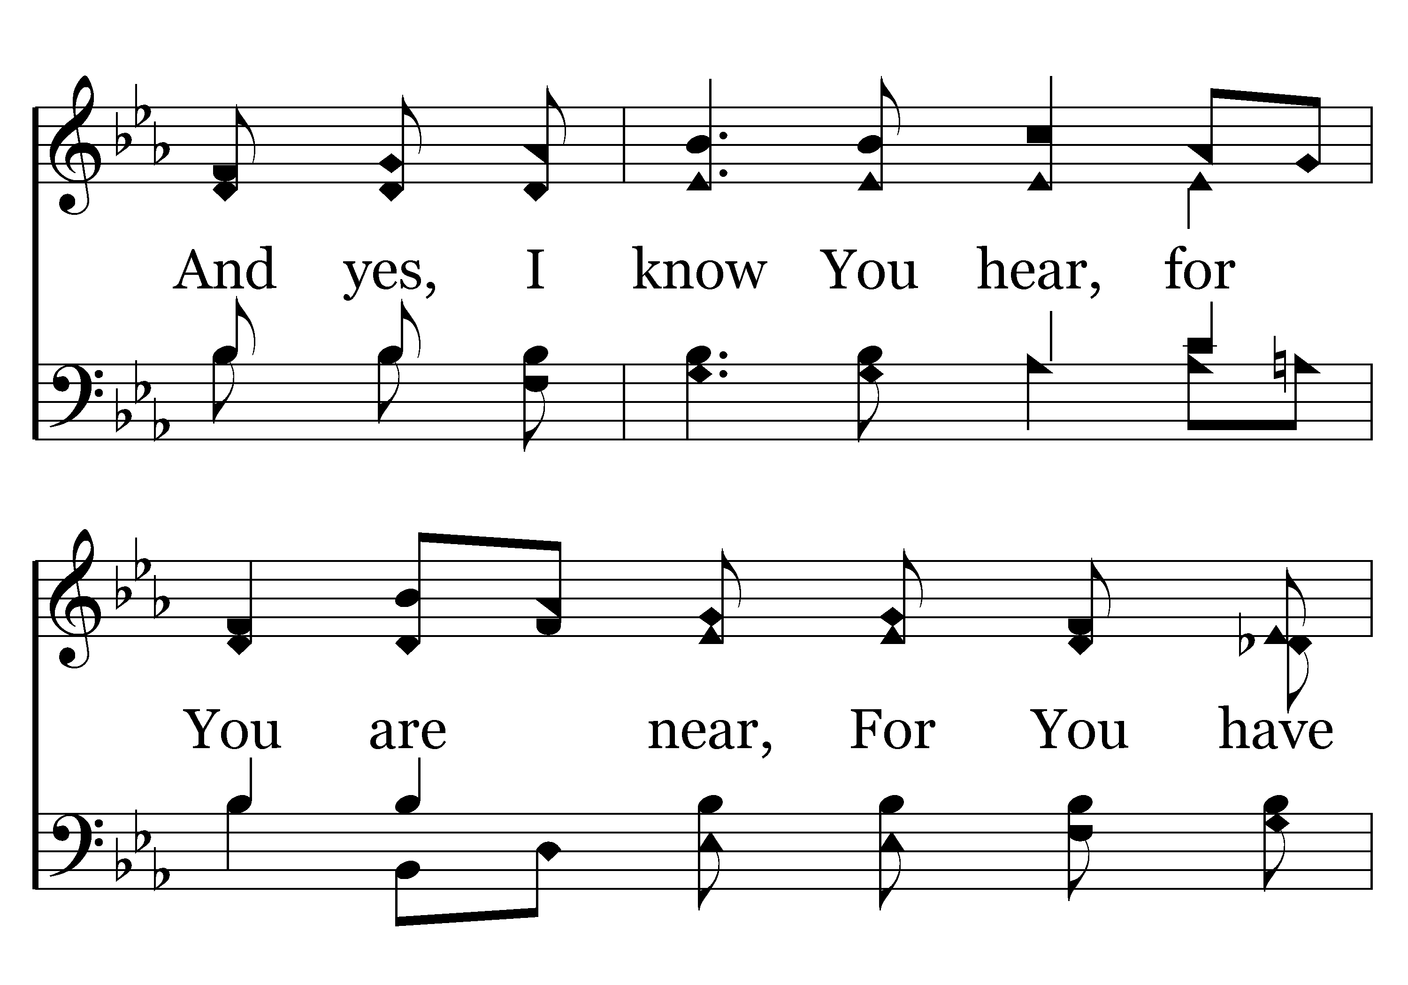
028 - For You Have Promised - 1.2

Slide 27
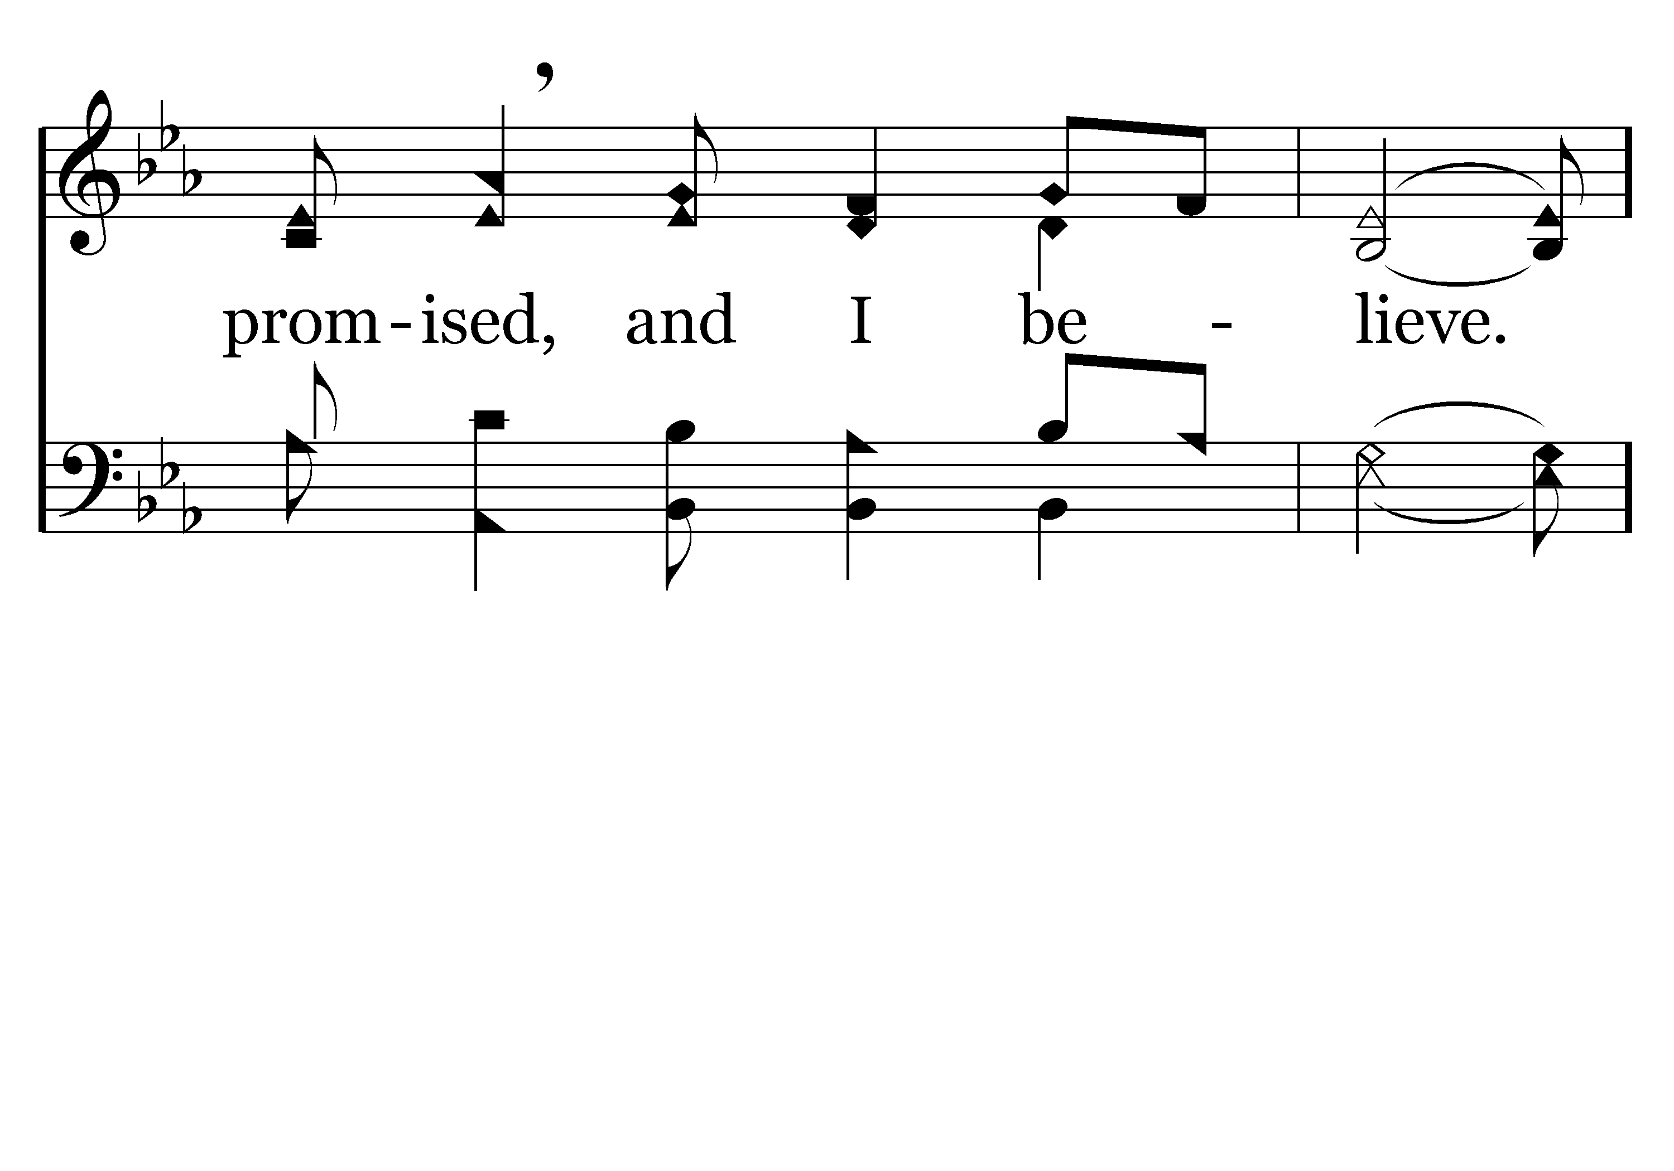
028 - For You Have Promised - 1.3

Slide 28
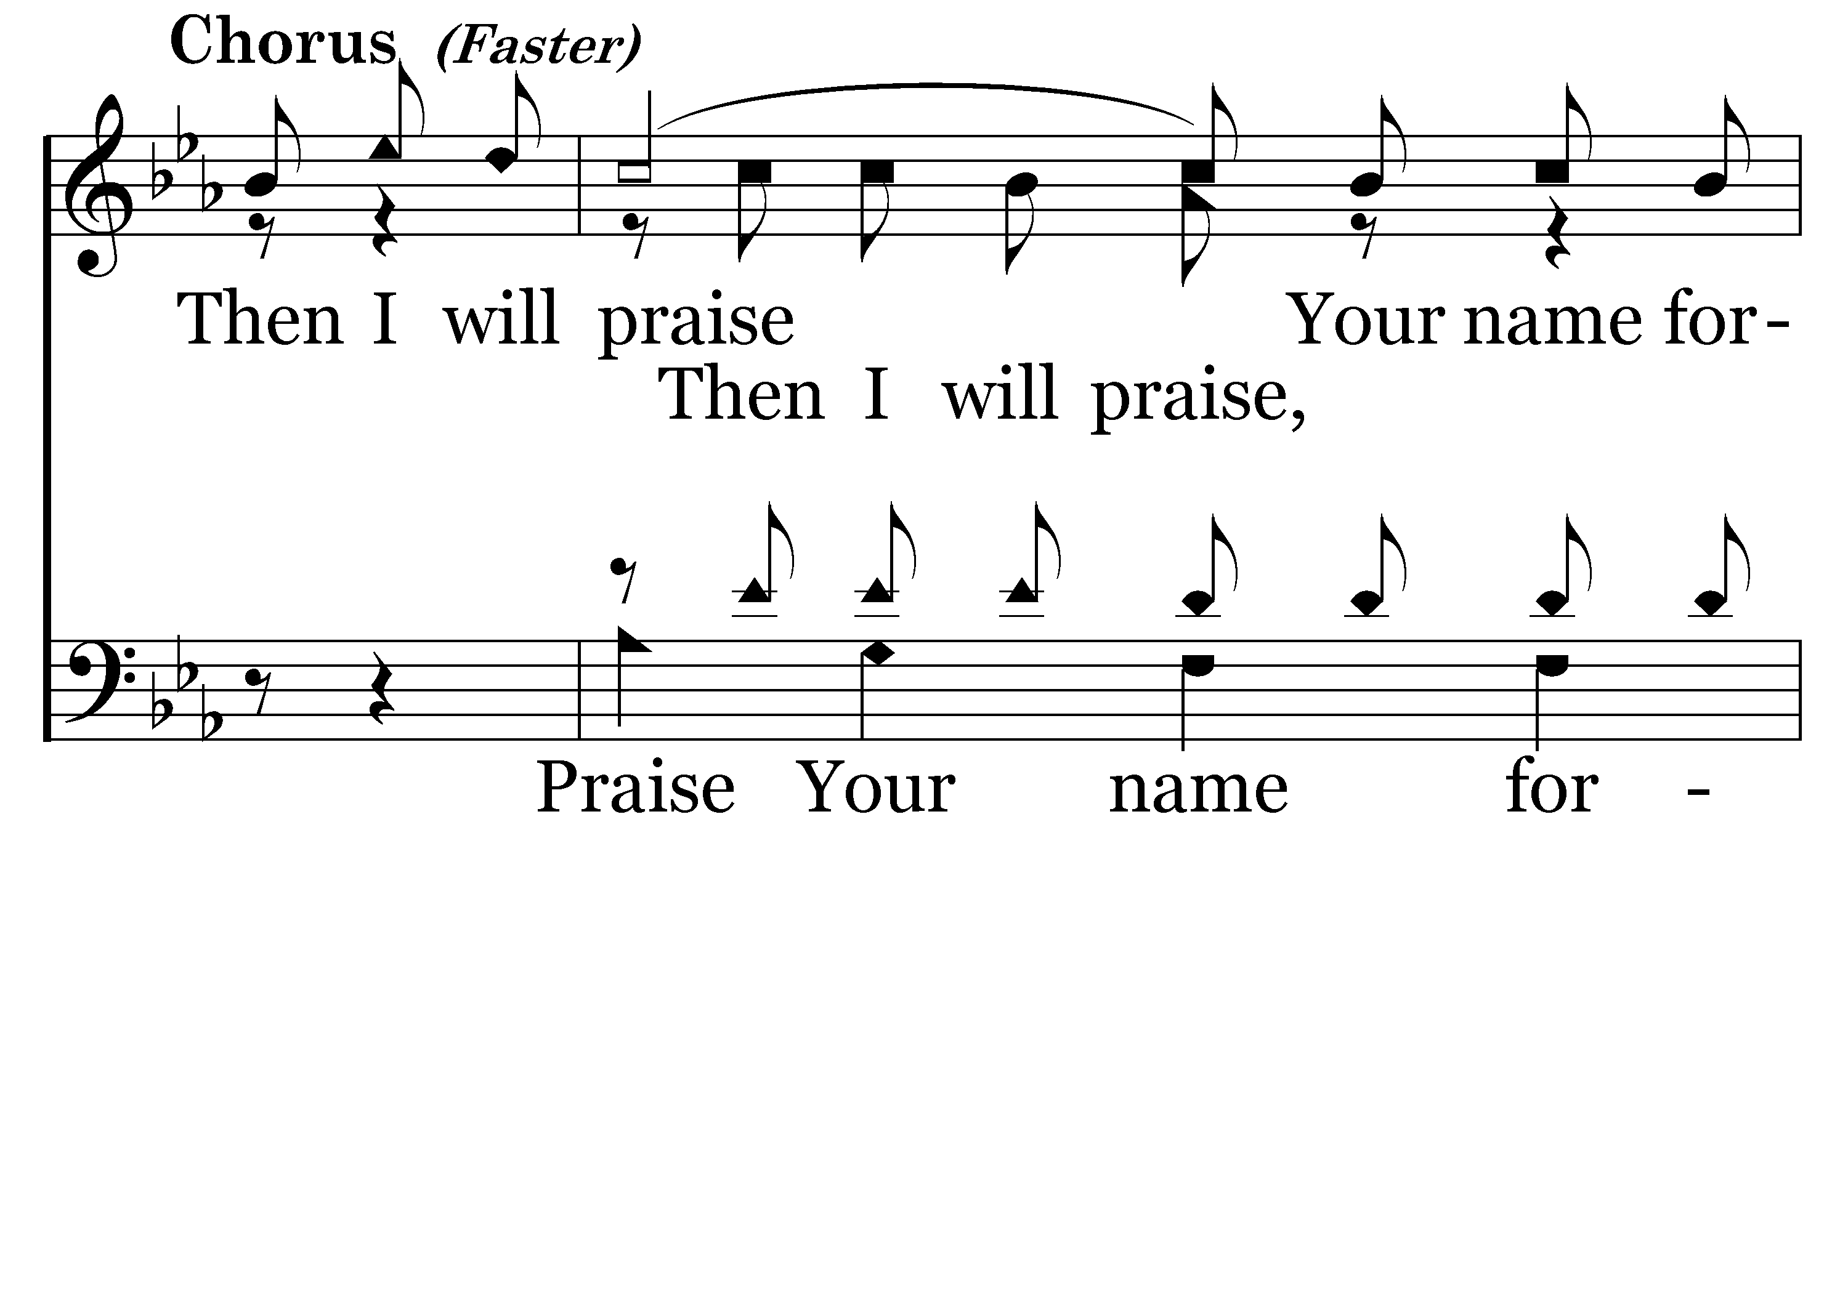
028 - For You Have Promised - C.1

Slide 29
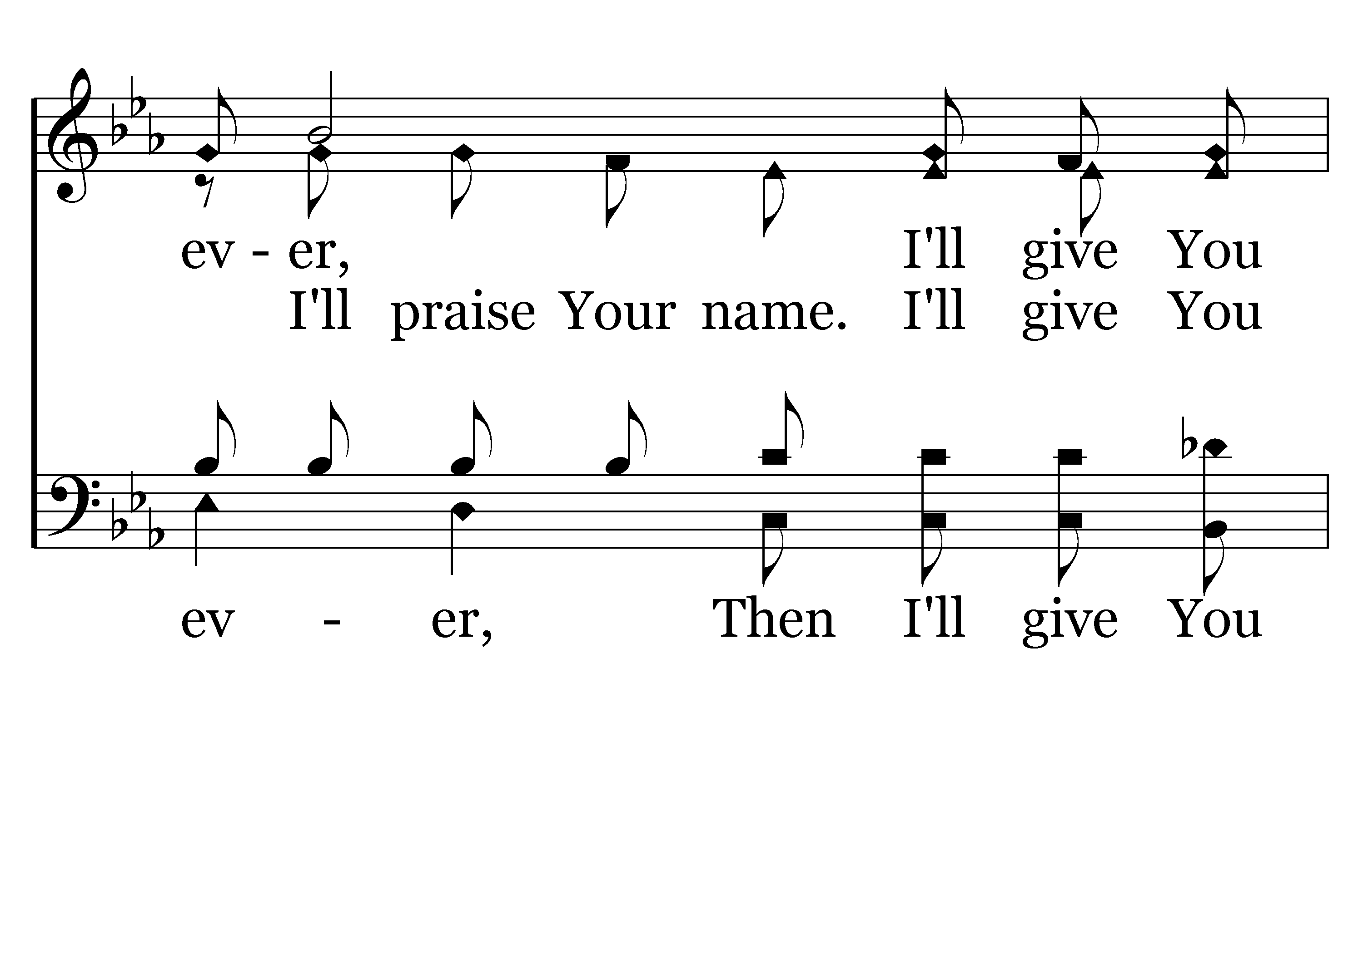
028 - For You Have Promised - C.2

Slide 30
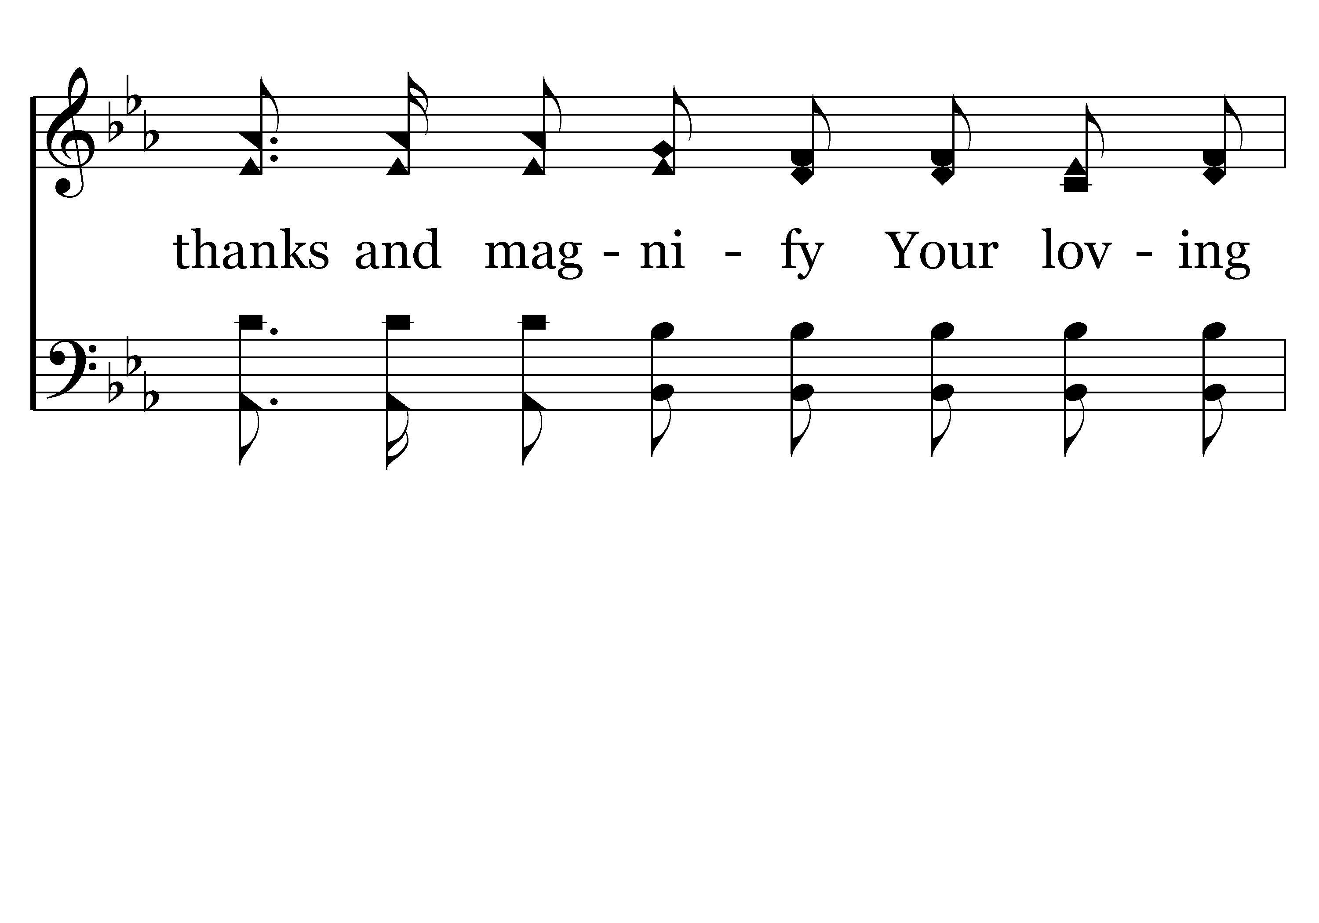
028 - For You Have Promised - C.3

Slide 31
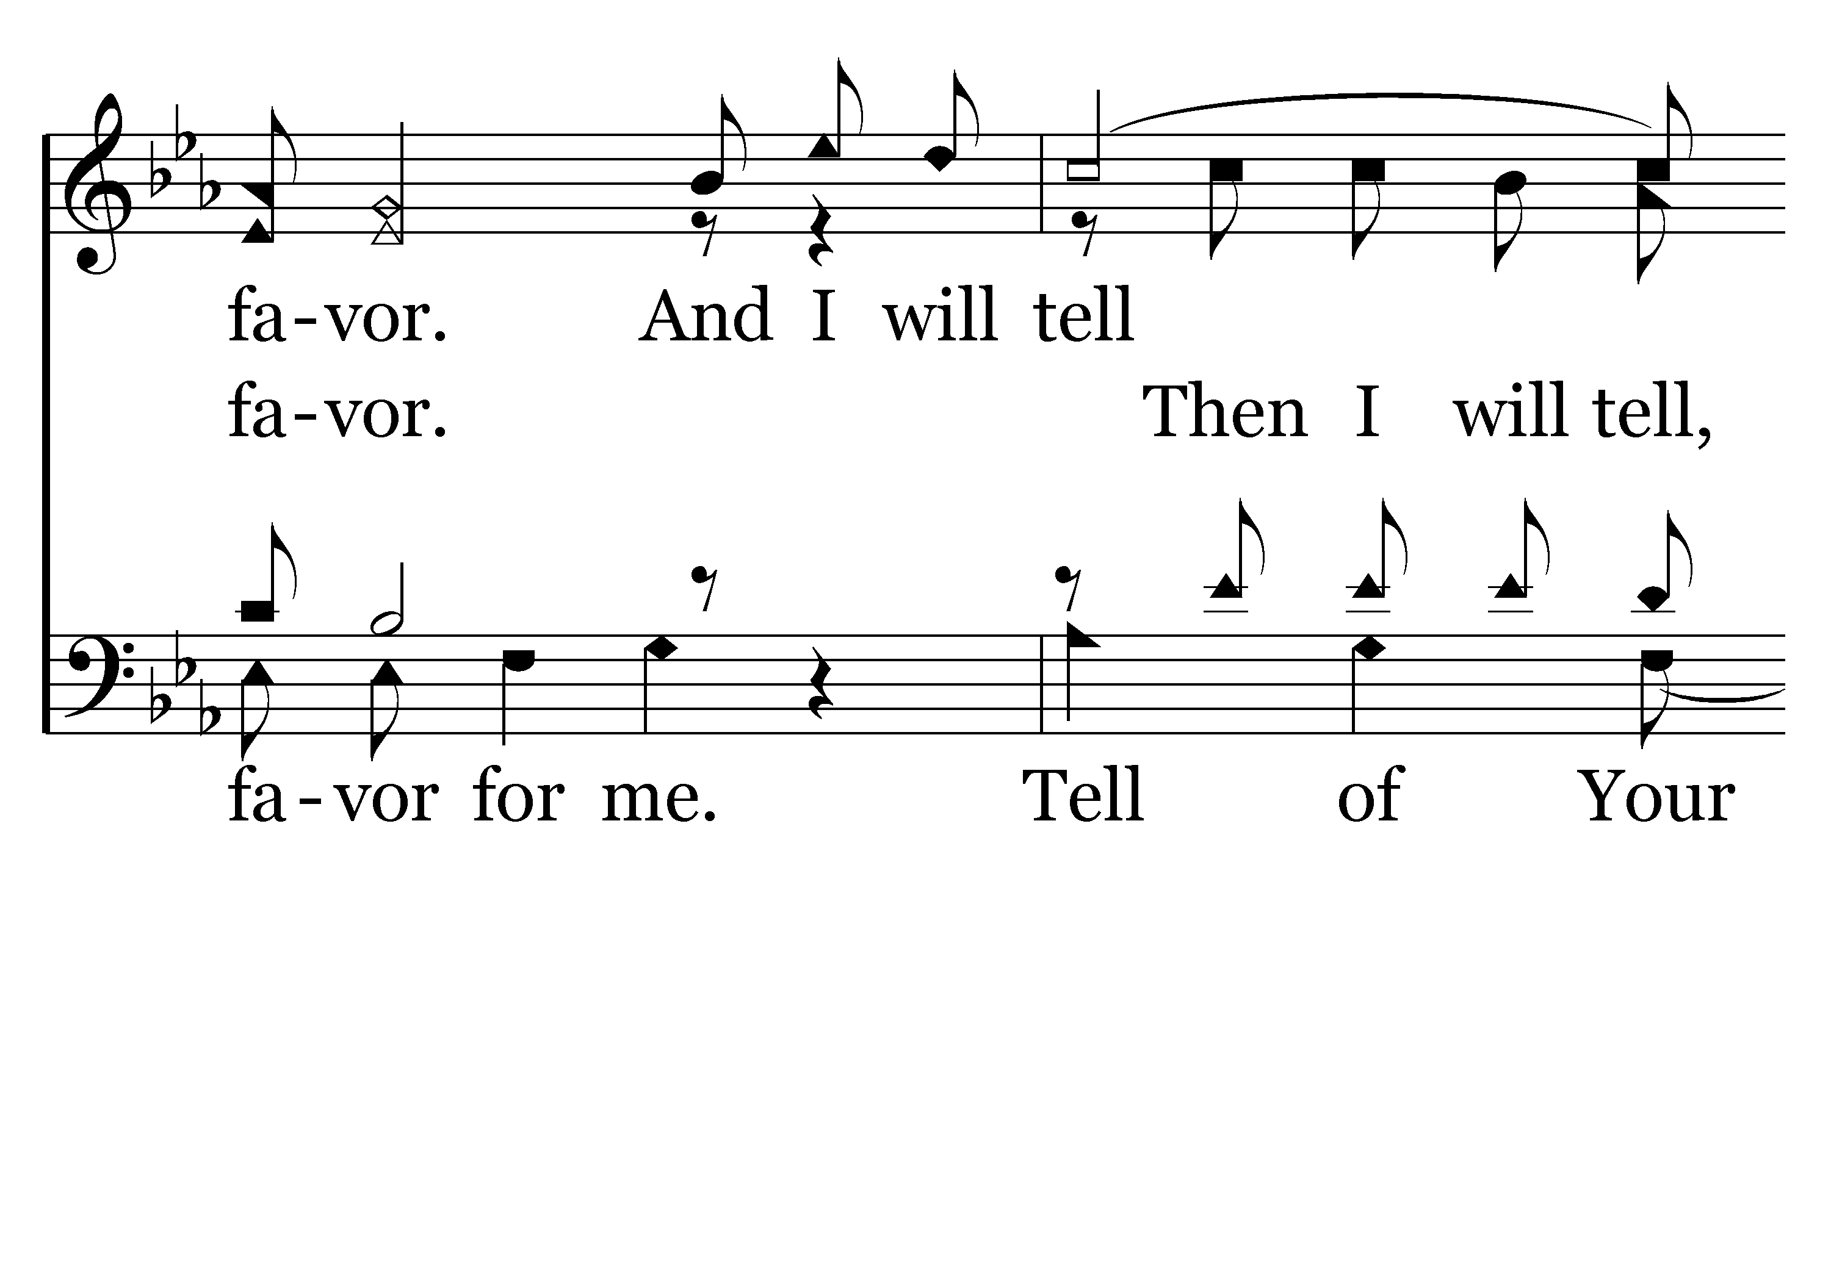
028 - For You Have Promised - C.4

Slide 32
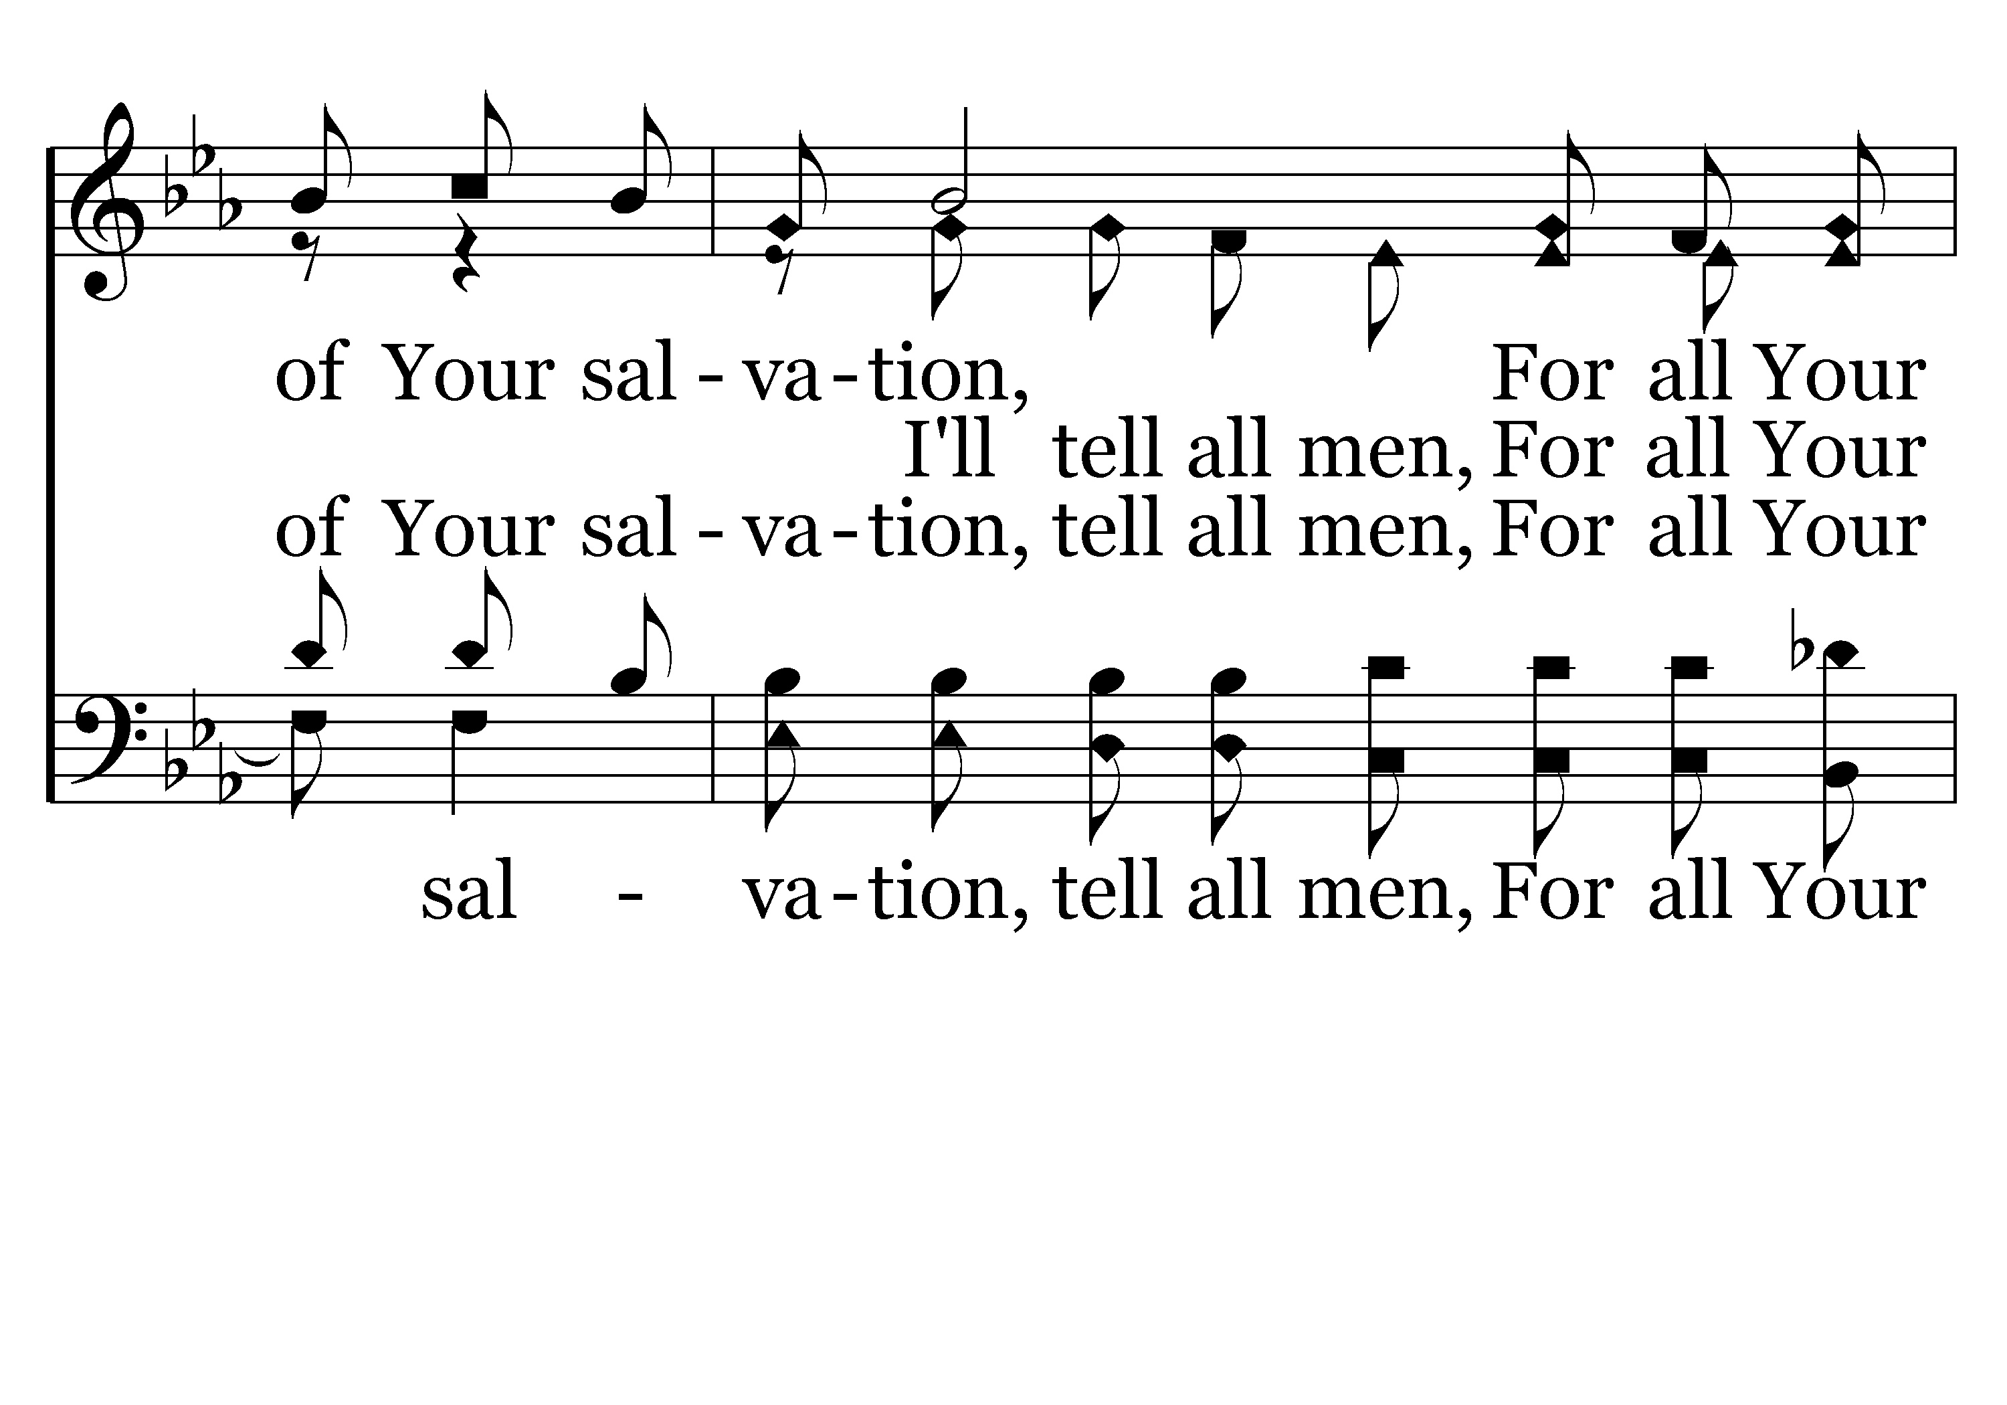
028 - For You Have Promised - C.5

Slide 33
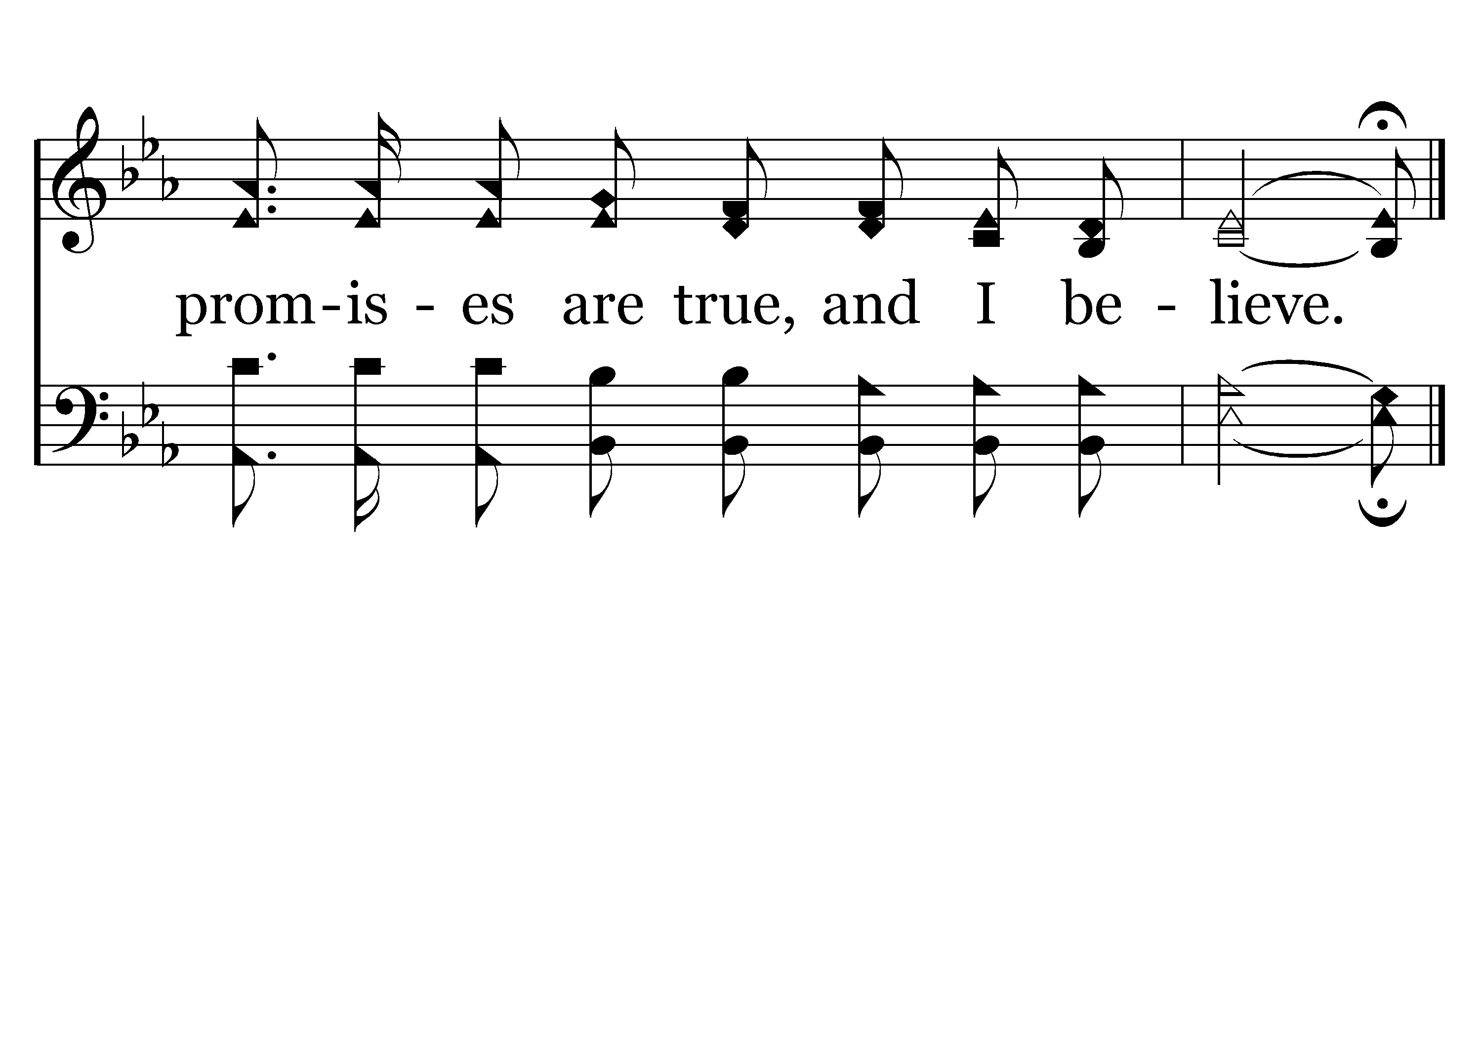
028 - For You Have Promised - C.6
End of Verse 1

Slide 34
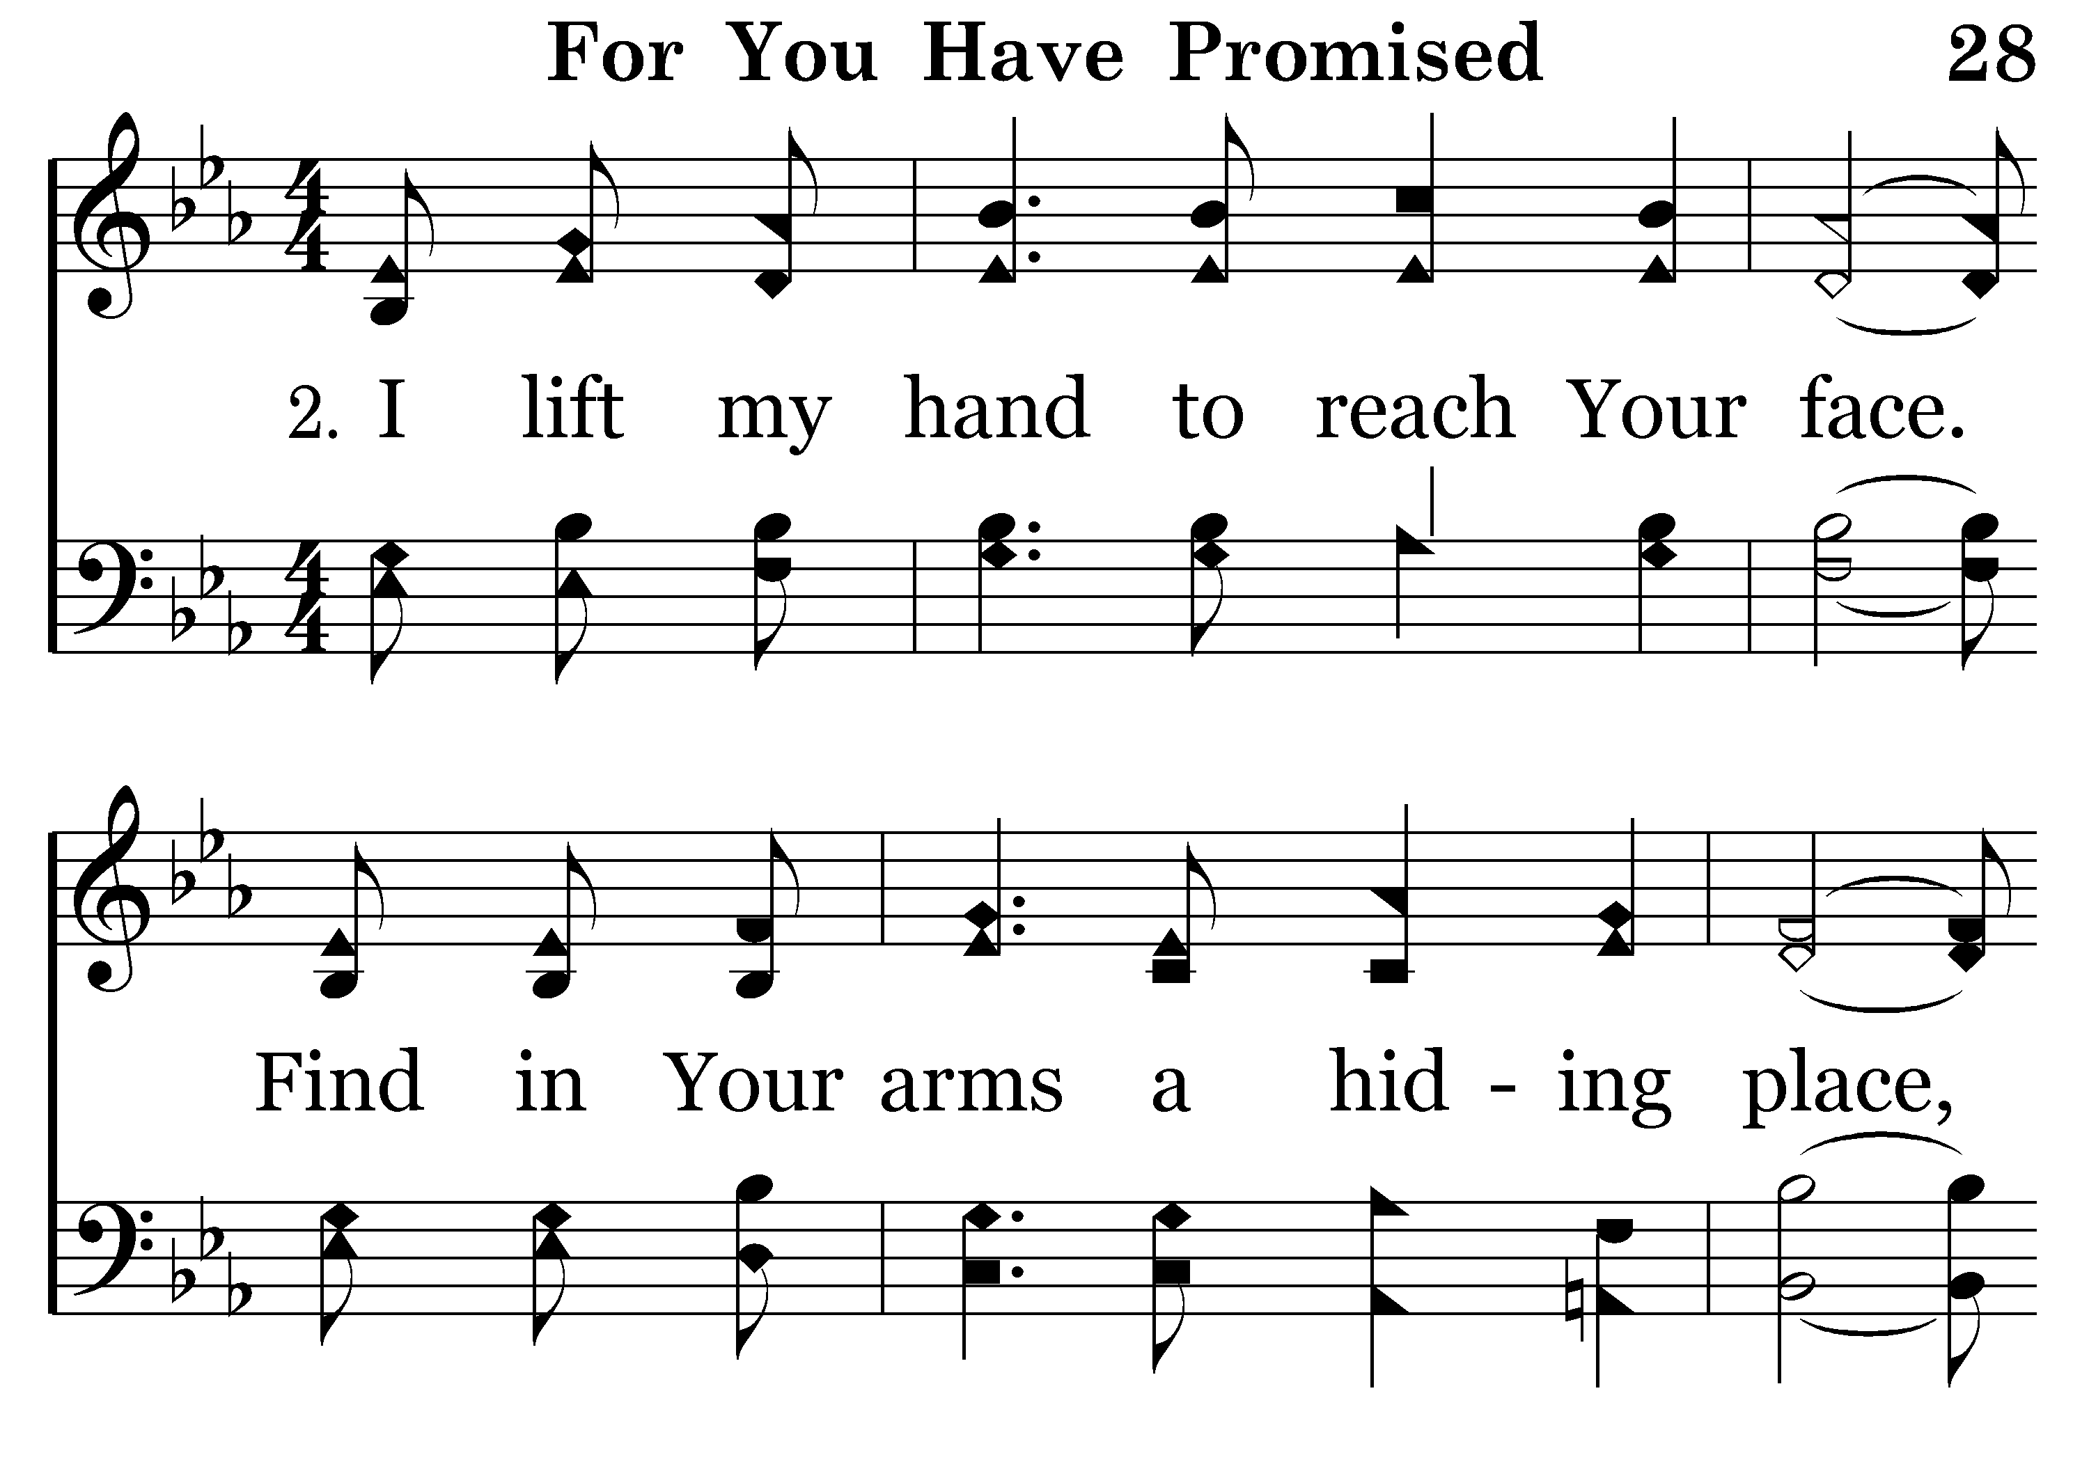
028 - For You Have Promised - 2.1

Slide 35
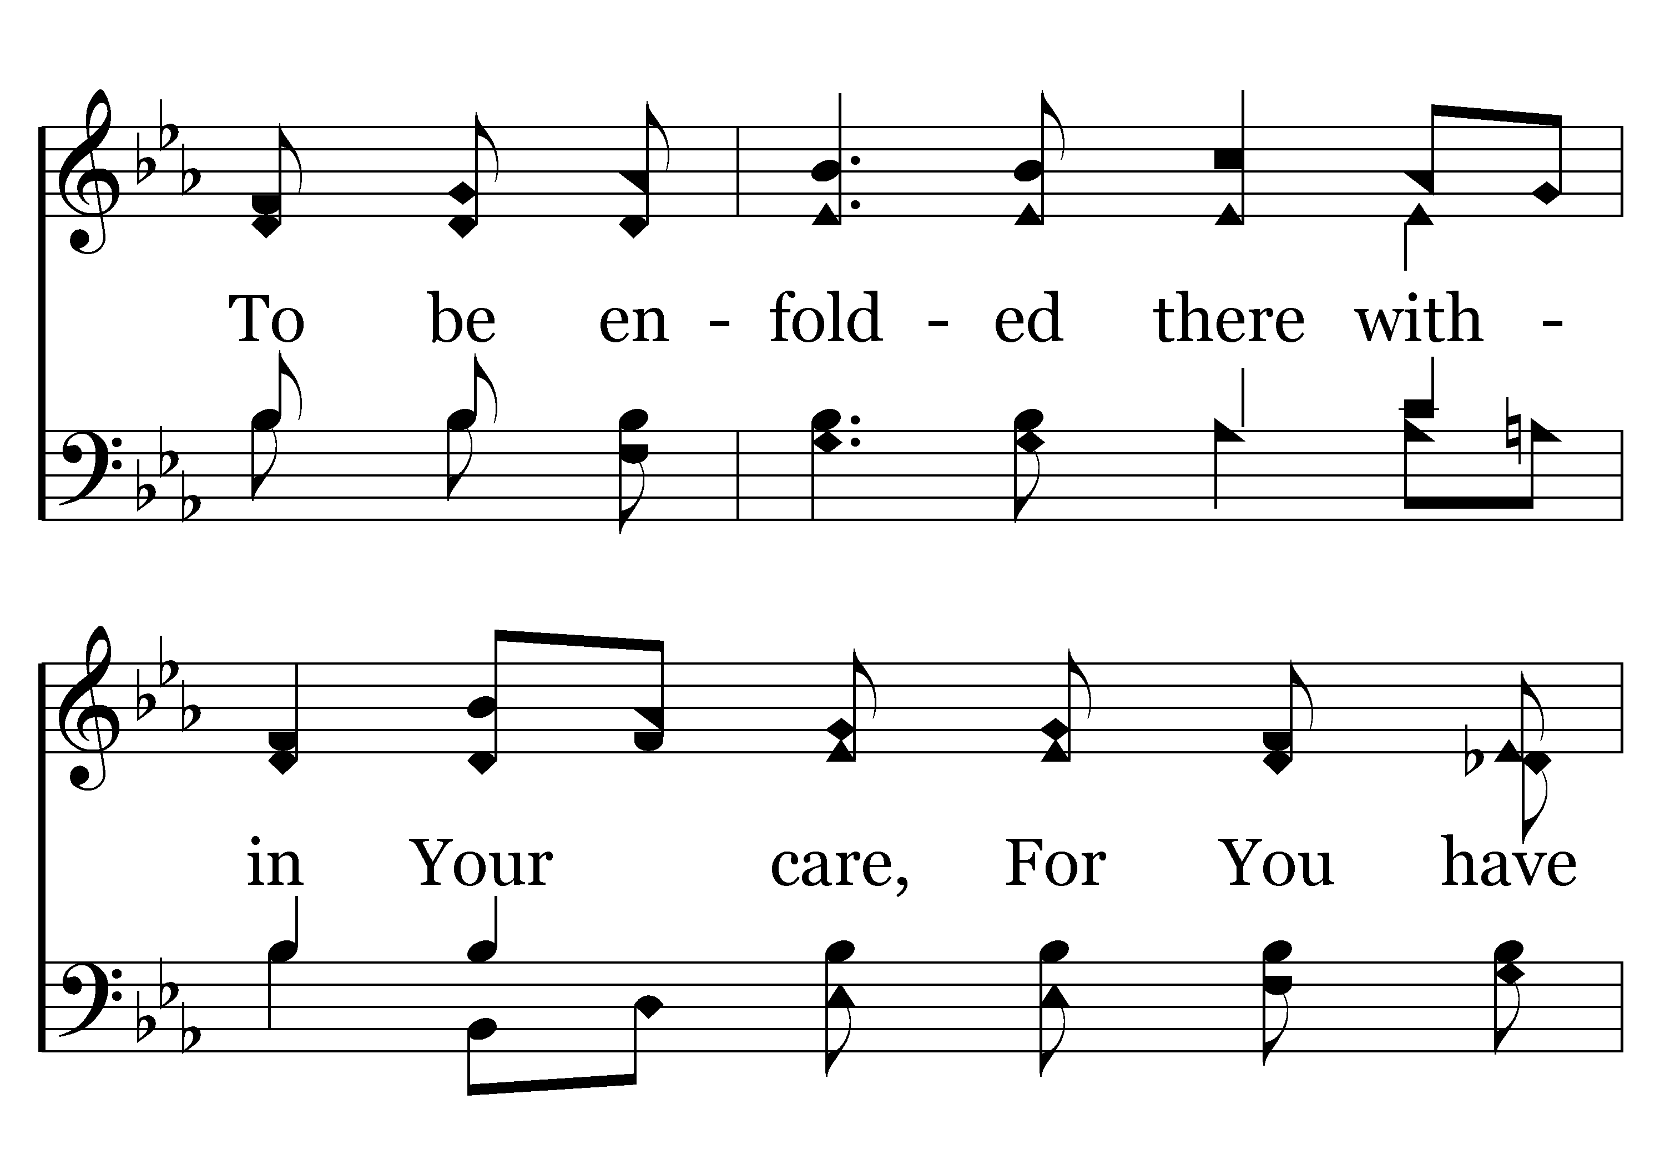
028 - For You Have Promised - 2.2

Slide 36
028 - For You Have Promised - 2.3

Slide 37
028 - For You Have Promised - C.1

Slide 38
028 - For You Have Promised - C.2

Slide 39
028 - For You Have Promised - C.3

Slide 40
028 - For You Have Promised - C.4

Slide 41
028 - For You Have Promised - C.5

Slide 42
028 - For You Have Promised - C.6
End of Verse 2

Slide 43
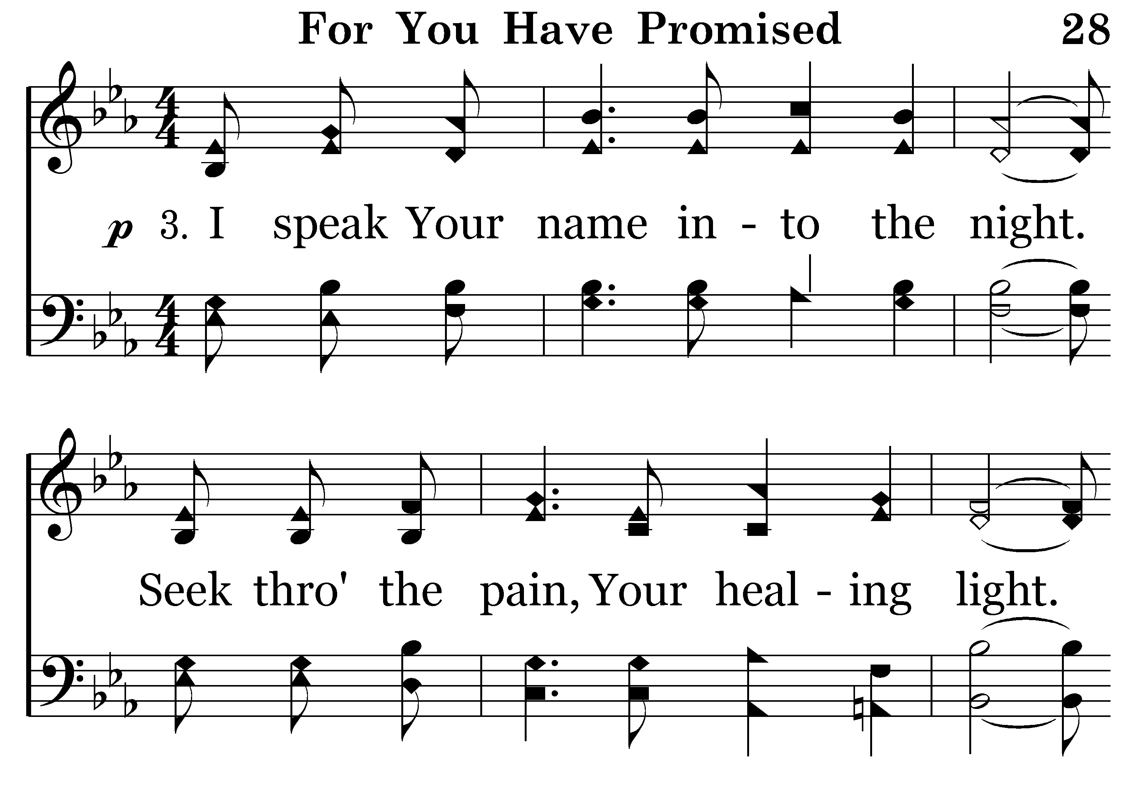
028 - For You Have Promised - 3.1

Slide 44
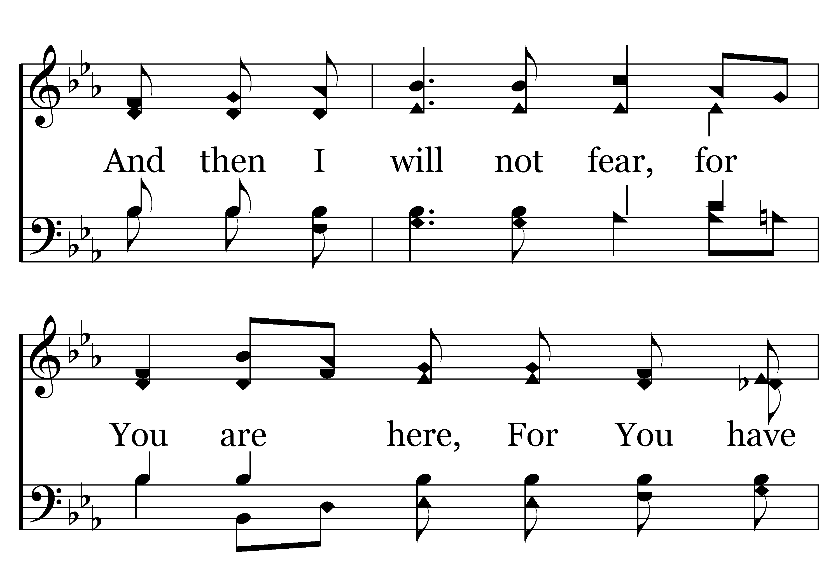
028 - For You Have Promised - 3.2

Slide 45
028 - For You Have Promised - 3.3

Slide 46
028 - For You Have Promised - C.1

Slide 47
028 - For You Have Promised - C.2

Slide 48
028 - For You Have Promised - C.3

Slide 49
028 - For You Have Promised - C.4

Slide 50
028 - For You Have Promised - C.5

Slide 51
028 - For You Have Promised - C.6
End of Verse 3

Slide 52
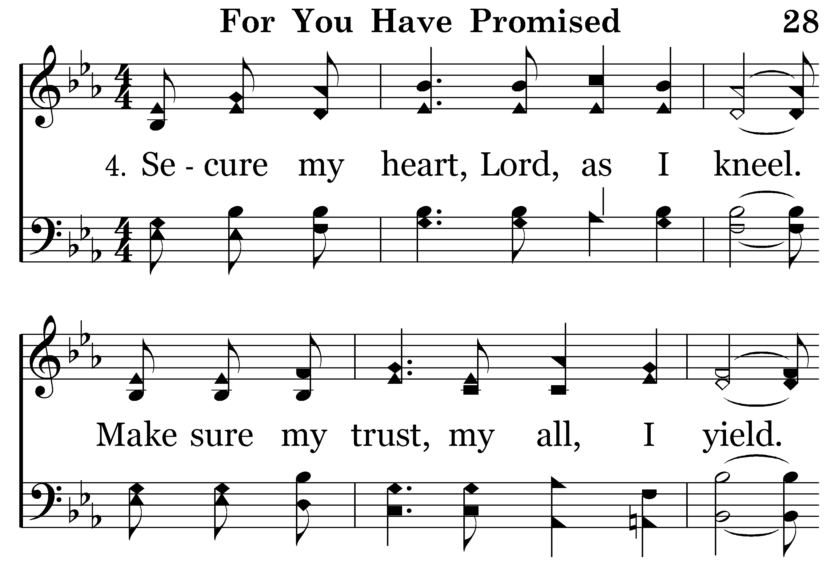
028 - For You Have Promised - 4.1

Slide 53
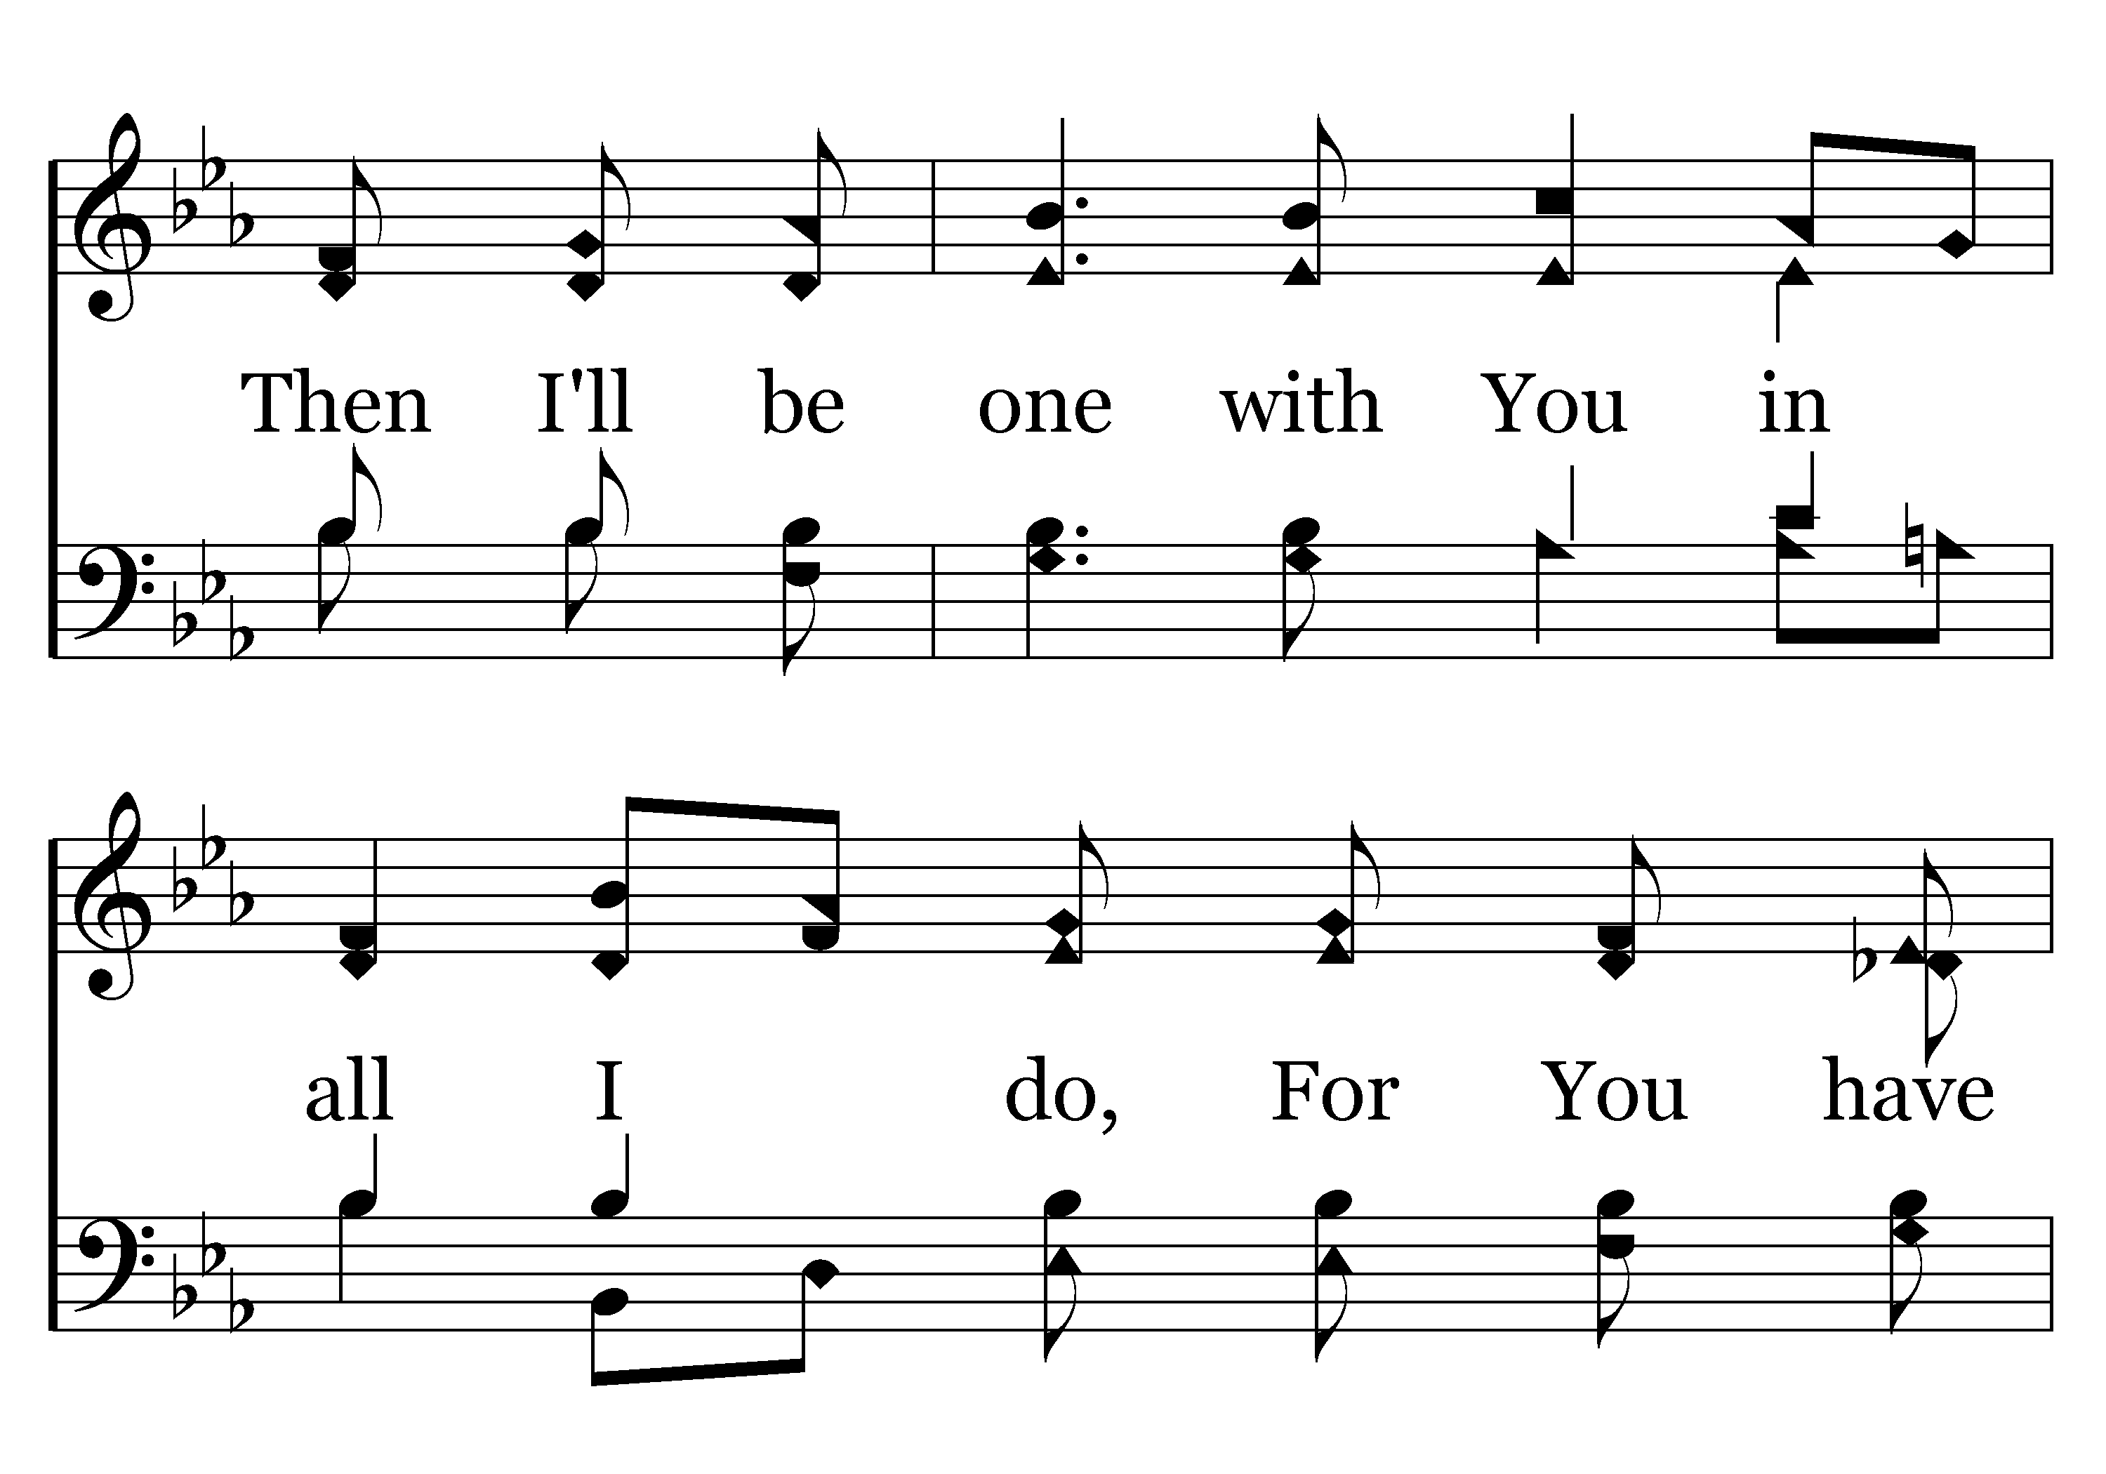
028 - For You Have Promised - 4.2

Slide 54
028 - For You Have Promised - 4.3

Slide 55
028 - For You Have Promised - C.1

Slide 56
028 - For You Have Promised - C.2

Slide 57
028 - For You Have Promised - C.3

Slide 58
028 - For You Have Promised - C.4

Slide 59
028 - For You Have Promised - C.5

Slide 60
028 - For You Have Promised - C.6
End of Song

Slide 61


Slide 62


Slide 63

576 - Faith Is The Victory - Title

Slide 64
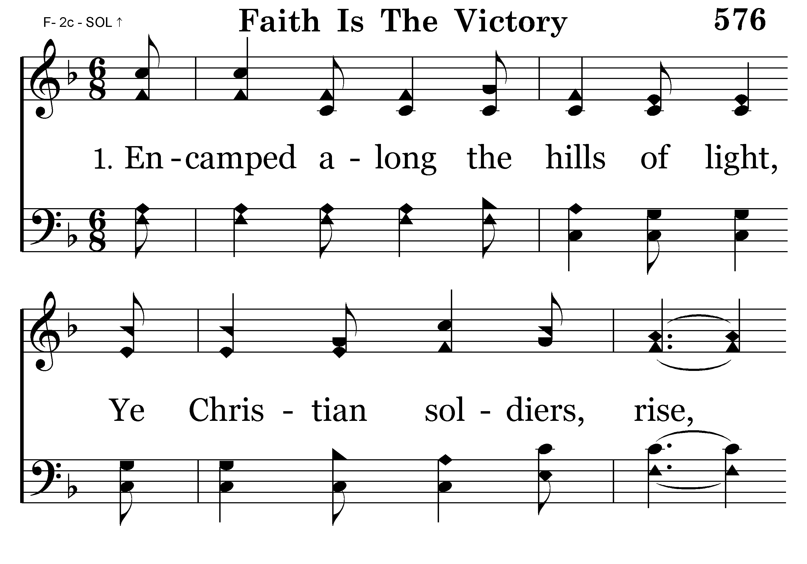
576 - Faith Is The Victory - 1.1

Slide 65
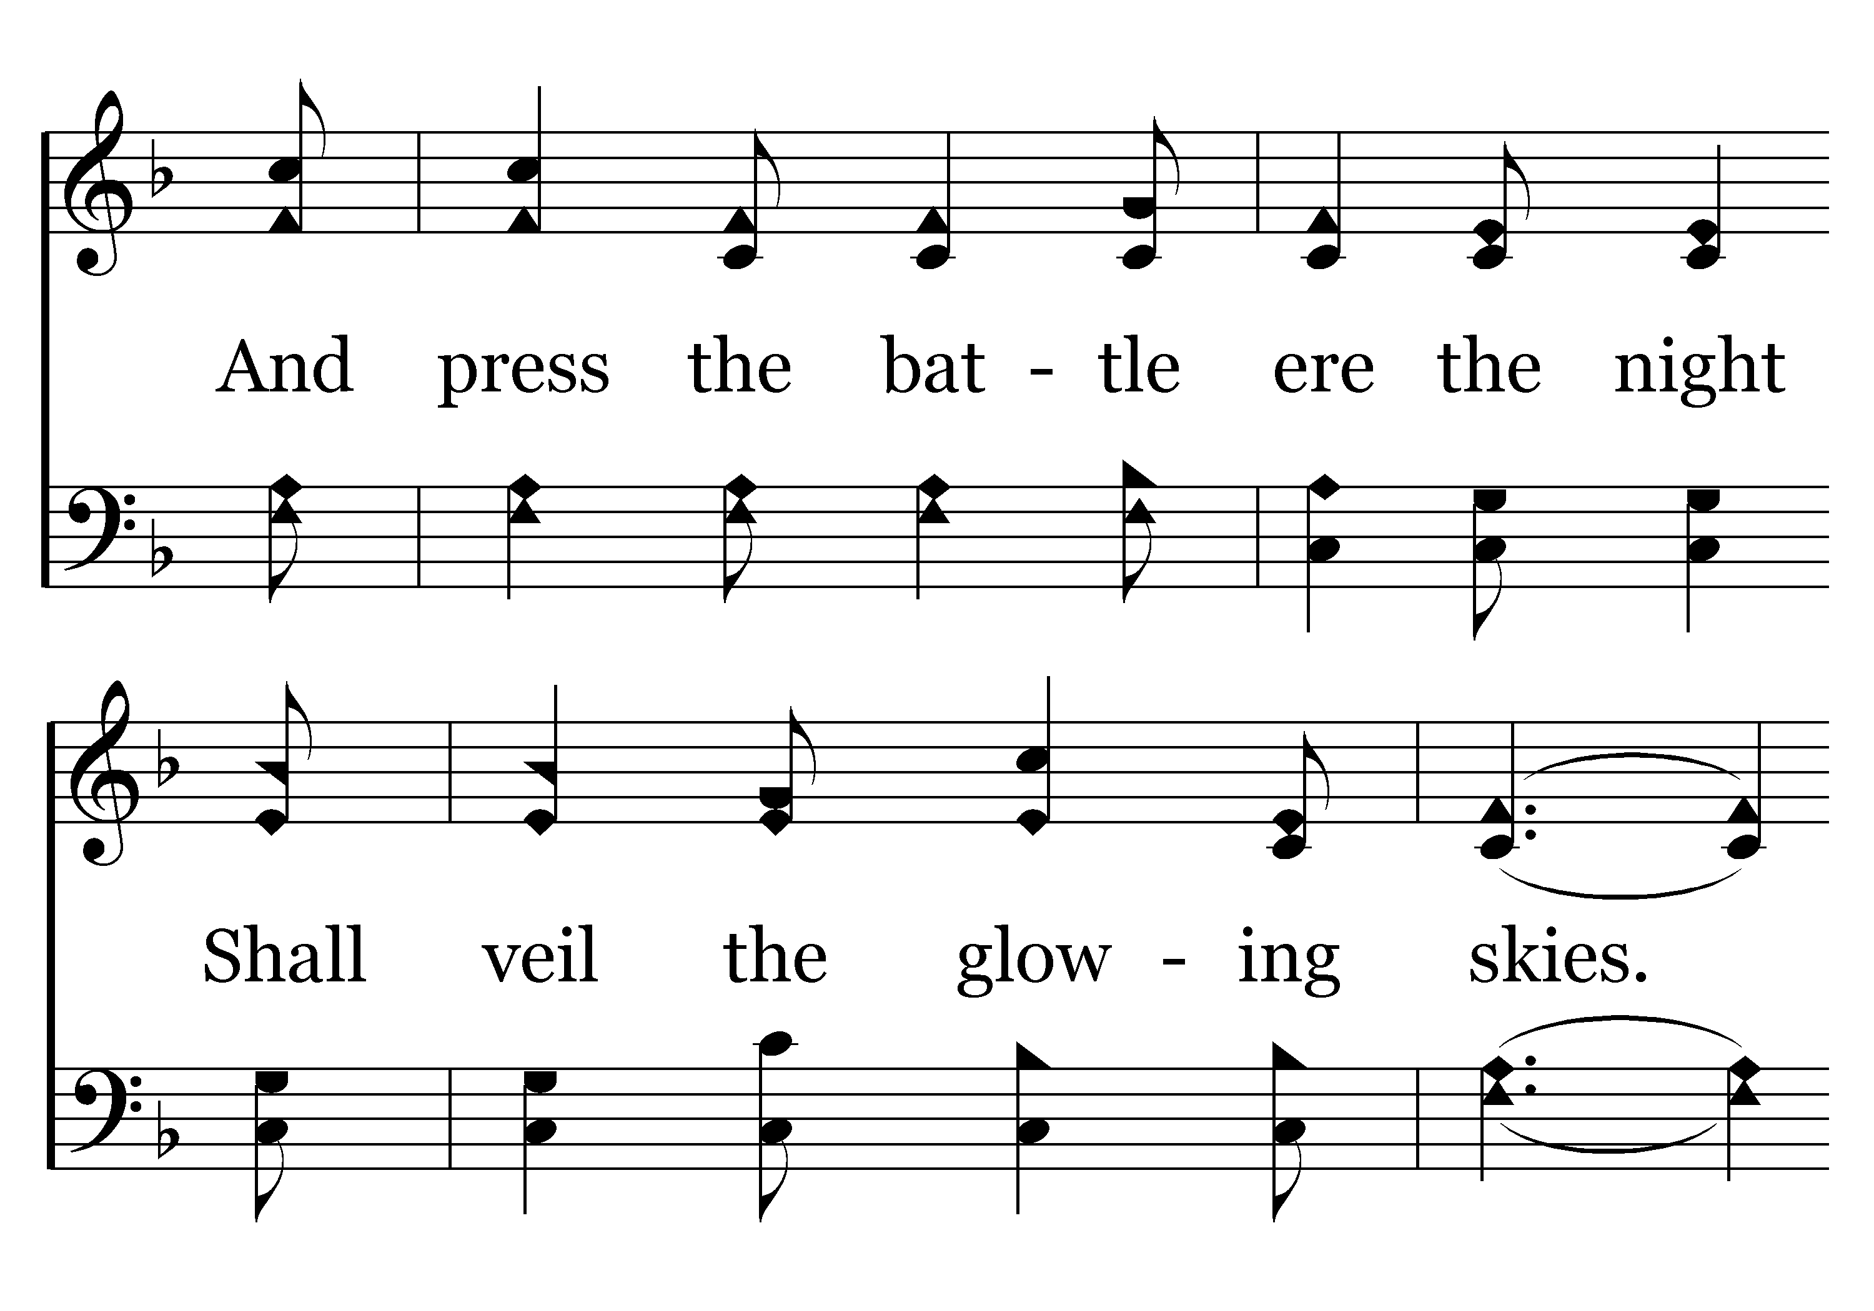
576 - Faith Is The Victory - 1.2

Slide 66
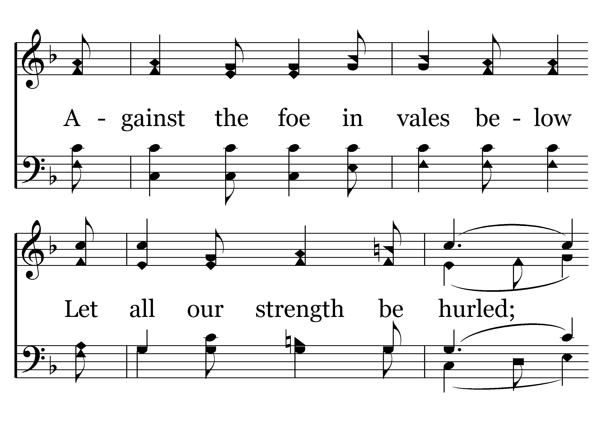
576 - Faith Is The Victory - 1.3

Slide 67
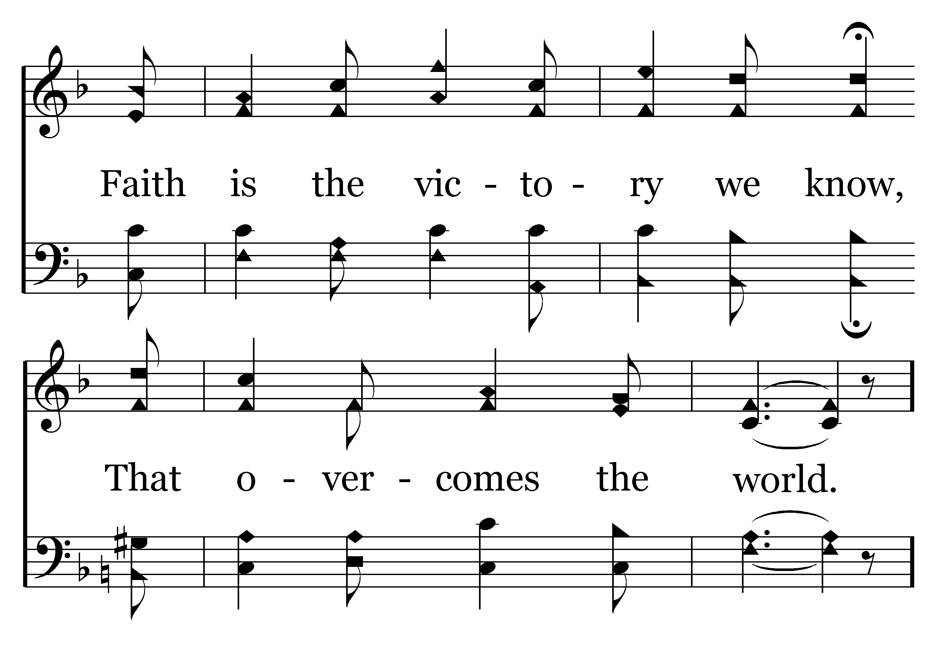
576 - Faith Is The Victory - 1.4

Slide 68
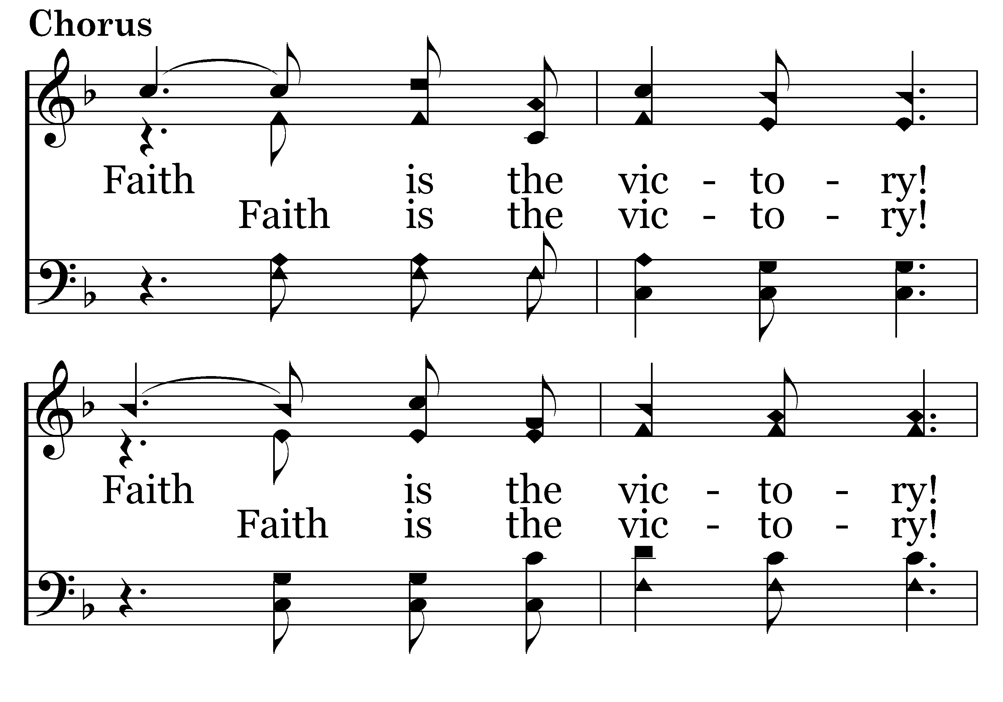
576 - Faith Is The Victory - C.1

Slide 69
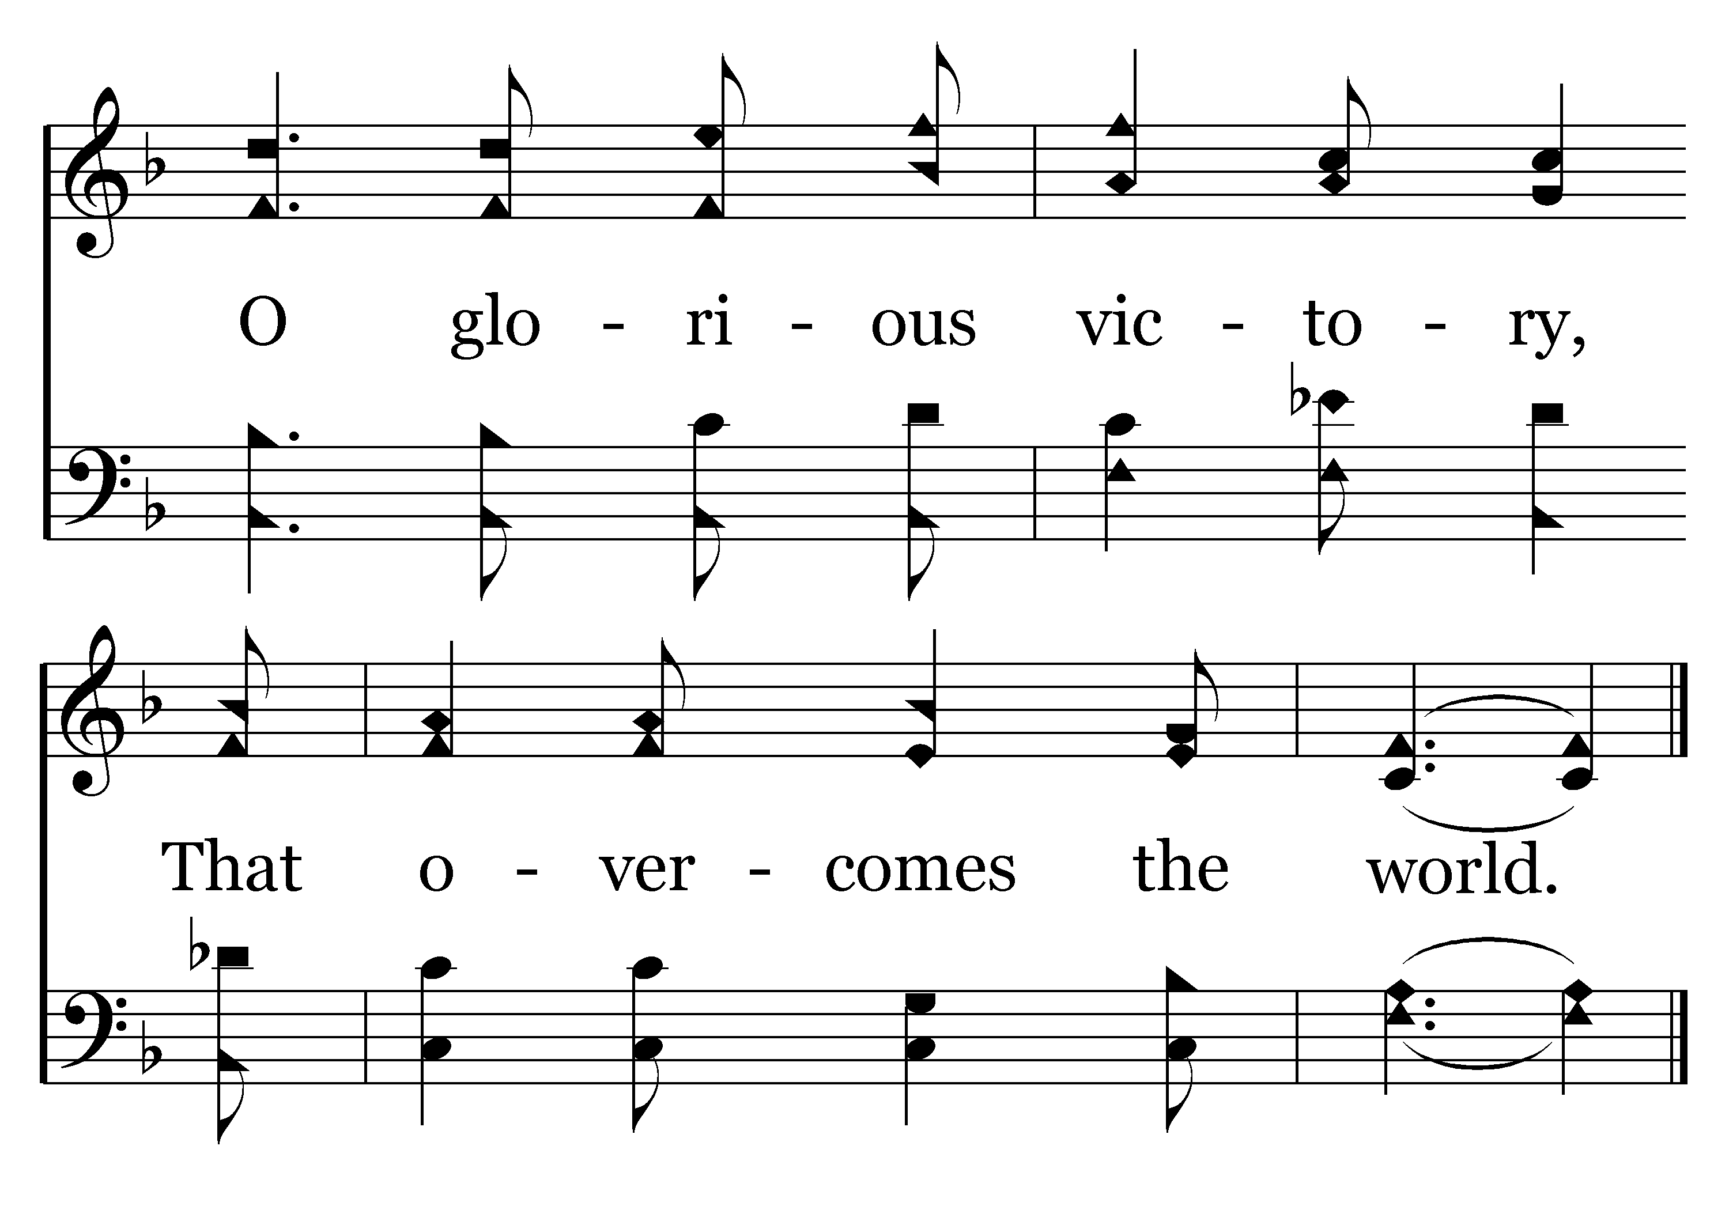
576 - Faith Is The Victory - C.2
End of Verse 1

Slide 70
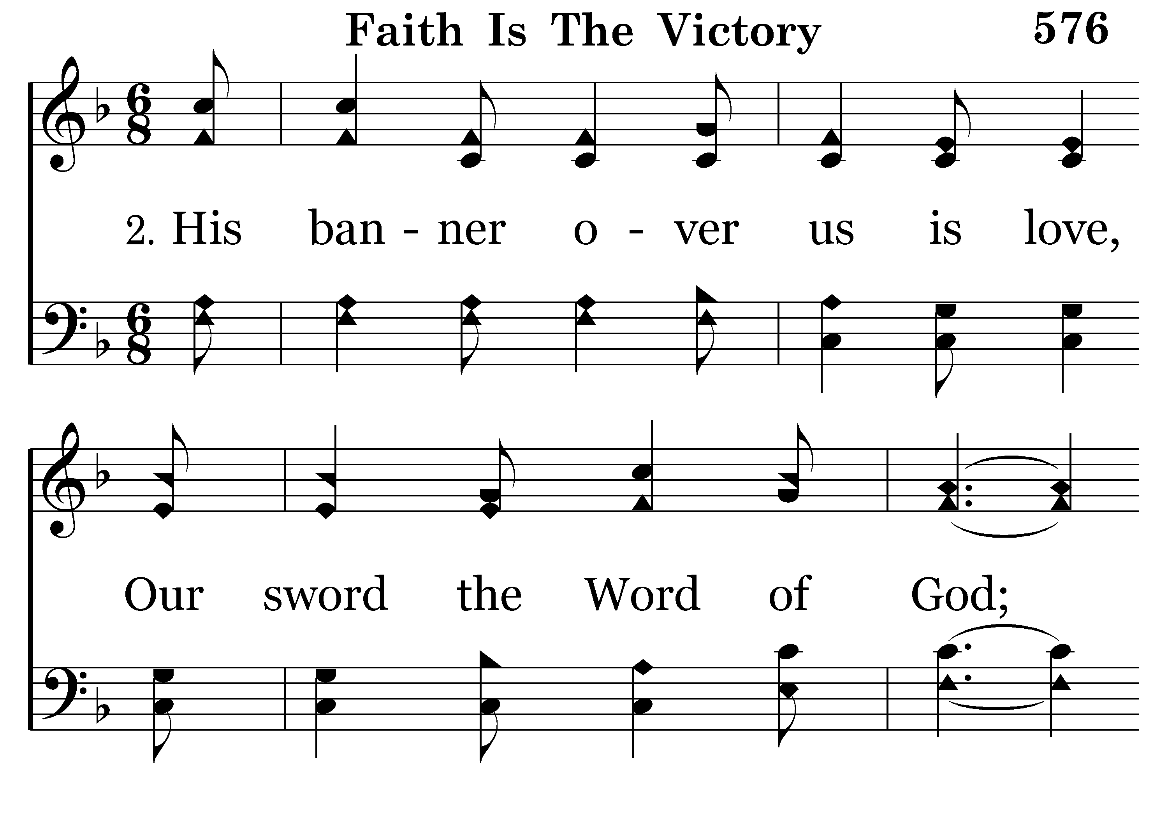
576 - Faith Is The Victory - 2.1

Slide 71
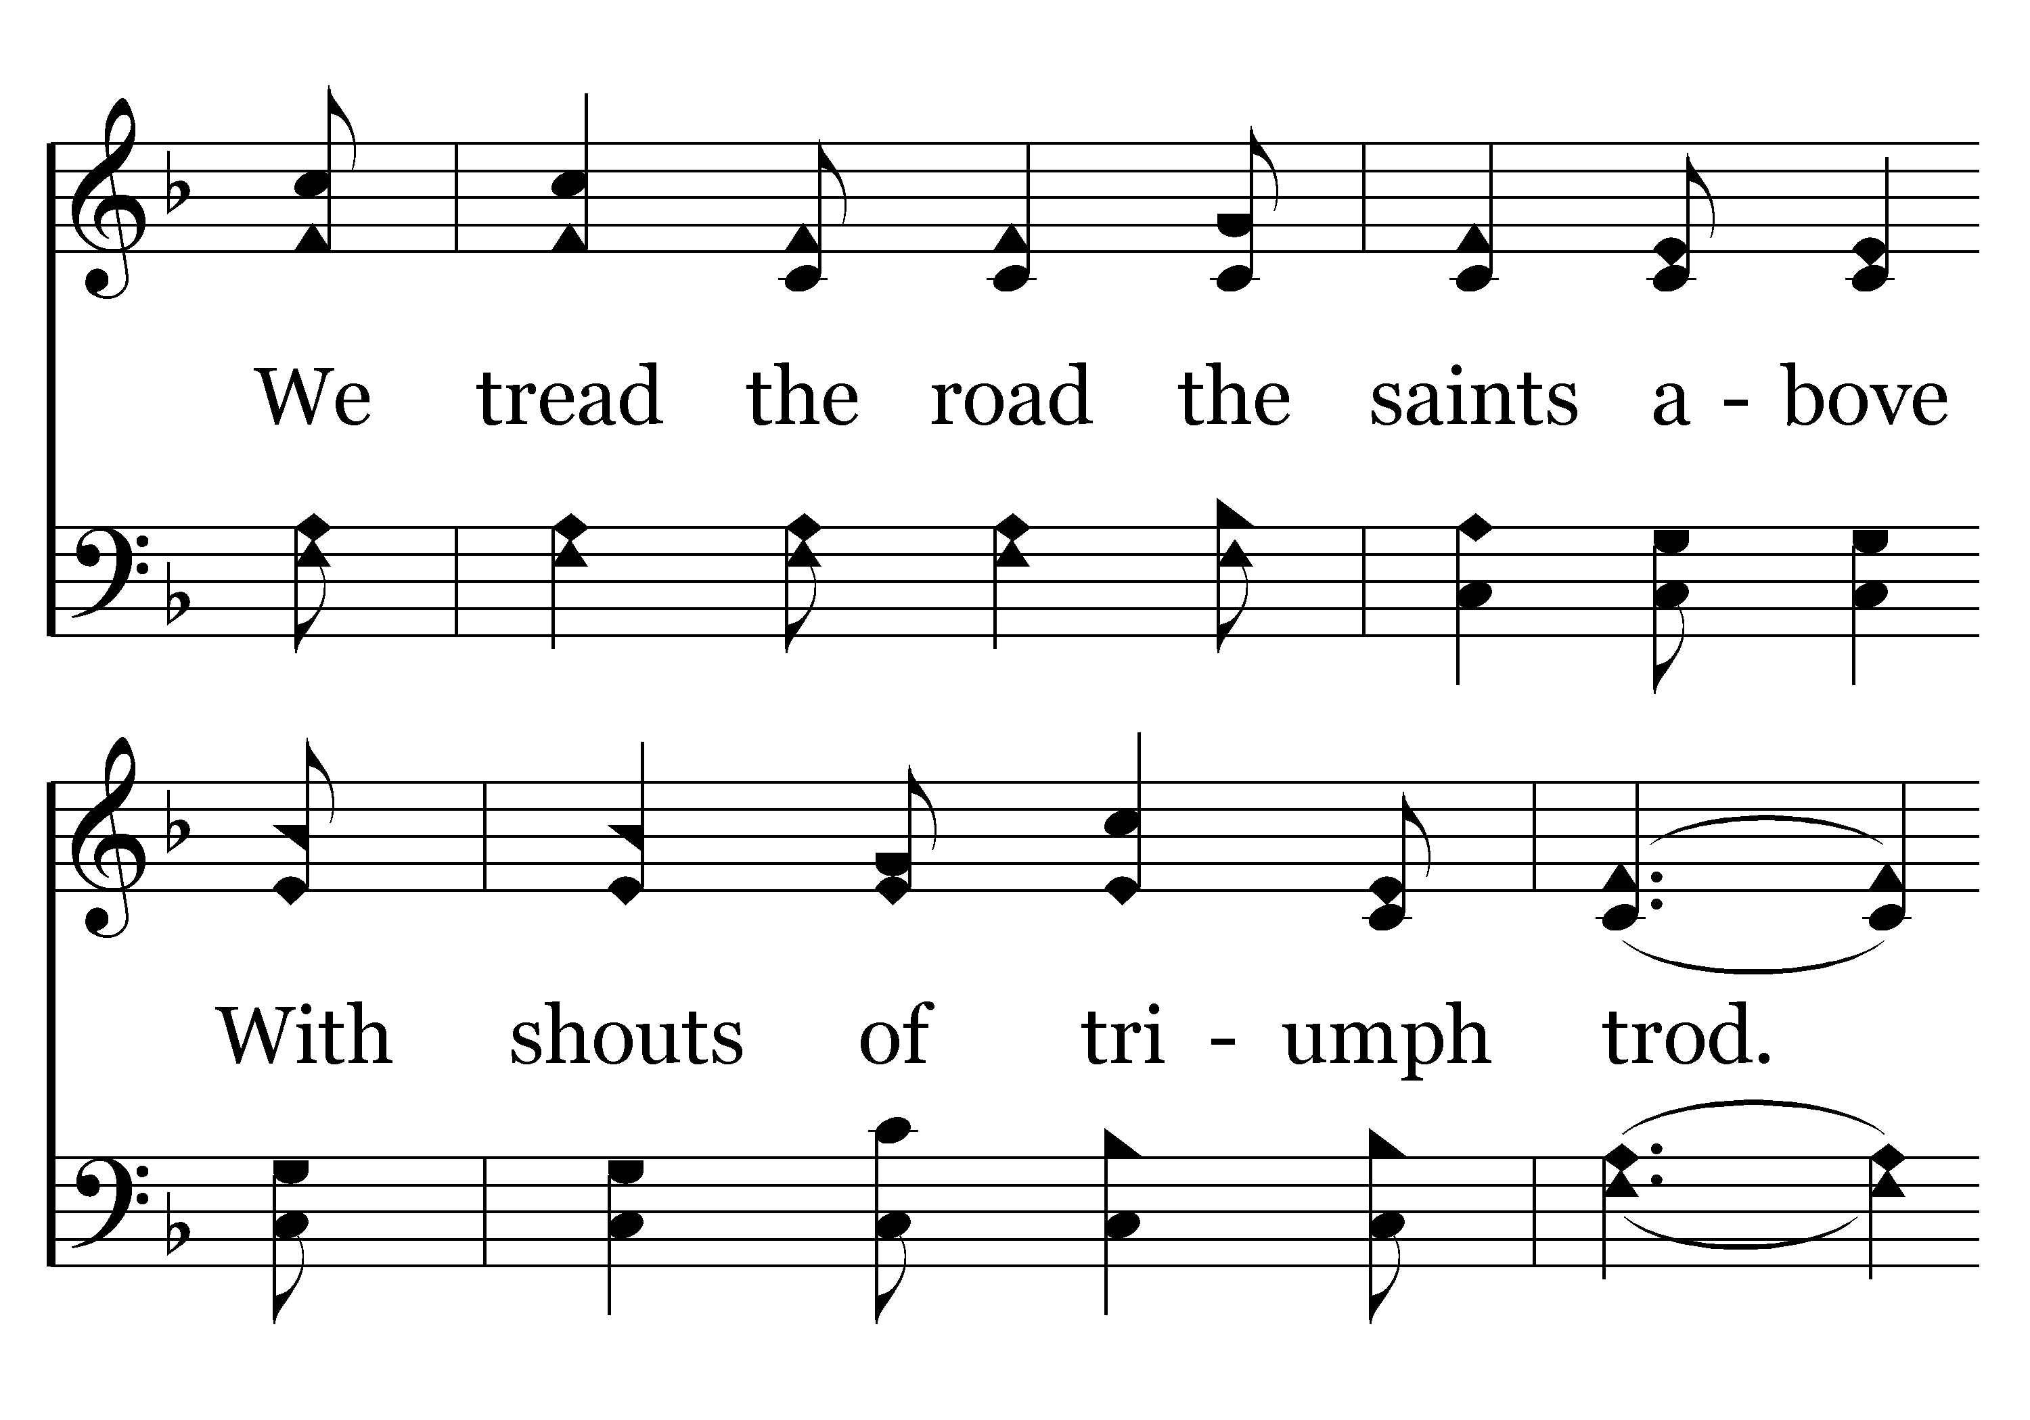
576 - Faith Is The Victory - 2.2

Slide 72
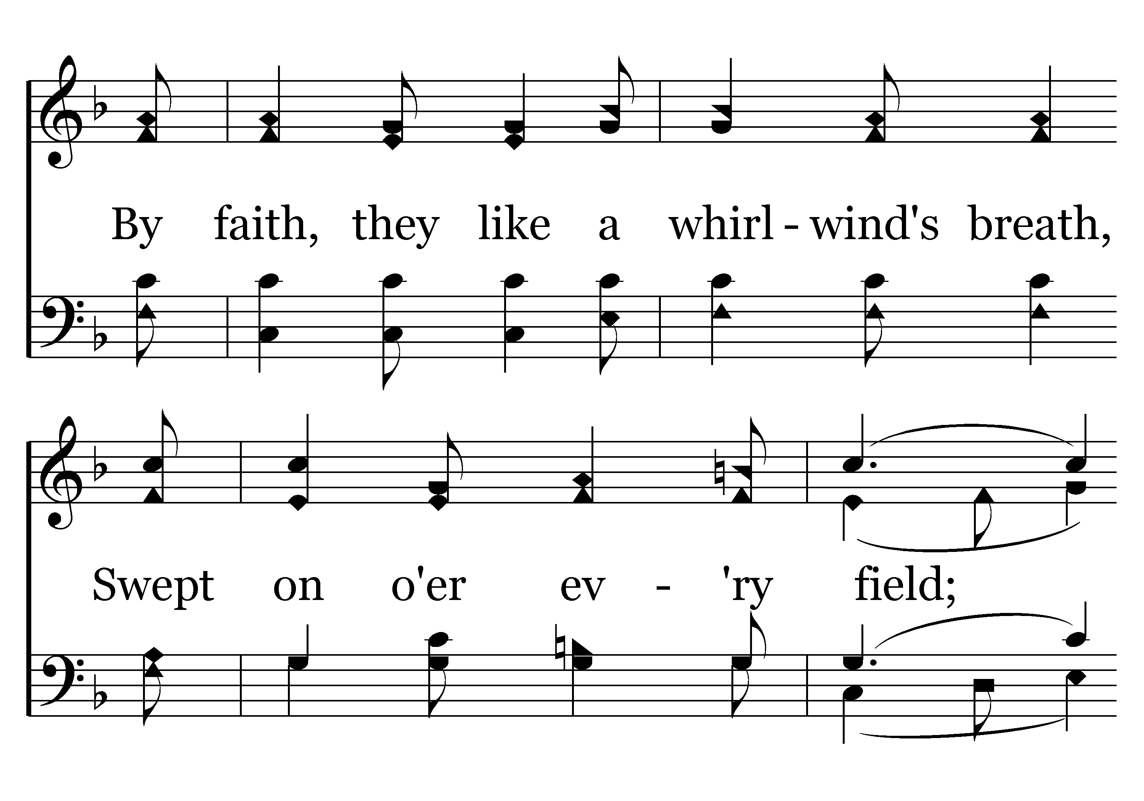
576 - Faith Is The Victory - 2.3

Slide 73
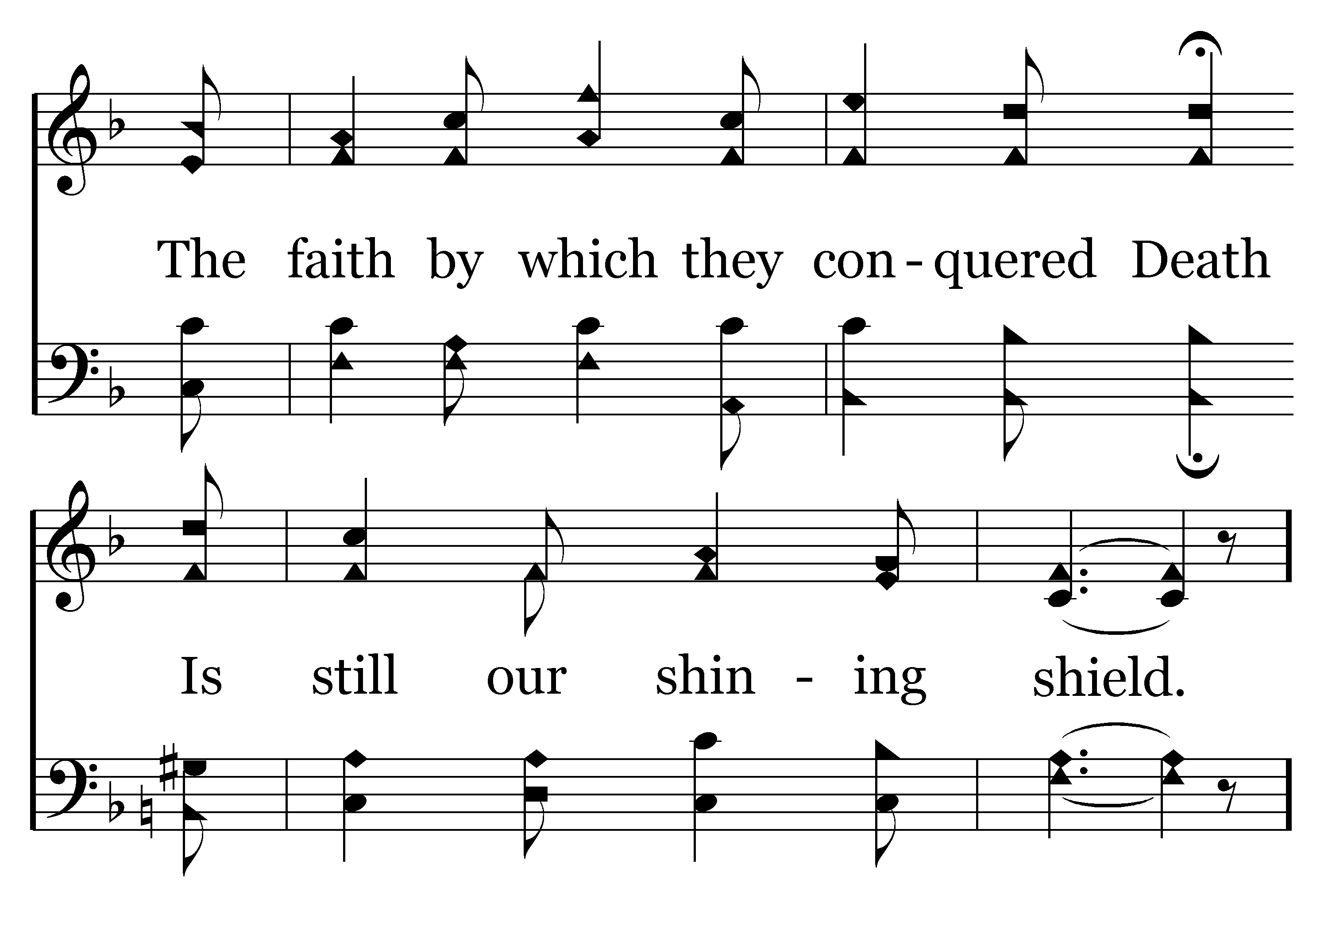
576 - Faith Is The Victory - 2.4

Slide 74
576 - Faith Is The Victory - C.1

Slide 75
576 - Faith Is The Victory - C.2
End of Verse 2

Slide 76
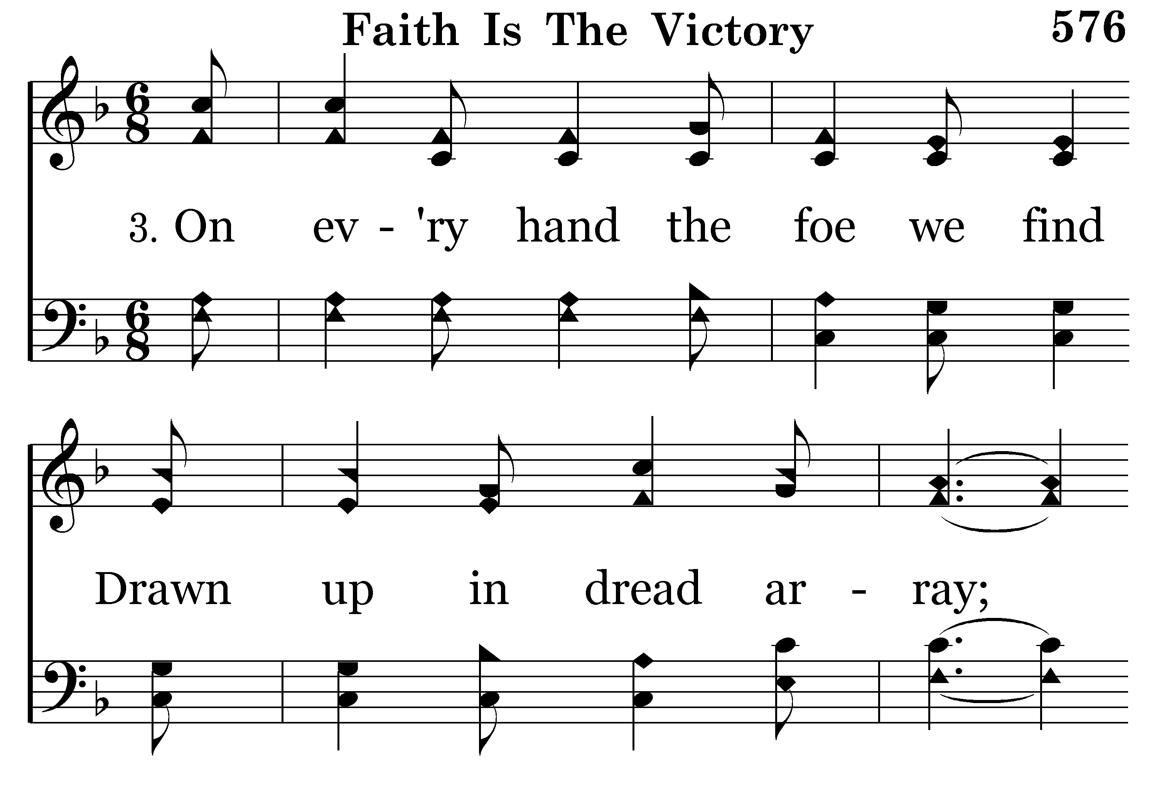
576 - Faith Is The Victory - 3.1

Slide 77
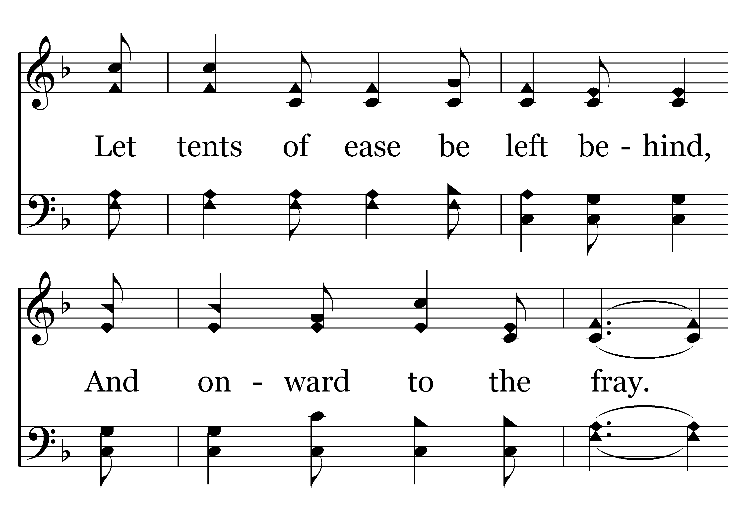
576 - Faith Is The Victory - 3.2

Slide 78
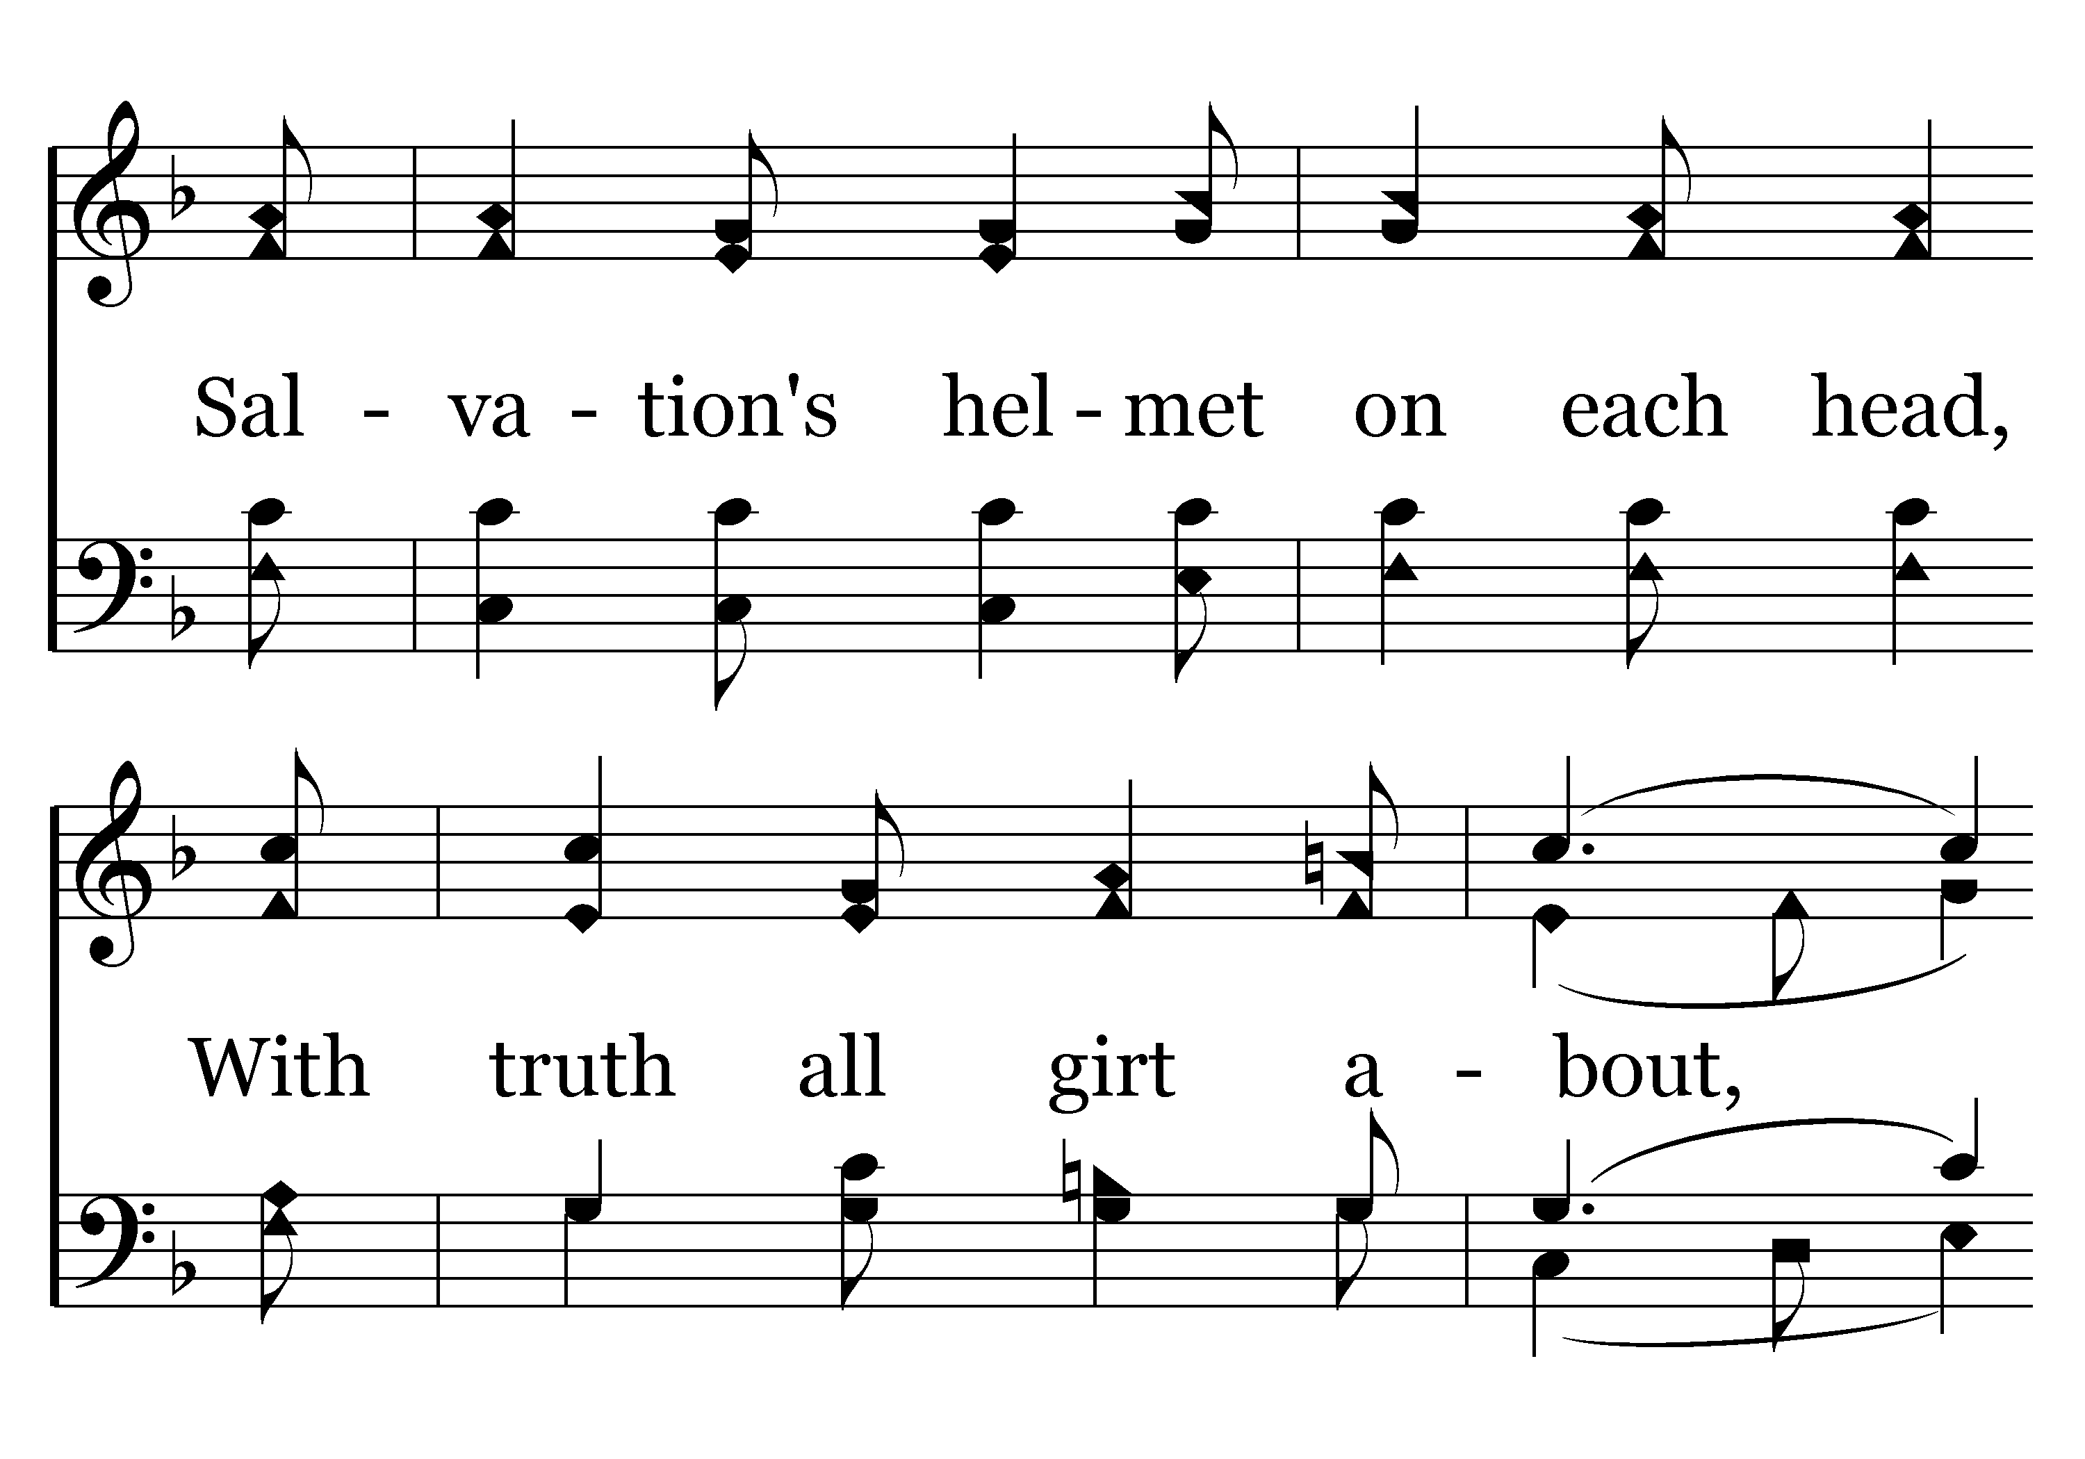
576 - Faith Is The Victory - 3.3

Slide 79
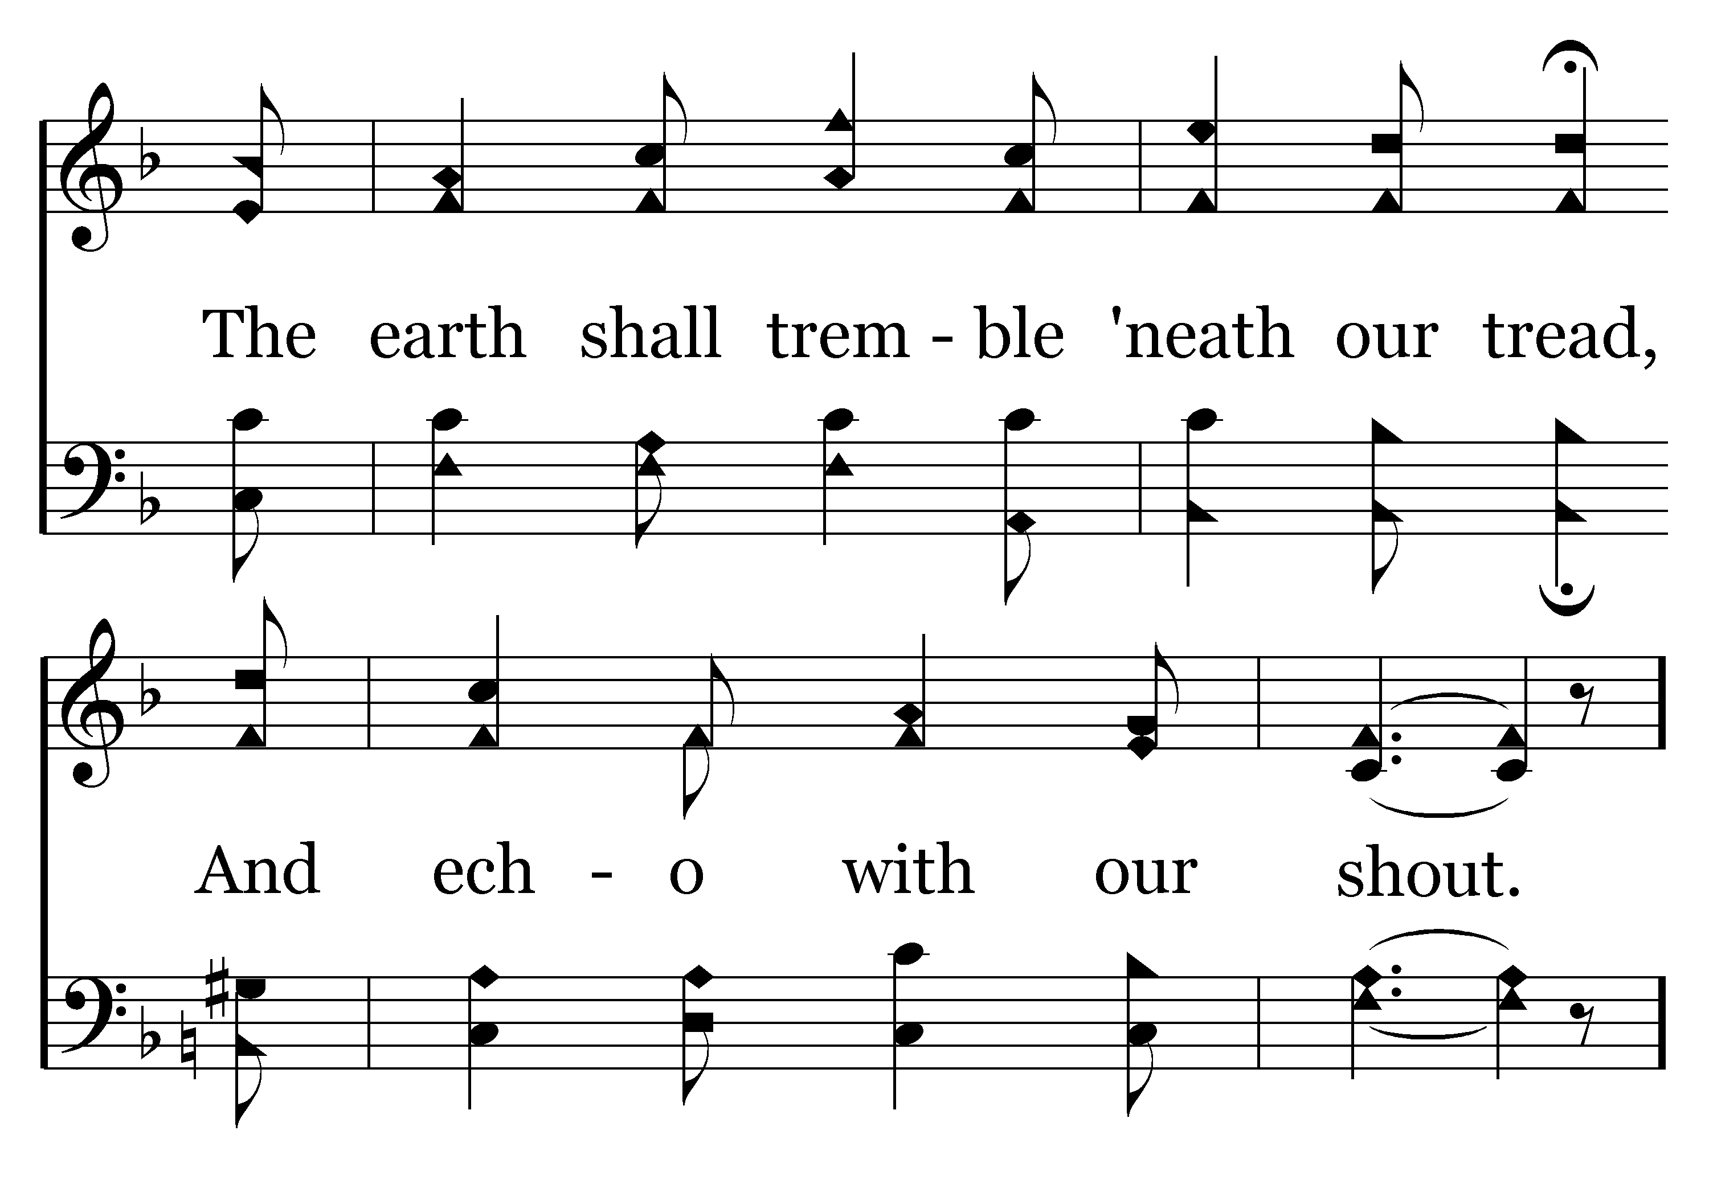
576 - Faith Is The Victory - 3.4

Slide 80
576 - Faith Is The Victory - C.1

Slide 81
576 - Faith Is The Victory - C.2
End of Song

Slide 82



Slide 84
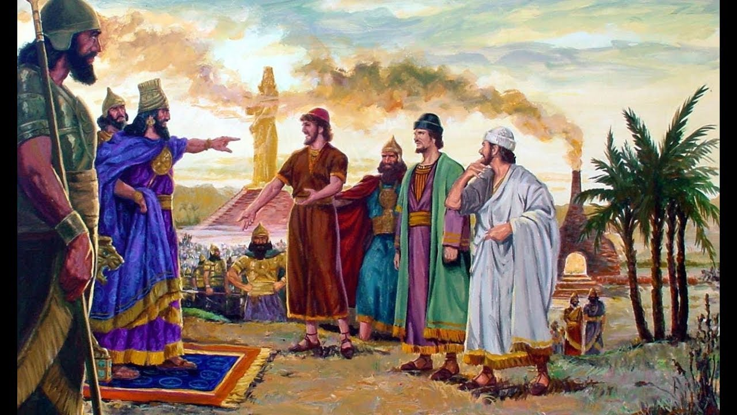
Faith in the Face of Fire
Daniel 3

Slide 85
Their Trial vs. 8-15
They had a choice to make - sacrifice their lives or
sacrifice their convictions.

Slide 86
Their Testimony vs. 16-18
They demonstrated their faith in the power of God (vs. 16-17).
They demonstrated their faith in the will of God (v. 18).

Slide 87
Their Triumph vs. 19-30
A new sense of freedom (vs. 23-25)
A new source of fellowship (v. 25)
A new person praising God (vs. 27-29)
A new opportunity for service (v. 30)

Slide 89
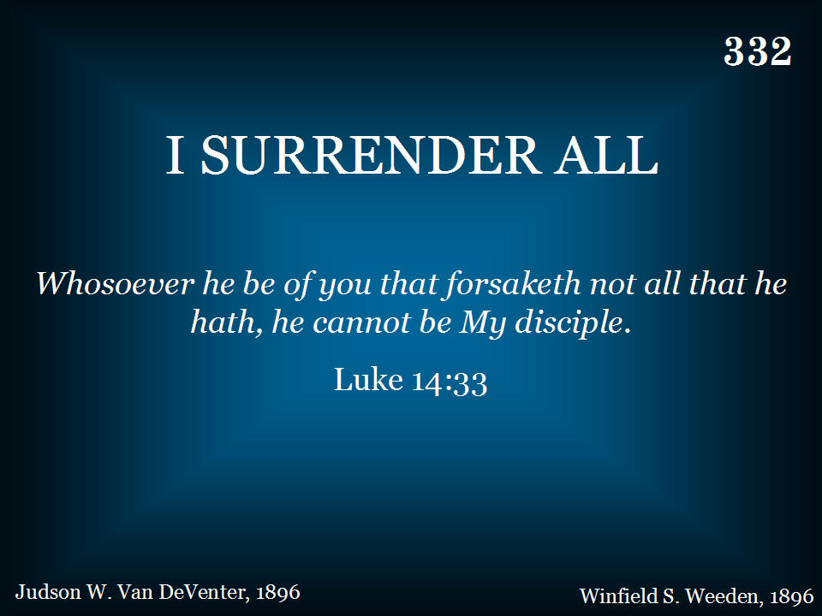
332 - I Surrender All - Title

Slide 90
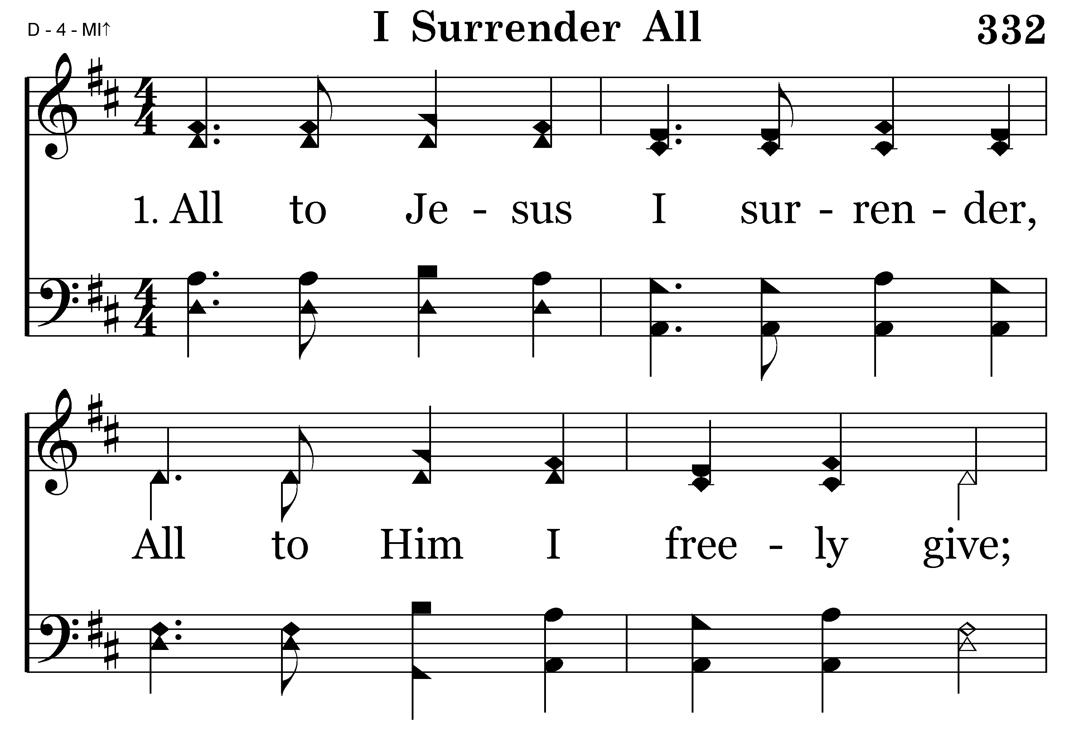
332 - I Surrender All - 1.1

Slide 91
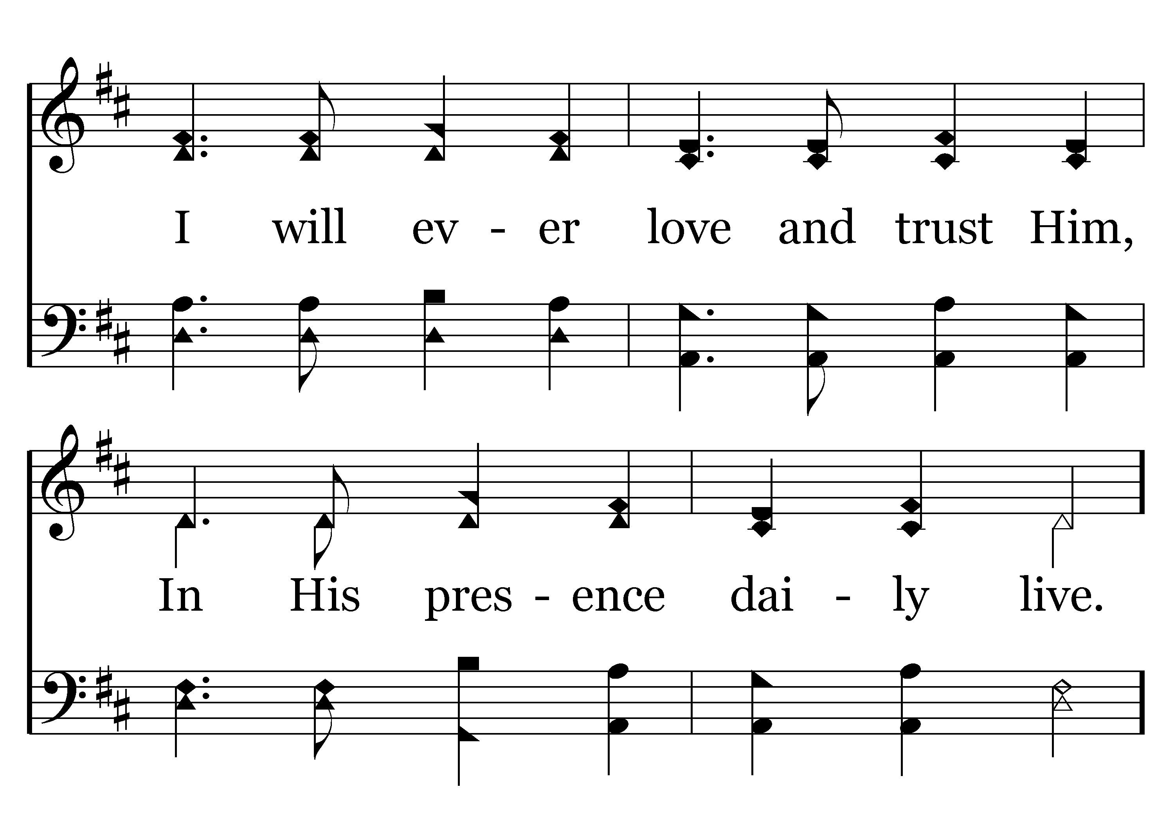
332 - I Surrender All - 1.2

Slide 92
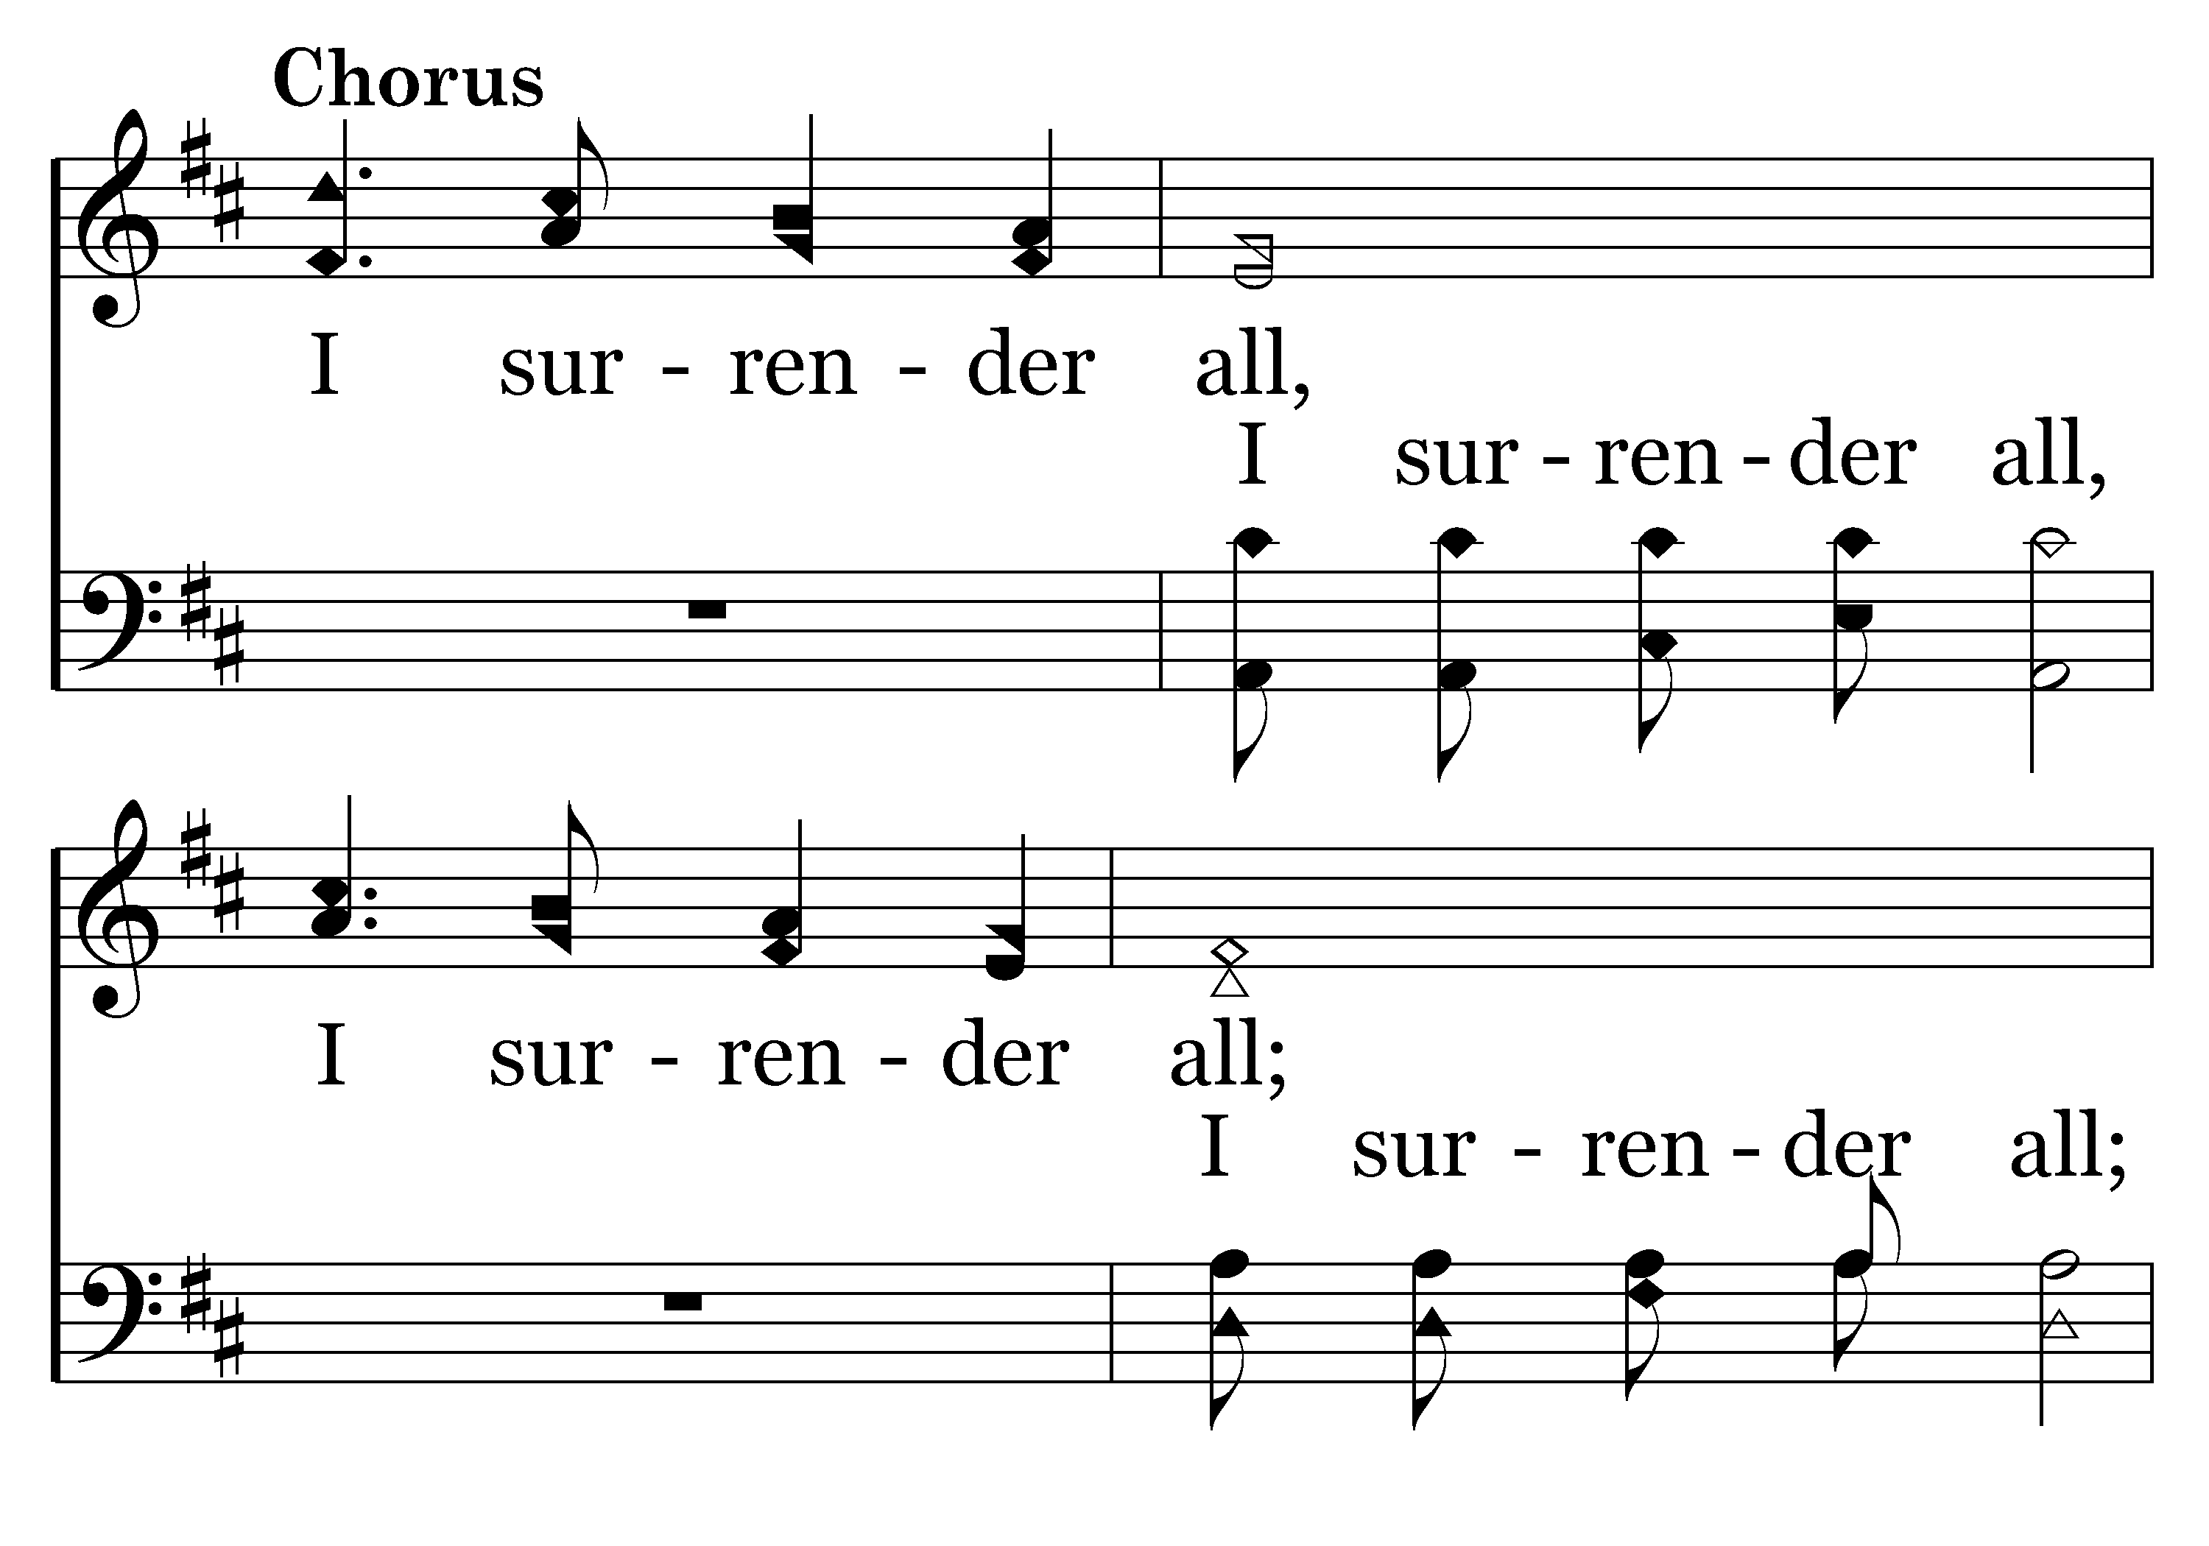
332 - I Surrender All - C.1

Slide 93

332 - I Surrender All - C.2
End of Verse 1

Slide 94

332 - I Surrender All - 2.1

Slide 95

332 - I Surrender All - 2.2

Slide 96
332 - I Surrender All - C.1

Slide 97
332 - I Surrender All - C.2
End of Verse 2

Slide 98

332 - I Surrender All - 3.1

Slide 99

332 - I Surrender All - 3.2

Slide 100
332 - I Surrender All - C.1

Slide 101
332 - I Surrender All - C.2
End of Song

Slide 102

168 - Beneath The Cross Of Jesus - Title

Slide 103

168 - Beneath The Cross Of Jesus - 1.1

Slide 104

168 - Beneath The Cross Of Jesus - 1.2

Slide 105

168 - Beneath The Cross Of Jesus - 1.3

Slide 106

168 - Beneath The Cross Of Jesus - 1.4
End of Verse 1

Slide 107

168 - Beneath The Cross Of Jesus - 2.1

Slide 108

168 - Beneath The Cross Of Jesus - 2.2

Slide 109

168 - Beneath The Cross Of Jesus - 2.3

Slide 110

168 - Beneath The Cross Of Jesus - 2.4
End of Verse 2

Slide 111

168 - Beneath The Cross Of Jesus - 3.1

Slide 112

168 - Beneath The Cross Of Jesus - 3.2

Slide 113

168 - Beneath The Cross Of Jesus - 3.3

Slide 114

168 - Beneath The Cross Of Jesus - 3.4
End of Song

Slide 115


Slide 117

Vacation Bible School
Mon-Fri, June 24-28
Youth Lecture Series
Sat-Sun, July 13-14 with Mark Russell
Booth at Greene County Fair
July 28-August 3 – 5:00-9:00pm

