Slide 2
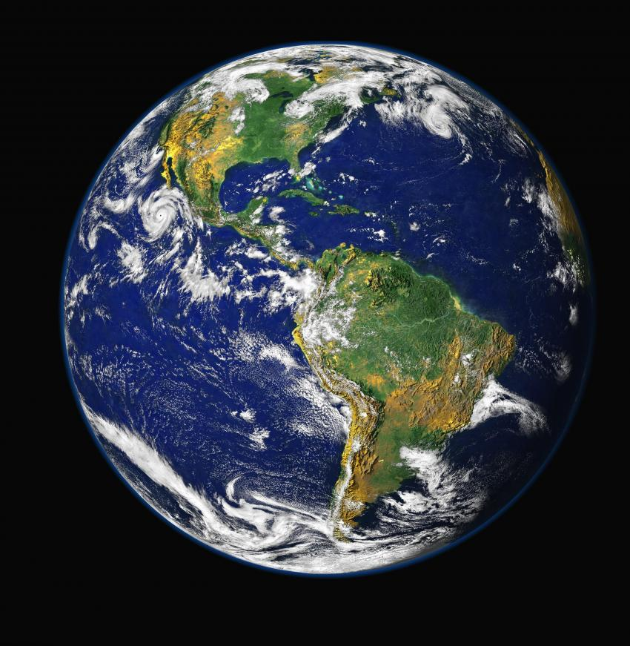
Overcoming Worldliness
Drugs & Alcohol Materialism
Fornication Stealing
Homosexuality Gambling
Pornography Dancing
Immodest Dress
Sinful Entertainment
Sinful Speech

Slide 3

The Dangers of Materialism

Slide 4
What is Materialism?
Materialism is defined as a “preoccupation with or emphasis on material objects, comforts, and considerations, with a disinterest in or rejection of spiritual, intellectual, or cultural values.”
www.dictionary.com

Slide 5
1. Materialism Cannot Deliver What It Promises

Slide 6
1. Materialism Cannot Deliver What It Promises
mirth, pleasure, laughter (Eccl. 2:1-2)
fine dining (v. 3)
beautiful homes, pools, gardens, orchards, vineyards (vs. 4-6)
numerous servants to do his work for him (v. 7)
great herds and flocks (v. 7)
silver, gold, valuables (v. 8)
entertainment (v. 8)
power and fame (v. 9)

Slide 7
1. Materialism Cannot Deliver What It Promises
mirth, pleasure, laughter (Eccl. 2:1-2)
fine dining (v. 3)
beautiful homes, pools, gardens, orchards, vineyards (vs. 4-6)
numerous servants to do his work for him (v. 7)
great herds and flocks (v. 7)
silver, gold, valuables (v. 8)
entertainment (v. 8)
power and fame (v. 9)
Then I looked on all the works that my hands had done and on the labor in which I had toiled; and indeed all was vanity and grasping for the wind. There was no profit under the sun” (v. 11).

Slide 8
1. Materialism Cannot Deliver What It Promises
Materialism is vanity (Eccl. 2:11).
Does not satisfy (5:10).
Requires management and upkeep (v. 11).
Robs man of his peace (v. 12).
Worry about impact upon his family (2:18-19).

Slide 9
2. Materialism Blinds Us To Our Spiritual Needs and Responsibilities
Life is not about our possessions (Luke 12:13-21).
  Materialism makes us selfish and renders us unprepared for eternity.
Man is a spiritual being living for a brief time with a physical body in a physical world.
“He who dies with the most toys” must still face God in judgment (Eccl. 12:13-14).

Slide 10
3. Materialism Affects the Way We Treat Others
James 2:1-9
Materialism turns people into objects.
The Gospel calls upon us to love all men.

Slide 11
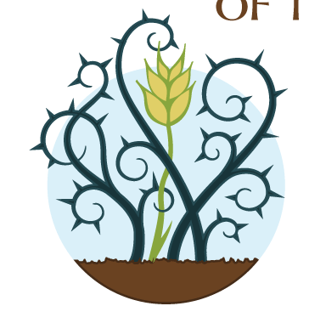
4. Materialism Prevents Spiritual Growth and Fruitfulness
Luke 8:14 – the thorny soil represents the crowded or preoccupied heart.
  Cares
  Riches
  Pleasures of Life

Slide 12
5. Materialism Draws Us Away and Drowns Us in Sorrow and Destruction
1 Timothy 6:9-10

Slide 13
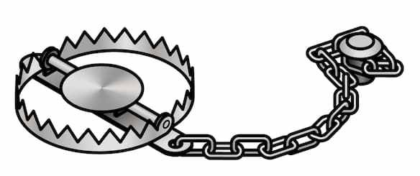
5. Materialism Draws Us Away and Drowns Us in Sorrow and Destruction
1 Timothy 6:9-10
A Trap

Slide 14
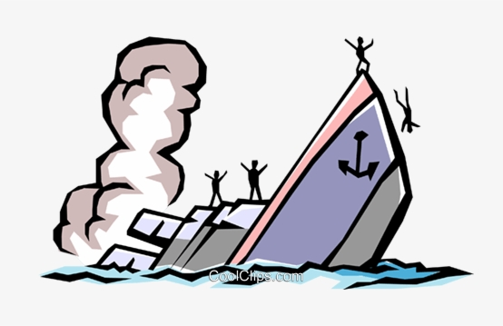
5. Materialism Draws Us Away and Drowns Us in Sorrow and Destruction
1 Timothy 6:9-10
A Trap
A Sinking Ship

Slide 15
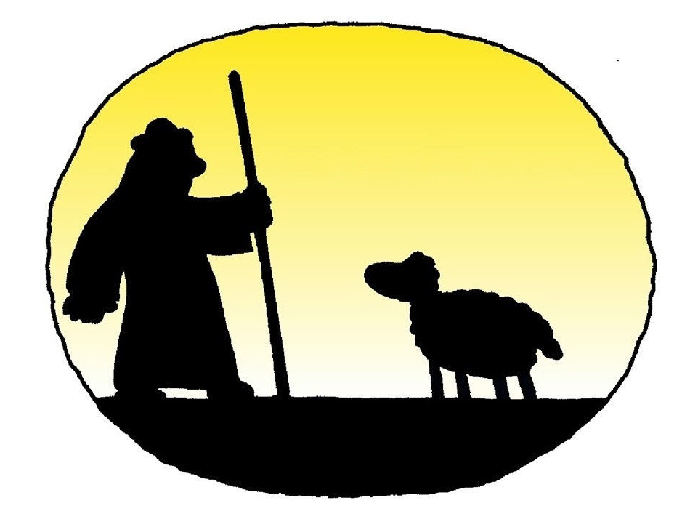
5. Materialism Draws Us Away and Drowns Us in Sorrow and Destruction
1 Timothy 6:9-10
A Trap
A Sinking Ship
A Wanderer

Slide 16

5. Materialism Draws Us Away and Drowns Us in Sorrow and Destruction
1 Timothy 6:9-10
A Trap
A Sinking Ship
A Wanderer
An Impaled Victim

Slide 17
Dangers of Materialism
Cannot Deliver What It Promises
Blinds Us To Our Spiritual Needs and Responsibilities
Affects the Way We Treat Others
Prevents Spiritual Growth and Fruitfulness
Draws Us Away and Drowns Us In Misery

