Slide 2

REPENTANCE

Slide 3
What is Repentance?
Being sorry for our sins?
2 Corinthians 7:8-10
Repentance and sorrow are connected, but they are not the same thing.
Repentance is not an emotion to be felt. It is a command to obey.

Slide 4
What is Repentance?
A changed life?
A changed life is evidence that repentance has occurred.
“bear fruits worthy of repentance” - Luke 3:7-14
“do works befitting repentance” - Acts 26:20

Slide 5
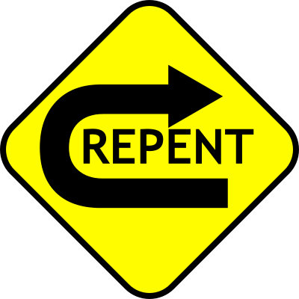
What is Repentance?
To Turn
“…that they should repent, turn to God, and do works befitting repentance” - Acts 26:20

Slide 6
What is Repentance?
To Turn
The people of Nineveh repented at the preaching of Jonah (Matt. 12:41).
“Then God saw their works, that they turned from their evil way…” (Jonah 3:10).

Slide 7
What is Repentance?
To Turn
“To open their eyes, in order to turn them from darkness to light, and from the power of Satan to God, that they may receive forgiveness of sins and an inheritance among those who are sanctified by faith in Me” (Acts 26:18).

Slide 8
How Sinners Are
Brought To Repentance
One must consider (Ezek. 18:28)…
The Goodness of God
  Rom. 2:4; Ezek. 18:29, 32; 2 Peter 3:9
The Terror of Judgment
  Ezek. 18:30-31; Acts 17:30-31
  Luke 13:3; Jonah 3:4; 2 Cor. 5:9-11

