Slide 2
Washed
Sanctified
Justified
First Corinthians 6:11

Slide 3
1 Corinthians 6:9-11
Do you not know that the unrighteous will not inherit the kingdom of God? Do not be deceived. Neither fornicators, nor idolaters, nor adulterers, nor homosexuals, nor sodomites,
nor thieves, nor covetous, nor drunkards, nor revilers, nor extortioners will inherit the kingdom of God.
And such were some of you. But you were washed, but you were sanctified, but you were justified in the name of the Lord Jesus and by the Spirit of our God.

Slide 4
1 Corinthians 6:9-11
Do you not know that the unrighteous will not inherit the kingdom of God? Do not be deceived. Neither fornicators, nor idolaters, nor adulterers, nor homosexuals, nor sodomites,
nor thieves, nor covetous, nor drunkards, nor revilers, nor extortioners will inherit the kingdom of God.
And such were some of you. But you were washed, but you were sanctified, but you were justified in the name of the Lord Jesus and by the Spirit of our God.

Slide 5
1 Corinthians 6:9-11
Do you not know that the unrighteous will not inherit the kingdom of God? Do not be deceived. Neither fornicators, nor idolaters, nor adulterers, nor homosexuals, nor sodomites,
nor thieves, nor covetous, nor drunkards, nor revilers, nor extortioners will inherit the kingdom of God.
And such were some of you. But you were washed, but you were sanctified, but you were justified in the name of the Lord Jesus and by the Spirit of our God.

Slide 6

1. I Am Washed
apopouo – “to wash off or away”
Man is powerless to cleanse himself (Titus 3:5).
This washing is done by the blood of Jesus Christ (Rev. 1:5).
This cleansing blood is contacted in baptism
(Acts 22:16).

Slide 7
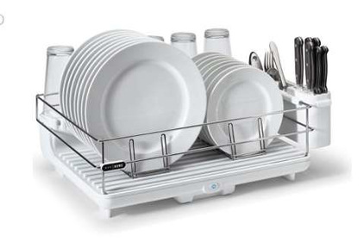
2. I Am Sanctified
hagiazo – “to make holy, purify or consecrate”
Separated from sin and set apart to God.
Removed from the world and translated into the kingdom of God’s Son (Col. 1:13).
We are now God’s
own special people
(1 Peter 2:9-10).

Slide 8
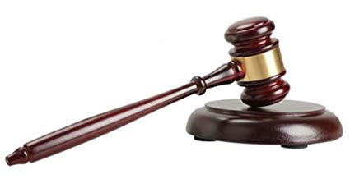
3. I Am Justified
dikaioo – “to be declared just, declared righteous”
God does not declare us to be just or righteous by ignoring our sin or overlooking our sin.
We are without guilt because our sin has been washed away in the blood of Jesus Christ
(Rom. 3:23-26).

Slide 9
If I am a Christian, I am…
Washed – no longer filthy with sin!
Sanctified – set apart from sin!
Justified – no longer guilty of sin!

Slide 10
1 Corinthians 6:9-11
Do you not know that the unrighteous will not inherit the kingdom of God? Do not be deceived. Neither fornicators, nor idolaters, nor adulterers, nor homosexuals, nor sodomites,
nor thieves, nor covetous, nor drunkards, nor revilers, nor extortioners will inherit the kingdom of God.
And such were some of you. But you were washed, but you were sanctified, but you were justified in the name of the Lord Jesus and by the Spirit of our God.

