Slide 2

Overcoming Worldliness
Drugs & Alcohol Materialism
Fornication Stealing
Homosexuality Gambling
Pornography Dancing
Immodest Dress
Sinful Entertainment
Sinful Speech

Slide 3

Immodest Dress

Slide 4
Dress Code Rules for Visitors of Ohio Inmates
All prisons in Ohio follow a dress code. The dress code is in place for the order, safety and security of visitors, inmates and staff, and is strictly adhered to. Failure to follow the dress code will result in your visit being denied. We suggest you always bring a change of clothes with you and leave them in your car. This enables you to quickly change if a staff member objects to an article of clothing you are wearing and prevents you from potentially missing out on a visit.
www.prisonpro.com/content/visiting-inmate-ohio

Slide 5
Dress Code Rules for Visitors of Ohio Inmates
All visitors must wear appropriate undergarments, underwear, bra, slip etc.
Underwear should not be visible during visits.
No clothes should expose the midriff, back, shoulders, cleavage, thighs or sides.
Sleeveless clothing, including halter tops, tank tops, tube tops, and low-cut clothing that exposes the stomach, underwear, buttocks or chest is not allowed.
Dresses, shorts, skirts, culottes etc., must not have a hem or slit above the middle of the knee.
Wrap skirts, dresses, and break away pants are not allowed.

Slide 6
Dress Code Rules for Visitors of Ohio Inmates
Clothing with holes, rips, or cut outs that expose skin are not allowed.
Tight/form fitting clothing such as spandex, leggings, Lycra, including tight jeans, tight pants, leotards, unitards, or clothing that is see through, sheer or netted is not allowed.
Excessive jewelry is not allowed, and may make the metal detector go off and require a more intrusive search.
Clothing with gang symbols, or that is associated as gang-wear is prohibited.
If your clothing contains offensive language or images you will not be allowed to visit.

Slide 7
Dress Code Rules for Visitors of Ohio Inmates
Clothing with holes, rips, or cut outs that expose skin are not allowed.
Tight/form fitting clothing such as spandex, leggings, Lycra, including tight jeans, tight pants, leotards, unitards, or clothing that is see through, sheer or netted is not allowed.
Excessive jewelry is not allowed, and may make the metal detector go off and require a more intrusive search.
Clothing with gang symbols, or that is associated as gang-wear is prohibited.
If your clothing contains offensive language or images you will not be allowed to visit.
“The dress code is in place for the order, safety and security of visitors, inmates and staff, and is strictly adhered to. Failure to follow the dress code will result in your visit being denied.”

Slide 8
Rebellion Against God
“Then the eyes of both of them were opened, and they knew that they were naked; and they sewed fig leaves together and made themselves coverings” (Gen. 3:7).
“So he said, ‘I heard Your voice in the garden, and I was afraid because I was naked; and I hid myself’” (v. 10).
“Also for Adam and his wife the Lord God made tunics of skin, and clothed them” (v. 21).

Slide 9
Rebellion Against God
Tunic (kethoneth)
“A tunic, the basic outer garment worn next to the skin, was a long shirt reaching the knees or ankles” (Wenham).
“A tunic that was worn next to a person’s body, often with long or half sleeves and reaching to the knees or ankles” (Grasham).

Slide 10
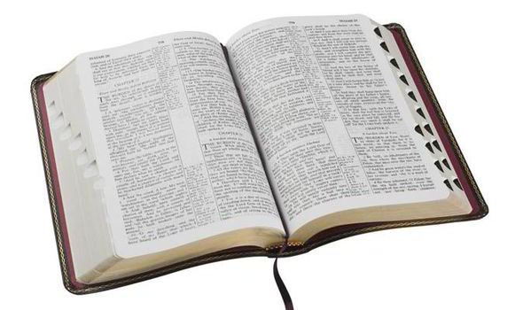
Rebellion Against God
In like manner also, that the women adorn themselves in modest apparel, with propriety and moderation, not with braided hair or gold or pearls or costly clothing,
but, which is proper for women professing godliness, with good works.
1 Timothy 2:9-10

Slide 11
Rebellion Against God
In like manner also, that the women adorn themselves in modest apparel, with propriety and moderation, not with braided hair or gold or pearls or costly clothing,
but, which is proper for women professing godliness, with good works.
1 Timothy 2:9-10

Slide 12
Rebellion Against God
In like manner also, that the women adorn themselves in modest apparel, with propriety and moderation, not with braided hair or gold or pearls or costly clothing,
but, which is proper for women professing godliness, with good works.
1 Timothy 2:9-10

Slide 13
Rebellion Against God
In like manner also, that the women adorn themselves in modest apparel, with propriety and moderation, not with braided hair or gold or pearls or costly clothing,
but, which is proper for women professing godliness, with good works.
1 Timothy 2:9-10

Slide 14
Rebellion Against God
In like manner also, that the women adorn themselves in modest apparel, with propriety and moderation, not with braided hair or gold or pearls or costly clothing,
but, which is proper for women professing godliness, with good works.
1 Timothy 2:9-10

Slide 15
Makes People Naked
One does not have to be completely nude to be naked in a Scriptural sense (Gen. 3:7, 10).
The Bible consistently associates shame with nakedness.
Rev. 3:18; 16:15; Micah 1:11; Nahum 3:5

Slide 16
Makes People Naked
Thigh
“And you shall make for them linen trousers to cover their nakedness; they shall reach from the waist to the thighs” (Ex. 28:42).
“Take the millstones and grind meal. Remove your veil, take off the skirt, uncover the thigh, pass through the rivers. Your nakedness shall be uncovered, yes, your shame will be seen…”
(Isaiah 47:2-3).

Slide 17
Makes People Naked
Buttocks
“So shall the king of Assyria lead away the Egyptians as prisoners and the Ethiopians as captives, young and old, naked and barefoot, with their buttocks uncovered, to the shame of Egypt”
(Isaiah 20:4).

Slide 18
Makes People Naked
Breasts
“I made you thrive like a plant in the field; and you grew, matured, and became very beautiful. Your breasts were formed, your hair grew, but you were naked and bare” (Ezekiel 16:7).

Slide 19
It Sends the Wrong Message
Some clothing is designed to send a message.
“the attire of a harlot” (Prov. 7:10)
Clothing that reveals the flesh or form of the “midriff, back, shoulders, cleavage, chest, thighs, sides, stomach, buttocks” sends a message to those who see it.
Such clothing is dangerous in that it poses a threat to one’s purity and one’s safety.

Slide 20
Causes One To Be A Stumbling Block
We are held responsible for the things we stare at and the thoughts we have.
  2 Sam. 11:2; 12:7, 13; Matt. 5:27-29
However, God will also hold us responsible for giving people something to stare at and lust after.
  Matt. 18:6-7

Slide 21
Immodest Dress
Is Rebellion Against God
Makes People Naked
Sends The Wrong Message
Causes One To Be A Stumbling Block

