Slide 2
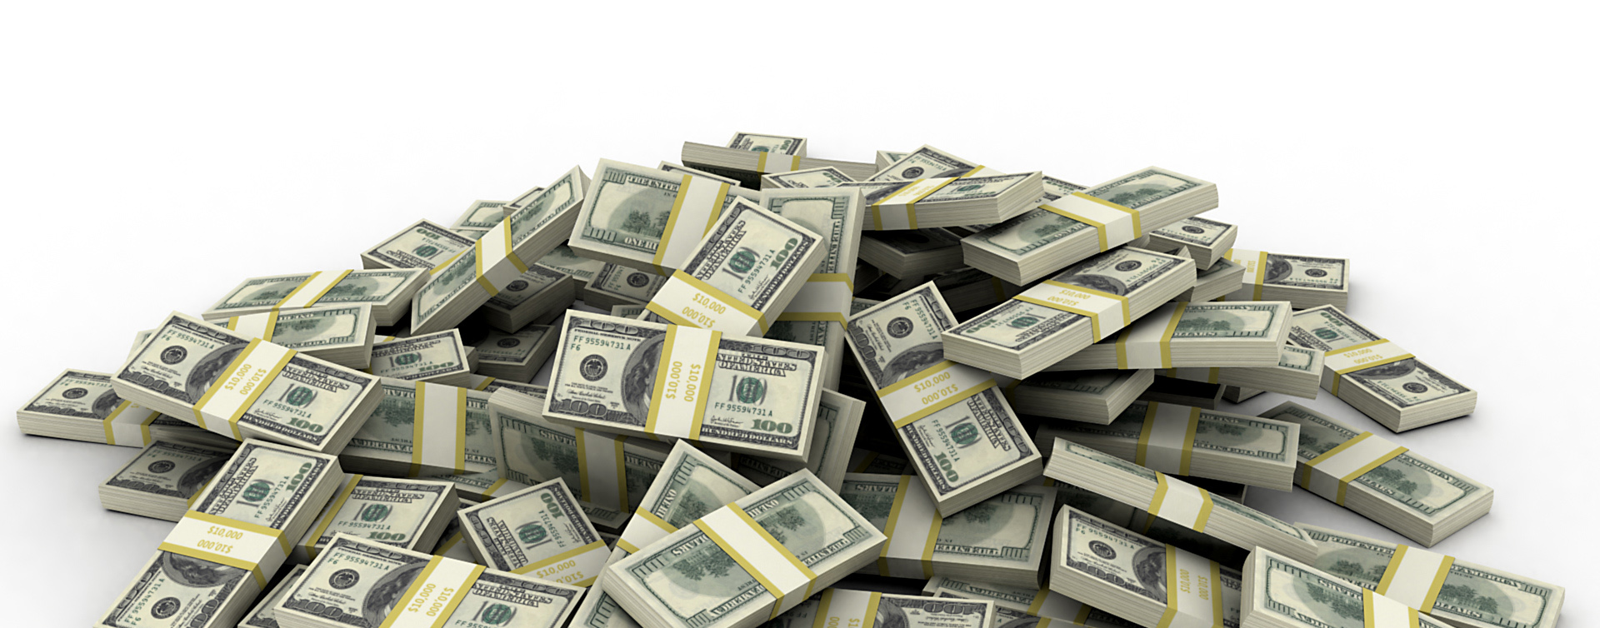
Ahab Sold Himself To Do Wickedness
First Kings 16-22

Slide 3
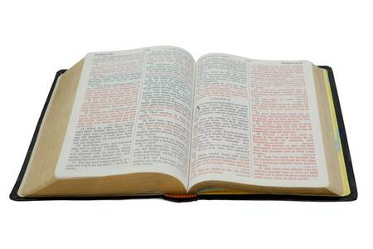
“But there was no one like Ahab who sold himself to do wickedness in the sight of the Lord, because Jezebel his wife stirred him up.”
First Kings 21:25

Slide 4
Ahab Sold Himself To Do Evil
He viewed sin as a trivial thing
He married a worldly person
He took on a worldly religion

Slide 5
4. He Blamed Others For His Problems
1 Kings 18:17-18
Playing the “blame game” is as old as sin itself (Gen. 3:12-13; 1 Sam. 15:15)
We will have to give an account for the way we have lived (Rom. 14:12)

Slide 6
5. He Did What He Wanted To Do
1 Kings 20:35-42
Man cannot improve upon God’s commands.
  Isaiah 55:8-11
There is no substitute for obedience
  1 Sam. 15:22-23

Slide 7
6. He Was Selfish and Discontent
1 Kings 21:1-7
Jezebel got the vineyard for him (vs. 8-14)
Ahab showed no remorse or condemnation, but got up and took possession of the vineyard (vs. 15-16)
He got his way

Slide 8
7. He Had No Regard For Those Who Told Him The Truth
1 Kings 22:1-8
Ahab hated Micaiah because he never prophesied good concerning him (v. 8)
Micaiah only spoke what the Lord said to him (v. 14)
What is our attitude towards those who love us enough to tell us the truth?

Slide 9
Ahab Sold Himself To Do Evil
He viewed sin as a trivial thing
He married a worldly person
He took on a worldly religion
He blamed others for his own problems
He did what he wanted, not God’s will
He was selfish and discontent
He had no regard for those telling the truth

Slide 10
Can I Be Selling Myself To Do Evil?
Do I view sin as a trivial thing?
Am I strongly influenced by worldly people?
Do I take on the religious views of the world?
Do I blame others for my problems?
Do I obey God, or do what I want?
Am I selfish? Do I demand my way?
How do I treat those who tell me the truth?

