Slide 2
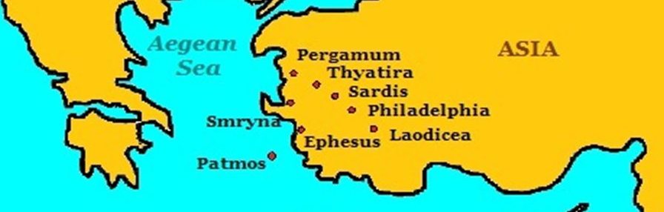
Challenges For Local Churches
Revelation 2-3

Slide 3
The challenge of…
Maintaining Balance - Rev. 2:1-7
Remaining Faithful - Rev. 2:8-11
Doctrinal Compromise - Rev. 2:12-17
Tolerating Error - Rev. 2:18-29
Staying Alive - Rev. 3:1-6
Opportunity - Rev. 3:7-13
Commitment - Rev. 3:14-22

Slide 4
Challenges For Local Churches
Revelation 2-3

