Slide 2
Our Prayers
Our Conduct
Our Speech
Colossians 4:2-6

Slide 3
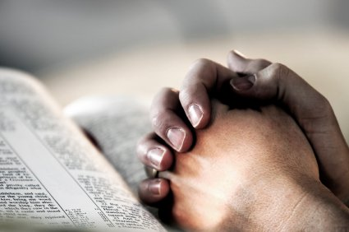
1. Our Prayers
Faithful
  1 Thess. 5:17; Luke 18:1-8; Dan. 6:10
Watchful
  1 Peter 4:7; 1 Thess. 5:6
Thankful
  Phil. 4:6
Purposeful
  2 Thess. 3:1-2; Eph. 6:19-20

Slide 4

2. Our Conduct
Our Influence
  Phil. 1:27
Our Opportunities
  Ps. 118:24
  John 9:4

Slide 5

3. Our Speech
Always With Grace
  Eph. 4:29
  Prov. 16:21-24; 25:11-12

Slide 6
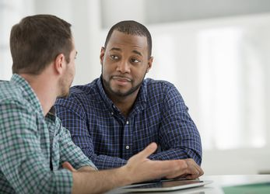
3. Our Speech
Seasoned With Salt
  Careful to speak in a way that our words are received well by others.
  Prov. 15:28

Slide 7

3. Our Speech
How We Ought To Answer Each One
  1 Peter 3:15
  Different people need to be answered differently.

Slide 8
Our Prayers
Our Conduct
Our Speech
Colossians 4:2-6

