Slide 2

Drugs and Alcohol

Slide 3
Condemned As Works of the Flesh
Galatians 5:19-21
Now the works of the flesh are evident, which are: adultery, fornication, uncleanness, lewdness, idolatry, sorcery, hatred, contentions, jealousies, outbursts of wrath, selfish ambitions, dissensions, heresies, envy, murders, drunkenness, revelries, and the like…

Slide 4
Condemned As Works of the Flesh
1 Peter 4:3-4
For we have spent enough of our past lifetime in doing the will of the Gentiles — when we walked in lewdness, lusts, drunkenness, revelries, drinking parties, and abominable idolatries.

Slide 5
Condemned As Works of the Flesh
1 Peter 4:3-4
For we have spent enough of our past lifetime in doing the will of the Gentiles — when we walked in lewdness, lusts, drunkenness, revelries, drinking parties, and abominable idolatries.

Slide 6
Condemned As Works of the Flesh
1 Peter 4:3-4
For we have spent enough of our past lifetime in doing the will of the Gentiles — when we walked in lewdness, lusts, drunkenness, revelries, drinking parties, and abominable idolatries.

Slide 7
Condemned As Works of the Flesh
1 Peter 4:3-4
For we have spent enough of our past lifetime in doing the will of the Gentiles — when we walked in lewdness, lusts, drunkenness, revelries, drinking parties, and abominable idolatries.

Slide 8
Condemned As Works of the Flesh
1 Peter 4:3-4
For we have spent enough of our past lifetime in doing the will of the Gentiles — when we walked in lewdness, lusts, drunkenness, revelries, drinking parties, and abominable idolatries.
Social drinker is not abstaining from every form of evil (1 Thess. 5:22).
He is setting a terrible example and is a potential stumbling block to a young or weak Christian (Matt. 18:6-7).
The occasional imbiber is supporting the alcohol industry.

Slide 9
Condemned As Works of the Flesh
Galatians 5:19-21
Now the works of the flesh are evident, which are: adultery, fornication, uncleanness, lewdness, idolatry, sorcery, hatred, contentions, jealousies, outbursts of wrath, selfish ambitions, dissensions, heresies, envy, murders, drunkenness, revelries, and the like…

Slide 10
Condemned As Works of the Flesh
Translated from the Greek word pharmakeia from which we get our English word “pharmacy.”
In ‘sorcery,’ the use of drugs, whether simple or potent, was generally accompanied by incantations and appeals to occult powers, with the provision of various charms, amulets, etc., professedly designed to keep the applicant or patient from the attention and power of demons, but actually to impress the applicant with the mysterious resources and powers of the sorcerer’” (Vine’s 587).

Slide 11
Impair Sobriety and Self-Control

Slide 12
Impair Sobriety and Self-Control
“It is not for kings, O Lemuel, it is not for kings to drink wine, nor for princes intoxicating drink; lest they drink and forget the law, and pervert the justice of all the afflicted” (Prov. 31:4-5).
“But they also have erred through wine, and through intoxicating drink are out of the way; the priest and the prophet have erred through intoxicating drink, they are swallowed up by wine, they are out of the way through intoxicating drink; they err in vision, they stumble in judgment” (Is. 28:7).

Slide 13
Impair Sobriety and Self-Control
We are commanded to be sober; to be in control of our mind.
Ephesians 5:15-18
1 Peter 1:13

Slide 14
Impair Sobriety and Self-Control
When does one come under the influence of intoxicants? The first drink!
“Alcohol is metabolized extremely quickly by the body. Unlike foods, which require time for digestion, alcohol needs no digestion and is quickly absorbed. Alcohol gets ‘VIP’ treatment in the body – absorbing and metabolizing before most other nutrients. About 20 percent is absorbed directly across the walls of an empty stomach and can reach the brain within one minute” (http://www.healthchecksystems.com/alcohol.htm).

Slide 15
Destroy the Body
1 Corinthians 6:19-20
Or do you not know that your body is the temple of the Holy Spirit who is in you, whom you have from God, and you are not your own? For you were bought at a price; therefore glorify God in your body and in your spirit, which are God’s.

Slide 16
Destroy the Body
Alcohol – destroys brain cells, as well as damages the heart, liver, pancreas, and immune system. It also contributes to several types of cancer.
Tobacco – damages the lungs, heart, brain and skin, and contributes to types of cancer.
Marijuana – damages the brain, heart and lungs. Use by expecting mothers has been linked to low birth weight, increased risk of brain defects and behavioral problems in children.

Slide 17
Destroy the Body
Cocaine – destroys the brain.
Stimulants – push the body past normal limits of endurance. Some have died after their first use.
Depressants – slow down the body, can cause heart problems or death.
Hallucinogens – remain in the body, can cause “flashbacks.”
Inhalants – damage the throat, lungs, brain, liver, and kidneys.

Slide 18
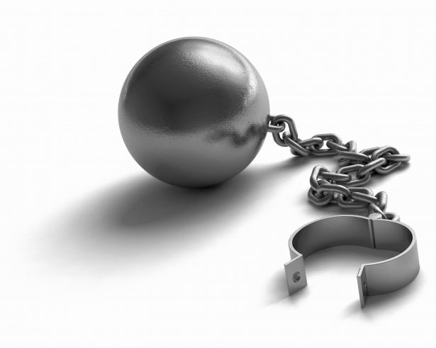
They Are Addictive
1 Corinthians 6:12
All things are lawful for me, but all things are not helpful. All things are lawful for me, but I will not be brought under the power of any (NKJV).
mastered by (NASU)
enslaved by (ESV)

Slide 19
They Are Illegal
Romans 13:1-2
Let every soul be subject to the governing authorities. For there is no authority except from God, and the authorities that exist are appointed by God.
Therefore whoever resists the authority resists the ordinance of God, and those who resist will bring judgment on themselves.

Slide 20
They Bring Misery and Loss
Proverbs 20:1
Proverbs 23:29-35
Violates the Golden Rule and Second Greatest Command - Matt. 7:12; 22:39
We are to have NO fellowship with the works of darkness - Eph. 5:11
We are to abstain from every form of evil -
1 Thess. 5:22

Slide 21
Why people try or use drugs, alcohol, and tobacco.
Peer pressure – Rom. 12:2
Prove their maturity/rite of passage –
Gal. 6:7-8
Become addicted during medical
treatment – 1 Cor. 6:12
Escape reality – Phil. 4:6-7
Pleasure – Heb. 11:25; 1 John 2:15-17

