Slide 2

Portraits of the Church
from
the Book of Ephesians

Slide 3
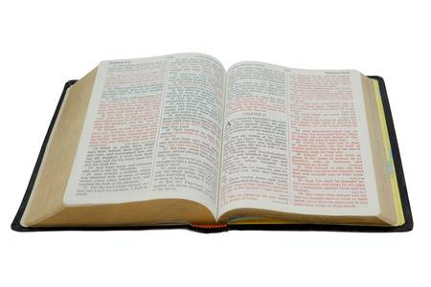
1. The Body of Christ
And He put all things under His feet, and gave Him to be head over all things to the church, which is His body, the fullness of Him who fills all in all.
Ephesians 1:22-23

Slide 4
1. The Body of Christ
Christ is the Head of the body - Eph. 1:22-23
The body is made up of Jews and Gentiles - 2:11-16
There is only one body - 4:4
This one body must work together - 4:11-16

Slide 5
2. The Household of God
Now, therefore, you are no longer strangers and foreigners, but fellow citizens with the saints and members of the household of God.
Ephesians 2:19

Slide 6
2. The Household of God
Now, therefore, you are no longer strangers and foreigners, but fellow citizens with the saints and members of the household of God.
Ephesians 2:19

Slide 7
2. The Household of God
Now, therefore, you are no longer strangers and foreigners, but fellow citizens with the saints and members of the household of God.
Ephesians 2:19

Slide 8
3. A Holy Temple in the Lord
Having been built on the foundation of the apostles and prophets, Jesus Christ Himself being the chief cornerstone, in whom the whole building, being fitted together, grows into a holy temple in the Lord, in whom you also are being built together for a dwelling place of God in the Spirit.
Ephesians 2:20-22

Slide 9
3. A Holy Temple in the Lord
Having been built on the foundation of the apostles and prophets, Jesus Christ Himself being the chief cornerstone, in whom the whole building, being fitted together, grows into a holy temple in the Lord, in whom you also are being built together for a dwelling place of God in the Spirit.
Ephesians 2:20-22

Slide 10
3. A Holy Temple in the Lord
Having been built on the foundation of the apostles and prophets, Jesus Christ Himself being the chief cornerstone, in whom the whole building, being fitted together, grows into a holy temple in the Lord, in whom you also are being built together for a dwelling place of God in the Spirit.
Ephesians 2:20-22

Slide 11
3. A Holy Temple in the Lord
Having been built on the foundation of the apostles and prophets, Jesus Christ Himself being the chief cornerstone, in whom the whole building, being fitted together, grows into a holy temple in the Lord, in whom you also are being built together for a dwelling place of God in the Spirit.
Ephesians 2:20-22

Slide 12
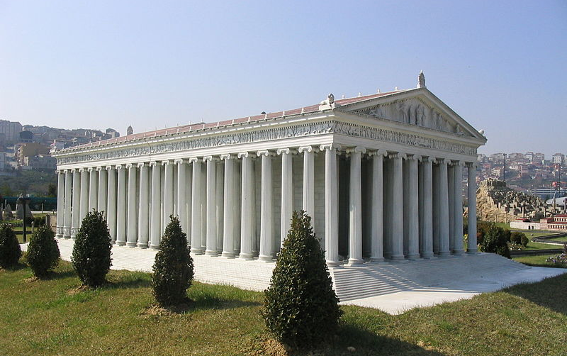
The Temple of Diana in Ephesus

Slide 13
4. The Bride of Christ
For the husband is head of the wife, as also Christ is head of the church; and He is the Savior of the body…
Husbands, love your wives, just as Christ also loved the church and gave Himself for her.
Ephesians 5:23, 25

Slide 14
4. The Bride of Christ
The church has a responsibility to…
Submit to the authority of Christ - v. 24
Maintain its purity in Christ - vs. 26-27
Remain loyal and faithful to Christ - v. 33

Slide 15
5. The Army of the Lord
Ephesians 6:10-17
We have a Commander - v. 10
We have armor and weapons - vs. 11, 14-17
We have an enemy - v. 11
We have a battle - vs. 12-13

Slide 16
Portraits of the Lord’s Church
The Body of Christ
The Household of God
A Holy Temple in the Lord
The Bride of Christ
The Army of the Lord

