Slide 2
The “I Am” Statements of Paul
Romans 1:14-16

Slide 3
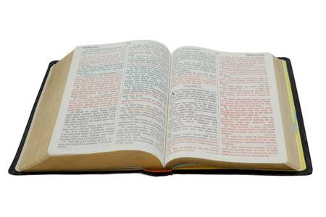
1. “I Am A Debtor”
I am a debtor both to Greeks and to barbarians, both to wise and to unwise.
Romans 1:14

Slide 4
1. “I Am A Debtor”
Paul was indebted because of what Christ had done for him.
  1 Timothy 1:12-17
In turn, Paul did everything he could to save as many people as he could.
  1 Corinthians 9:16, 19-22
We should feel the same indebtedness.
  Ephesians 2:1-10

Slide 5
2. “I Am Ready”
So, as much as is in me, I am ready to preach the gospel to you who are in Rome also.
Romans 1:15

Slide 6
2. “I Am Ready”
Readiness requires preparation.
  1 Peter 3:15; 2 Timothy 2:15
Readiness requires devotion.
  2 Corinthians 8:5, 12
Readiness requires watchfulness.
  2 Timothy 4:2; Titus 3:1

Slide 7
3. “I Am Not Ashamed”
For I am not ashamed of the gospel of Christ, for it is the power of God to salvation for everyone who believes, for the Jew first and also for the Greek.
Romans 1:16

Slide 8
The Gospel is God’s Power To…
Turn sinners away from power of Satan and towards God’s forgiveness (Acts 26:18).
Save man from the punishment of sin (Rom. 6:23).
Restore man’s fellowship with God (2 Cor. 5:18-20).
Cast down every thought, scheme, and false doctrine against God (2 Cor. 10:5).
Rescue sinners from the power of darkness and deliver them to God’s kingdom (Col. 1:13).
Pierce and judge man’s heart (Heb. 4:12).

Slide 9
3. “I Am Not Ashamed”
Paul was not ashamed to suffer for the gospel.
  2 Timothy 1:8, 12
We must not be ashamed of Christ or His words as we live in this wicked world.
  Mark 8:38

Slide 10
- We Can Be Like Paul -
We can be motivated by a sense of indebtedness.
We can prepare ourselves and be ready to do the Lord’s work.
We can be unashamed of the Lord and the power of His word in the midst of a crooked and perverse generation.

