Slide 2
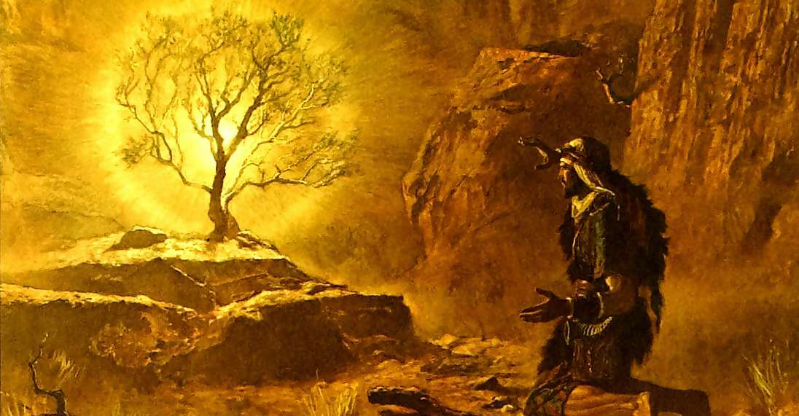
When Moses Met God - Ex. 3-4

Slide 3

1. God is Holy
“Do not draw near this place. Take your sandals off your feet, for the place where you stand is holy ground” (Exodus 3:5).
God is approachable, but it is dangerous to draw near the presence of God without
acknowledging His holiness.
Leviticus 10:3

Slide 4
2. God Knows What is Going On
God knew what was happening to the children of Israel (Exodus 3:7-10).
God knows what is happening in our lives (Hebrews 4:13).
God hears our cries and answers
our prayers (Psalm 34:4, 6).

Slide 5
3. God is the Great “I AM”
God is Self-Existent
  Translated from Hebrew for “to be.”
God is Eternal
  Malachi 3:6; Hebrews 13:8
God is the Only God
  Isaiah 44:6; Revelation 1:8
God is the Faithful God
  Genesis 15:13-16

Slide 6
4. God Doesn’t Accept Our Excuses
Who am I that I should go to Pharaoh? (3:11)
I don’t know Your name (3:13)
Suppose the Israelites won’t believe me (4:1)
I am not an eloquent speaker (4:10)
Please send someone else! (4:13)
God does not accept excuses -
only obedience (Luke 14:15-24).

Slide 7
5. God Equips His People To Do His Will
You will accomplish the task (3:12)
“I AM” (3:14)
Moses was given three signs to perform (4:2-9)
Aaron was given as Moses’ spokesman (4:14-17)
God has equipped us with His word,
our faith, our talents and abilities.
We CAN do His work.

Slide 8
What Moses Learned About God
God is Holy
God Knows What is Going On
God is the Great “I AM”
God Does Not Accept Our Excuses
God Equips His People
To Do His Will

